Slide 1
Using Crossword Puzzles
In
Applied Statistics Courses
John D. McKenzie, Jr.
Babson College
Babson Park, MA 02457-0310
mckenzie@babson.edu

Slide 2
Abbreviated Abstract
This webinar explains how crossword puzzles can be used as in-class exercises, quizzes, and examination questions in applied statistics courses to assist the students in learning basic statistical terminology. It presents innovative numerical crossword puzzles that can be to ask questions about statistical software output. It explains how the use of such puzzles was impractical in the past due to time it took to construct them but that this is no longer the case with the availability of a number of Internet sites.
Keywords
active learning exercises, statistical terminology,
statistics education, teaching tool

Slide 3
From Newspapers (Wynne, 1913) to
Tertiary Classrooms of
Psychology (Crossman and Crossman (1983) and Davis, Shepherd, and Zwiefelhofer (2009)),
Sociology (Childers (1996)), and Microbiology (Miller (2008)) for
In-Class Exercises,
Quizzes, and Examinations

Slide 4
A
Creative and Fun
Way to
Introduce
Statistical
Terminology

Slide 5
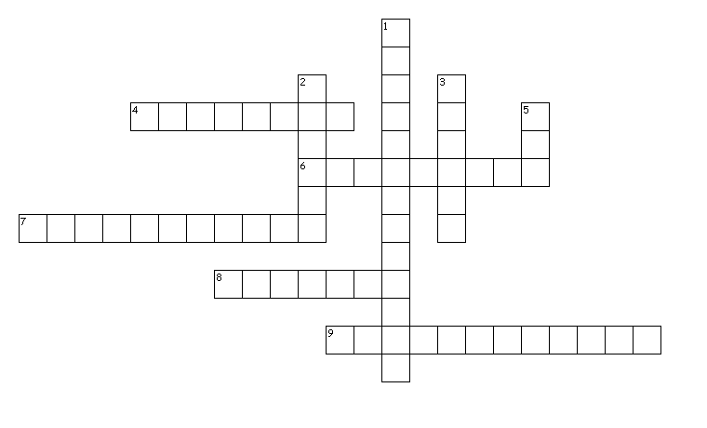
Quiz Complete this criss-cross puzzle with appropriate words, including words with hyphens.
Across
4. one scale for numerical variables
6. numerical measure that describes characteristic of population
7. alternative name for categorical variable
8. one scale for categorical variables
9. alternative name for numerical variable
Down
1. display to examine the shape and spread of sample data that provides digits from the actual data values
2. proportion of population
3. principle that exists when there are a “vital few” and a “trivial many”
5. chart to compare measure of data categories

Slide 6
Peck’s Progression
Formulas
Term Identification from Output
Definitional Identification of Term from Output

Slide 7
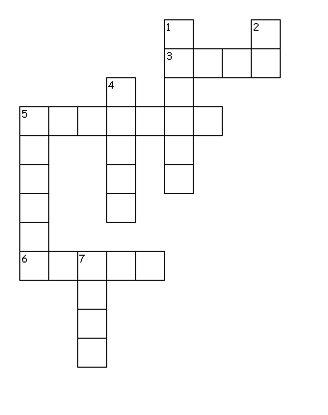
Final Exam Consider the Minitab output on the next page. Complete this criss-cross puzzle with appropriate numbers and decimal points.
Across
3. Percentage of variation of the response variable that is explained by the predictor variable in the regression model
5. Standard error of the estimate
6. Estimated mean value of the response variable when the predictor variable is zero
Down
1. Unexplained variation due to factors other the relationship between the response and predictors
2. Degrees of freedom for t distribution
4. Probability of getting a getting a test statistic equal to or more extreme than the sample result, given that the null hypothesis is true
5. Estimated expected change in the response variable per unit change in predictor variable
7. Test statistic associated with the null hypothesis that there is no linear relationship

Slide 8
MTB > Regress 'MonRent' 1 'Size';
SUBC> Constant;
SUBC> Brief 2.
Regression Analysis: MonRent versus Size
The regression equation is
MonRent = 177 + 1.07 Size
Predictor Coef SE Coef T P
Constant 177.1 161.0 1.10 0.283
Size 1.0651 0.1376 7.74 0.000
S = 194.595 R-Sq = 72.3% R-Sq(adj) = 71.1%
Analysis of Variance
Source DF SS MS F P
Regression 1 2268777 2268777 59.91 0.000
Residual Error 23 870949 37867
Total 24 3139726
Unusual Observations
Obs Size MonRent Fit SE Fit Residual St Resid
13 1985 2300.0 2291.4 123.2 8.6 0.06 X
17 1245 1100.0 1503.2 41.7 -403.2 -2.12R
24 1000 800.0 1242.3 43.1 -442.3 -2.33R
R denotes an observation with a large standardized residual.
X denotes an observation whose X value gives it large leverage.

Slide 9
www.discoveryeducation.com/free-puzzlemaker
Make a puzzle now! It's free! Choose a type of puzzle
from the list below and make your own puzzle online for classroom or home use.
Word Search
Criss-Cross
Double Puzzles
Fallen Phrases
Math Squares
Mazes
Letter Tiles
Cryptograms
Number Blocks
Hidden Message

Slide 10
To create your criss-cross, follow the steps below and click the “Create My Criss-Cross” button when you are done.
Puzzlemaker uses PNG image files which are only viewable in Netscape and Internet Explorer browsers version 4.0 or higher. Go to our Help page if you are having difficulty viewing Puzzlemaker puzzles.
Enter the title of your criss-cross puzzle
The title will appear at the top of your page. IMPORTANT: Puzzle titles are limited to 49 characters.
_____________________
Enter the number of squares for your puzzle
Width __50__ Height __50__
Enter the size of the square
Specify the size of each square. 30 is standard size.
Square size __30__
Enter the words and clues
On each line enter a word followed by a space and then the clue for that word.
______________________________
______________________________
______________________________
______________________________
______________________________
______________________________
Create My Puzzle

Slide 11
Three Insights
15 Minutes for 10-Term Quiz
Different Versions by the Click of the Mouse
One-Word Responses including Hyphenated Responses

Slide 12
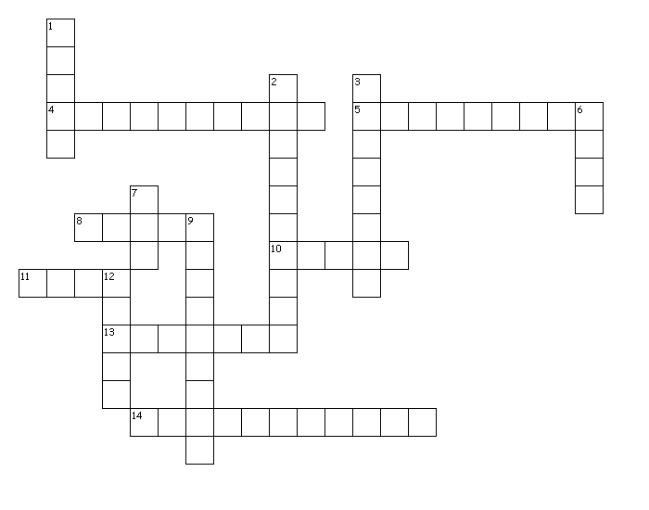
In-Class Exercise Complete this criss-cross puzzle with appropriate words, including words with hyphens.
Across
4. inferential method in addition to hypothesis testing
5. critical region
8. sigma assumption for Z test
10. sign always present in null hypothesis
11. probability of Type II error
13. observed level of significance
14. opposite of null hypothesis
Down
1. 1 - beta
2. 1 - alpha
3. value that divides nonrejection and rejection regions
6. status quo hypothesis
7. size of p-value to reject null hypothesis
9. assumption for t test
12. level of significance

Slide 13
Final Examination Question
Below are four survey questions related to your introduction to terminology by the use of crossword puzzles in QTM1310. This question has two parts. First answer the four survey questions Q1 to Q4 based on your classroom experience; then in the second part provide answers about the nature of the four survey questions. If you were not present in the crossword puzzle classes, use the Minitab missing data response to answer that question. To receive full credit for this question, complete all parts. For Q1 to Q4 enter your answer on the blank line. For a to c print your answers in the spaces provided.
Q1: Did you enjoy the use of crossword puzzles for an introduction to terminology?
_________________________
Yes No
Q2: Did the use of crossword puzzles enhance your learning of terminology?
_________________________
Definitely No Probably No Neutral Probably Yes Definitely Yes
Q3: What is the most appropriate number of terms for a QTM1310 crossword puzzle?
_________________________
0-5 6-10 11-15 16 or more
Q4: What is the most appropriate number of terms for a QTM1310 crossword puzzle?
_________________________

Slide 14
Rows: Q1 Columns: Q2
D No D Yes Neutral P No P Yes All
No 1 0 2 3 1 7
14.29 0.00 28.57 42.86 14.29 100.00
50.00 0.00 13.33 42.86 6.25 14.89
2.13 0.00 4.26 6.38 2.13 14.89
Yes 1 7 13 4 15 40
2.50 17.50 32.50 10.00 37.50 100.00
50.00 100.00 86.67 57.14 93.75 85.11
2.13 14.89 27.66 8.51 31.91 85.11
All 2 7 15 7 16 47
4.26 14.89 31.91 14.89 34.04 100.00
100.00 100.00 100.00 100.00 100.00 100.00
4.26 14.89 31.91 14.89 34.04 100.00
Cell Contents: Count
% of Row
% of Column
% of Total

Slide 15
Tally for Discrete Variables: Q3
Q3 Count Percent
0-5 2 4.26
6-10 13 27.66
11-15 24 51.06
16+ 8 17.02
N= 47
Descriptive Statistics: Q4
Variable Mean StDev Min Q1 Q2 Q3 Max
Q4 12.957 4.268 2.00 10.00 14.000 15.00 24.00

Slide 16
Some Other Possibilities
Fill in the Blank Crossword Puzzles
Group Crossword Puzzles
Exam Review Crossword Puzzles
Student Creation Crossword Puzzles
Other Types of Puzzles

