Slide 1
Enhancing your STEM song with technology
How to bring your STEM Song to life with a music track and video
Mary McLellan
Teacher AP Statistics
Aledo High School
Aledo, Texas

Slide 2
My Process
  Purchase the Karaoke version of the song on Itunes
  Import the song into the free software AUDACITY
    Cut the song track to be the correct length for your needs
    Consider splicing the end of track onto the end of the shortened song you created
    Add your vocal track
    Export the song as mP4
  Import the song into iMovie
    Find pictures that are meaningful to your lyrics educationally
    Add in the text
    Line up the pictures and lyrics with the music that you imported
  Upload finished product to YouTube

Slide 3
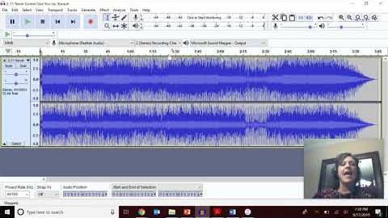
Making your music TRACK using AUDACITY
https://youtu.be/sUpnp9M_ubY

Slide 4
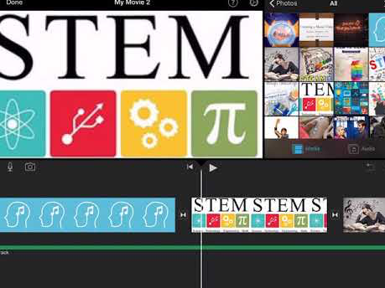
Making your music VIDEO using iMovie
https://youtu.be/9Qwzp1R5C8E

Slide 5
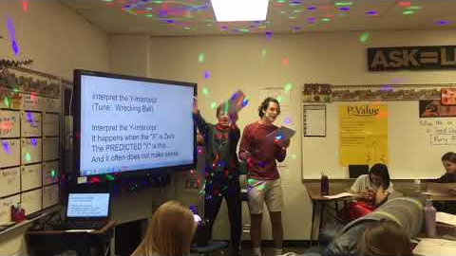
Students in Action with my Music Videos
https://youtu.be/Wv3tV27lwEY

Slide 6
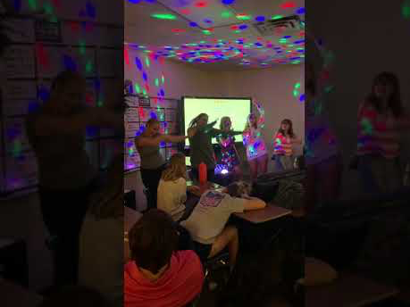
Students in Action with my Music Videos
https://youtu.be/a7feX-fz8aw

Slide 7
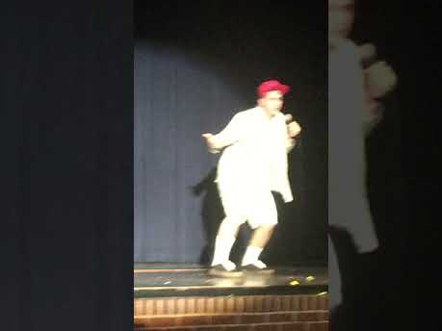
Students in Action with my Music Videos
https://youtu.be/YC1zCPWqHzc

Slide 8
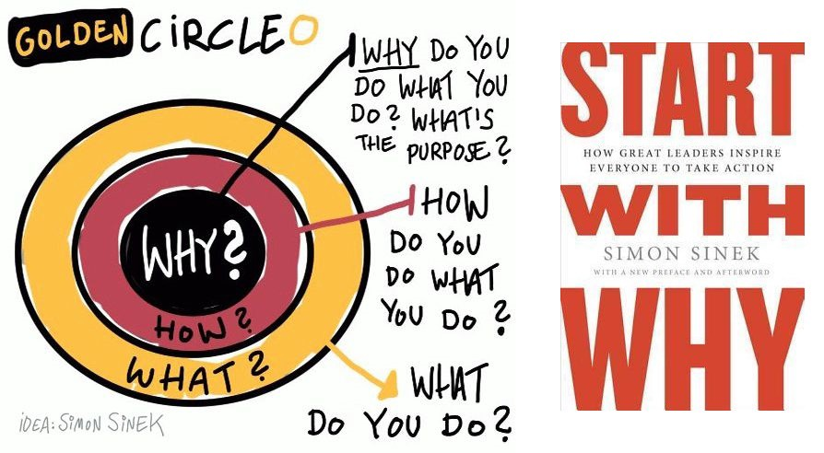
Why the Buy in?
Simon Sinek’s Golden Circle:

Slide 9
Why the Buy in?
What I think the students “GET”
My WHY : I believe that ALL KIDS CAN LEARN
My HOW : I use music as a tool to help in the
learning
My WHAT : My content (statistics) is what I
passionately teach

Slide 10
Why the Buy in?
What I want doubting professionals to know
My WHY : I believe in the Power of Statistics. I believe that an understanding of statistics can change the lives of my students and make their lives better.
My HOW : I teach the fundamental WHY of the curriculum first and foremost!
My WHAT : My music is the icing on the cake to solidify concepts and pull together the material.

Slide 11
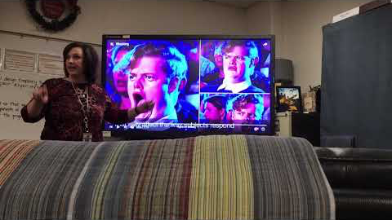
Connections in the Curriculum with Music
https://youtu.be/PXDsrXX1EPc

Slide 12
Curriculum Connections with Music
Bringing your STEM Curriculum to life with a music track and video
Mary McLellan
Teacher AP Statistics
Aledo High School
Aledo, Texas

