Slide 1
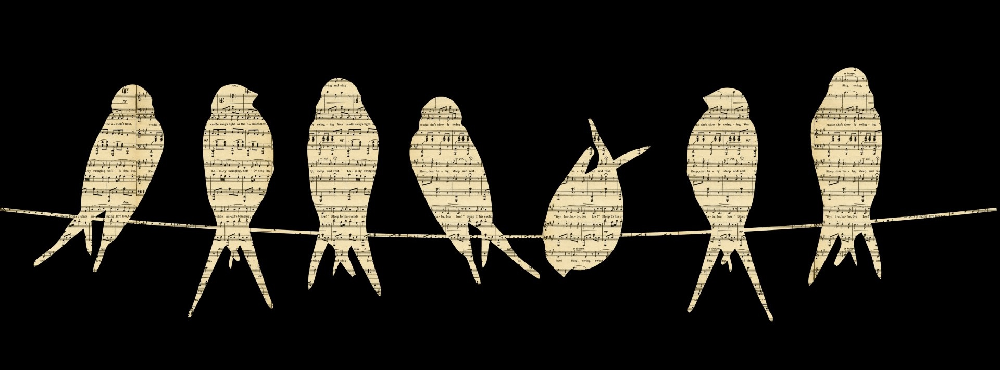
Musical Annotation
Rick Heineman
Kutztown University
Public Domain, Karen Arnold

Slide 2
Problem: Good AND information-rich parodies are hard!
“Semiconservative replication”
Figurative or imprecise language

Slide 3
Change Over Time
Genes slipped through generations blindly in search of you.
Shaping and shaped by your ancestors that they flowed through.
Each birth, changing, gained or cast aside,
The past hides inside of us
Change over,
No planning needed, just selection and a little chance,
All of your parents lived long enough to find romance,
Genes evolved to make us,
They never knew,
They never needed to…
Mutations, duplications and deletions
They don’t think, they don’t want, they don’t understand,
Change over time,
But they urgently replicate and expand,
Change over time,
And our lives are spelled out in their double strands,
Change over time,
And we hold just one pair of each cradled in our hands,
Change over time.
In frequency
Genetic drift
For a broad
definition of “romance”
Diploidy!
(e.g. RR)

Slide 4
Complication 1: Info Overload
Keep it short!
More annotations where song has less info
Slow down
Prep beforehand

Slide 5
My Love Is Diffusing
I have a high [love]
My love is diffusing from me into you
Like oxygen leaving my veins turns them blue
You’re semipermeable, my love goes through
But you are so loveless none comes back from you.
(With other factors)
Love moves down
concentration gradient

Slide 6
Complication 2: Mechanics
Student volunteers?
Foot pedals?
https://www.amazon.com/iKKEGOL-Triple-Keyboard-Control-Hospital/dp/B0753CSGTK/ref=sr_1_2?s=office-products&ie=UTF8&qid=1506260829&sr=8-2&keywords=powerpoint+foot+pedal

Slide 7
Complication 3: Lose some advantages of song
No rhymes or scansion to aid recall

Slide 8
Assessment
The notes and/or illustrations presented alongside the lyrics on the PowerPoint were useful.
Heineman, R.H. 2017. Engaging college students by singing the science. Journal of Microbiology and Biology Education. 18(1). doi:10.1128/jmbe.v18i1.1206

Slide 9
To “Hello” by Adele
Hello
I can’t hear you
We were once the same before mutations when we split in two
Before I learned
To be free
And now I’ve just about forgotten everything I used to be.
Each small difference
Builds between us
As I change lifestyles…
Hello from the other side
I’ve divided a thousand times
But when you call and say that I’ve gotta slow down
I don’t listen cause my genes have had a breakdown.
Hello, I’ve metastasized
Now I refuse to suicide
I’m immortal and I grow in other tissue
I bring in new blood and I’ll happily grow over you, I don’t care…
Single zygote
divides to make body
Mutation by mutation by mutation…
Tumor suppressors inactivated
No apoptosis
Continued!
Angiogenesis
No contact inhibition!

Slide 10
Hello
How are you?
Seems this body that we share is somehow failing now, I’m sorry
Even all my…oncogenes
Won’t allow me to keep growing
once the nutrients stop flowing.
It’s no secret
That each body
Is running out of time.
But something lasts though we have died
Through germ cells we are purified
As we age, our cells maximize their own fitness
But each new birth keeps our variation suppressed, for a while.
Cancer genes that increase growth
Cancer cells die with body
As mutations accumulate
Our children!
Often killing us!
Cells are genetically similar at first, so they cooperate
Heineman, R.H. 2017. Songs about cancer, gene expression, and the biochemistry of photosynthesis. Biochemistry and Molecular Biology Education. doi: 10.1002/bmb.21085

Slide 11
Conclusion
Easy, effective
Annotation

Slide 12
Acknowledgments
Kutztown University
My students
rickheineman.weebly.com

