Slide 1




Songs of Space and Time
The merging of scientific learning and the fine arts!

Slide 2

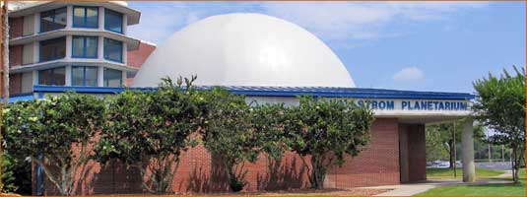
Hallstrom Planetarium
Fort Pierce, Florida
Jon U. Bell, Planetarium Director
Maxima debetur puero reverentia

Slide 3
Why is Jon Bell Doing This Workshop?
My Music Background
Grew up singing in choirs and choruses and around campfires
Sang with Virginia Opera, Opus II & the Doorway Singers
Played tuba for Paradise Garden Rooftop Orchestra
Cantor, soloist, Latin Mass choir director
1980’s - present: series of astronomy workshops for kids at the museum and planetarium, college
1996, 2016: The Astronomer’s Songbook http://www.irsc.edu/uploadedFiles/Best-of-Astronomers-Songbook-2011.pdf
2003, 2005, 2013, 2014, 2018 Space Songs shows at the Hallstrom Planetarium

Slide 4
What resources are needed to perform a space song?
You. Can you sing? Are you comfortable standing up in front of people and singing? Musical accompaniment
  Piano, guitar, autoharp, karaoke, a cappella
Music sheets to hand out or ways to put the words up on a screen
A place to sing – campfire, classroom, or…

Slide 5
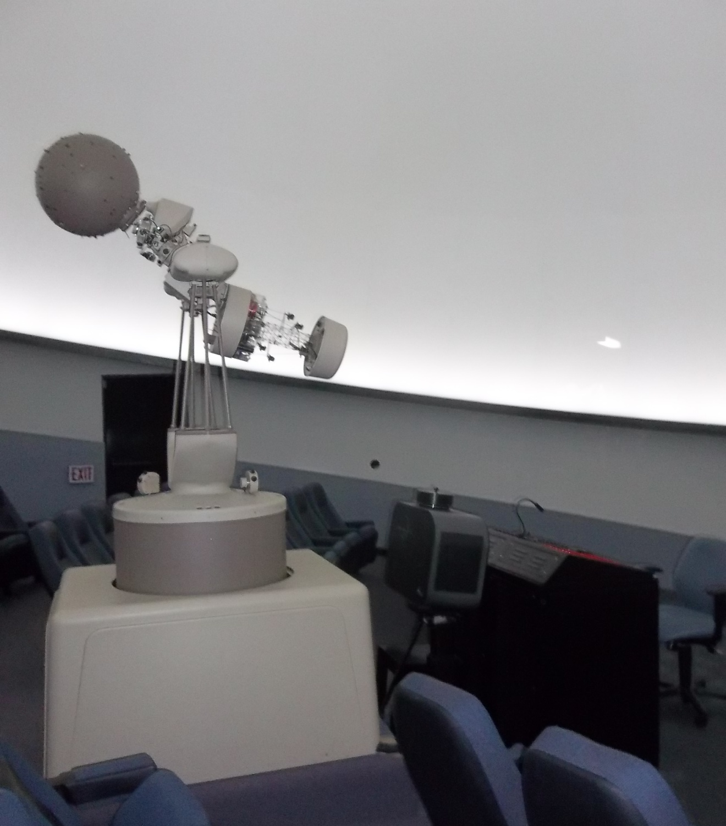
A terrific theater with comfortable seats, excellent multimedia, and great acoustics!

Slide 6

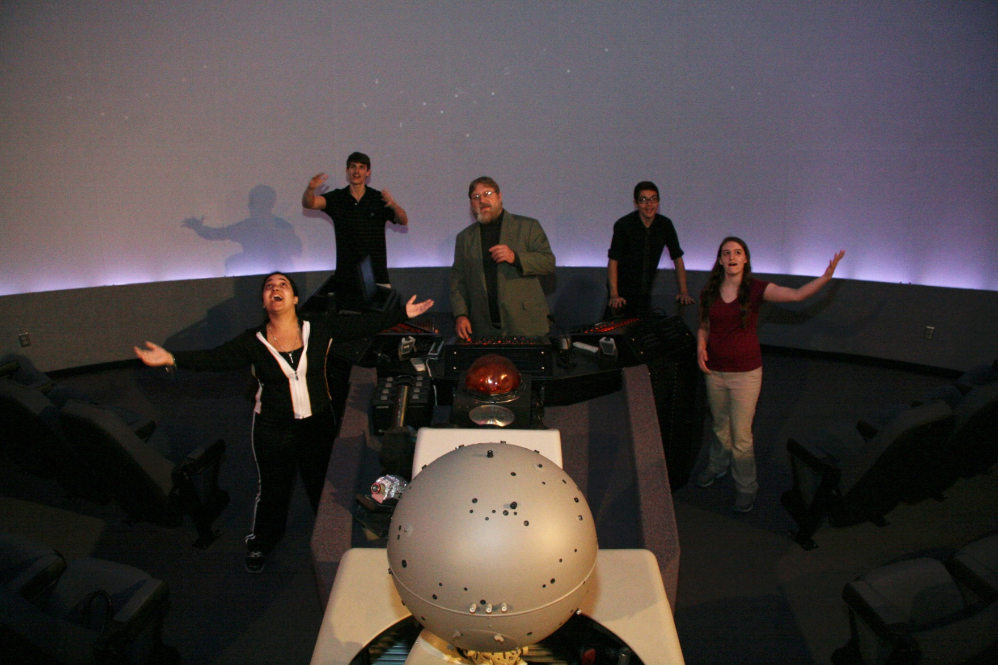
The Hallstrom Planetarium Singers

Slide 7
The Production
Enlist the musical talents of IRSC’s Dr. Dale Rieth and the recording talents of WQCS’ Joe Lenartiene
Recruit students to learn script, words and music to the show
Write a script, add some new numbers
Storyboard, slides, lighting and special effects, video, captions, programming
How do you get to Carnegie Hall?
Dress rehearsals, promotion
Performances

Slide 8
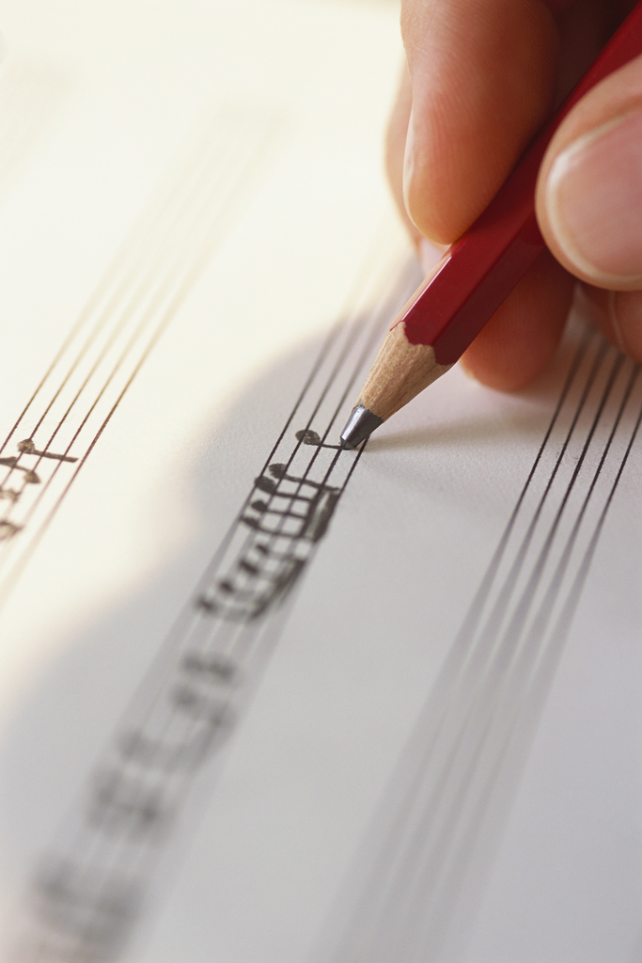
The Script
Premise: Fine Arts students are my astronomy students, worried about upcoming test
Students interrupt my opening to ask questions, are assured that we can do the show AND help them prepare
Student questions move us along to various topics in astronomy
Students get an “A” for their hard work!

Slide 9
List of Songs (in order)
Title Play time Accomp?
What is a Shooting Star? 1:05 a cappella (done)
Universe Calling! 5:00 D Rieth done
What is Gravity? 1:40 D Rieth/C Kays done
Phases, Eclipses, etc. 6:00 D Rieth done
Night and Day 2:25 D Rieth done
Ode to Planet Number 9 2:55 D Rieth done
Constellation Barcarolle 2:15 D Rieth done
The Ballad of HR Diagram 2:15 D Rieth done
Betelgeuse 1:40 D Rieth done
Jocelyn Found a Radio Star 2:30 D Rieth done
There Are Plenty of Stars 1:40 D Rieth done
The Universe Song 1:45 D Rieth/ C Kays done
Einstein the Genius 2:40 D Rieth/ C Kays done
TOTAL TIME FOR MUSIC ONLY 32:00
TOTAL SHOW TIME 45:00

Slide 10
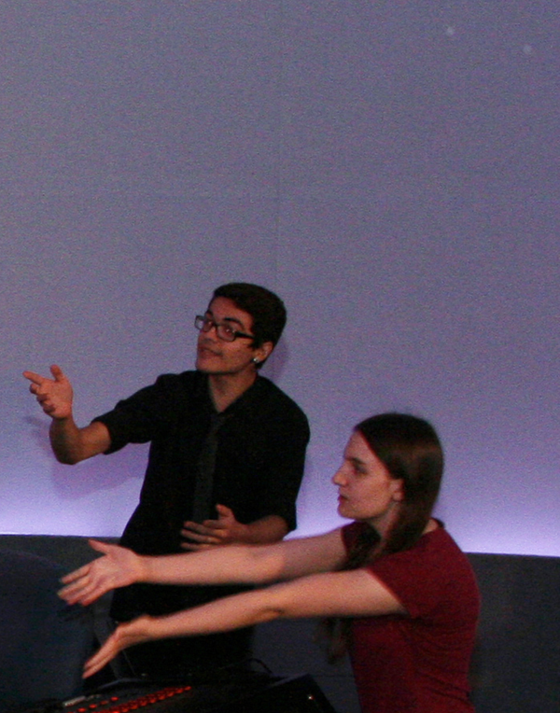
Results
Enthusiastic responses from audiences
Students learned and had fun
Show run was about right; enough shows to justify rehearsal time spent, but not too many that it became a burden to the students
Plan on doing it again; looking to cut an album now!

Slide 11
How to Sing a Space Song
Know your audience: kids; families; college students, etc. Tailor songs to the audience
Come up with talking points that connect the songs into some kind of pattern
Hand out song sheets or project the words on screen
Musical accompaniment
  no music at all, just out-loud recitation
  a cappella
  karaoke
  piano or other keyboard
  Guitar
  Autoharp or other instrument (ukalelee?)

Slide 12
How to Write a Space Song
Choose a topic that deserves a song
Create, or better, appropriate a tune that works (not too hard, memorable melody, public domain or fair use area)
Look through old songbooks
Decide which concepts/terms to write about
Rhyming dictionary (Rhymezone.com)
Make syllables agree with original lyrics
Keep or modify any original lyrics that work (Use the internet)

Slide 13
What Music Works?
Original Music
Public domain tunes and folk songs
Classical music
Opera or light opera
Music written in the U.S. before 1923.

Slide 14
What Music Doesn’t Work?
Sacred music
As a rule, avoid music that is strongly identified with another venue, like the National Anthem (but there are exceptions, such as, “The Battle Hymn of the Republic.”)
Copyrighted music written in the U.S. after 1923, unless permission is given, or it meets the fair use doctrine. Works published after 1922, but before 1978 are protected for 95 years from the date of publication. If the work was created, but not published before 1978, the copyright lasts for the life of the author plus 70 years. (I should mention that I’m not a lawyer.)
Avoid genres or styles or difficult-to-sing pieces that you can’t do
Don’t sing out of your range – find your range through practice and performance (e.g. When I sing in front of others, my range is higher)

Slide 15
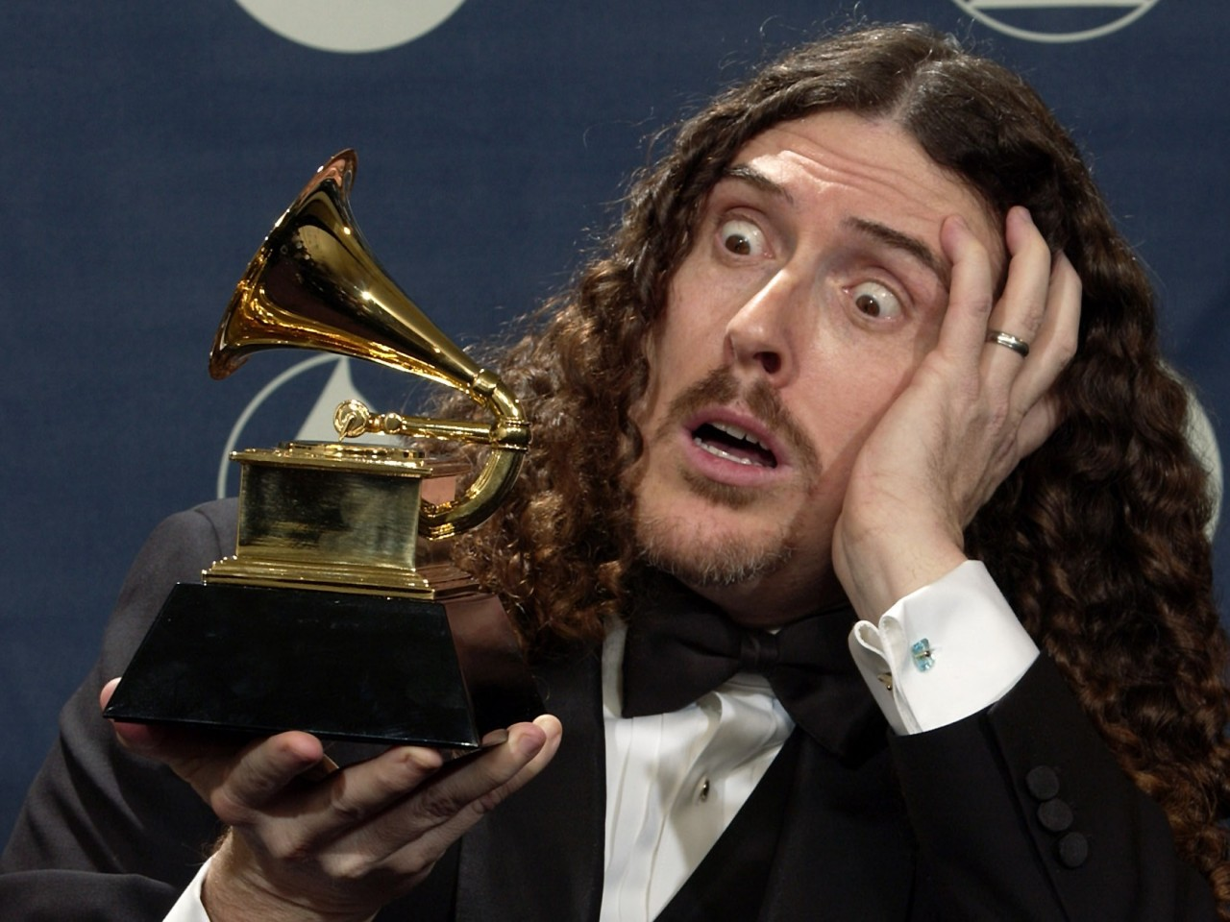
Fair Use/Copyright

Slide 16
Questions to consider…
Is it a parody or commentary on the original?
Who is your audience? Family and friends are different from your class, which is different from the general public
Are you making money doing it, or are you impacting the copyright holder’s ability to make money?
When in doubt, ask for permission. Weird Al does it even though he doesn’t need to, but on the other hand, Jimmy Buffet never replied to my written request.

Slide 17
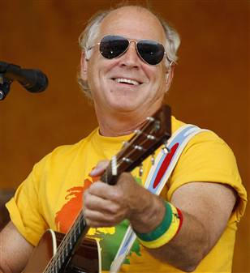

Lets take a singing break!

Slide 18
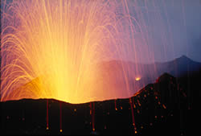

volcano
VOLCANO
Original song by Jimmy Buffet, Keith Sykes & Harry Dailey, New verses by Jon Bell
Accompaniment by Cindy Ressler

Slide 19
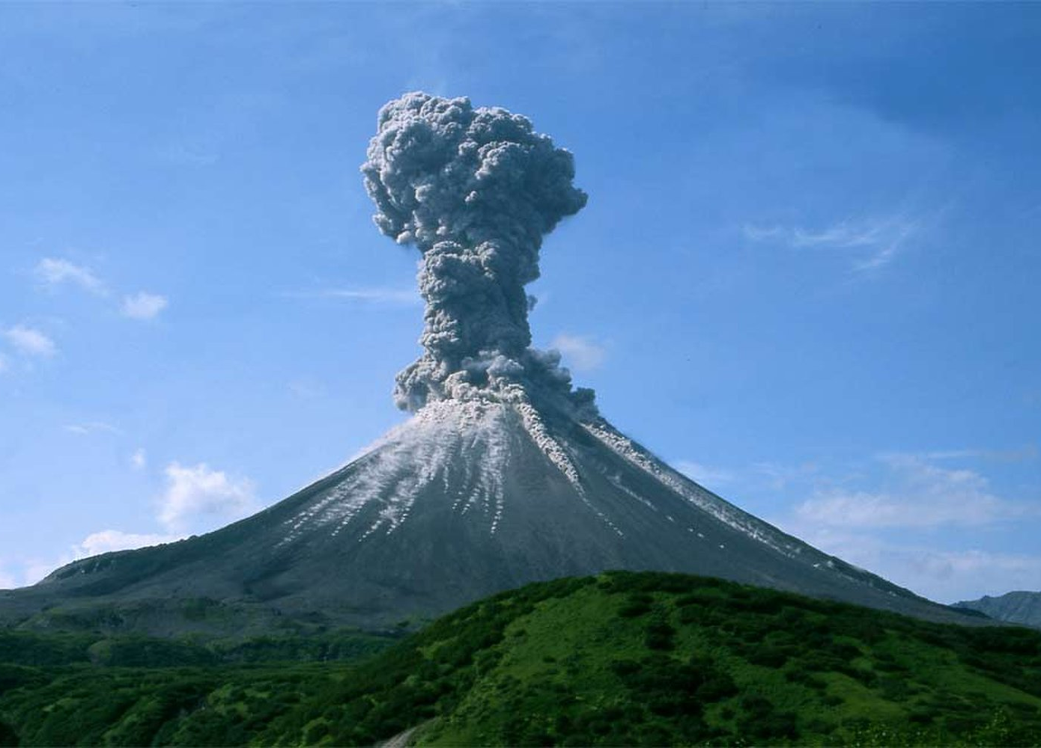
I don’t know, I don’t know,
I don’t know where I’m a gonna go
When the volcano blows!

Slide 20
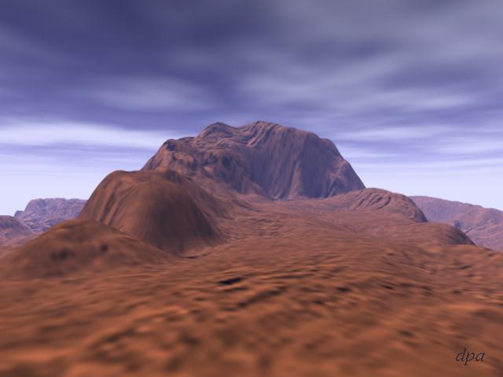
Don’t want to live up on
Maxwell Mountain,
Venus is not where I want to be.
.

Slide 21
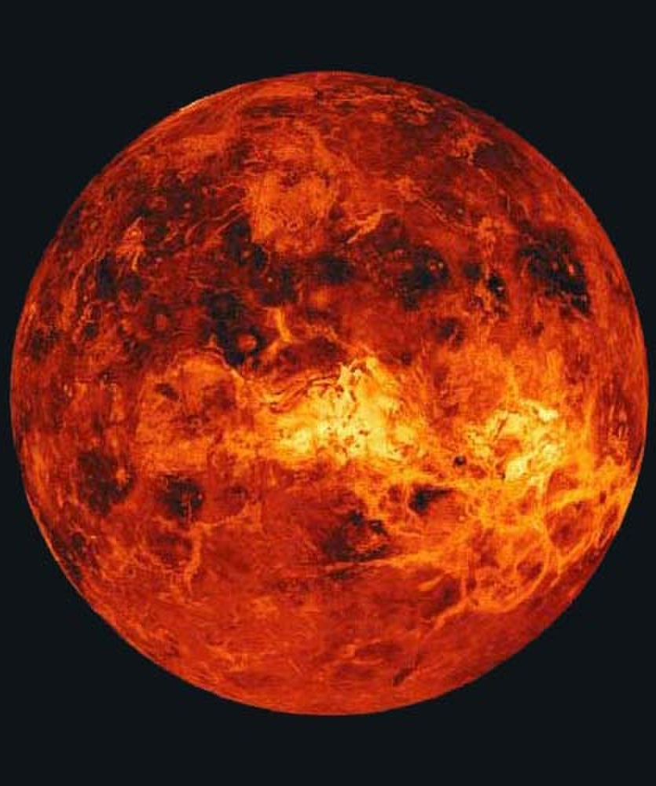
Temp’rature hot as a pizza oven
Molton hot rock and me disagree!

Slide 22
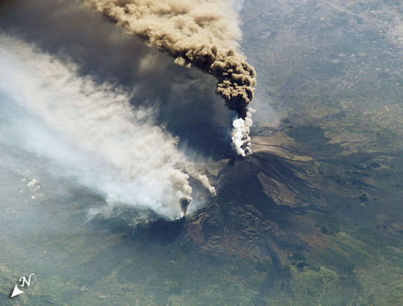
Now I don’t know, I don’t know,
I don’t know where I’m a gonna go When the volcano blows!
Notes:
22

Slide 23
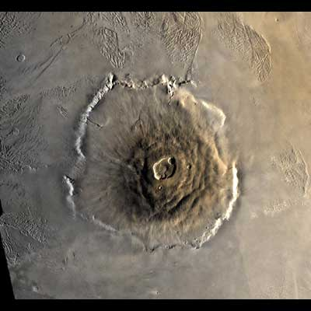
Don’t want to be on no
Mount Olympus,
Seventeen mile up the air is thin
Don’t want to be on no Mount Olympus,
Seventeen mile up the air is thin.
Carbon dioxide is not for breathing,

Slide 24
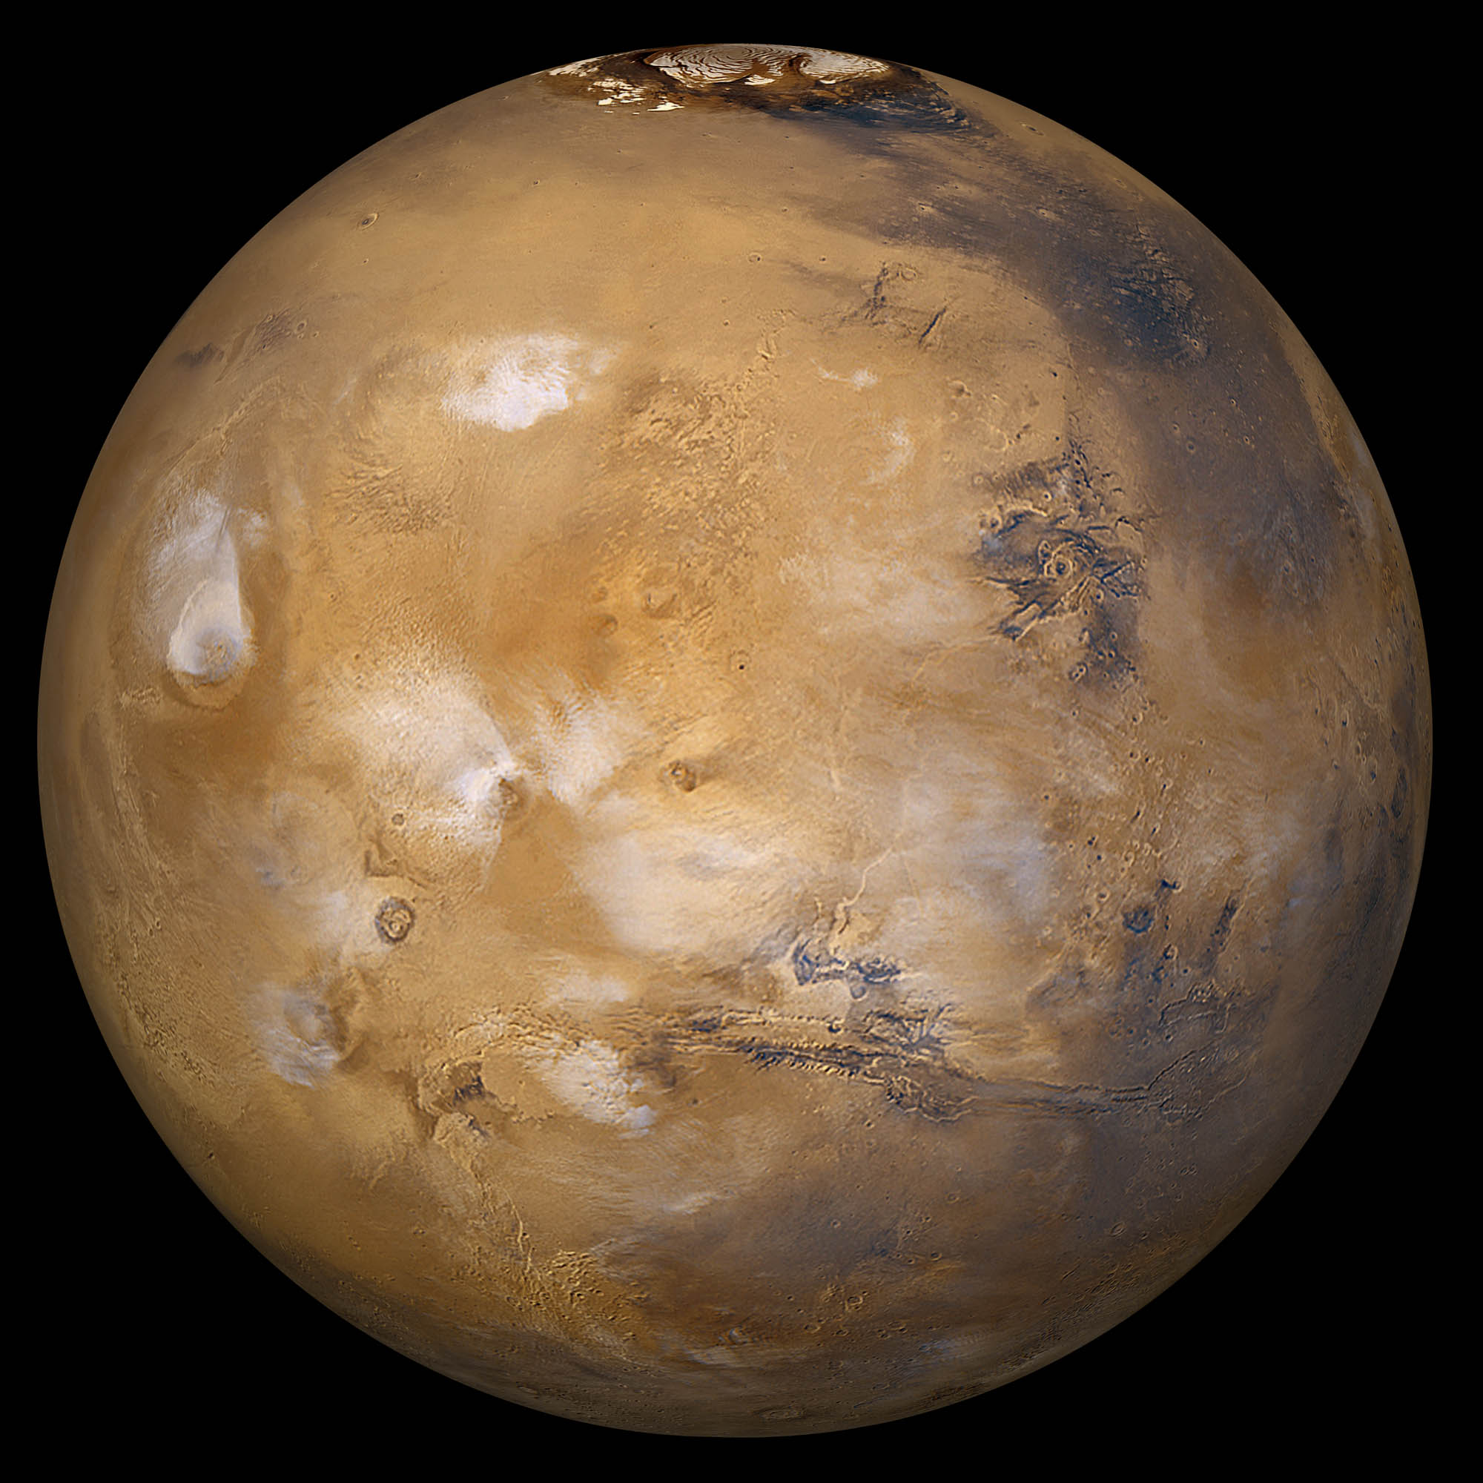
Carbon dioxide is not for breathing,
Mars is too cold for
me frozen skin!
Mars is too cold for my frozen skin.

Slide 25
Now I don’t know, I don’t know,
I don’t know where I’m a gonna go When the volcano blows!
Notes:
25

Slide 26
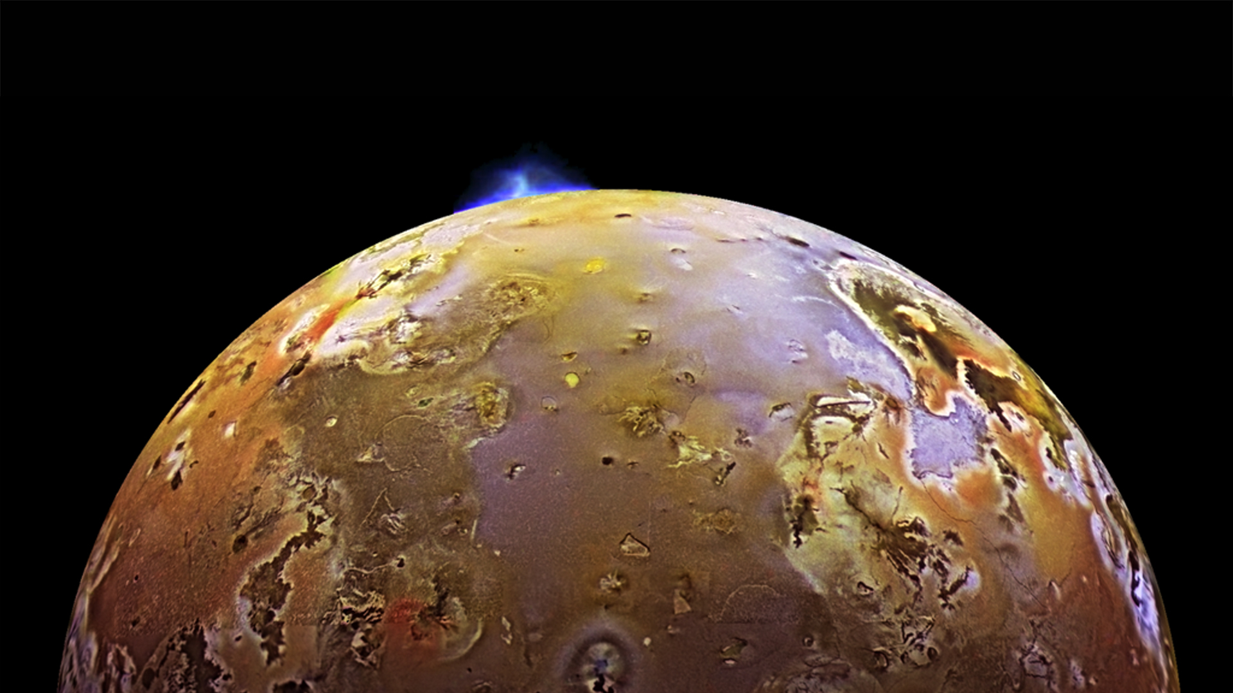
Don’t want to go to Loki Patera,
Io is not where I want to stay.

Slide 27
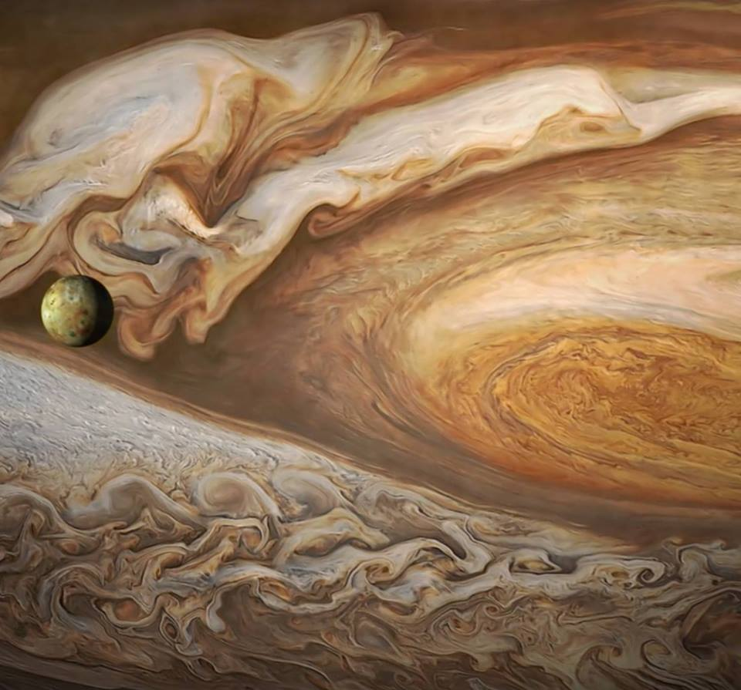
Jupiter’s moon smell like eggs all rotten,
Sulfur dioxide for sure not okay.

Slide 28
Now I don’t know, I don’t know,
I don’t know where I’m a gonna go When the volcano blows!
Notes:
28

Slide 29
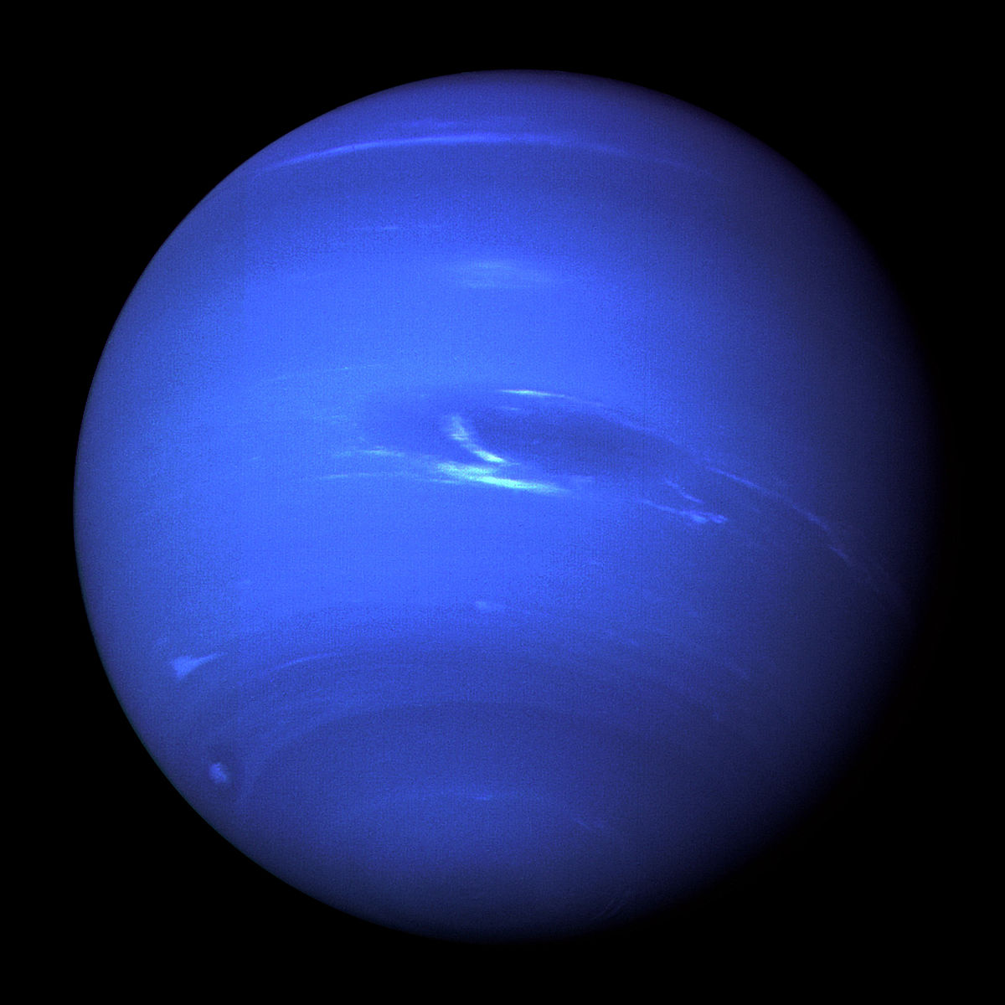
Don’t want to travel to
Far-out Neptune,
Place where me breath
Turn to solid ice

Slide 30
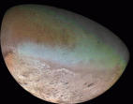
Nitrogen geysers on frozen moon Triton
Swimming in methane lakes is
not so nice.

Slide 31
Now I don’t know, I don’t know,
I don’t know where I’m a gonna go When the volcano blows!
Notes:
31

Slide 32
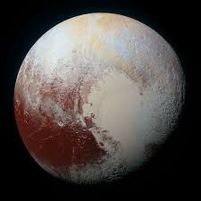
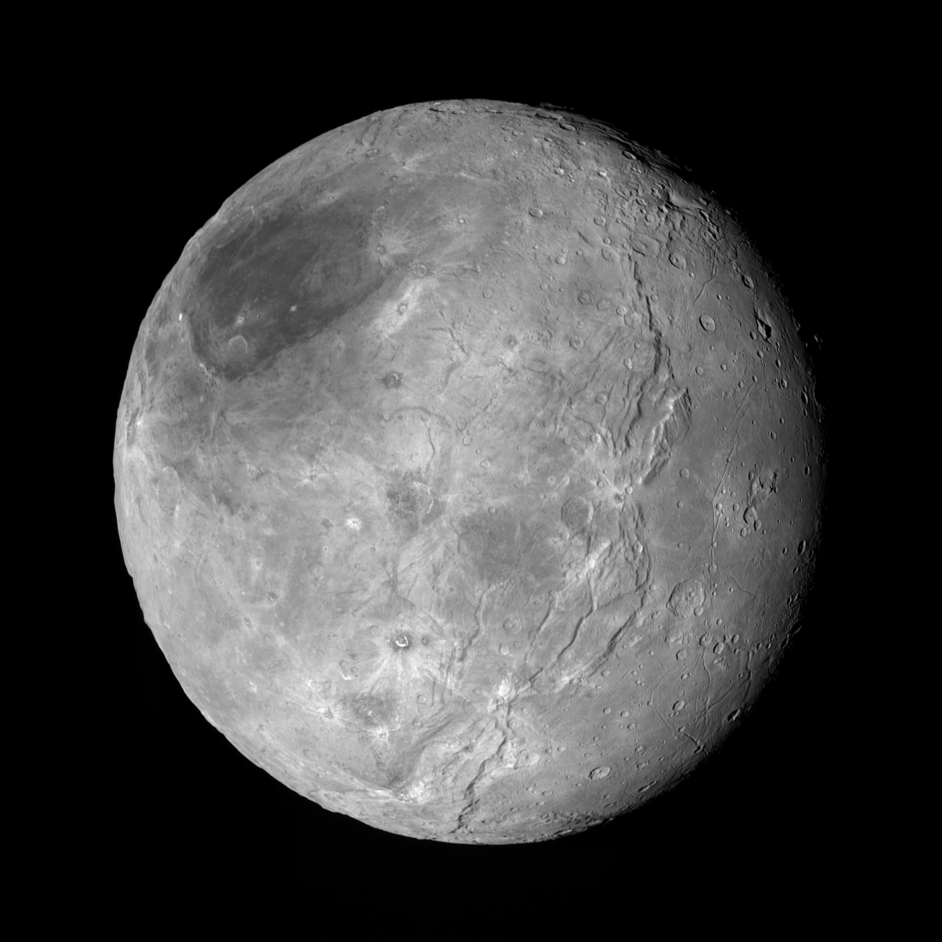
Don’t want to live out on tiny old Pluto -
Don’t want to live out on tiny old Pluto,
Land of perpetual twilight gray
Hundreds of years just to make one orbit,
Sun is a tiny spark far, far away.
- Land of perpetual twilight gray,

Slide 33
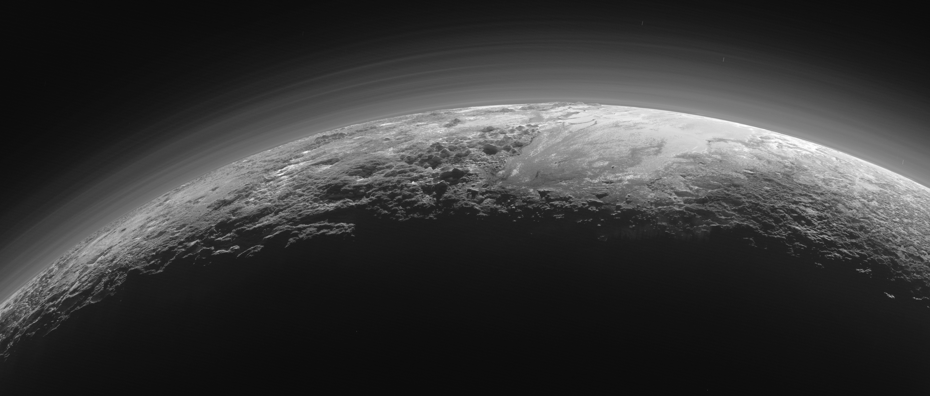
Hundreds of years just to make one orbit,
Sun is a tiny spark far, far away!

Slide 34
Now I don’t know, I don’t know,
I don’t know where I’m a gonna go When the volcano blows!
Notes:
34

Slide 35
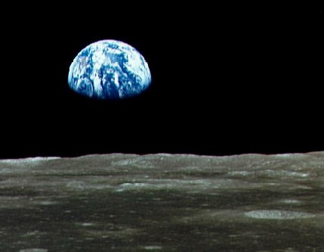
Think I will live on this pretty blue planet
This is my home, and I want to stay…
. Think I will live on this pretty blue planet,
This be my home, and me want to stay
Volcanoes on the Earth not half as scary

Slide 36
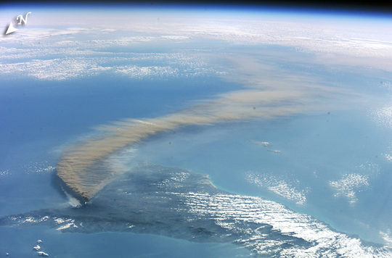
Volcanoes on earth not half as scary

Slide 37
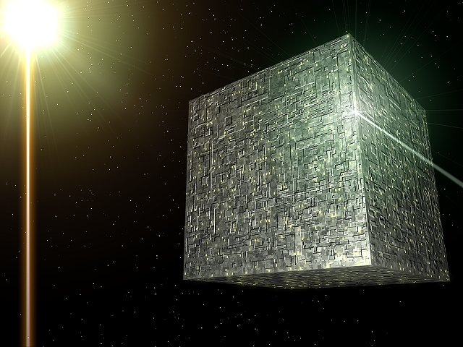
As most of the things in the big Milky Way.
As most of the things in the big Milky Way.

Slide 38
Now I don’t know, I don’t know,
I don’t know where I’m a gonna go When the volcano blows!
Notes:
38

Slide 39
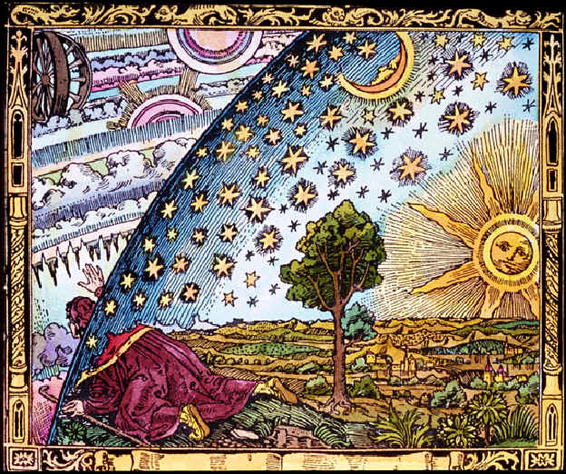

Slide 40
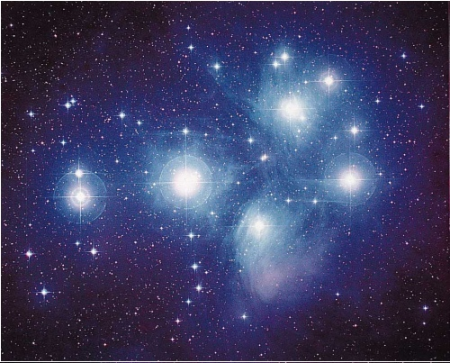
THERE ARE PLENTY OF STARS IN THE SKY!
Bell/Sullivan
Piano by Dr. Dale Rieth
M45, Pleiades star cluster (the Seven Sisters)

Slide 41
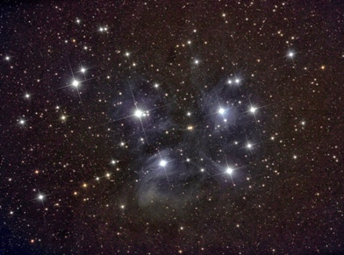
There are plenty of stars in the sky,
AUDIENCE: Sky – sky!
I’m not being hum’rous
Their numbers are num’rous
A fact that you cannot deny –
AUDIENCE: Nye – nye!
There are plenty of stars in the sky!
Gary Starkweather, TCAS

Slide 42
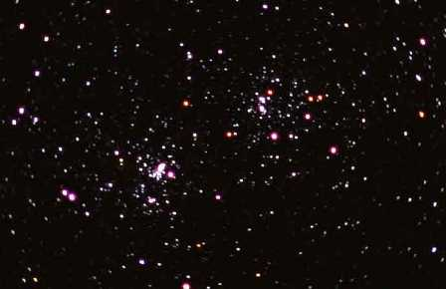
On this subject we’ll make you aware,
AUDIENCE: Ware – ware!
I’d say on the off-hand
There’s more than a thousand
And that’s just the ones that we see –
AUDIENCE: See – see!
And that’s just between you and me!
Scott Frank, TCAS

Slide 43
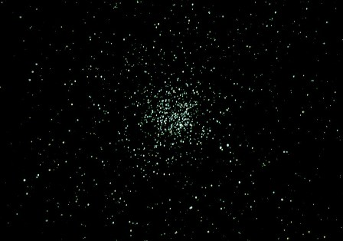
On this subject we’ll make you aware,
AUDIENCE: Ware – ware!
If you try to count them beware
AUDIENCE: Ware – ware!
Thomas Walker, TCAS

Slide 44
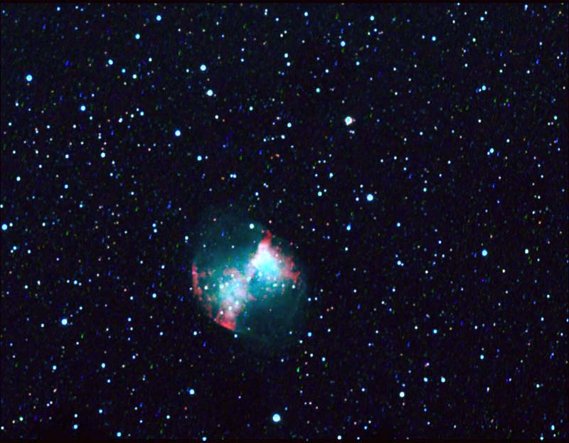
There are lots of bright stars in the sky,
There are plenty of stars in the sky!
There are lots of bright stars in the sky,
There are plenty of stars in the sky!
Bright stars, bright stars
Bright stars in the sky
Bright stars, bright stars
Bright stars in the sky
In the sky, in the sky, in the sky, in the sky!
David Holko, TCAS

Slide 45
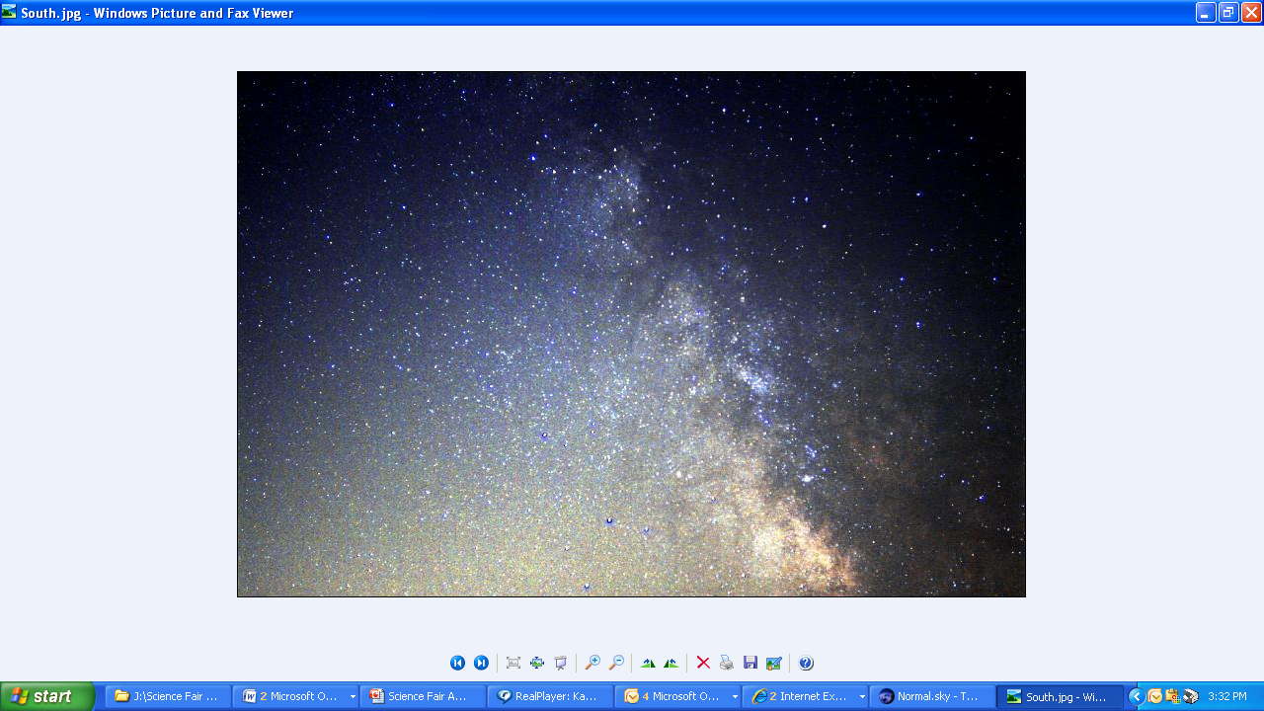
In this galaxy called Milky Way,
AUDIENCE: Way – way!
There’s more than a thousand,
There’s more than a million,
There’s hundreds of billions you see –
AUDIENCE: See – see!
And that’s just between you and me!
David Brown, TCAS

Slide 46
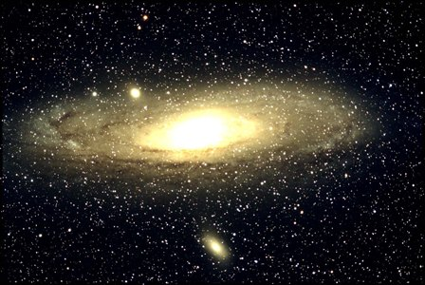
And beyond us there’s Andromeda,
AUDIENCE: Da-da!
A larger collection I feel I should mention,
Of stars that are far beyond us –
AUDIENCE: Us-us!
So please do not make such a fuss!
Roy Goderstad, TCAS

Slide 47
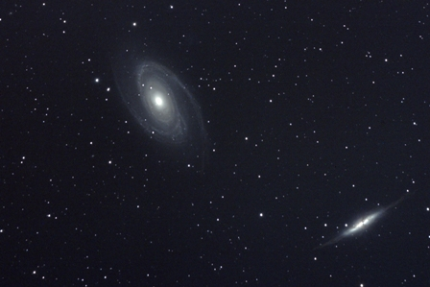
And there’s galaxies light years away –
AUDIENCE: Way-way!
There may be a trillion they say -
AUDIENCE: Say-say!
Larry Schilder, TCAS

Slide 48
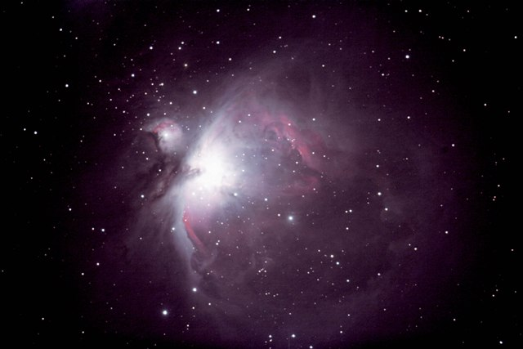
There are far, far more stars in the sky
Than the grains of the sand on the beach
There are far, far more stars in the sky
Than the grains of the sand on the beach
The sand, the sand, the sand on the beach
The sand, the sand, the sand on the beach
On the beach, on the beach,
On the beach, on the beach!
Lee Tinker, TCAS

Slide 49
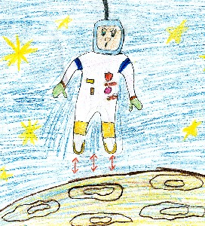

Slide 50
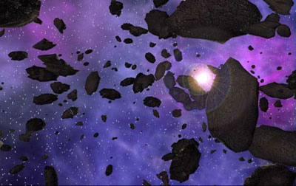
TUMBLING ASTEROIDS
by Jon Bell,
sung to “Tumbling Tumbleweeds” by Bob Nolan)
Synthesizer by Jennifer Kane
Notes:
50

Slide 51
Chorus:
See them tumbling round,
Rolling, not making a sound
Out beyond Mars they’ll be found
Drifting along with the tumbling Asteroids!
Notes:
51

Slide 52
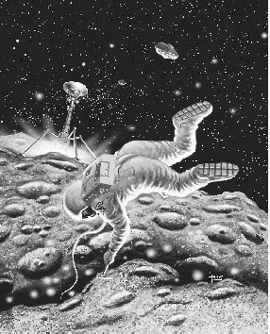
I’m a roaming spaceman, Trav’ling out in space,
Asteroids around me Keep harmonic pace -
Notes:
52

Slide 53
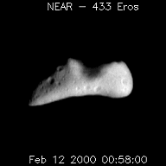
Nights come as quickly as the days -
When you spin ‘neath the sun’s rays!
Notes:
53

Slide 54
Chorus:
See them tumbling round,
Rolling, not making a sound
Out beyond Mars they’ll be found
Drifting along with the tumbling Asteroids!
Notes:
54

Slide 55
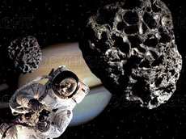
Rocks I have passed are behind
Rocks up ahead I will find
Resonantly they’re aligned,
Drifting along with the tumbling Asteroids!
Notes:
55

Slide 56
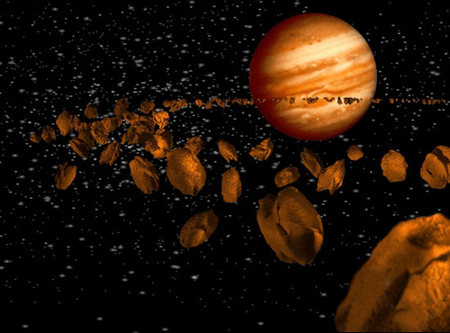
I know when Jove is nigh,
That this rock is going to fly!
Notes:
56

Slide 57
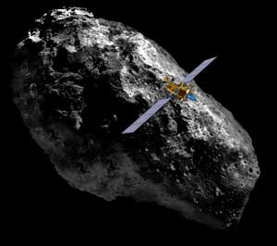
And I'll keep rolling along
Deep in my heart is a song
Out beyond Mars I belong
Drifting along with the tumbling asteroids…
Notes:
57

Slide 58
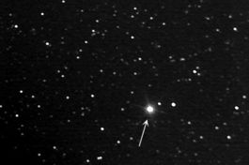

Slide 59
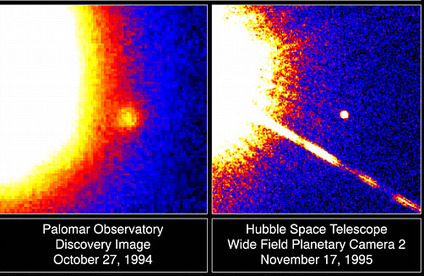
LITTLE BROWN DWARF, by Jon Bell

Slide 60
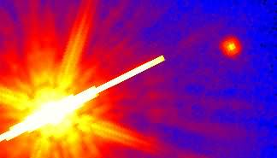
The smallest stars of which are known
Are plentiful and not alone,
The little brown dwarfs of our galaxy
Are cool and dim and hard to see!

Slide 61
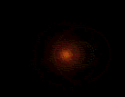
The stars are all far out in space,
Ha ha ha,
Hee hee hee,
Good interferometry!
Ha ha ha,
Hee hee hee,
Little brown dwarf now I see thee!

Slide 62
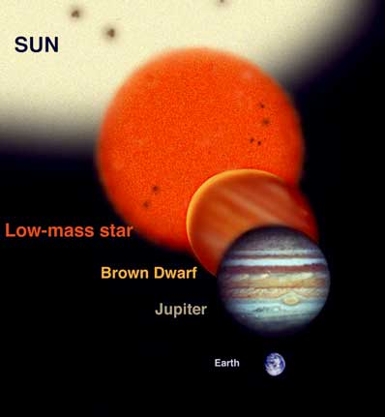
Of mass and color.
Its size is smaller than a star
But bigger yet than Jupiter,
Nuclear fusion’s not easy,
It’s just a stellar wanabee!

Slide 63
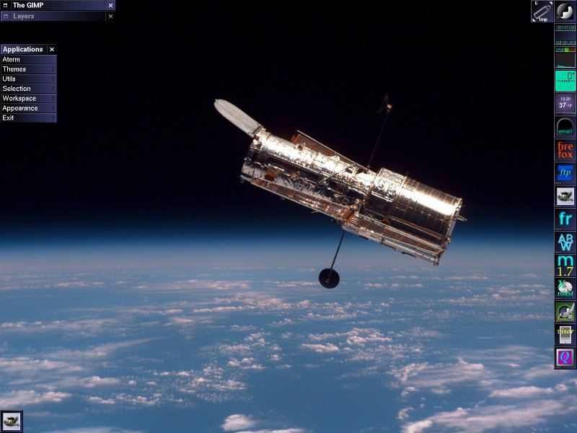
Ha ha ha, hee hee hee,
Thanks to space telescopy -
Ha ha ha, hee hee hee,
Little brown dwarf now I see thee!

Slide 64
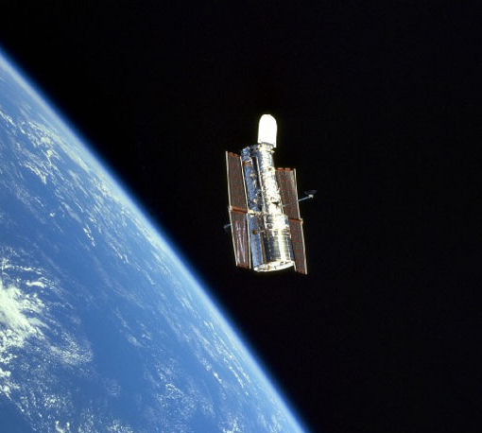
Ha! Ha! Ha! Hoo! Hoo! Hoo!
Hubble’s got a splendid view!
Ha! Ha! Ha! Hoo! Hoo! Hoo!
Little brown dwarf now
I see you!

Slide 65
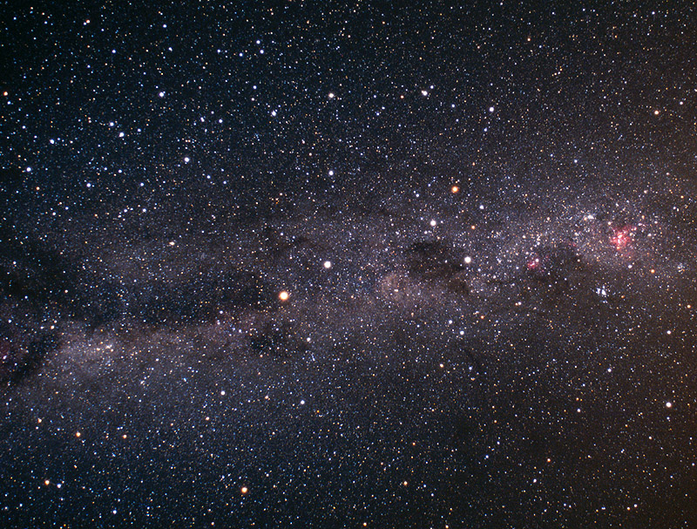

Slide 66
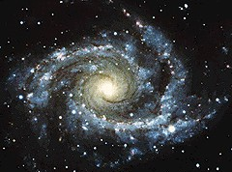
UNIVERSE CALLING!
By Jon Bell, to the tune, Lilli Burlero
Piano by Dr. Dale Rieth

Slide 67

The stars in the sky that we see every night,
Their beauty inspires us – a heavenly sight!
They shine down upon us from light-years away
And someday we hope to be going their way!

Slide 68
So look to the stars, tell me what do you see?
The Heavens unfolding, a great mystery;
The Universe calling, ‘cross in-fin-i-tee,
Per ardua ad astra, they beckon to me!

Slide 69

Stonehenge was built on the plains of Sals’bree,
A calendar temple, three thousand B.C.
Sunrise o’er heelstone, the solstice in June,
Eclipse of the sun and eclipse of the moon!

Slide 70
So look to the stars, tell me what do you see?
The Heavens unfolding, a great mystery;
The Universe calling, ‘cross in-fin-i-tee,
Per ardua ad astra, they beckon to me!

Slide 71




Pythagoras said, “Listen: the tune of the spheres”
Plato told Ari, “Save that which appears”
Hipparchus made charts & gave star magnitudes
Ptolemy’s book met some dark interludes.

Slide 72
So look to the stars, tell me what do you see?
The Heavens unfolding, a great mystery;
The Universe calling, ‘cross in-fin-i-tee,
Per ardua ad astra, they beckon to me!

Slide 73


Kepler he had him a thought most profound,
The orbits of planets are not all that round;
“Velocity varies with distance,” sayeth he,
P squared equals A cubed, elliptically!”

Slide 74



A telescope built in the year sixteen-nine
Gave Galileo a view simply divine!
The moons of great Jove
Were laid out on display
The phases of Venus, the moon rough and gray!

Slide 75



In Cambridge an apple did fall from a tree,
Sir Isaac then noted the force gravity;
“The moon’s like an apple,”
The great Newton said,
“It falls ‘round the Earth, just not on my head!”

Slide 76

Einstein the genius addressed gravity:
“You’re not what you seem,
Just what can you be?
“Everything’s relative,
Space-time is curved,
“To travel the speed of light
Seems quite absurd!”

Slide 77


Annie Jump Cannon quite often did see
Dark spectral lines at Harvard Observa-tree;
She catalogued them hot to cool by degree,
O B A F G K M, won’t you kiss me!

Slide 78


Chandrasekhar did establish his goals
For white dwarfs & neutron stars,
And for black holes:
“One point four, two point four, mass of the sun,
Determines the fate in the end of each one!”

Slide 79

Huchra and Geller, their students as well,
Discovered the places where galaxies dwell;
Great walls & voids John & Margaret did chart,
A stick-man revealed by their red-shifted art!

Slide 80

“Quasars are distant and brilliant,” said Schmidt,
Hawking said, “Black holes radiation emit,”
Galaxies crash and collide as they go
It’s amazing how much
We now know we don’t know!

Slide 81


Slide 82

BETELGEUSE
By Peter Jedicke,
to the tune, “Edelweiss” by Richard Rogers
Piano by Dr. Dale Rieth, guitar by Cindy Ressler
Betelgeuse HST

Slide 83
Betelgeuse, Betelgeuse, bright red star in Orion

Slide 84

Soon I’m told you’ll explode
So you’re worth keeping my eye on!

Slide 85

Only two hundred parsecs away
And we know what this means

Slide 86

You’re so near that some year
You’ll blow us all to smith’reens!

Slide 87

Betelgeuse, Betelgeuse
Speckle interferometry

Slide 88

Seems to show spots that glow
Spoil your spherical symm’try.

Slide 89

You’re losing mass by convecting gas
You’ll go supernova!

Slide 90

Cosmic rays
Will amaze,
Then it all will be over.

Slide 91


Slide 92

EINSTEIN THE GENIUS
by Henry Jankiewicz
Piano by Dr. Dale Rieth, IRSC
Banjo and backup vocal: Cindy Kays
EINSTEIN THE GENIUS
Albert Einstein (1879-1955) enjoying a bike ride in Santa Barbara, CA, 1933.
Image Credit: California Institute of Technology.

Slide 93

Einstein was a genius,
Unlike you or me,
He wrote equations every day
On Mondays he wrote three,
Mondays, he wrote three.

Slide 94

Albert,
Dance around
Albert,
Be profound
Albert let your Hair stick out
And your socks hang down!

Slide 95

I had a frame of reference,
I left it on the fence
Along come relativity,
ain't seen the darn thing since,
Ain't seen the darn thing since!

Slide 96

Albert,
Dance around
Albert,
Be profound
Albert let your hair stick out
And your socks hang down!

Slide 97

A man looked through a telescope
Until his eye was red;
Looked through outer space and saw
The back of his own head,
Back of his own head!

Slide 98

Albert,
Dance around
Albert,
Be profound
Albert let your hair stick out
And your socks - hang down!

Slide 99

A man got in a spaceship,
Flew a million miles,
Busted through the speed of light -
He came back a child,
He came back a child!

Slide 100

Albert,
Dance around
Albert,
Be profound
Albert let your hair stick out
And your socks hang down!

Slide 101

A wave and a particle
Were walking
Side by side.
One said
to the other,
Which one of us am I?
Which one of us am I?

Slide 102

Albert,
Dance around
Albert,
Be profound
Albert let your hair stick out
And your socks -hang down!

Slide 103

Newton had an apple, it hit him
on the head,
Doc McCoy stepped up to him, said, "Jim, I think he's dead.” “Jim, I think he's dead!"

Slide 104

Albert, dance around
Albert, be profound
Albert let your hair stick out
And your socks hang down!

Slide 105

Einstein played the violin,
He liked to shout and sing,
If that ain't Genius,
That ain't anything!
That ain't anything!

Slide 106
Albert,
Dance around
Albert,
Be profound
Albert let your hair stick out
And your socks hang down!

Slide 107

Albert,
Dance around
Albert,
Be profound
Albert let your hair stick out
And your socks hang down!

Slide 108


