Slide 1
Music as a Tool for Environmental Education and Advocacy
Jennifer Publicover, M.Mus, MES
Dalhousie University
Dr. Tarah Wright
Environmental Sciences,
Dalhousie University
Dr. Steven Baur
Fountain School of Performing Arts, Dalhousie University
Dr. Peter Duinker
School for Resource and Environmental Studies,
Dalhousie University

Slide 2
Tackling Environmental Problems
Environmental education is a key tool
However, increased knowledge ≠ increased action.
People must also care
UNEP, 1972; Jurin & Fortner, 2002
Notes:
“Through ignorance or indifference we can do massive and irreversible harm to the earthly environment on which our life and well-being depend. Conversely, through fuller knowledge and wiser action, we can achieve for ourselves and our posterity a better life in an environment more in keeping with human needs and hopes.”

Slide 3
The Arts
We frequently use the arts to process values, emotions, and motivations on a wide range of life issues
Affective (emotional) learning is a strength of the arts
Packalén, 2010; Coombs & Ahmed, 1974; Mocker & Spear, 1982;, Kolb, 1984; Eernstman & Wals, 2013

Slide 4
The Non-Verbal Language of Music…
pitch
timbre
setting up expections / fulfilling them, or not, or sending them in a different direction
harmony / consonance / dissonance
away from / towards tonal centre
tempo
tension / release
volume
range
tessitura
rhythm
familiar vs. novel material
extra-musical references
(from Levitin, 2006; Benward & Saker, 2014; Patel, 2008)

Slide 5
… Harnessed in the Service of an Extra-Musical Message
Star Wars score: John Williams

Slide 6
However:
“… any powers of physical, mental, or social transformation which music may have will result from a combination of social, psychological, and physical factors” (Ingram, 2010, p. 69)

Slide 7
Research Questions
The Music:
1. If music is one of the possible approaches that can be used to encourage pro-environmental thoughts and actions, then how, when, where, and why could professional musicians and environmental educators enlist music to help elicit these thoughts and actions in their audiences and networks?
Career and Life:
2. What are some of the sociological and career implications for performing musicians who engage with environment and sustainability issues in their professional and/or personal lives?

Slide 8
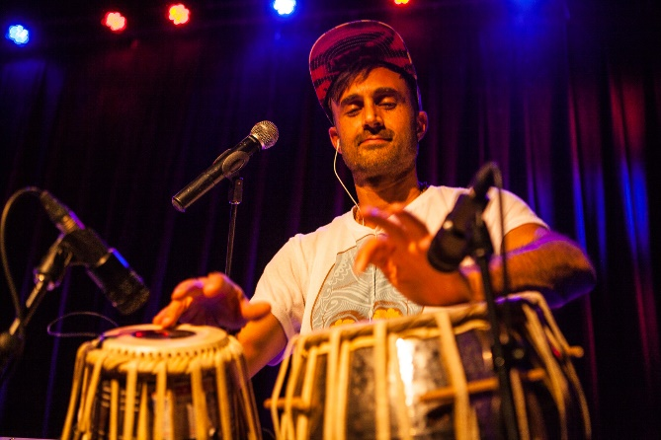
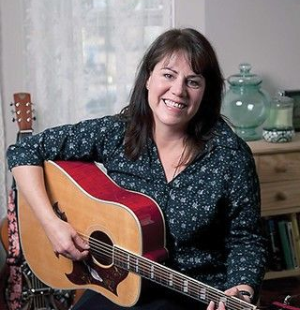
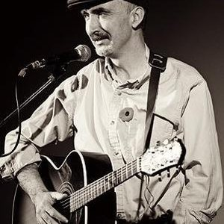
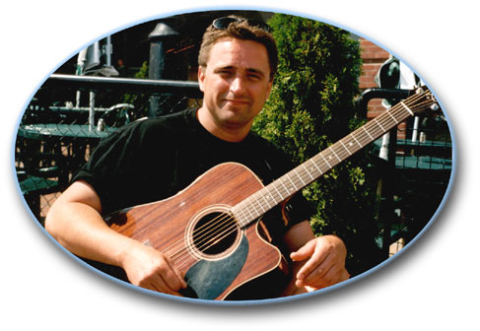
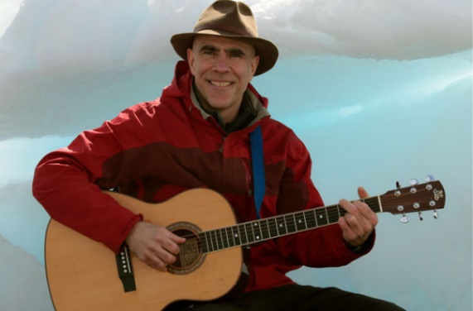
David Suzuki Foundation Playlist for the Planet

Slide 9
Interview Questions: Music and Environmental Engagement
Open-ended, semi-structured questions Answers coded in grounded inductive framework
Making and presenting the music
Balancing entertainment, advocacy
Challenges, risks, rewards
Off-stage pro-environmental actions: business, lifestyle
Tips for environmental educators and engaged musicians

Slide 10
Findings: A Framework for Musical Decision-Making
Career and Life:
Music:
4 Artistic Dimensions
5 Quality Dimensions
Challenges, Risks,
Rewards

Slide 11
Question #1: The Music

Slide 12
Four Artistic Dimensions (“Continua”)
Simple Complex
Feel-good Not-feel-good
Inclusive Adversarial
Direct Ambiguous

Slide 13
Simple vs. Complex
Remy Rodden:
“I’ve heard this anecdotally from teachers… the ‘brain worm’, the catchy song...”

Slide 14
Simple vs. Complex
Music as one form of a “captivating message”
Vivid, concrete, personal, easy to remember
(McKenzie-Mohr, 2011)

Slide 15
Feel-good vs. Not-feel-good
Tanya Tagaq:
“This is the thing when you’re discussing the human condition in art – I’m not trying to make it sound good… I’m trying to express what it’s like to be alive right now...”

Slide 16
Positive and Negative Environmental Messaging:
- Negative messages spur greater action than positive - “Problem-based coping”
- However, that can backfire into overwhelm and inaction if overdone - “Emotion-based coping”
(Lazarus & Folkman, 1984; McKenzie-Mohr, 2011; Kelsey & Armstrong, 2012))

Slide 17
Inclusive vs. Adversarial
David Myles:
“I wanted to be the type of performer and writer that brought all sorts of people to my shows, young and old, rich and poor…”

Slide 18
Inclusiveness and Communal Music-Making
- Making music with others makes us aware of ourselves in relation to others
- Releases oxytocin, a neurotransmitter responsible for social bonding
(Levitin, 2006)

Slide 19
Direct vs. Ambiguous
Danny Michel:
“I just try to do it artistically and throw some images out there, and let people put the puzzle together for themselves and decide however they want to feel about it.”

Slide 20
Direct vs. Ambiguous
- A balance to strike between directness and ambiguity in (visual) art (Jakesch & Leder, 2009)
- Other art forms too?

Slide 21
Five Quality Dimensions
Make high quality art
Keep relevant to audience
Recognize a diversity of possible “hooks”
Write from what you know and believe (authenticity)
“Don’t preach”

Slide 22
Quality and Relevance
Tarun Nayar (Delhi 2 Dublin):
“Art is the holy grail…”
“In general for that stuff to work, the music has to be good! And ideally, relevant to the audience...”

Slide 23
A Diversity of Artistic “Hooks”
For example, Todd Butler:
- Difficult issues approached with humour

Slide 24
Write from What You Know and Believe: Participants’ Inspiration
- Same as for non-environmental repertoire, i.e. writing about what moves them personally
- Examples: Nature, Community, Consumerism, etc.

Slide 25
Authenticity: Modelling
David Myles:
- 3 ways musicians can show values:
Art (onstage), Business, & Lifestyle
- Keep it real onstage; convinces no one when forced or phony

Slide 26
Actions Building Authenticity
Conservationist, researcher behavioural ecology
Eco-friendly landscaping firm
Environment Yukon
Danny Michel Ocean Academy Fund
Free the Children
Oxfam, USC, UN Mine Action Service, Friends of the Earth, etc.
Royal Saskatchewan Museum

Slide 27
Preaching Destroys Credibility
Hayley Sales:
“The best way to communicate isn’t by forcing it down people’s throats… It’s not as though they’re being scolded like a kid, it’s just that they’re looking at you and seeing your love for something, and that hopefully inspires them to care.”

Slide 28
Question #2: Career and Life

Slide 29
Challenges of Authenticity: Touring
David Myles:
“Being a musician is brutal for the environment… I fly all the time, and I think about that every time I fly... So for me to get up on stage and tell people how to live, it just doesn’t feel right, entirely…”

Slide 30
Challenges of Authenticity: Autonomy
Tara MacLean:
- Pulling out of gig because of unethical sponsor:
“My internal moral compass is ‘I can’t mix my music with this.’”

Slide 31
Migitating Challenges
All: Extensive fundraising, donation schemes, advocacy, lifestyle modifications, etc.
Jessie Farrell:
Puts environmental requests in rider for venues
Jack Lavoie:
Buys carbon offsets

Slide 32
Risks
Todd Butler:
“I’ve always imagined that there has been an impact on my career because of my outspokenness in certain areas. It’s really hard to tell, because if somebody doesn’t hire you for a gig, you don’t know that they didn’t hire you because they didn’t call – and why didn’t they call?...”

Slide 33
Rewards
Hayley Sales:
“… Whenever someone brings up a song to me or wants to talk about it, that to me is positive. Like, it connected with someone, they heard it, they got it, they wanted to talk about it.”

Slide 34
Keeping It Real: Managing Expectations
Bruce Cockburn:
“… What do you expect to get out of putting a song like that out? And one of the things you don’t expect to get is that people will suddenly run out and fix it all, because they don’t. And although individuals sometimes get inspired by songs – or their own inclinations are sufficiently reinforced by a song – that they will then actually take action, and that does happen sometimes, it’s not something you can expect or rely on.”
“Most of the time – and I learned this almost right away, getting involved with issues – you better not attach yourself to the outcome… Otherwise, you just burn out.”

Slide 35
Dr. Tarah Wright
Dr. Peter Duinker
Dr. Steven Baur
Dr. Lynn Fels
Thank You
Dr. Heather Castleden
Panos Grames
Lennie Gallant
David Orleans
All the Participants
School for Resource and Environmental Studies,
Dalhousie University
For links to scholarly publications, visit: www.jenniferpublicover.com/scholar

