Slide 1
The Climate it is a-Changin’: Songs in a Global Warming Class
Dargan M. W. Frierson
Associate Professor
Department of Atmospheric Sciences
September 27, 2017

Slide 2
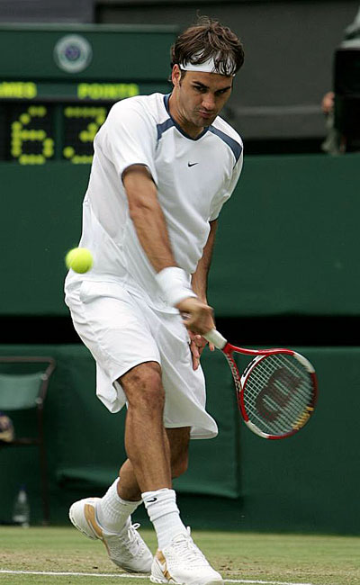
Key Concept for Climate: Albedo
Albedo: fraction of incident light
that’s reflected away
  Dark things absorb light – warm the climate
    Oceans, forests
  White things reflect light – cool the climate
    Snow, ice, clouds
When ice and snow melt, this causes more warming!

Slide 3
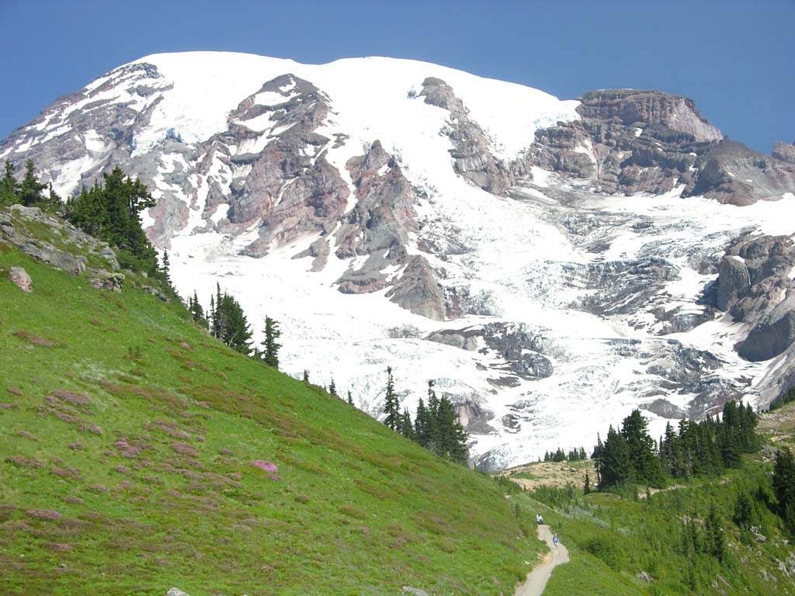
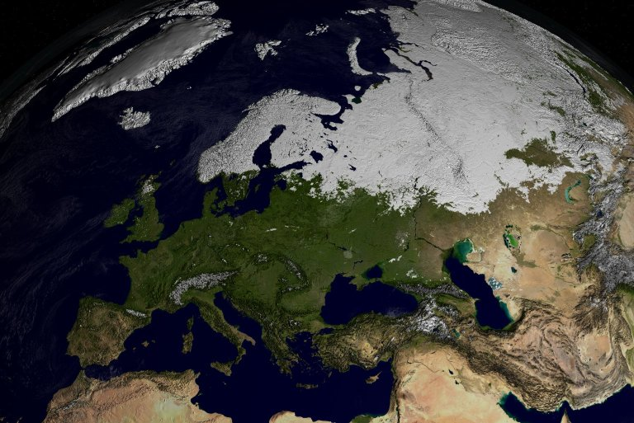
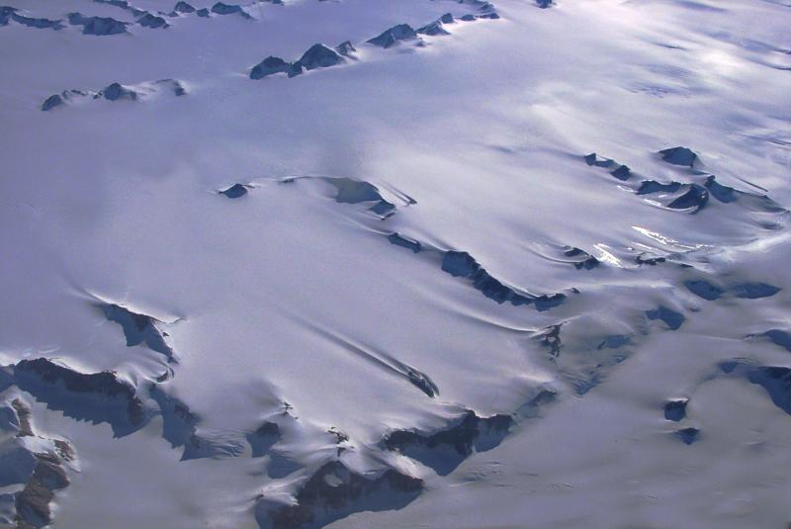
Sheets of ice and snowpack
They reflect radiation back
Where there is ice
Albedo

Slide 4
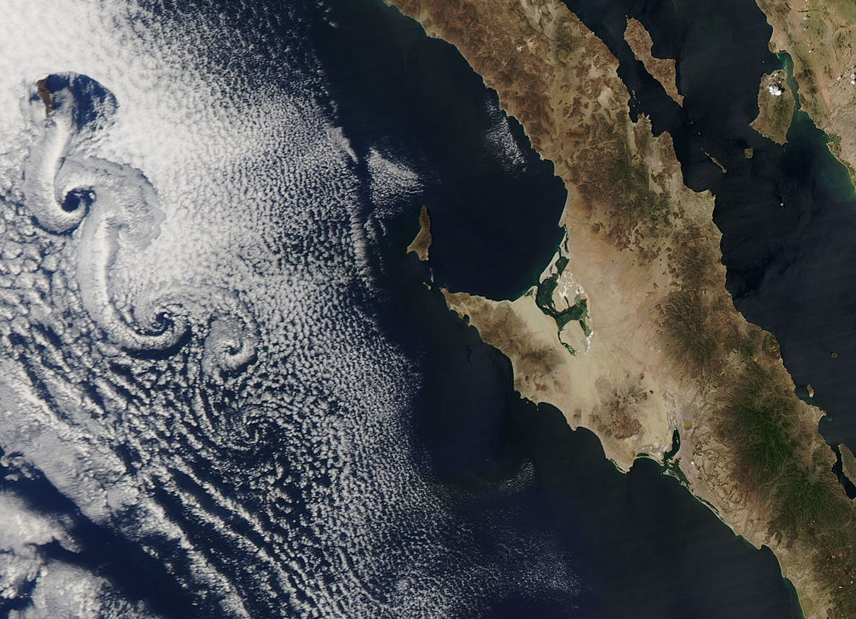
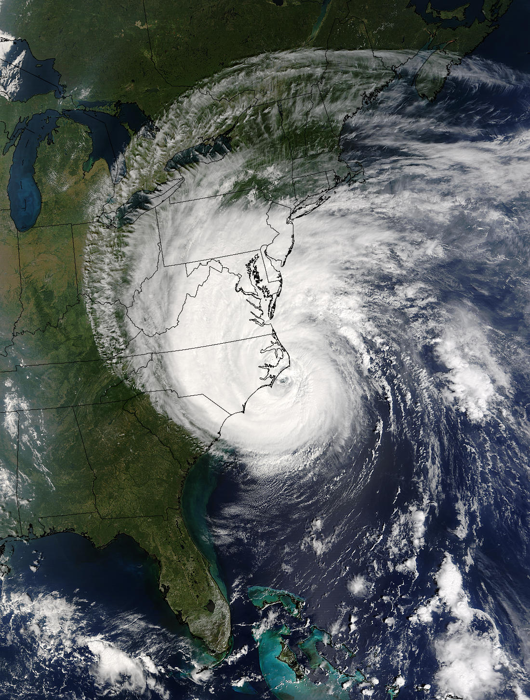
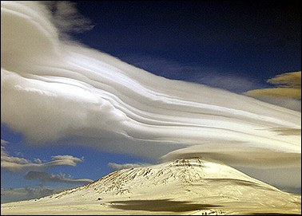
Tiny droplets in the sky
Cirrus, stratus, way up high
Where there is cloud
Albedo

Slide 5
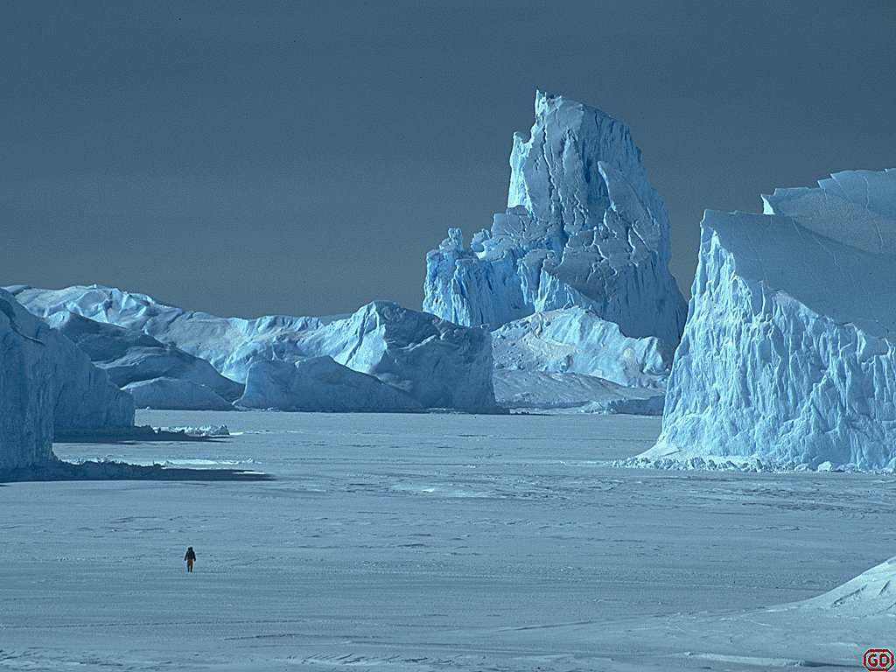
Albedo
Albedo
Where there is white
Albedo

Slide 6
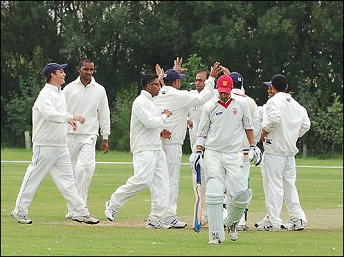
Albedo to reflect you
In a world so warm and bright,
I’m so glad you bounce that light
Where there is white, albedo

Slide 7
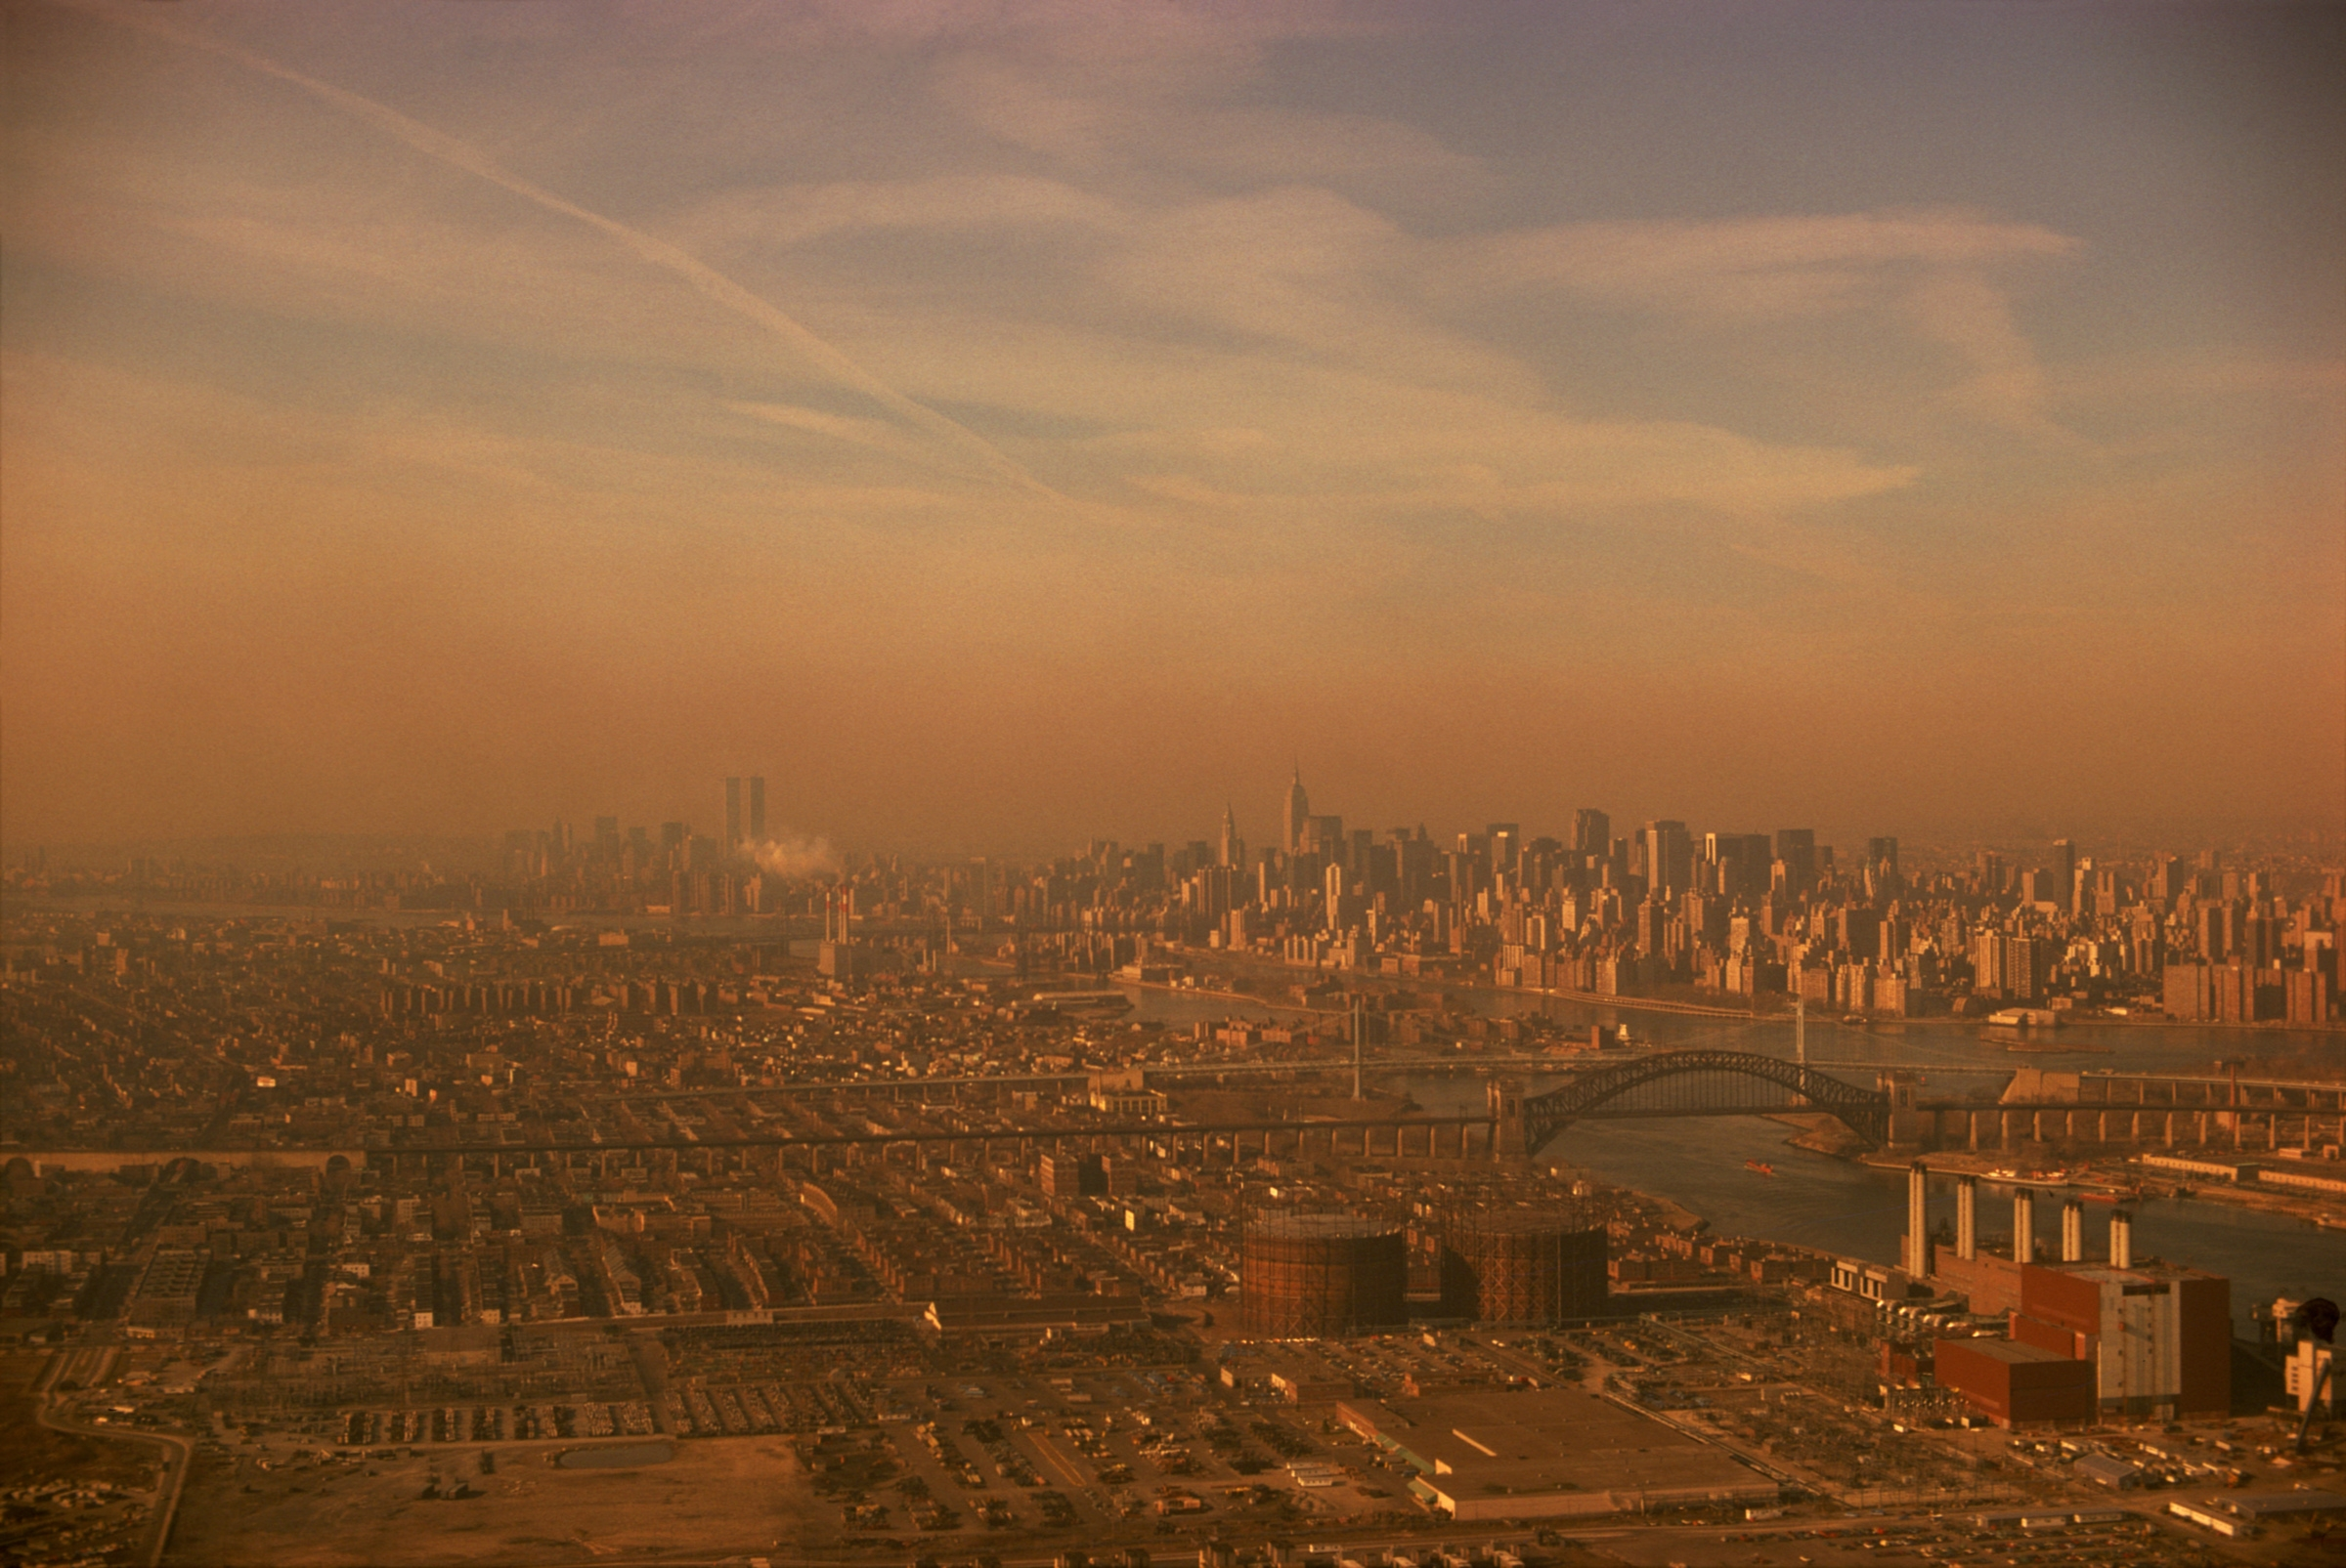
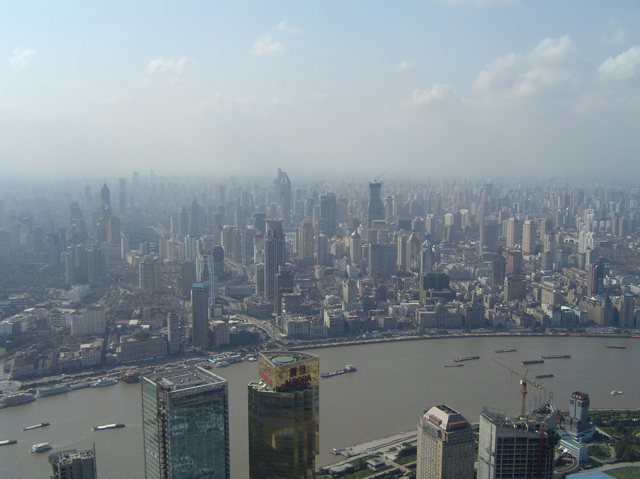
And if your city skies are never blue
With air pollution all surrounding you
Scattering light,
Think albedo
(at least that haze is keeping you a little cooler)

Slide 8
Albedo
Albedo
Where there is white
Albedo

Slide 9
ATM S 111: Global Warming
Survey course covering science, impacts, and solutions of climate change
240 students, mostly non-science majors
2 hour lecture period!
I sing a song each class (sometimes 2) about the science of the day
Almost all parodies, many to classic rock

Slide 10
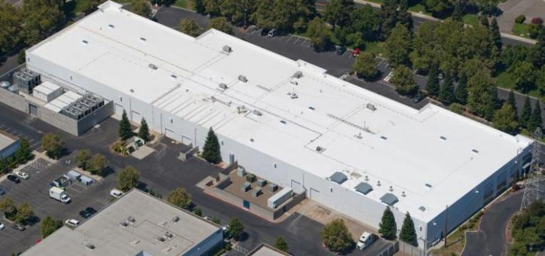
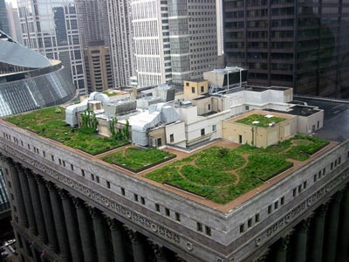
We can change albedo!
Heat waves hit cities especially hard
White or vegetated roofs are a potential method of reducing impacts
And could we change the albedo of the whole planet

Slide 11
From “Paint it White”
I see a dark roof and I want to paint it white
No light trapped any more, I want it to be bright
We know that climate changes are making our cities hot
We’ve got to get that heat out any way we’ve got

Slide 12
From “The Man Who Cooled the World”
he flew up in the sky, in a plane full of sulfur dioxide
shot out like a torpedo, to change the earth's albedo
the sulfurs oxidize, to offset temperature rise
a whole earth parasol in a stream of aerosol

Slide 13
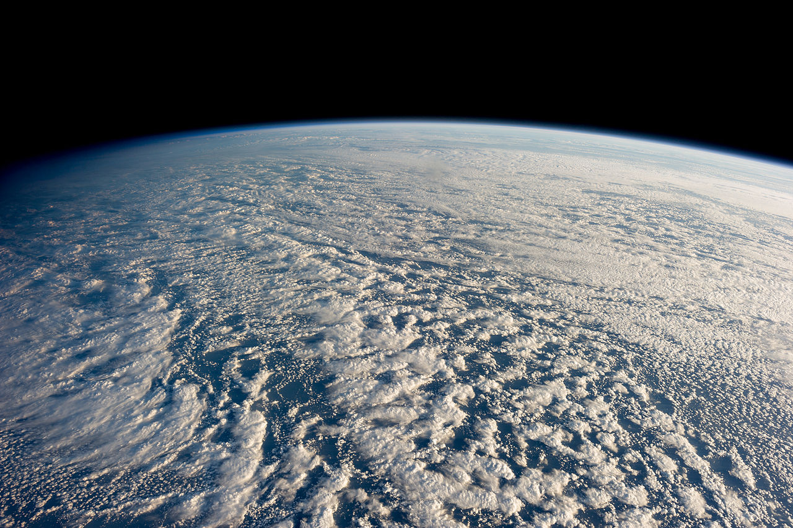
Stratocumuli are bright
High albedo, colored white
The cooling from the scattered light
I’ve looked at clouds that way
From ”Clouds”

Slide 14
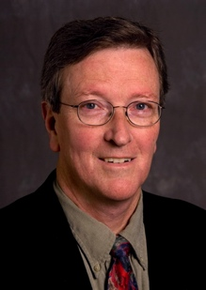
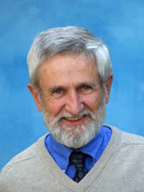
Importance of Mentors
Profs. Mike Wallace and Dennis Hartmann are both role models for my own songwriting
Departmental winter social features around 8 new parody songs each year
  Early source for the repertoire for the class
In my classes I’ve sung:
Mike’s “Daisy World” and “35 Tons”
Dennis’ “Last Chance” and “Surface Pressure”
and…

Slide 15
From “The Climate it is a-Changin’” by Prof. Mike Wallace
Come gather round people wherever you roam
And admit that the global sea level has grown
And accept it that soon we'll be drenched to the bone
If the world to you is worth saving
Then you'd better start swimming or you'll sink like a stone
For the climate, it is a changing

Slide 16
From “Ocean Acidification” by me, Dennis Hartmann and Dr. Mark Zelinka
At the present time weʼre very close to aragonite saturation
If CO2 keeps rising thereʼs no time for adaptation
Oysters unborn, coral reefs forlorn
ocean acidification, ocean acidification

Slide 17
Student-Written Songs
I’ve always offered extra credit for students to write songs
  Lyrics must be scientifically accurate!
Usually 1 great submission per year
  “Catch Longwaves” by Elaine Wellman
  “Some Day is Going to be a Great Day” by Ryan Rosas, Victoria O’Laughlin, Marina Martinez, and Ben Weymiller
Last year received many new ones
  “Ice Melts” to Jason Mraz’s “I’m Yours” by Liesl Danyluk
  “Eye of the Cyclone” by Joseph Zhong

Slide 18
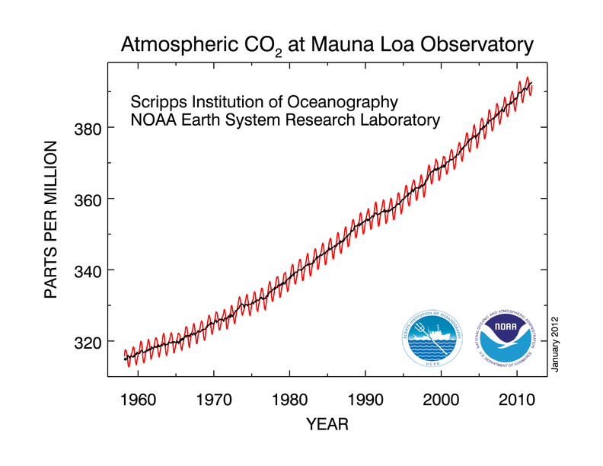
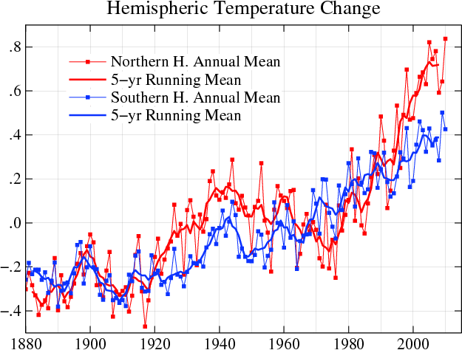
Climate Changes

Slide 19
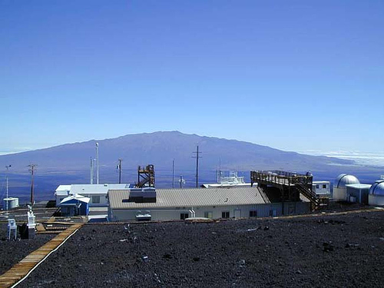
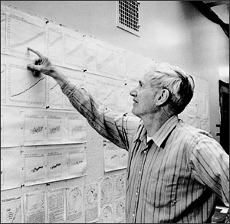
Keeling didn’t know what he was looking for
When he placed the carbon
sensors on the mountaintop,

Slide 20
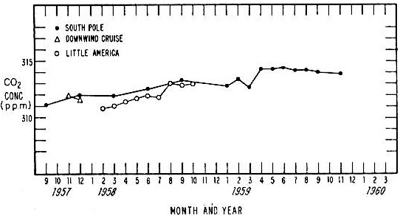
But pretty soon it became rather clear
That the rise wasn’t going to stop
Keeling 1960, Tellus

Slide 21
as we look back fifty years later
now over 400 ppm

Slide 22
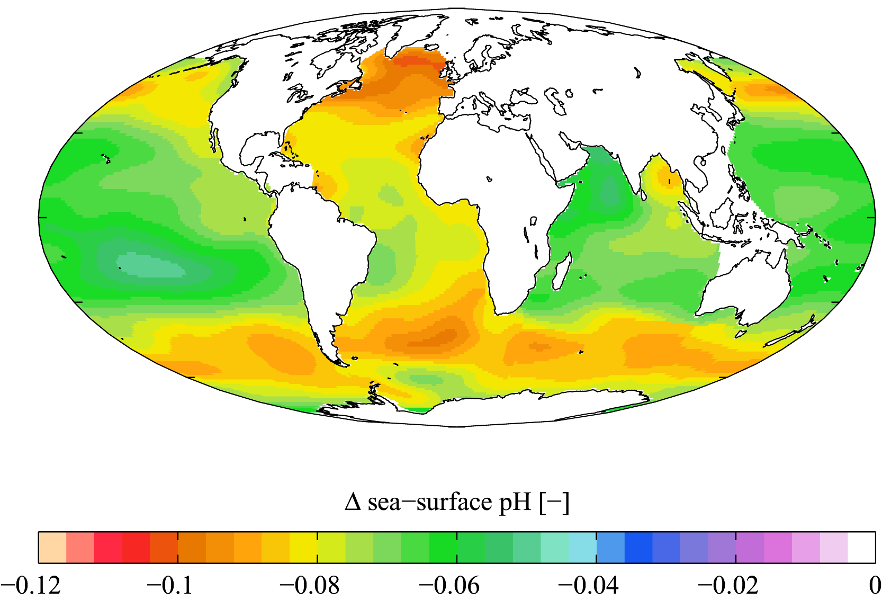
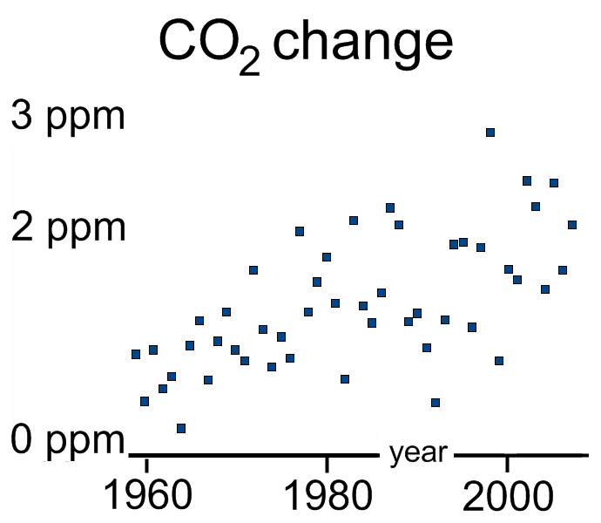
Our oceans are becoming acid
and still no sign of abatement

Slide 23
Ch-ch-ch-changes,
Climate changes,
Don’t ignore the data, man

Slide 24
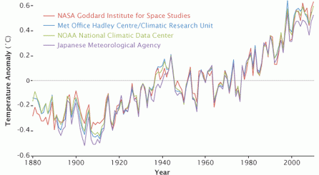
Ch-ch-ch-changes,
Climate changes,
it’s gonna be different, man.
Climate’s changing -- check the trend lines

