Slide 1
Quantifying the causal effects of conservative fourth down decision making in the National Football League
Derrick Yam 17’
Skidmore College

Slide 2
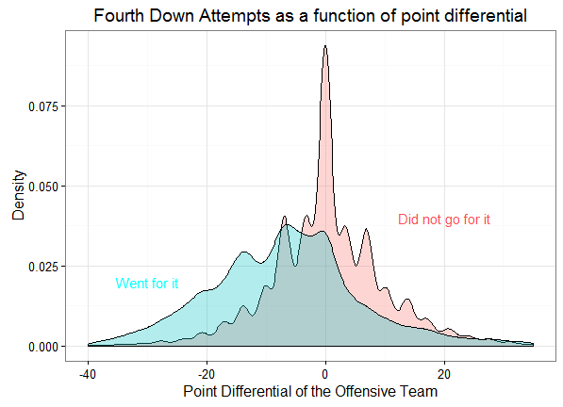
Motivation
Difficult to analyze from an empirical approach.
Density Curve shows the need for a more in-depth analysis.
Limitations to Romer’s study in 2006.

Slide 3
Process
Data: Play and Game level data from 2004-2015 via Armchair Analysis.
Matching Algorithm: Treatment (Going for it) paired to a Control (Kicking)
Based on the observation’s propensity score.
Restricted our range of observations to those recommended by the NYT 4th Down Bot
Maintained 3,607 Treatments from 522,193 regular season plays excluding overtime.
Outcome: ΔWin Probability as constructed by Lock & Nettleton

Slide 4
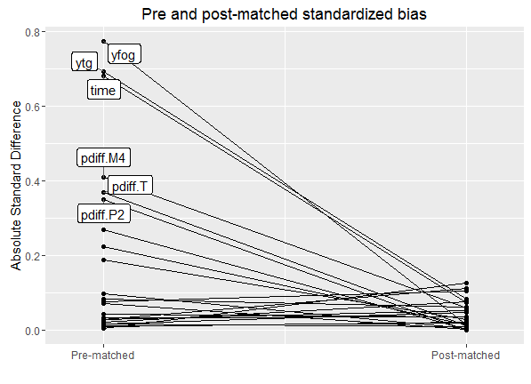
Love Plot

Slide 5
Results
On average, teams that went for it had a change in win probability 1.5% greater than teams that did not go for it

Slide 6
Future Work
Situational analysis to choose the optimal setting for an aggressive fourth down strategy.
Field Position
Yards to Go
Time Remaining
A review of the potential games lost in the NFL due to conservative fourth down decision making.

