Slide 1
BIO 162 Apical Dominance Experiment

Slide 2
Auxin and Apical Dominance
Apical dominance is a growth pattern restricted to the main stem of the plant, while lateral buds remain dormant. If the apical bud is removed, lateral buds will grow
Auxin produced by apical meristem
More auxin, less lateral growth

Slide 3
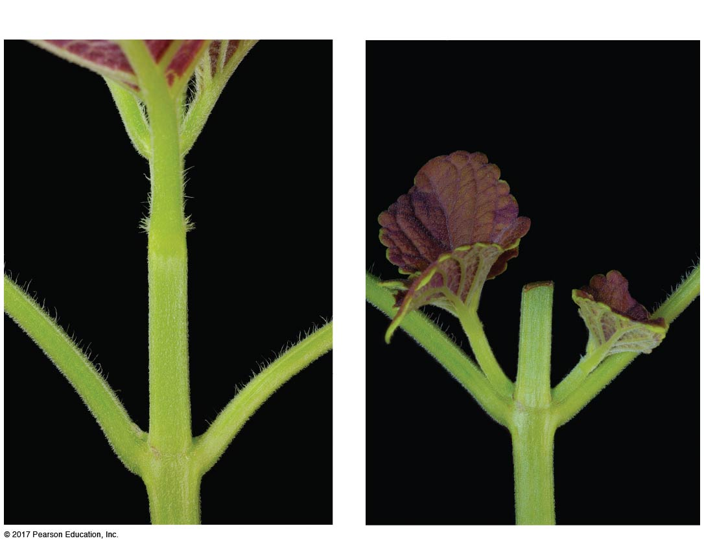
Apical Dominance
(a) Apical meristem intact
(b) Apical meristem cut off
Dormant
lateral
buds
Lateral
shoots

Slide 4
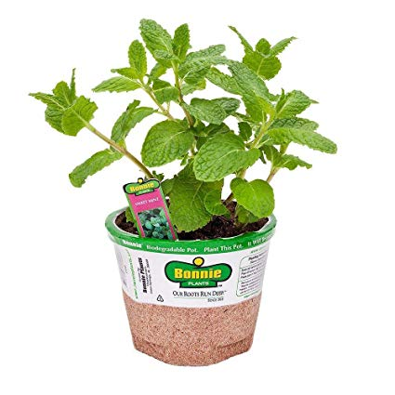
Auxin and Apical Dominance Experiment
How can we manipulate a plant’s auxin concentrations to test for auxin’s role in apical dominance?
Work in groups of two on experimental design worksheet
Class will discuss and come to an agreement on experimental design
Set up experiment
Leave at least six pages of lab notebook blank for data collection and homework

