Slide 1
Statistical thinking in undergraduate biology courses
CAUSE webinar March 12, 2019

Slide 2
Webinar overview
Motivations for STUB
Goals for STUB
Initial STUB activities
summary
lessons learned/opportunities
next steps

Slide 3
Motivations for STUB
Practice of biology now very quantitative
Teaching of biology – how will include data-informed/statistical thinking? (AAAS, 2010)
Undergraduate biology includes descriptive statistics and chi-square test in Bio 101/AP Bio (Aikens and Dolan 2014)
1.2 million students per year now learning some statistics in biology courses
Dearth of active discussion about teaching and assessment when integrating statistical thinking into biology courses

Slide 4
Gaps in the discussion
Gap #1. Discussions about quantitative thinking in undergraduate biology courses often blur the lines between mathematical (deductive) thinking and statistical (inductive) thinking.
Gap #2. Implementation of statistical topics in undergraduate biology courses can easily be reduced to algorithms and tools, leaving students unable to see the overarching process of drawing conclusions from data and failing to see the connections between biology courses and statistics courses.
Gap #3. Many efforts to assist the teaching of statistical topics in undergraduate biology courses do not assist instructors to implement the changes they would like to make in way that promote best practices.

Slide 5
Gaps in the discussion
Gap #4. There is a general lack of clarity and agreement about specific statistical learning objectives that should be accomplished in an undergraduate biology course (Aikens & Dolan, 2014).
Gap #5. Recent progress in statistics education has demonstrated the efficacy of simulation-based methods and the potential these methods bring for improving student and instructor attitudes towards statistics. (Chance et al., 2016; N. L. Tintle et al., 2014; N. Tintle et al., 2012, 2011). These methods have not been widely considered for use in undergraduate biology courses
Gap #6. Little effort has been made to assist instructors in assessing statistical thinking in undergraduate biology courses nor to understand current student attitudes or conceptual understanding about statistics in these courses (Aikens & Dolan, 2014).

Slide 6
Overarching grant goals
Grant from NSF’s Research Coordination Network – Undergraduate Biology Education grant program (2018-2023)
Initial steering committee consisting of
Cal Poly – SLO: Beth Chance, Elena Keeling, Soma Roy
Dordt College: Jeff Ploegstra and Nathan Tintle
Dutchess County Community College: Mark Condon and Barbara Dolansky
Hope College: Greg Murray, Todd Swanson and Jill VanderStoep
UCLA: Rob Gould and Noa Pinter-Wollman

Slide 7
Overarching grant goals
The goals of the network include: (a) the development and wide dissemination of numerous freely available modules and assessment items for teaching,
(b) published peer-reviewed articles on teaching best practices and assessment results related to statistical thinking in undergraduate biology courses,
(c) a long-lasting improvement in the teaching of statistical thinking in the undergraduate biology curriculum, and
(d) introductory statistics courses reflecting the needs and perspective of biology (and other quantitative science) students.

Slide 8
Workshops – So far
Workshop #1 – Morro Bay, CA
Very interdisciplinary – 1.5 day workshop
Teams of statisticians and biologists
Respond to GAISE and SBI
Respond to biological examples used that illustrate statistics
Set stage for network, network goals, materials development and assessment activities
Developed some preliminary materials
#2 – Project Kaleidoscope, Atlanta, GA
#3 – Am Soc Cell Biology, San Diego, CA

Slide 9
Workshops – Future plans
Shorter, 1 to 2.5 day ‘workshops’
talk to those who show up;
more ‘dissemination’ focused;
respond to materials;
recruit assessment project

Slide 10
Workshop lessons learned and opportunities
Lessons learned:
Receptive of GAISE and SBI
Some ‘wow’ from SBI approach
Good contexts from biologists
Good sample materials ready to be class tested
Interdisciplinary teams are a real strength
Shorter workshops at conferences are more dissemination than ‘work’
Follow-up post workshop with folks is challenging to keep them engaged and productive

Slide 11
Assessment of students
Primary goal: Benchmark gains on statistical concepts and attitudes change in biology courses
Comparison to changes we have been finding in statistics courses
Comparisons on specific questions
Comparisons based on student background (e.g., whether or not have taken their introductory statistics course)
Preliminary assessment project underway
Discussion of goals re: statistical knowledge
Pre- and post- course/module assessment
Leverage existing assessments (e.g., SLSI (Metz, 2008); CAOS/Goals; SATS)
Instructor survey
Notes:
Statistics learning survey instrument (Metz)

Slide 12
Online presence
www.causeweb.org/stub
Blog – TBD
Sample materials – a few things
Workshops – more TBD
Assessment project- more coming after initial results shared

Slide 13
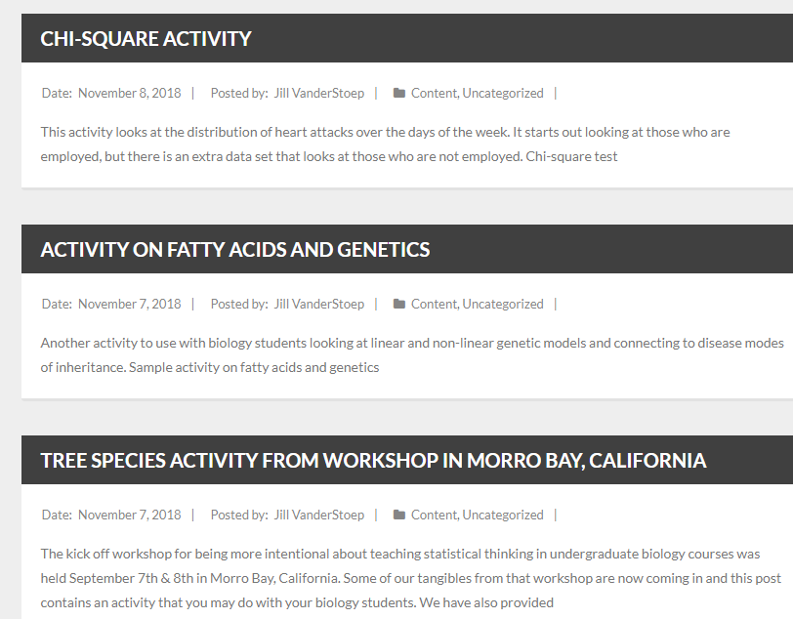
Sample materials

Slide 14
Sample collaboration
Data collection in biology lab to investigate “signaling” mechanism in mint plants
Data often very messy; not analyzed
Met with course instructors and lead TA
More focus on experimental design, common protocol
Pooling of responses across students
Use of SBI to analyze data in lab
Met with lab TAs to review goals of assignment

Slide 15
Questions and feedback for discussion
Workshop location/format?
Assessment research questions?
Materials utilization/development/dissemination?
How to spread the word?

Slide 16
Acknowledgments
Steering committee
Mark Condon (Biology; Dutchess County Community College)
Barbara Dolansky (Statistics; Dutchess County Community College)
Elena Keeling (Biology; Cal Poly-SLO)
Robert Gould (Statistics; UCLA)
Greg Murray (Biology; Hope)
Noa Pinter (Biology; UCLA)
Jeff Ploegstra (Biology Dordt)
Soma Roy (Statistics; Cal Poly-SLO)
Todd Swanson (Statistics; Hope College)
Jill VanderStoep (Statistics; Hope College)
NSF RCN-UBE grant # 1730668

