Slide 1
The importance of statistics and computational thinking for the “New Biology”
Jeff Ploegstra, MS, MAT, PHD
ISTS Meeting, October 2019
Notes:
Dordt → university of Iowa→ Kennedy HS→ Dordt

Slide 2
The New Biology
Notes:
Huge data sets are being generated at both the microscale and macroscale. The connections between biology and other disciplines are also growing requiring new tools and techniques to be developed and refined. All of these changes are leading to what some are calling “The New Biology.” (NRC, 2009)

Slide 3
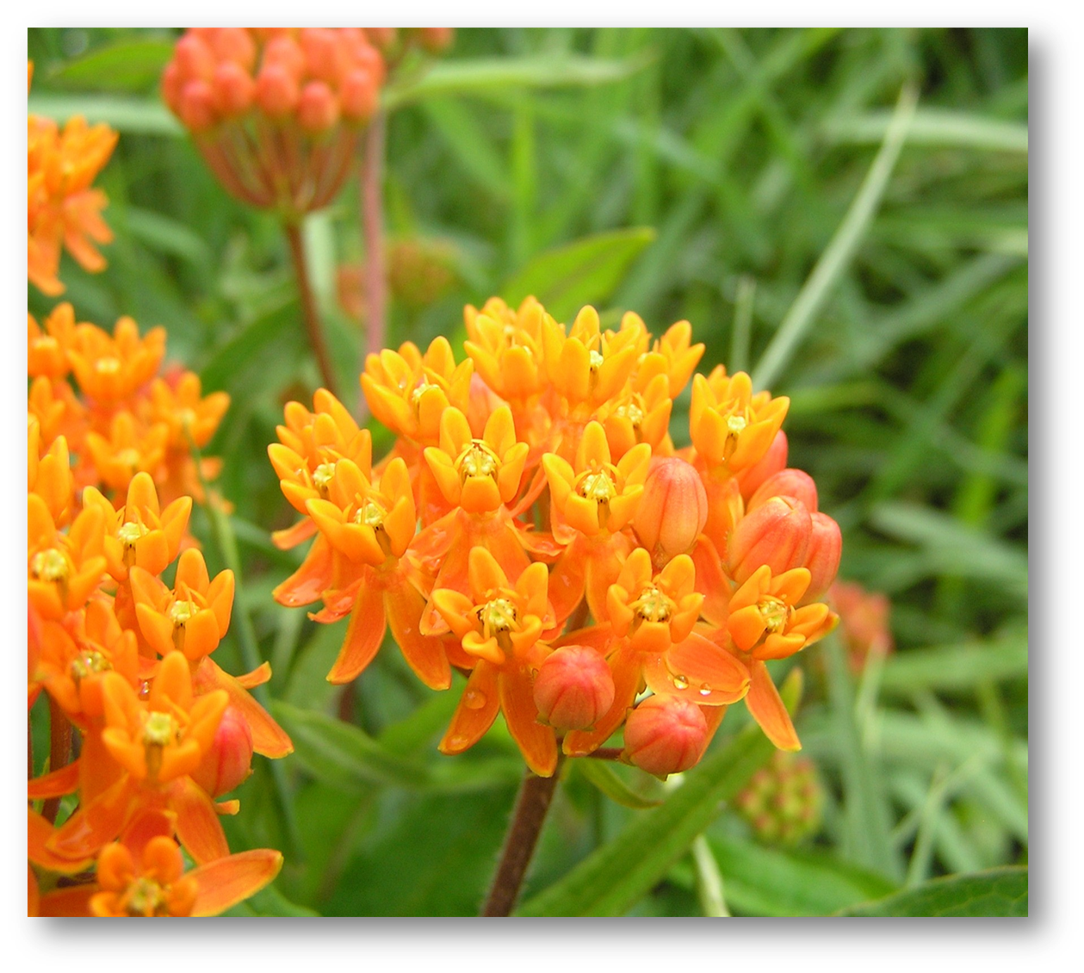
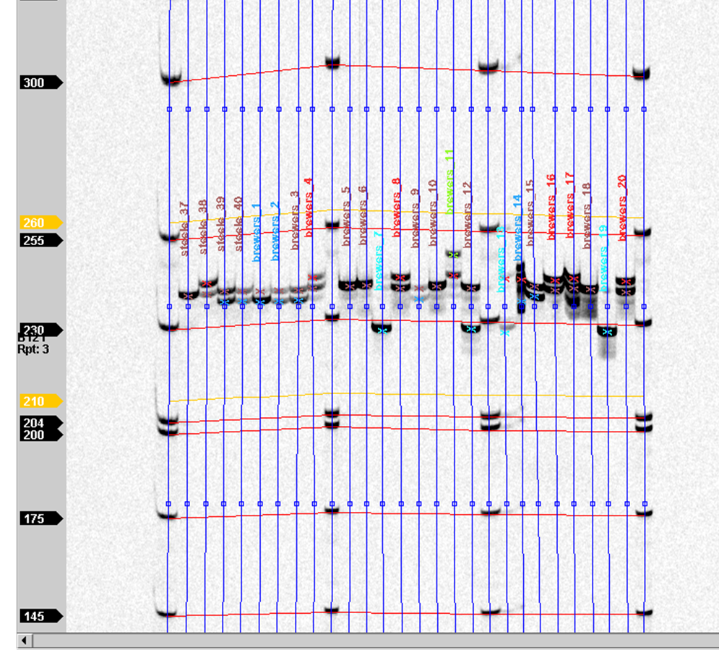
Population Fragmentation
Examining within and between population variation using microsatellites.
Notes:
-fragmentation
It is not unusual for plants to exhibit a certain amount of self incompatibility– that is, if the self-pollinate, they will not produce viable offspring. In other cases, inbreeding leads to increased frequency of genetic diseases in the population as the likelihood of homozygosity increases within inbred populations. You see this with people too- we don’t marry cousins. In other cases there is insufficient genetic diversity to maintain genetics that are adaptive over the range of environmental conditions that a landscape might exhibit over 50 or 100 or 1000 years. As landscapes become fragmented, populations (of plants particularly) become genetically isolated from one another, increasing the likelihood of pollination from self-or near genetic relatives.
Brittany and I and a variety of students had the opportunity to look at the genetic diversity of butterfly milkweed on a variety of native and restored prairies to look for danger inbreeding and outbreeding depression, genetic incompatibility, and overall risk of declining populations due to fragmentation.

Slide 4
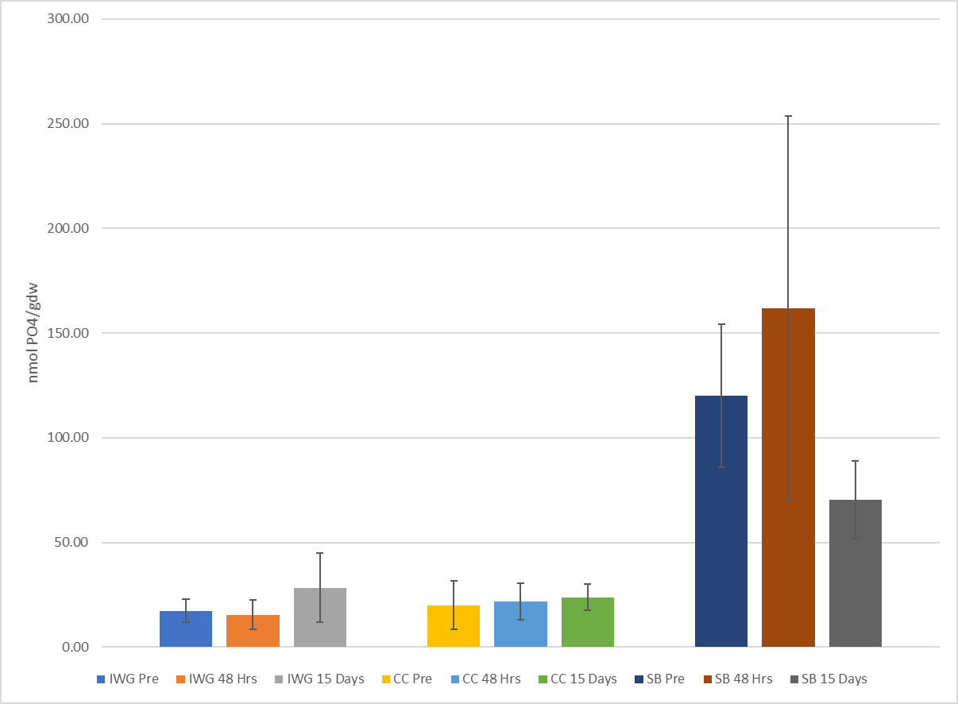
Soil Microbial Profiling using eDNA
Notes:
Quantitative PCR and Minion sequencing

Slide 5
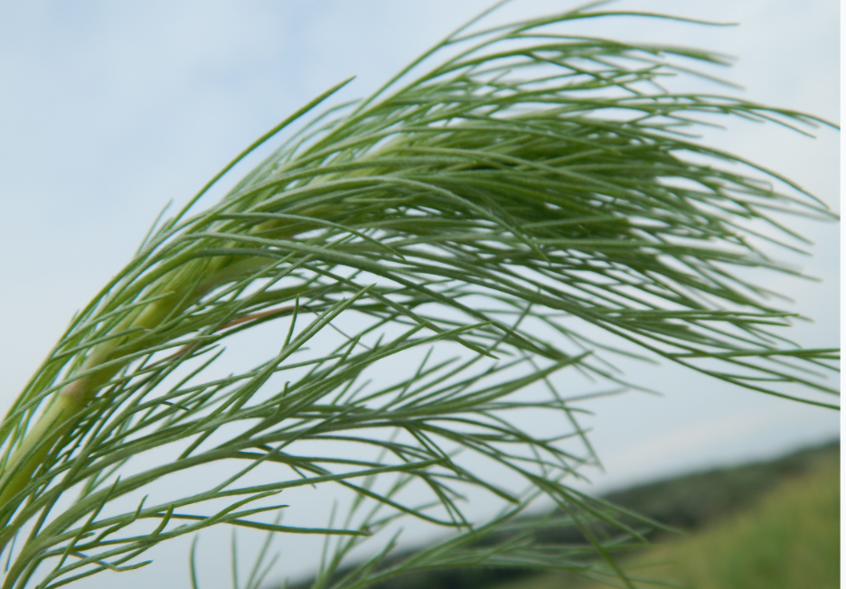
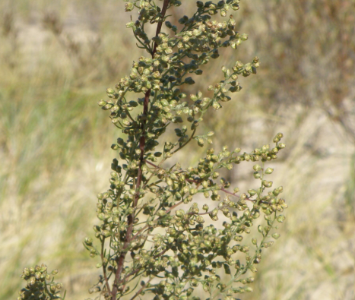
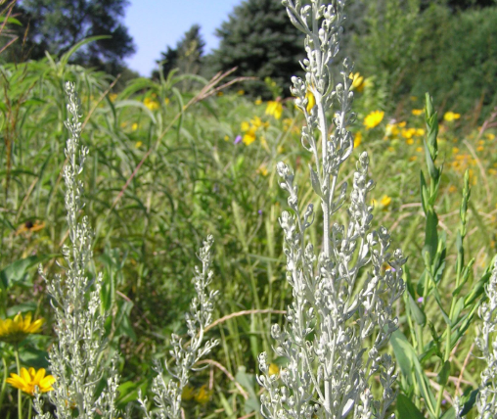
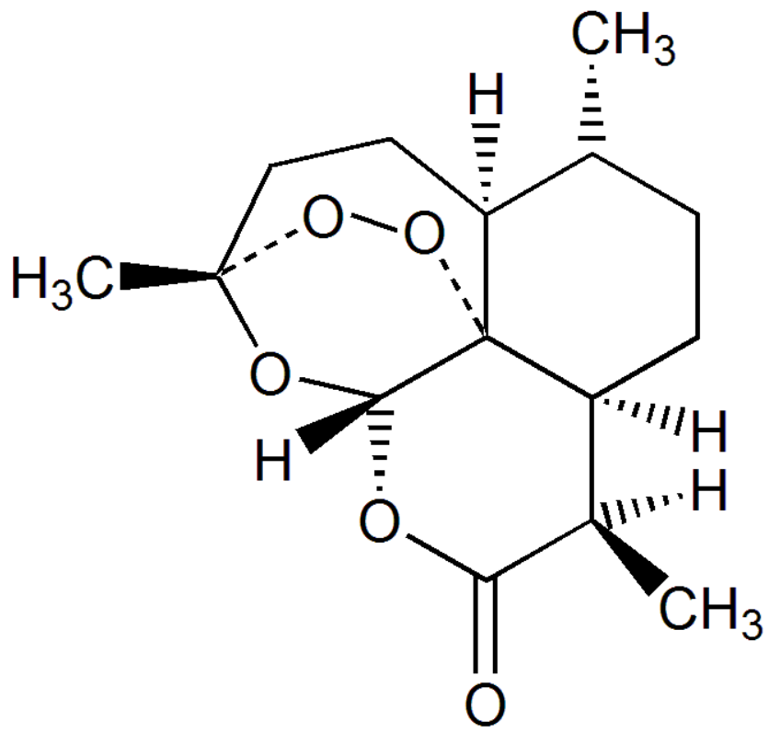
Mapping Metabolic Pathways
Notes:
Medications-
You might be surprise to learn that Botany was first widely taught in medical schools– and this makes sense- historically, the vast majority of our medications came from plants and bacteria. That is shifting but plants produce a huge variety of unique compounds with diverse affects on humans and other animals.
Poppies from - morphine, heroine, codeine
Plants in the genus Datura, Brugmansia and related plants produce atropine (slow heart rate)– dilate pupils, scopolamine (nausea and vomiting) suppress salivation
Artemisinin comes from the plant Artemisia Annua (annual wormwood) and is currently one of the primary treatments for malaria. Tu Youyou, a Chinese scientist, won the Nobel prize in 2015 for identifying Artemisinin.
Dylan Van Dyk- using GC/MS to attempt to extract, identify, and quantify the same compound in perennial wormwoods from North America.

Slide 6
Next Generation Science Standards

Slide 7
The NGSS

Slide 8
The NGSS

Slide 9
Statistical Thinking in Undergraduate Biology (STUB)
GOALS:
Develop a network of biologists and statisticians to discuss, reflect, and coordinate the teaching of statistical thinking in introductory biology courses.
Coordinate the assessment of statistical thinking and student attitudes in introductory biology courses.

Slide 10
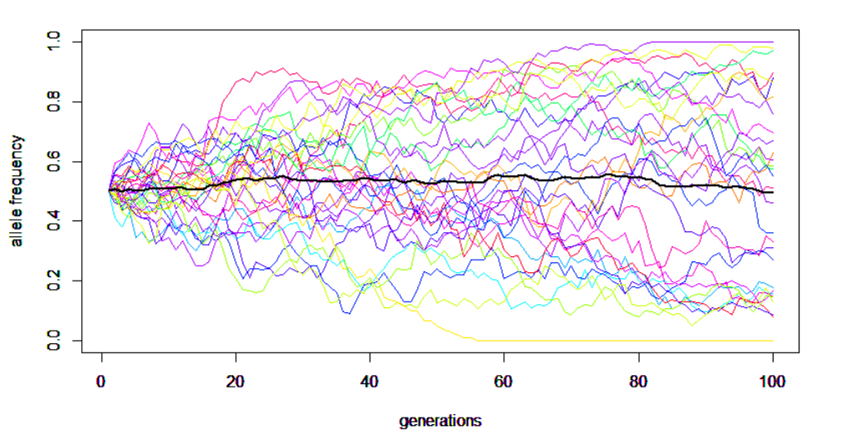
Example 1: Probability and Modeling
Notes:
Retrieved from "http://hawaiireedlab.com/gwiki/index.php?title=File:DriftN100.png&oldid=378"

Slide 11
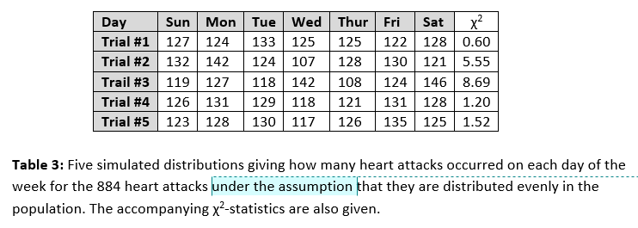
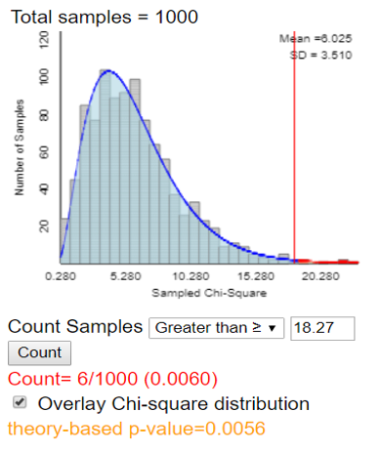
Example 2: Goodness of Fit (χ²)
Heart Attacks and Days of the Week
Notes:
http://www.rossmanchance.com/applets/GOF.html

Slide 12
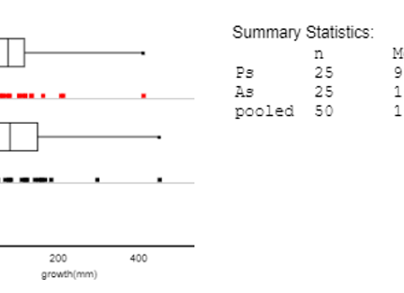
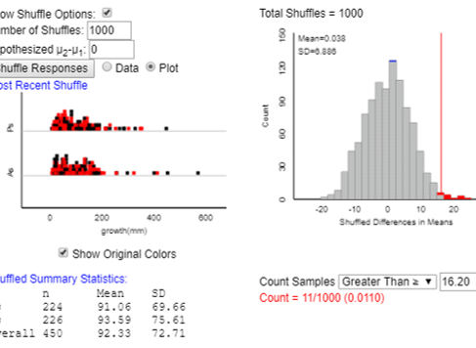
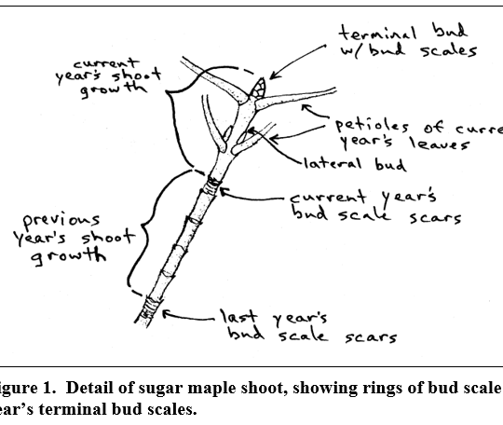
Example 3: Comparison of Means
How confident are we that two groups are actually different?

Slide 13
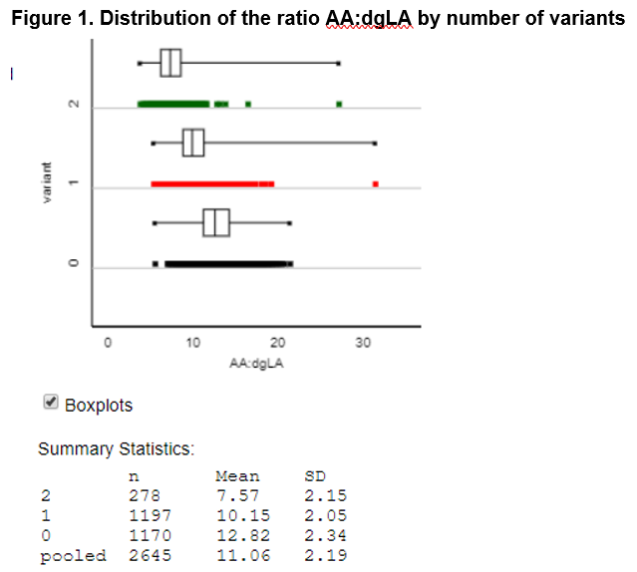
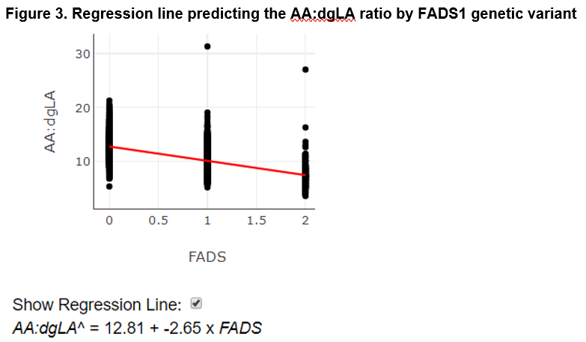
Example 4: ANOVA and Linear Regression
Investigating genetic profiles of fatty acids and cardiometabolic traits
Learning goals: Contrasting linear and non-linear genetic models and connecting them to disease modes of inheritance

Slide 14
Experimental Design
How good is your data?
How much data do you need?
How do you figure out how much data you need?
Calculate Power

Slide 15
Deciding what to integrate?
Which statistical concepts are most valuable to students?
Which are most developmentally appropriate and intellectually accessible?
Which are the most difficult to introduce?

Slide 16
Next steps
What are you doing right now that others might benefit from?
Where do you see opportunities to draw out modeling and statistical ideas in your biology classes?

Slide 17
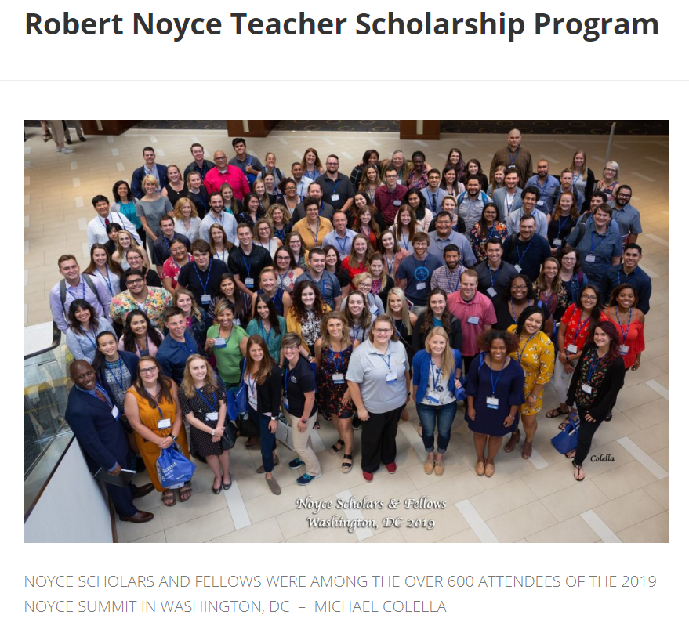
NOYCE
Future teachers?
Two years @ $10K/year
Two years of service for each year of scholarship

