Slide 1

The Art of
Jennifer L. Green, Shannon Willoughby, Leila Sterman, Bryce Hughes, Brock LaMeres, & Kent Davis
Montana State University

Slide 2
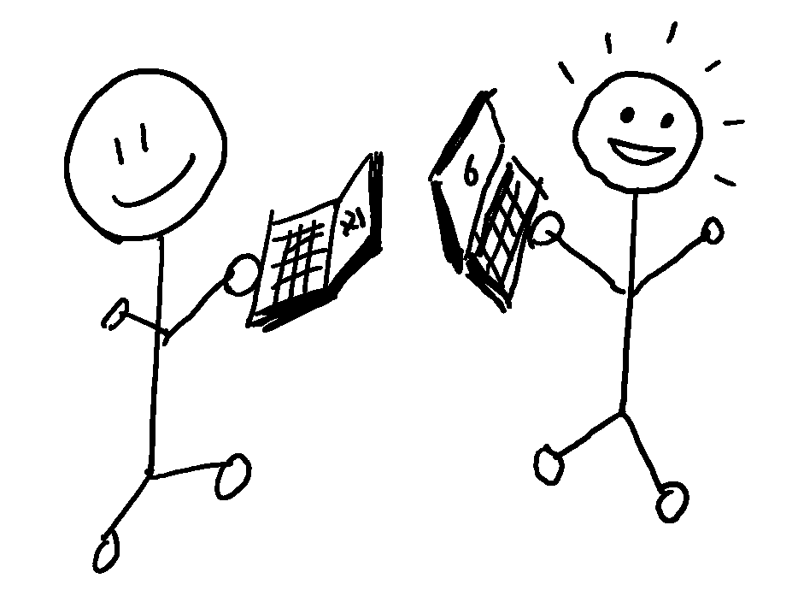
Describe your latest research project…
Colleague
Notes:
Describe latest research project to a partner:
First round: speak to partner as a colleague

Slide 3
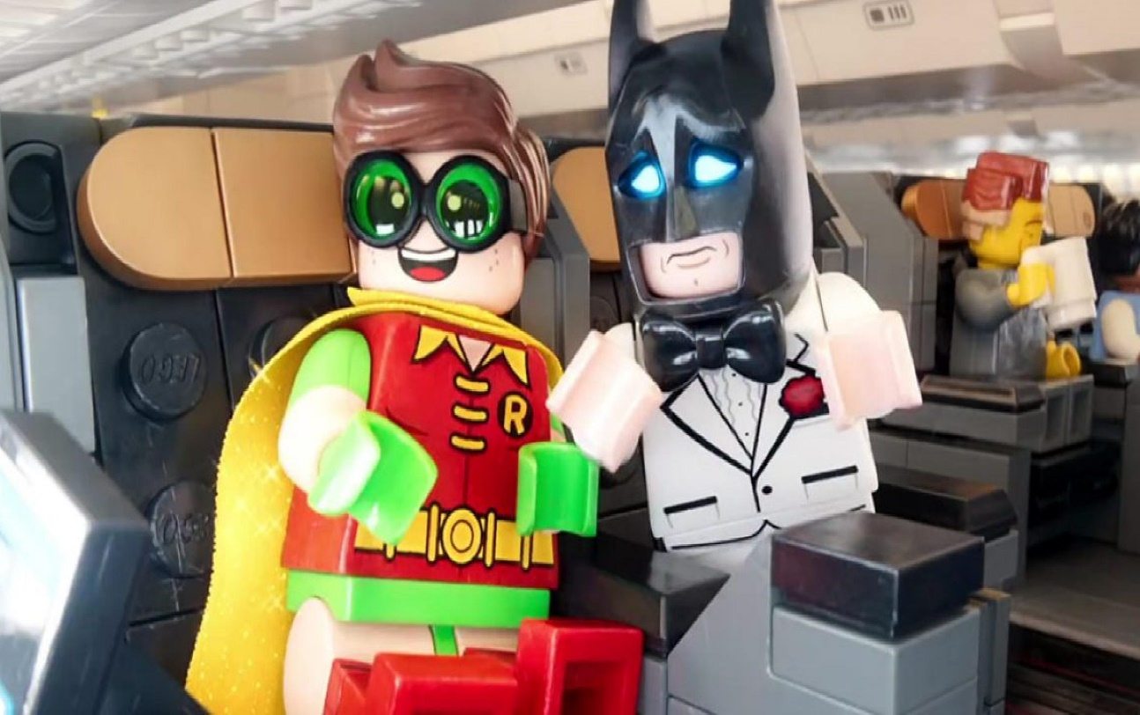
Describe your latest research project…
Turkish Airlines
Colleague
Airplane Acquaintance
Notes:
Describe latest research project to a partner:
Second round: person who sat next to you on the plane
What did you choose to include? How did you decide how to say it?

Slide 4
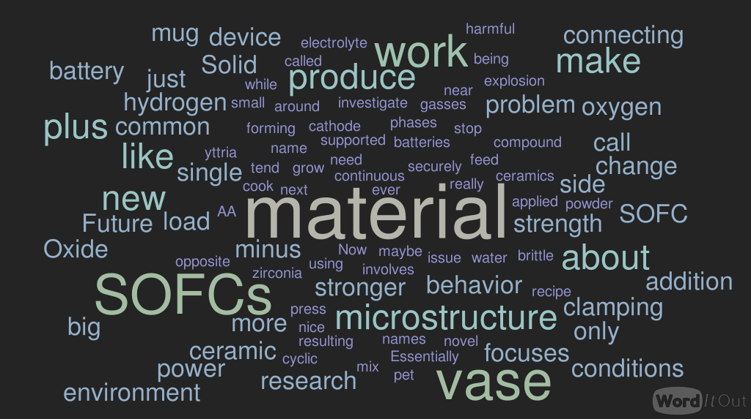
Notes:
Summary of a graduate student’s 3 minute audio recording about their research for a general scientific audience, but how do we translate our work for different audiences and purposes? More importantly, where do we learn how to do this?

Slide 5


coursework
presentations
research
teaching
writing
consulting
Notes:
In graduate school, we take coursework, conduct research, and often share our content and research with others through publications and presentations. BUT we are often trained to share it with other academics and disciplinary experts.
Graduate students in Science, Technology, Engineering and Mathematics (STEM)-related fields often lack the formal communication training needed to easily share their work with the general public (“Rising Above..”, 2007), perpetuating the gap in communication

Slide 6
Why translate science for the public?

Slide 7
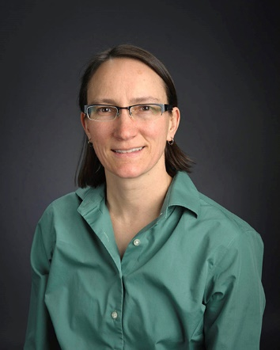
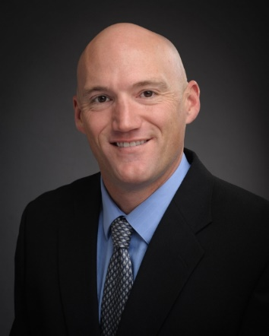
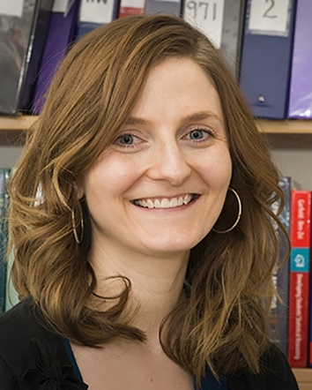
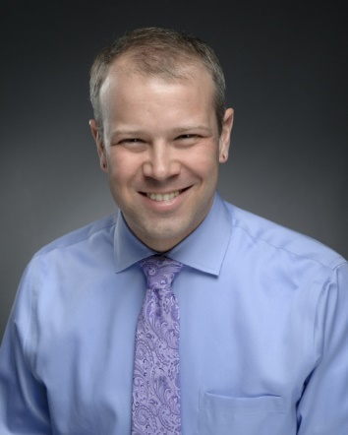

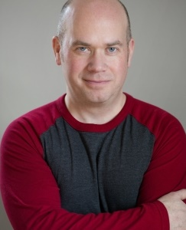
How can we do this?
  Physics
  Engineering
  Math Sciences
  Education
  Library Sciences
  Author & Actor

Slide 8
STEM Storytellers
Fall: Podcasting
Explain why your research matters
Discuss an unexpectedly important facet of your research
Explain a scientific concept that is misunderstood in your field
Summarize a paper in your field for:
  Disciplinary colleagues
  Non-disciplinary colleagues
  A lay audience
Tell a story to make a boring fact interesting
Notes:
Each year, one cohort of eight STEM students (and faculty mentors) participate in weekly 1.5 hour workshops. During the fall semester, the students learn about and practice podcasting, and during the spring semester, the students prepare for their 10 minute oral presentation with the public at a “Curiosity Café.”

Slide 9
STEM Storytellers
Fall: Podcasting
Spring: Curiosity Cafés (10 min)
Explain why your research matters
Discuss an unexpectedly important facet of your research
Explain a scientific concept that is misunderstood in your field
Summarize a paper in your field for:
  Disciplinary colleagues
  Non-disciplinary colleagues
  A lay audience
Tell a story to make a boring fact interesting
Discuss an important facet of your research
Use metaphors to enhance audience understanding of research facet
Outline opening, structure, and patterns for talk; Visualize pattern to identify gaps
Create slides to enhance presentation
Perform talk, debrief, edit – repeat cycle
Practice using and reading body language
Notes:
Each year, one cohort of eight STEM students (and faculty mentors) participate in weekly 1.5 hour workshops. During the fall semester, the students learn about and practice podcasting, and during the spring semester, the students prepare for their 10 minute oral presentation with the public at a “Curiosity Café.”

Slide 10
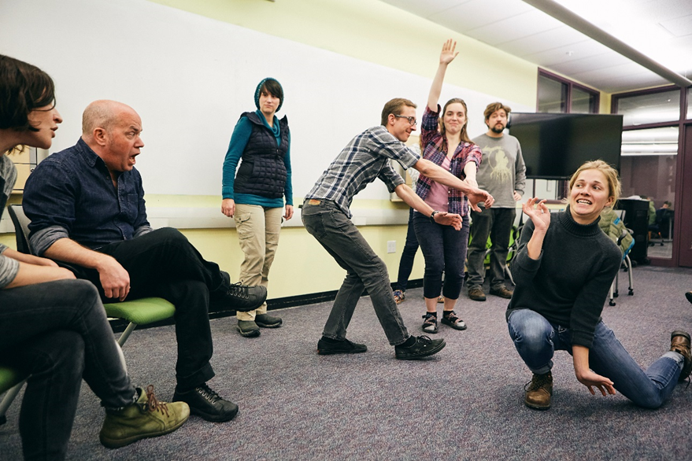
Goal-Oriented Improvisation
Yes and…
Focus on assessing audience
Leveraging metaphors
Classifying ideas
Employing storytelling patterns
Clarifying core ideas

Slide 11
Learning Goals
CONNECT
Notes:
Cultivate connection with your audience

Slide 12
Learning Goals
CONNECT
CAPTIVATE
Notes:
Craft an engaging narrative and present an engaged presence

Slide 13
Learning Goals
CONNECT
CAPTIVATE
CONVEY
Notes:
Construct content that is clear, accurate, and compelling to your target audience

Slide 14
Learning Goals
CONNECT
CAPTIVATE
CONVEY
Tell a better story!

Slide 15
“The Story…Matters, Not Just the Ending”
--Paul Lockhart
Notes:
Think back to your favorite, most memorable talk someone gave – what made it memorable? How did they connect with and captivate you in order to convey their story?
Good stories make us care and build relationships by connecting us to the storyteller and to what the stories are about.
We are all doing critically important work – that is not the question. The question is, how do we communicate that to others?

Slide 16
Storytelling
Break away from the norm
  Suspense! Surprise!
Notes:
Break away from the traditional research talk (Intro, Outline, Results and Facts, Conclusion) and borrow from the experts (inject elements of storytelling) – e.g., start with your conclusion, consider a new order, etc.; Add an element of Suspense! Surprise!

Slide 17
Storytelling
Break away from the norm
  Suspense! Surprise!
Clear structure and purpose: So what?
Clarity and focus: What is the take-away message?
Notes:
But even when mixing it up, Great stories have a clear structure and purpose – building up to a climax (story arc) and communicating why the work is important while maintaining a clear focus on the main take-away message
Great stories are simple and focused - Maintain clarity and focus: What is the take-away message?
It can be hard to parse down a portion of the work when we want to tell the WHOLE story – details and all!

Slide 18
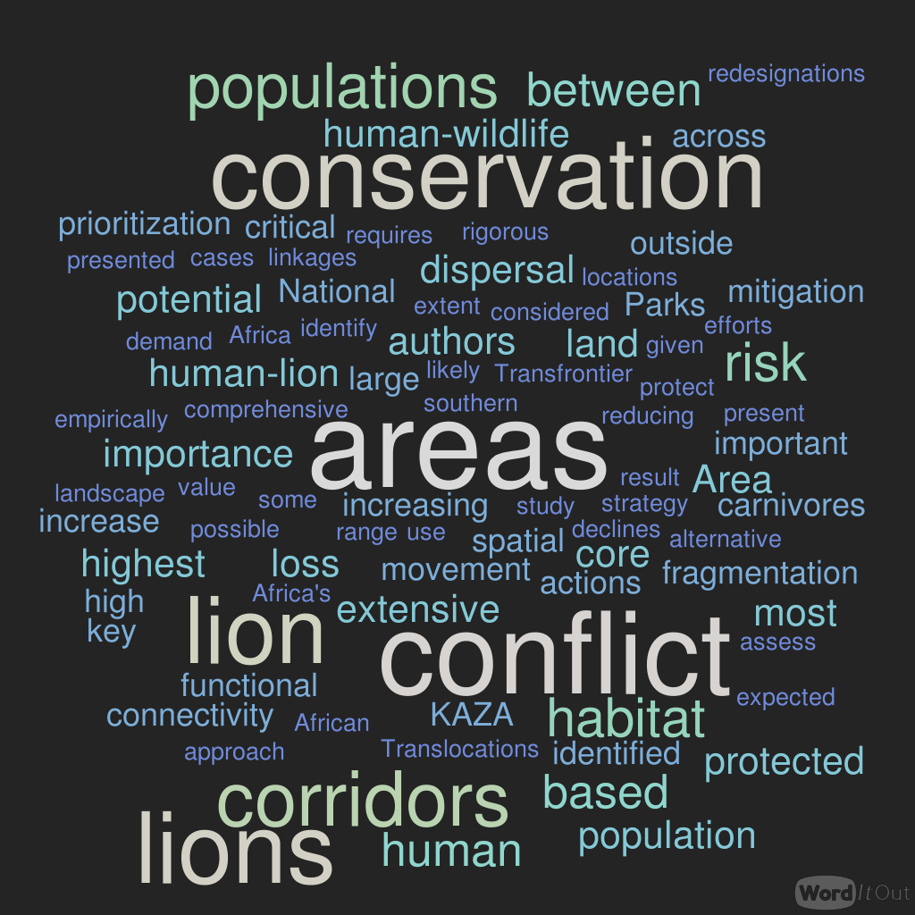

Notes:
EXAMPLE – July 2018 pLOS One Article
Recording 1. 4-6 min. “The facts”
This recording will use the language and structure of the article as written. Please edit the paper to create a shortened document that explains the major points of the paper and creates a narrative that promotes understanding of concepts. This version may use jargon or other discipline specific language or structure to convey meaning.

Slide 19
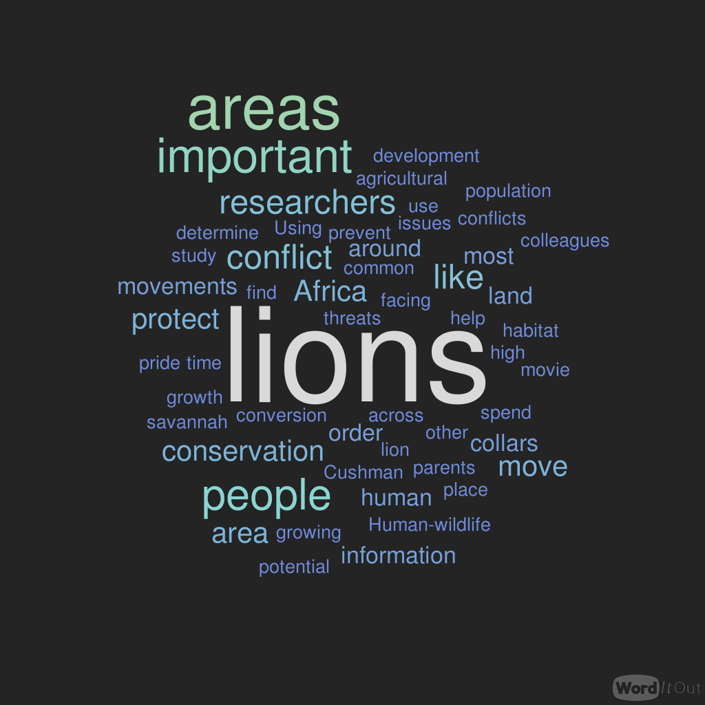
Notes:
EXAMPLE –July 2018 pLOS One Article
Recording 2. 4-6 min. “Broader Understanding”
The second recording should translate recording 1 into layperson language while attempting to cover the same concepts. You may use metaphor and similar devices to deepen understanding but stick to the content in the article as much as possible.

Slide 20
Translation
What does the audience need to know?
Why should they care?
Notes:
This is one of the core questions of all of this work: thinking about what words, images, and stories will be most functional at achieving deeper understanding in the particular audience to whom we're telling this story right now.

Slide 21
Translation
What does the audience need to know?
Why should they care?
“You should behave as if the listeners know nothing but are capable of understanding everything.”

Slide 22
Lion Podcasts
Africa’s human population is expected to increase threefold by the end of this century and growth is expected to be highest near protected areas….
Accelerating declines of carnivores as a result of human-carnivore conflict and habitat loss are likely.
The movie the lion king has been captivating audiences since 1994. … Many people dream of visiting Africa and seeing lions in their natural habitat.
However, people may be the bigger threat that lions face.
Notes:
EXAMPLE

Slide 23
Storytelling
Break away from the norm
  Suspense! Surprise!
Clear structure and purpose: So what?
Clarity and focus: What is the take-away message?
Analogy and metaphor
Notes:
Embrace analogy and metaphor – identify examples that allow others to connect the value of your work to their own lives!
But we must not deceive – we still need to maintain credibility and remain factual!

Slide 24
Lion Podcasts
[G]rowth is expected to be highest near protected areas.
The fastest growing areas in Africa are along the borders of protected areas. This would be like the US having major human development occurring around Yellowstone and Yosemite national parks as opposed to around metropolitan areas.
Notes:
EXAMPLE – analogy and metaphor

Slide 25
“It’s All in the Delivery”
Animate with voice
Nonverbal communication
Visuals

Slide 26
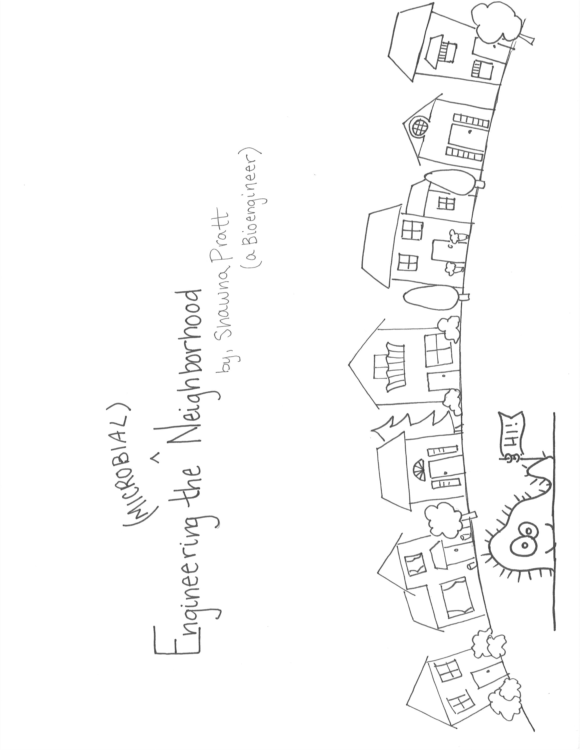
Microbial Communities
Notes:
EXAMPLE

Slide 27
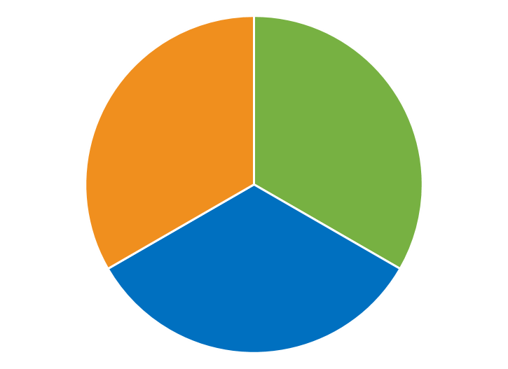

  Hormay rest-rotation
  Year 1
  Grazed during growing season
  Grazed post-growing season
  Rested
Notes:
EXAMPLE

Slide 28
  Hormay rest-rotation
  Year 1
  Grazed during growing season
  Grazed post-growing season
  Rested

Slide 29
  Hormay rest-rotation
  Year 1
  Year 2
  Year 3
  Grazed during growing season
  Grazed post-growing season
  Rested

Slide 30
Notes:
Leave slide blank! Have to look at presenter – except in a webinar! :)

Slide 31
Take-Aways
Know your audience
Tell a better story: Connect, Captivate, Convey
Translate
“You should behave as if the listeners know nothing but are capable of understanding everything.”
Practice!

Slide 32
Take-Aways
Broader impacts apply to anyone
Faculty benefits
  “Yes, AND” vs. “Yes, BUT”
  Slides + Words
  Ongoing
Notes:
Broader impacts apply to ANYONE you could be talking to about the importance of your work!!
Faculty members were also deeply affected by participating in this course
Even if we can’t have program on our campuses, can still focus on developing and using these skills ourselves and mentoring our students through that process
As statisticians, we are used to telling the stories of data – let’s extend this art of storytelling to break traditional barriers that allow us to share our enthusiasm and the value of our work with the world, not just one another.

Slide 33
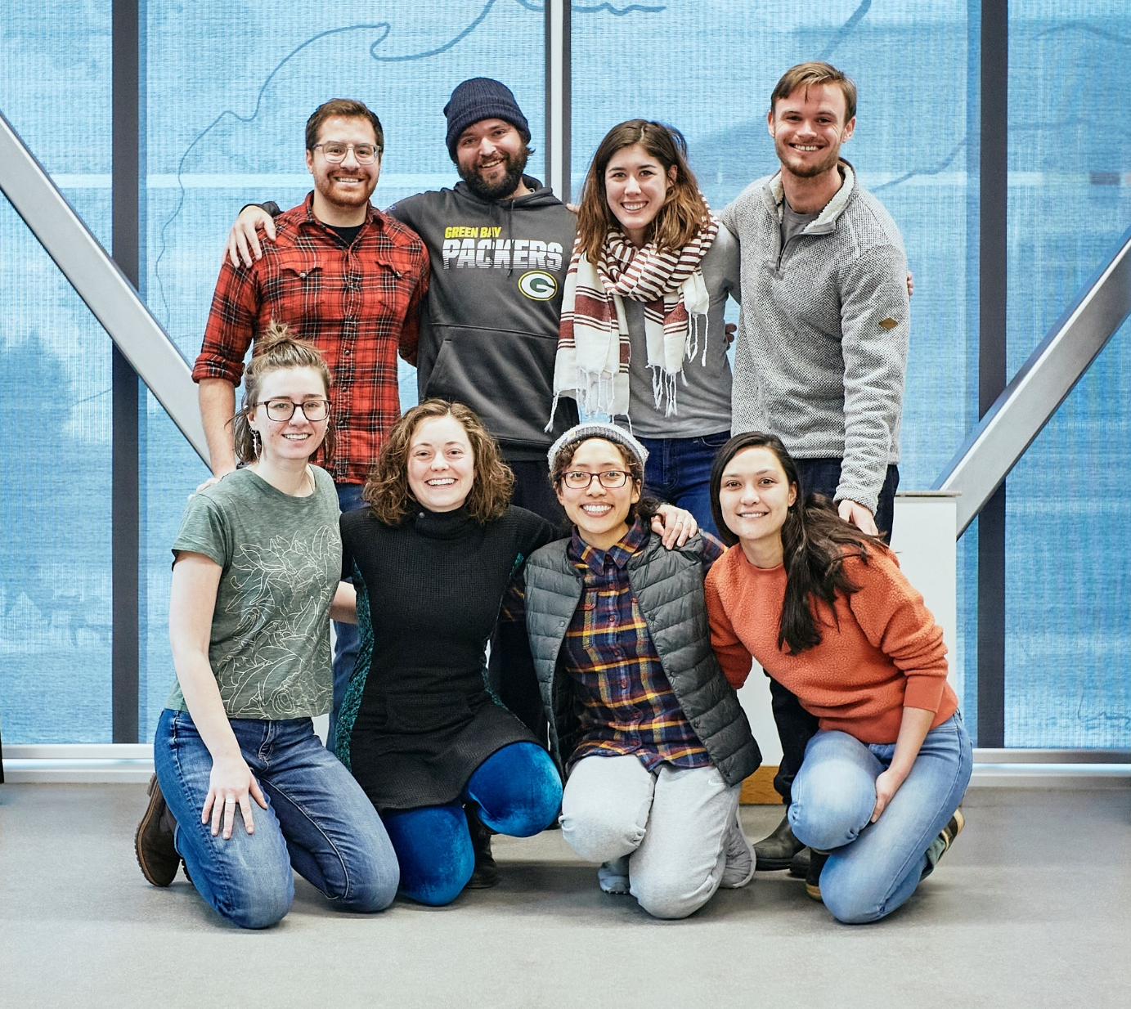
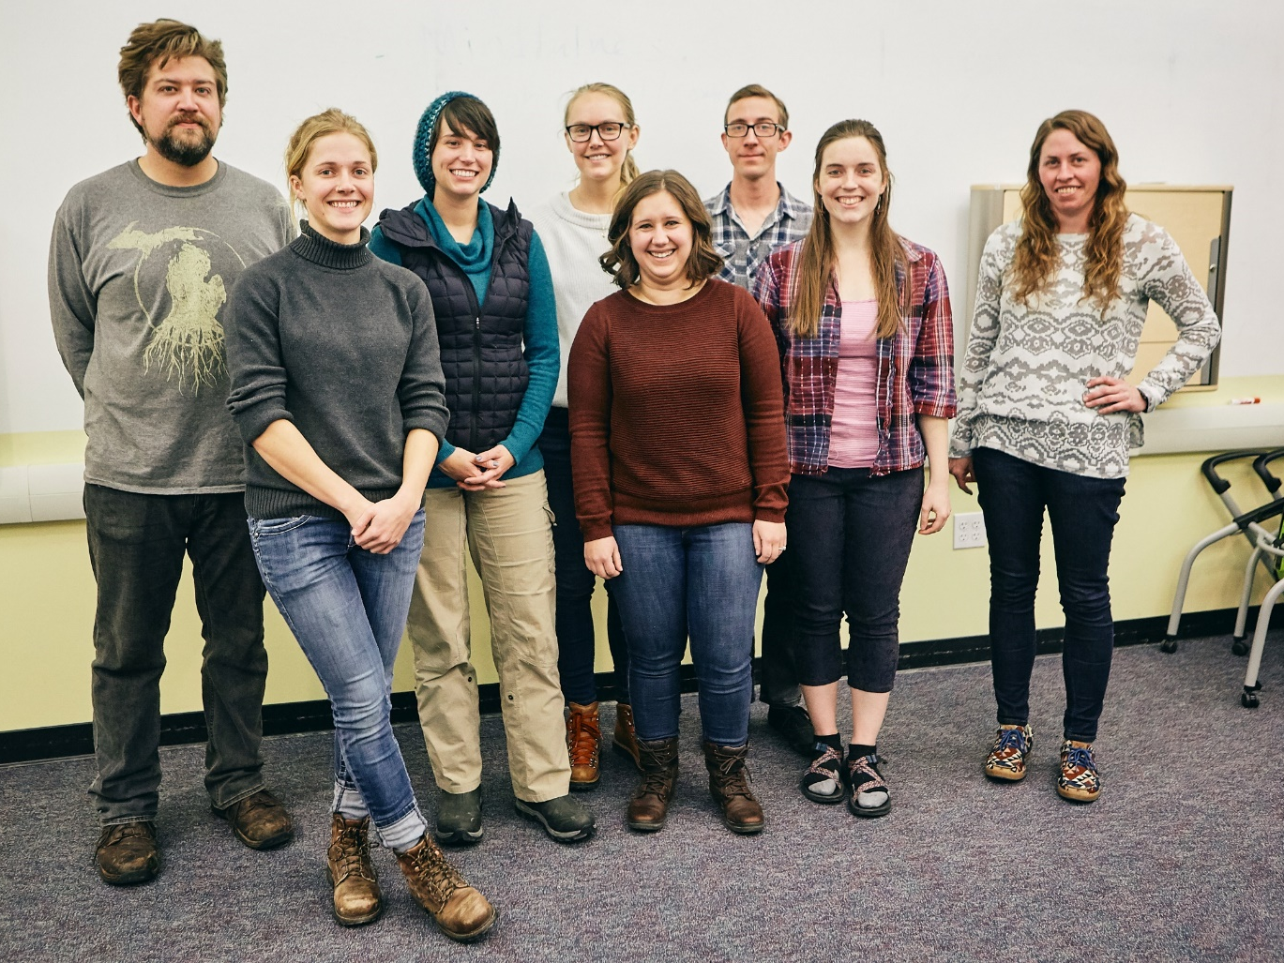
www.montana.edu/stemstorytellers

Slide 34


Questions?
Jennifer L. Green, jgreen@montana.edu
Associate Professor of Statistics, Montana State University
This work is based in part by support from the National Science Foundation’s Innovations in Graduate Education (NRT:IGE) program through award number 1735124. The findings of this work are those of the author and do not necessarily reflect the views of the NSF.

