Slide 1
Mobile Teaching Statistics by Using
Web-based Dynamic Graphical Stat Software eStat, www.estat.me
Jung Jin Lee, Soongsil University, Korea
jjlee@ssu.ac.kr

Slide 2
Jung Jin Lee, Prof of Soongsil U, Seoul, Korea
- B.S. , M.S. Computer & Statistics, Seoul National U
- Ph.D. O.R., Case Western Reserve U
- President, Korean Statistical Society, 2014
- Chairman, IASC-ARS, 2015-2017
- Professor of Mississippi State U, 1987-90

Slide 3
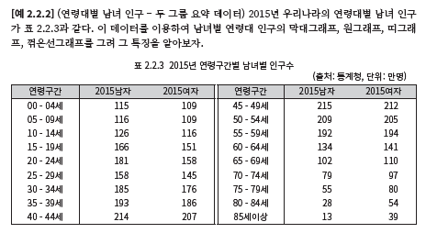
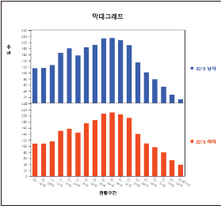
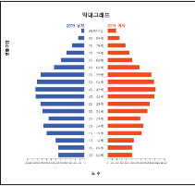
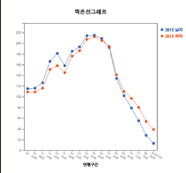
Example of mobile teaching statistics by using eStat
Book + eLecture + eStat Practice
QR for lecture movie
QR for eStat
eStat practice

Slide 4
1. eStat Project Background
2. eStat System Overview
3. eStat Demonstration
4. eStat Mobile Teaching
5. Conclusion

Slide 5
1. eStat Project Background
Rapid Advance in Information Technology
=> Big Data are generated
=> Statistics is more important than any other era
=> Data analysis by using a statistical packages is essential
Statistics education by using SAS, SPSS, MINITAB, R become popular
=> Statistical packages are good for data processing
not enough for teaching statistics
=> Teaching SAS or R is not easy for non-statistics major
and elementary/middle school students

Slide 6
1. eStat Project Background
Teaching statistics for 4th – 9th students
=> Royal Statistical Society has initiated the project
census@school
=> TinkerPlots SW for children
good PC software for creative thinking
not enough to teach data processing and statistics
not a free software
not much connection with existing stat packages

Slide 7
2. eStat System Overview
◎ Project started in 2012, supported partially by KNSO
Web/Mobile based software
Easy User Interface for all levels of students
- mouse clicking only
Dynamic graphs to amuse students
Data processing for raw and summary data
Educational design of statistical outputs
Capability for eLearning system
Multilingual

Slide 8
2. eStat System Overview
◎ eStat modules
Elementary School
Middle School
High School
Binomial, Normal, Sampling Distribution, Law of Large Number, Confidence Interval

Slide 9
2. eStat System Overview
◎ eStat modules
University Level
Ch 1. Introduction to Statistics
Ch 7. Hypothesis Testing - Single Population
Ch 2. Visualization for Categorical Data
Ch 8. Hypothesis Testing - Two Populations
Ch 3. Visualization for Continuous Data
Ch 9. Hypothesis Testing - ANOVA
Ch 4. Data Summary Tables/ Measures
Ch 10. Hypothesis Testing - Nonparametric
Ch 5. Probability Distribution Models
Ch 11. Hypothesis Testing - Categorical Data
Ch 6. Sampling Distributions & Estimation
Ch 12. Correlation & Regression Analysis

Slide 10
2. eStat System Overview
◎ Technology & Manpower for eStat
HTML5, CSS3, JavaScript
D3.js for dynamic graphs
Handson table sheet
Statistical distribution library
- include nonparametric distributions
Professors in statistics, statistical computing
Professors in mathematics education
Elementary, middle, high school teachers

Slide 11
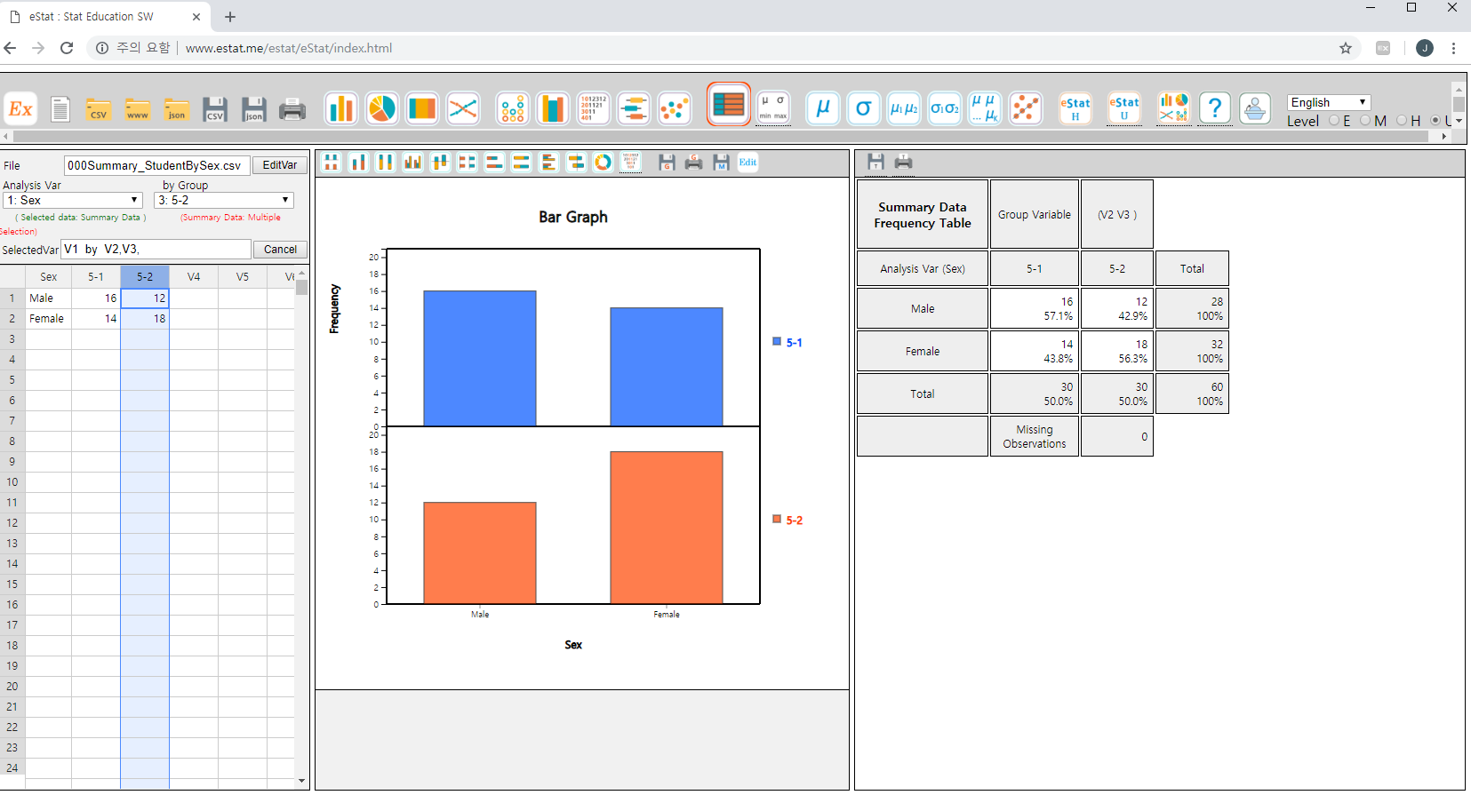
2. eStat System Overview
Language Selection
Easy UI - Icon only design
Examples
Level Selection
Easy UI – mouse clicking only
Log Window
Dynamic graph

Slide 12
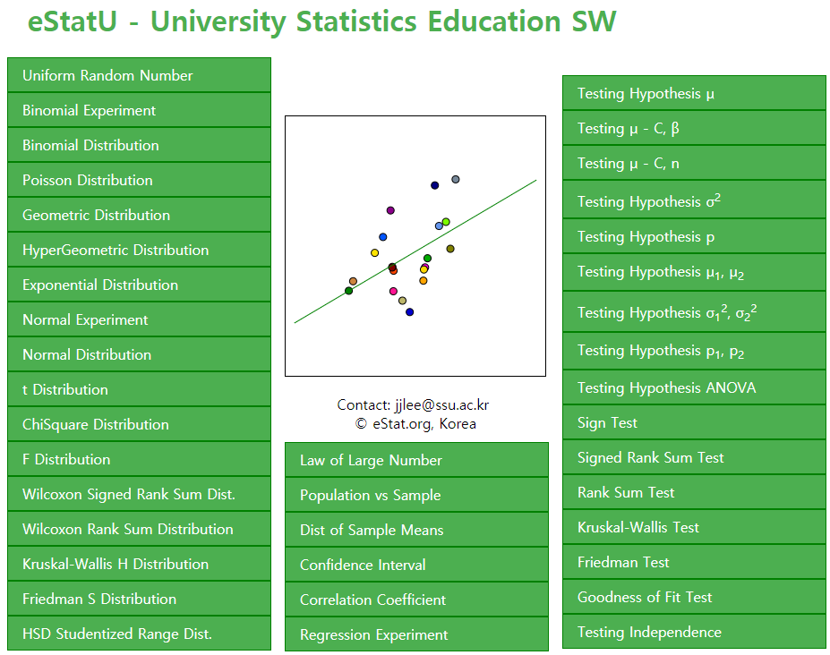
2. eStat System Overview

Slide 13
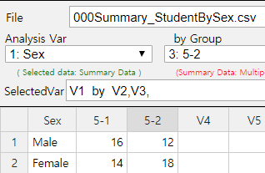
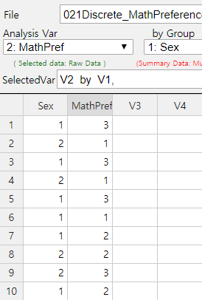
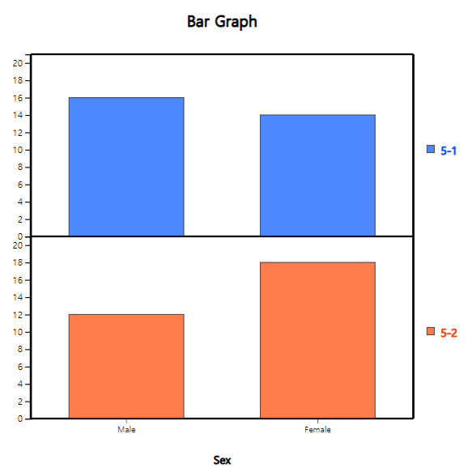
2. eStat System Overview
◎ Data and Dynamic Graph
Support csv and json format
Support summary and raw data for data processing
Dynamic graph

Slide 14
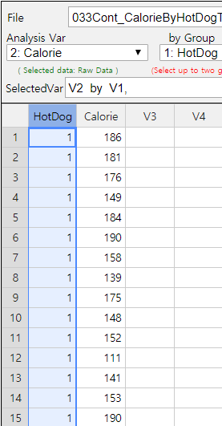
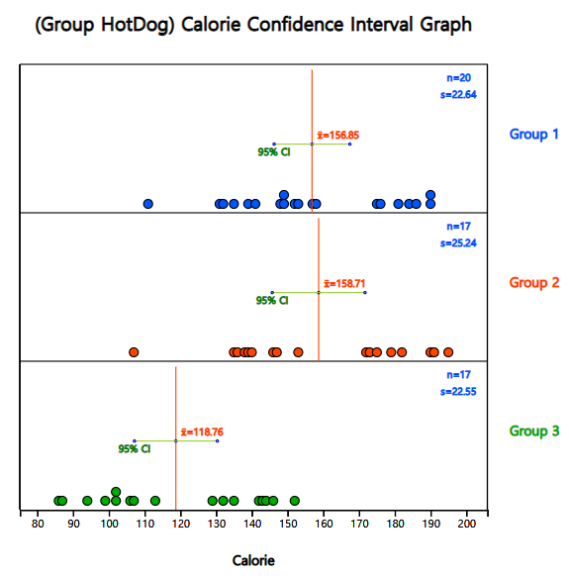
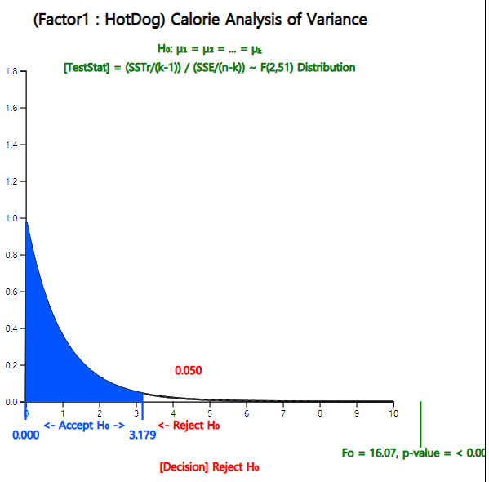
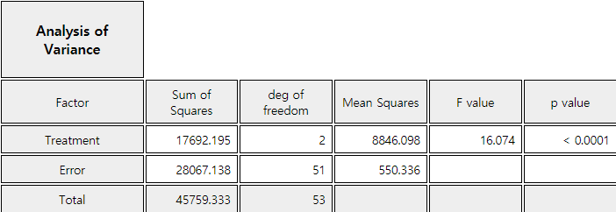
2. eStat System
◎ Graphical Result of Statistical Analysis - ANOVA

Slide 15
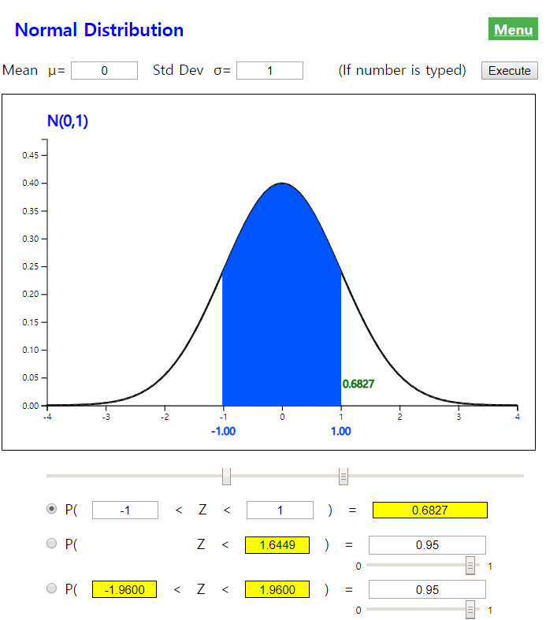
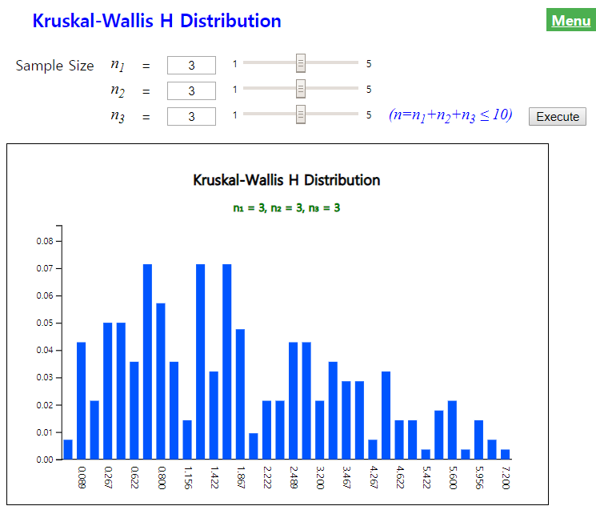
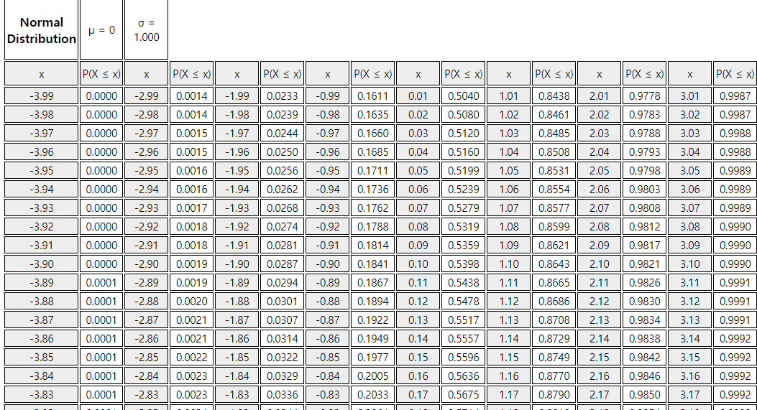
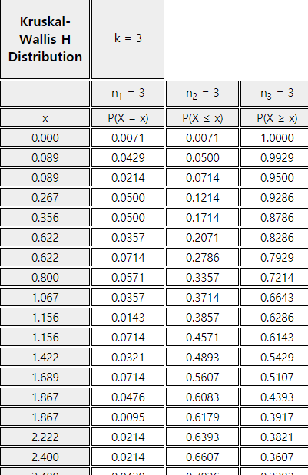
2. eStat System
◎ All tables of statistical distributions are on smart-phone

Slide 16
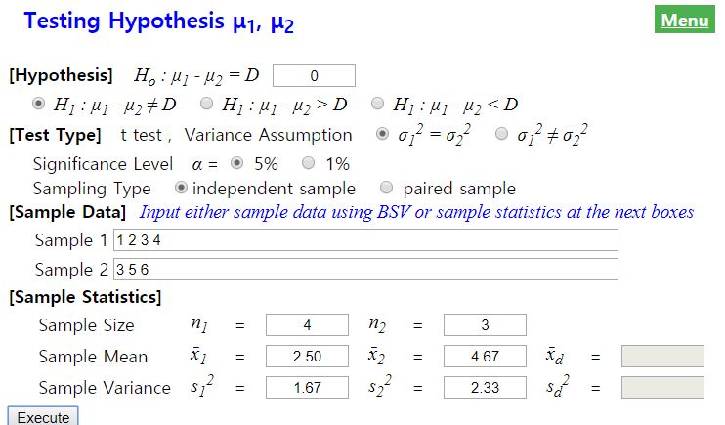
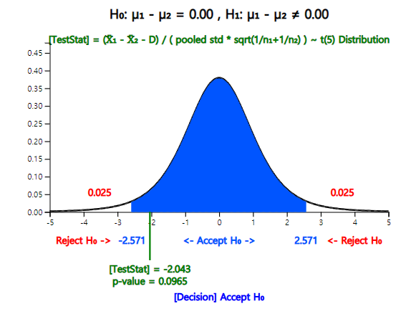
2. eStat System
◎ Modules for Home Work Assignment - eStatU

Slide 17
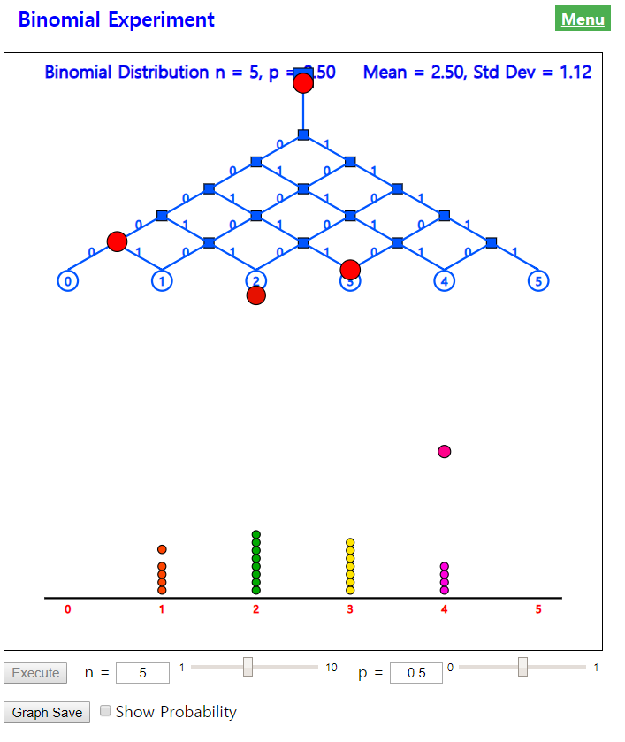
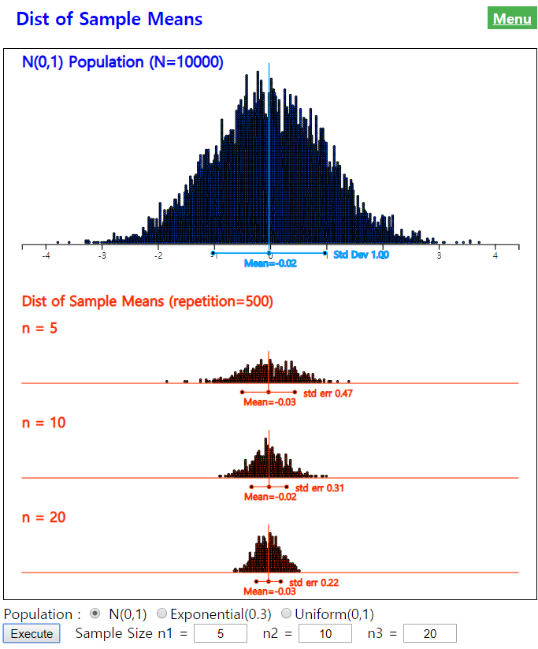
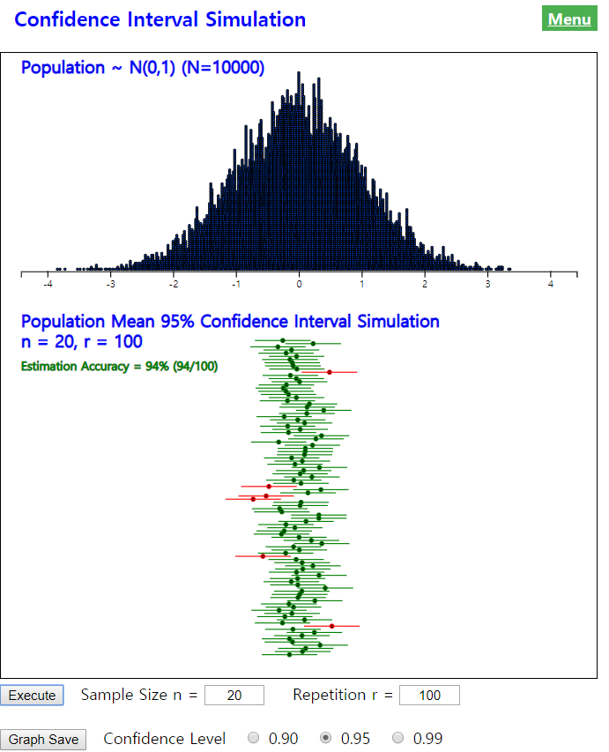
2. eStat System
◎ Simulation Experiments

Slide 18
3. eStat Demonstration
www.estat.me
( Work 100% with Google Chrome)
eStatU only for mobile
www.estat.me/estat/eStatU/

Slide 19
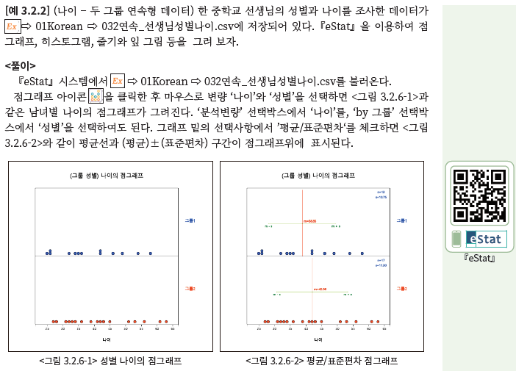
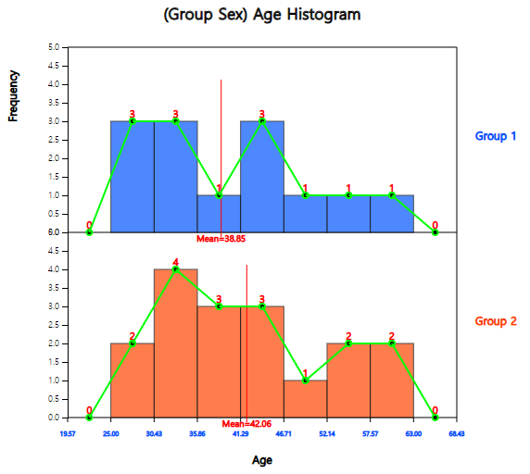
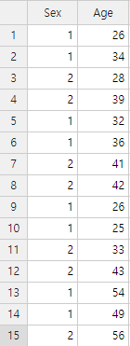
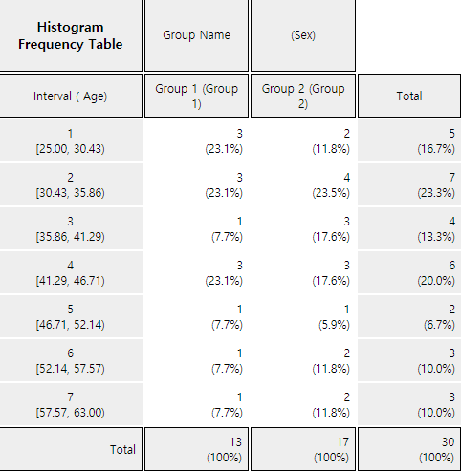
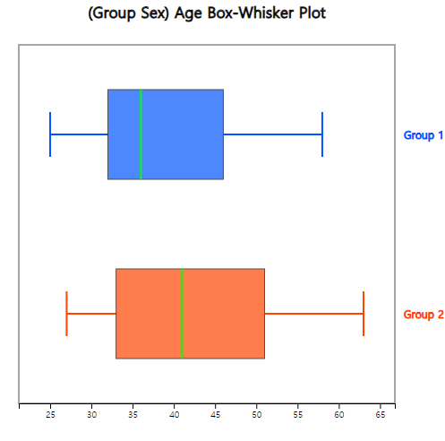
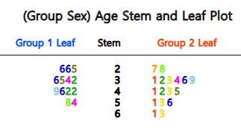
4. eStat Mobile Teaching
- Data Visualization
eStat practice

Slide 20
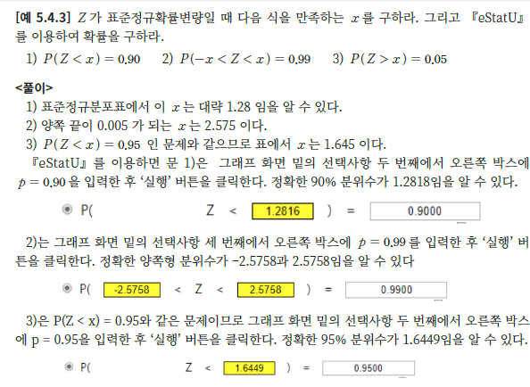
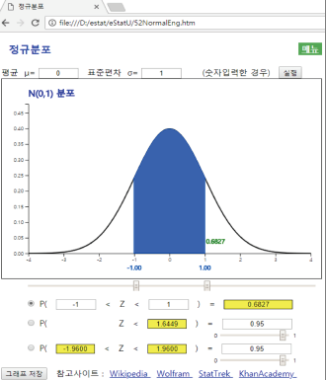
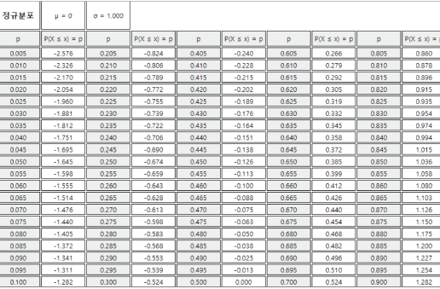
4. eStat Mobile Teaching
- Normal Distribution
eStat practice

Slide 21
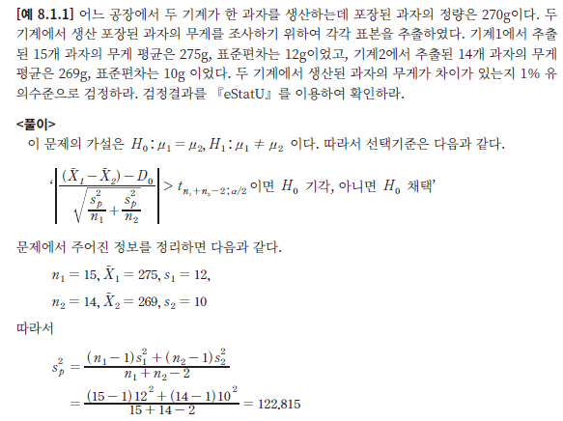
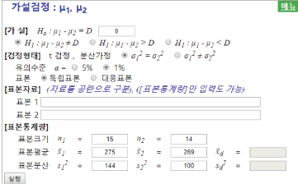
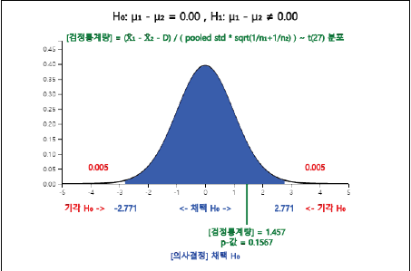
4. eStat Mobile Teaching
- Two group t-test
eStat practice

Slide 22
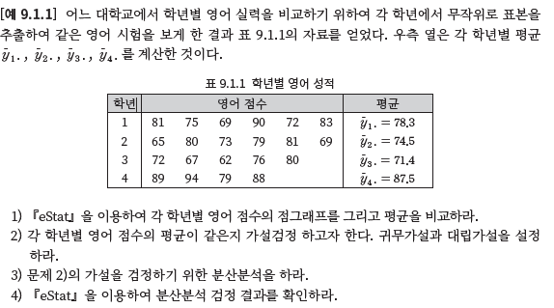
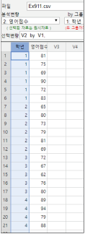
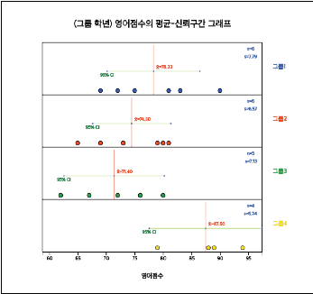
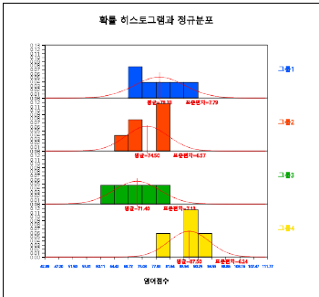
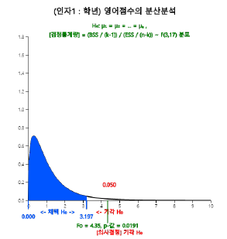
4. eStat Mobile Teaching
- ANOVA
eStat practice

Slide 23
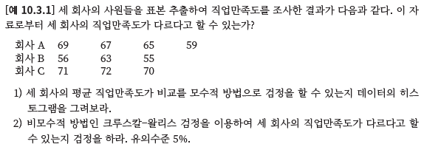
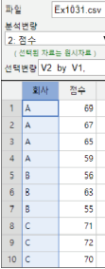
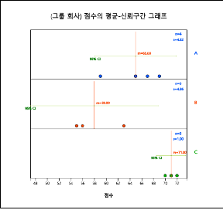
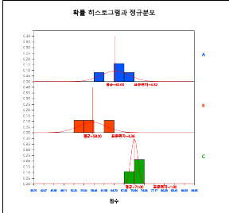
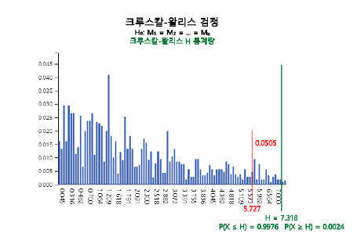
4. eStat Mobile Teaching
- Kruskal Wallis ANOVA
eStat practice

Slide 24
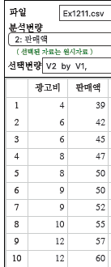
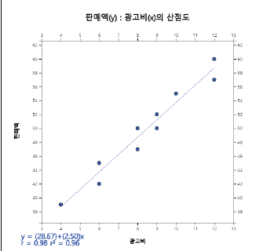
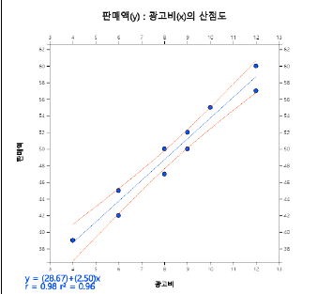
4. eStat Mobile Teaching
- Regression
eStat practice

Slide 25
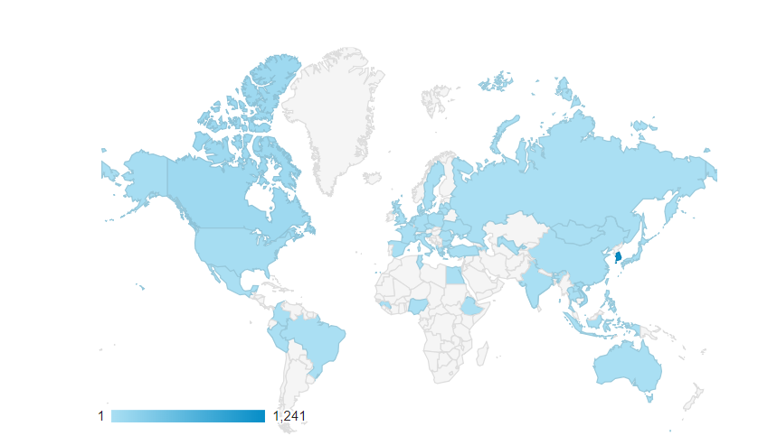
5. Conclusion
eStat is an integrated statistical software for teaching as well as data processing to all level of students.
eStat is the recommended SW by Japanese Inter-organizational Network for Statistics Education(JINSE)
Recent users of eStat with 10 translated languages

Slide 26
5. Conclusion
To continue this freeware eStat project,
=> collaboration among statistician, mathematics
education, computer scientist, school teachers
=> international collaboration to share experience,
idea, and technology
=> establish a non-profit organization

Slide 27
Thank you !!!

