Slide 1

A data visualization course for undergraduate data science students
Silas Bergen
Winona State University; Winona, MN, USA
CAUSE Webinar
December 12, 2016

Slide 2
Context
Spring 2015: Winona State launches Data Science major. Core consists of:
Statistics:
  Introductory statistics
  Intermediate statistics
  Regression analysis
Computer science:
  Algorithms and Problem-Solving I and II
  Databases and Management Systems
Data science:
  Introductory Data Science (DSCI 210)
  Data Summary and Visualization (DSCI 310)
  Management of Structured Data (DSCI 325)
STAT
CS
STAT

Slide 3
Data Science Curriculum: Context
  DSCI 210 (Introduction to Data Science)
    Principles of data aggregation and summarization
    Introduction to data wrangling tools
    Primary tools: Excel, R
    Unstructured data “light” (rvest and web-scraping, text analysis)
    Prerequisite for DSCI 310
  DSCI 310 (Data visualization)
  DSCI 325 (Management of structured data)
    “Data Science II”
    More advanced data management techniques
    Heavy use of dplyr and SAS

Slide 4
DSCI 310: Course Content

Slide 5
Visualization theory and best practices (~3 weeks)
  Draws from Tufte, Cleveland & McGill, Wickham
  How we perceive information (elementary perceptual tasks)
  Critique-based; no designs
  Assessments: regular visualization critiques

Slide 6
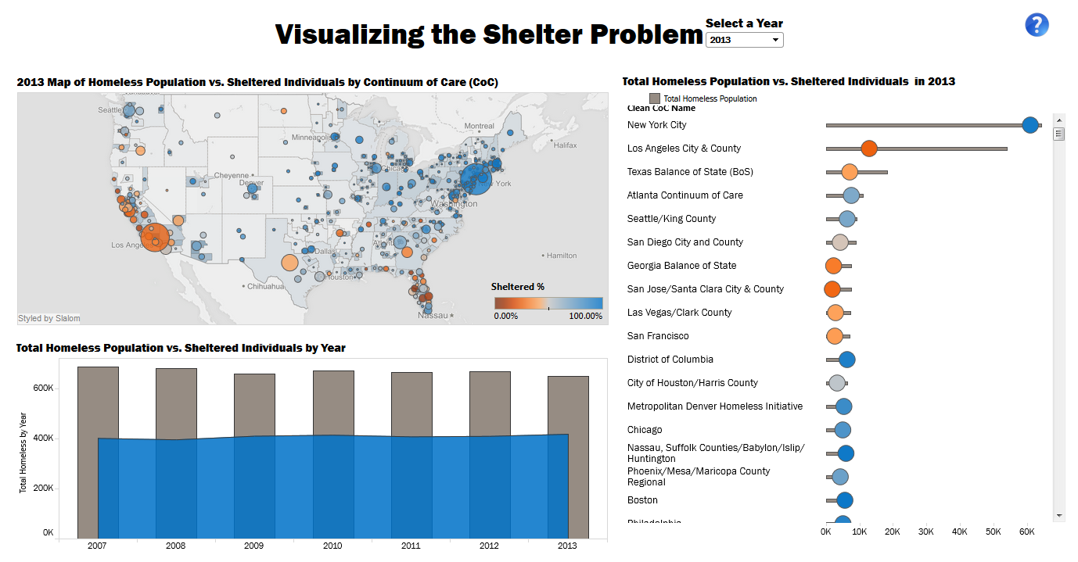
1. Visualization theory and best practices: Critique example
What are the variables encoded in this visualization, and what are the EPTs used to encode them?
Do you think the bar/area chart in the lower left is effective? If so, explain why. If it could be improved, explain how.
How is funding encoded? There is one relationship I would really be interested to explore, but which this visualization makes very difficult. Can you think what that might be, and how could this relationship be visualized effectively?
http://mmviz.blogspot.co.uk/2015/03/visualizing-shelter-problem.html

Slide 7
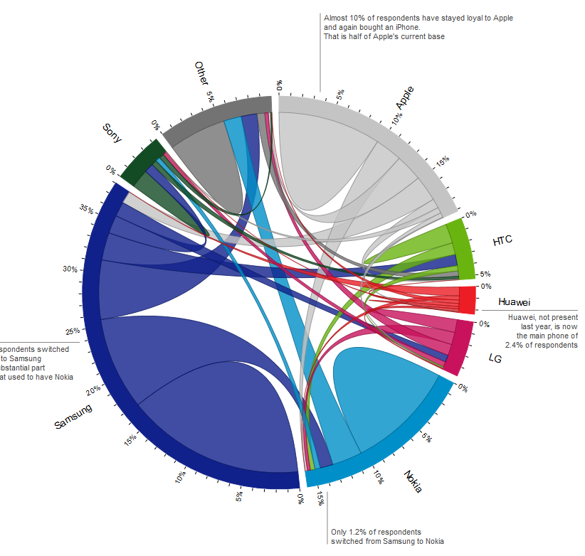
1. Visualization theory and best practices: Critique example
What are the variables, their types, and the EPTs used to encode them?
List at least 3 insights you can glean from this visualization.
Do you think this chord chart is more beautiful or confusing?
Does the surrounding text help or hinder your ability to navigate this visualization?
How could you visualize these data with a stacked bar chart? Would this be an improvement, or not?
http://bl.ocks.org/nbremer/raw/75c76f4be60fce435aba/

Slide 8
2. Visualization design tasks (~7 weeks)
  Data visualization:
    Univariate visualizations
    Multivariate visualizations
    Geographic visualizations
    Interactive & Static dashboards
  Tools: Tableau (primary); ggplot
  Assessments: “Design tasks”
    Students provided with data set and set of questions to answer visually
    Students submit draft to peer grading website CrowdGrader.org for peer feedback
      Must review 3 peer visualizations according to provided rubric
      Dual-edged benefit: feedback on their own visualization + chance to see peer designs
    Students get time to incorporate feedback; submit final draft to me for grading

Slide 9
Aside: Tableau
  PROS
  Point-and-click interface
  Easy interactivity (crosstalk-style)
  Tableau Public for online sharing
  Students can “master” by semester’s end
  CONS
  Easy interactivity
  Only Tableau Public is free, generally
  Minimal data manipulation and analytic capabilities
  Less flexibility than other options

Slide 10
2. Visualization design: Design task example
Using the American Community Survey data, create 3 visualizations that address the following question: how does inequity in median income comparing employed men to employed women vary across the country? The 3 visualizations should be:
A map with median income inequality encoded by color.
A map with median income inequality encoded by size.
A third visualization which is not a map of your own design.

Slide 11
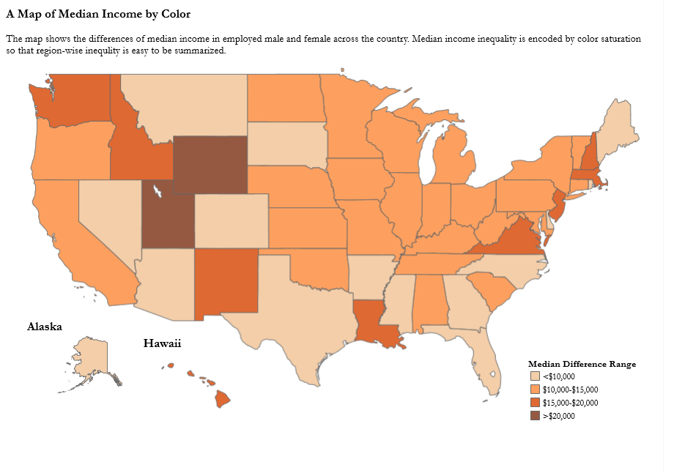
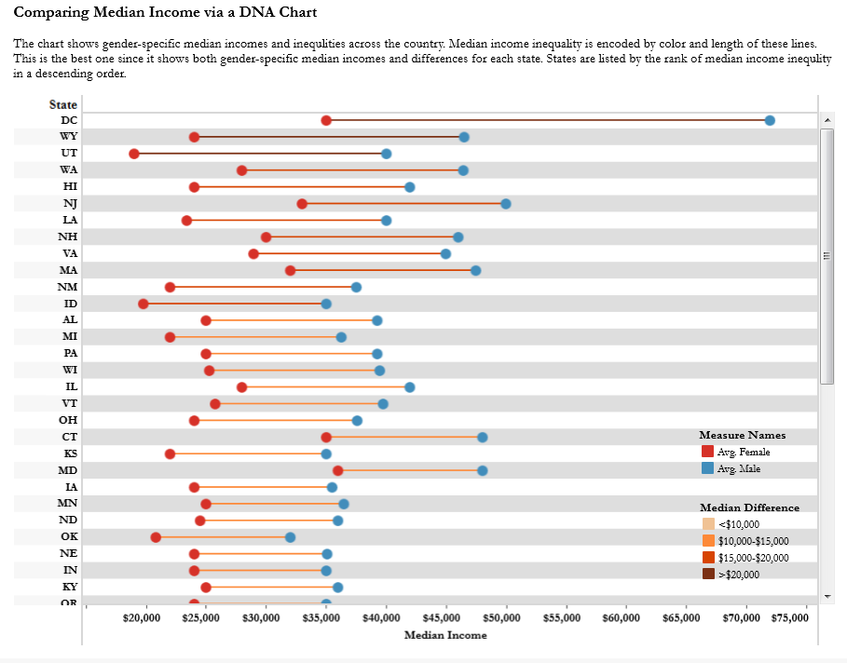
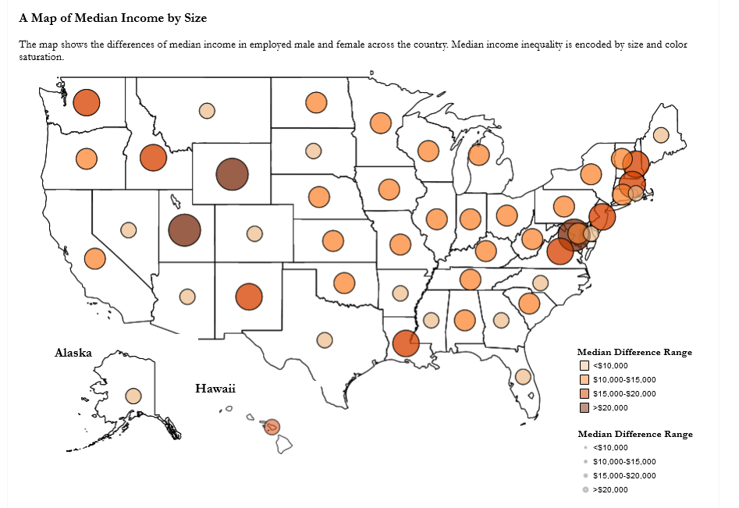
2. Visualization design: Design task example

Slide 12

2. Visualization design: Design task example
Teen pregnancy rates (TPRs) using CDC data
How have TPRs changed over time, both on the state-by-state level and overall?
Are there racial gaps in the TPRs? How have any gaps changed over time?
Which states have the best TPRs, and which states have the worst?
(Related to Q3): Which states have improved the most from 2003 to 2014?

Slide 13
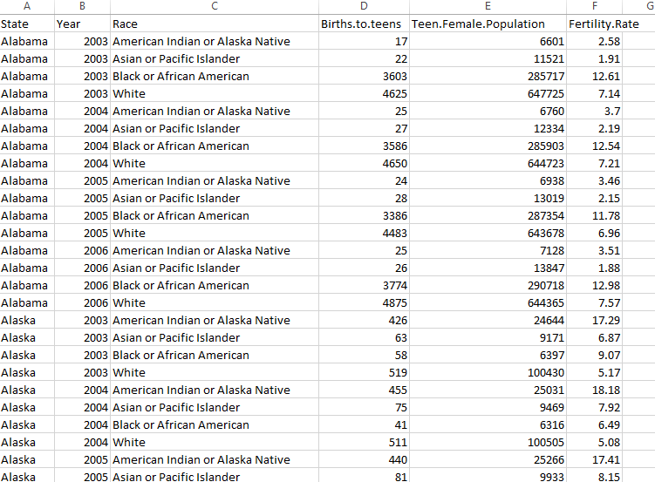
2. Visualization design: Design task example
Aggregation challenge:
Column of misdirection

Slide 14
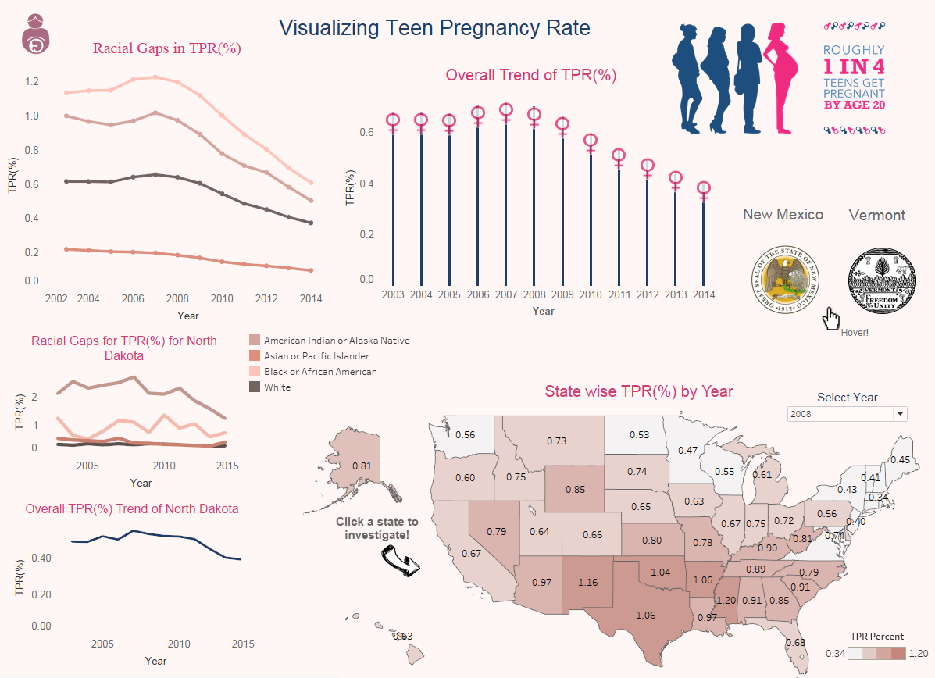
2. Visualization design: Design task example

Slide 15
3. Projects (~5 weeks)
  1 midterm group project
    Data provided to students
  1 final individual project
    Data found by students
  Oral presentations

Slide 16
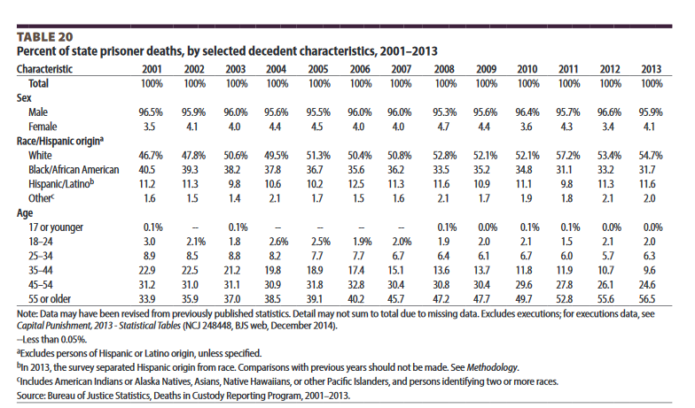

Group Projects: Examples
Task: create a visual report of the “Mortality in Local Jails and State Prisons” BJS report.
http://www.bjs.gov/latestreleases.cfm

Slide 17
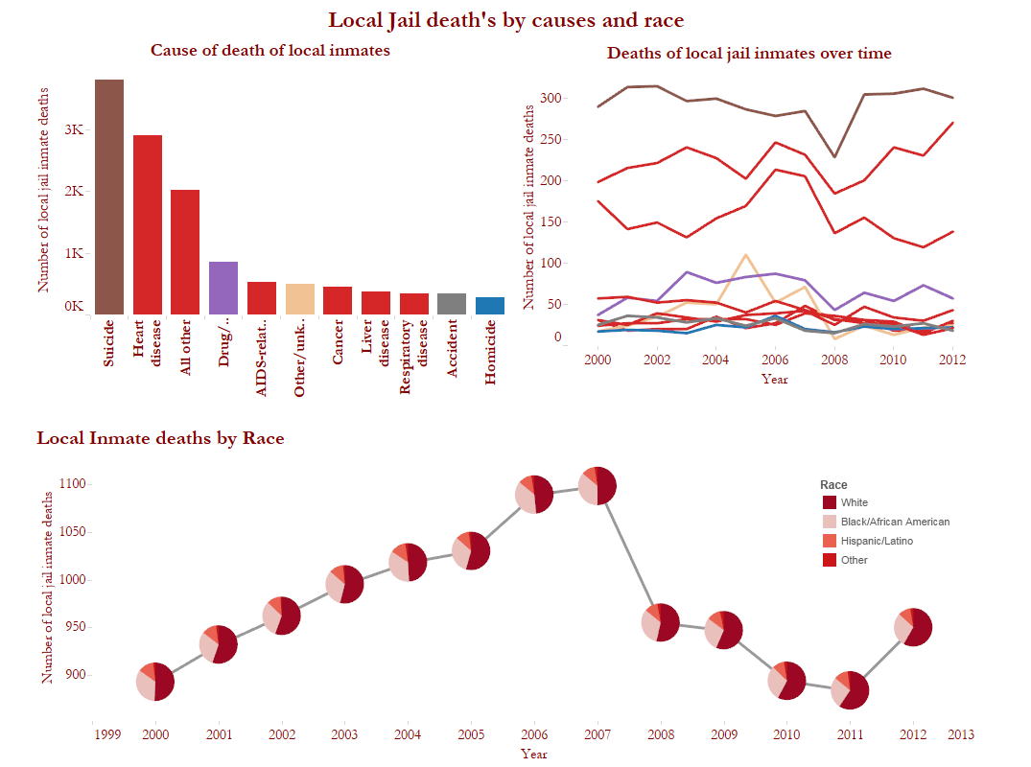
Group Projects: Examples

Slide 18
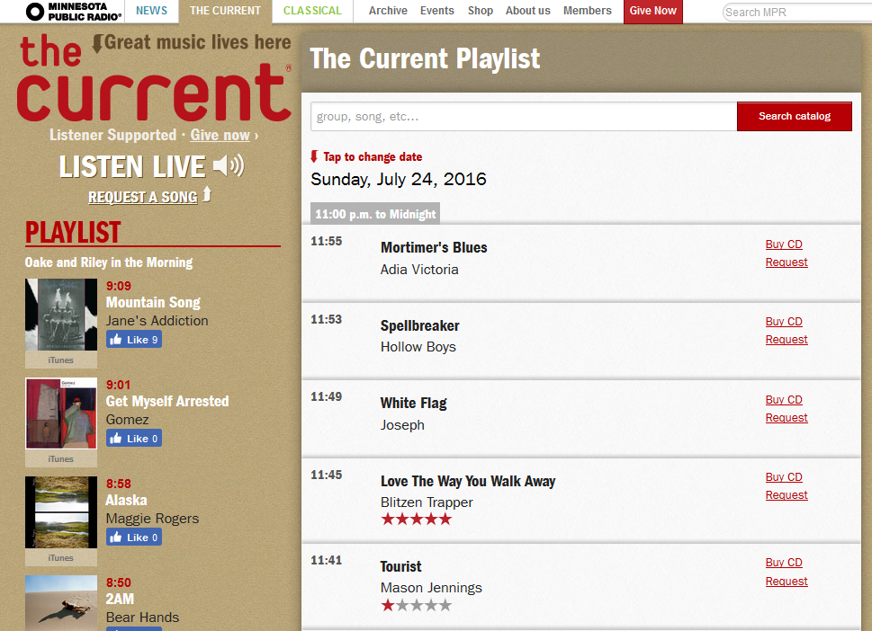
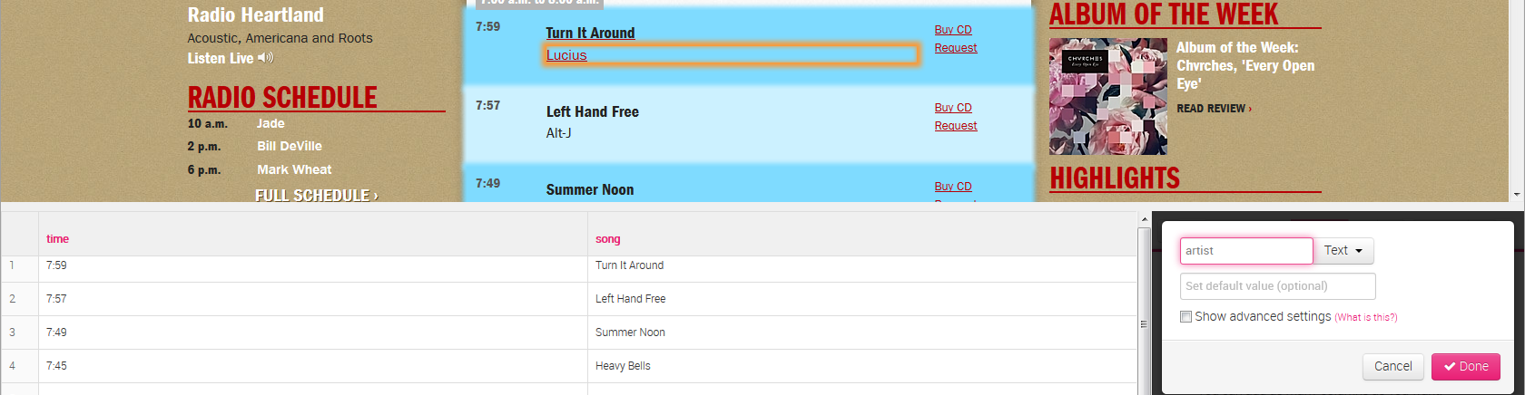
Group Projects: Examples
Individual Project #2:
Visualize The Current’s 2015 YTD playlist (www.thecurrent.org/playlist/)

Slide 19
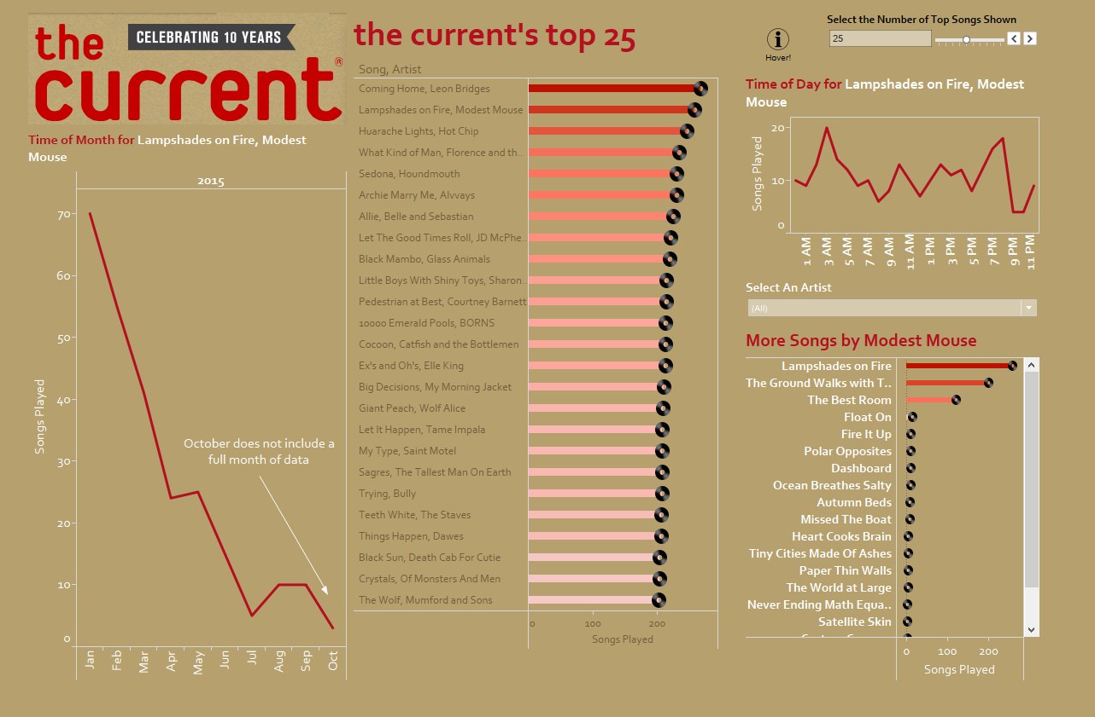
Group Projects: Examples

Slide 20
Final projects: Examples

Slide 21
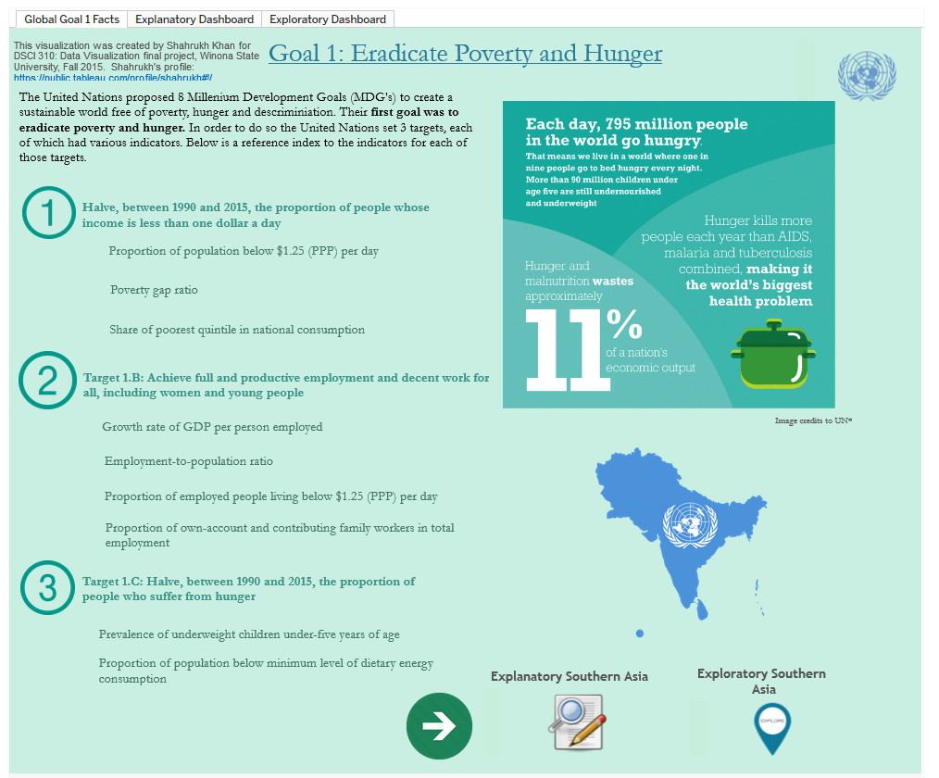
http://tabsoft.co/1UmY2UQ

Slide 22
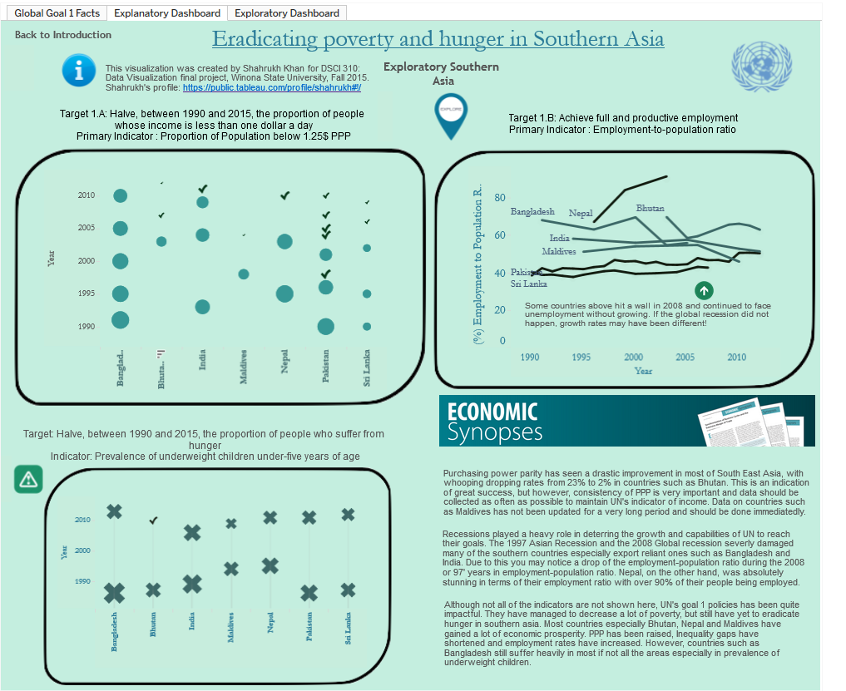
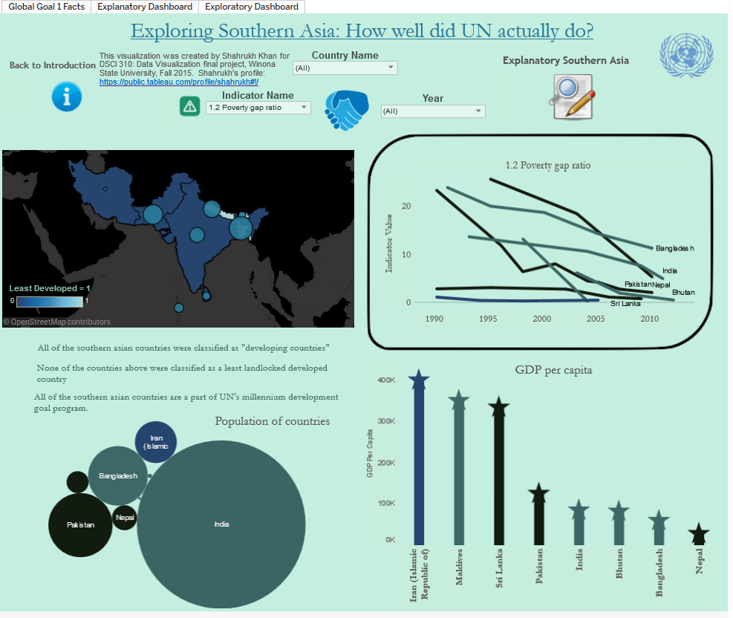
http://tabsoft.co/1UmY2UQ

Slide 23

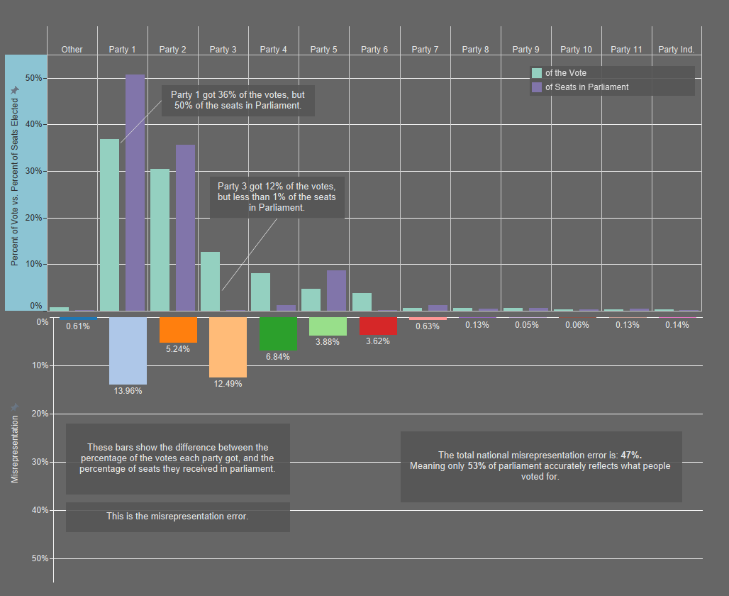

Slide 24
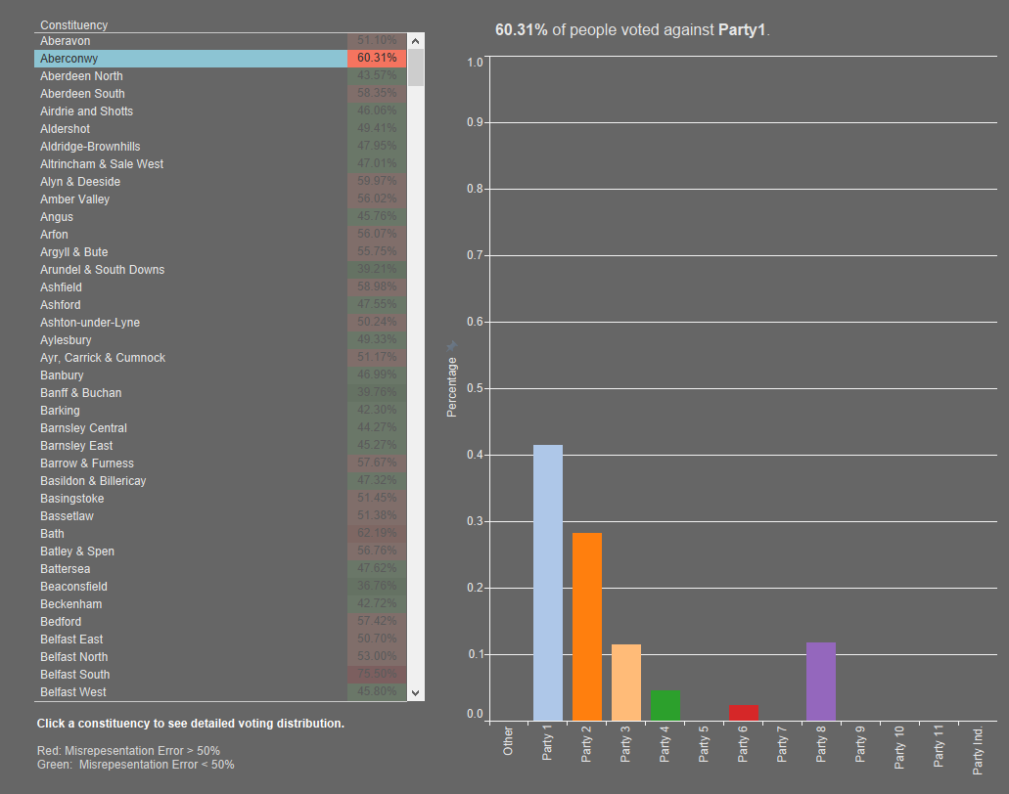

Slide 25

http://tabsoft.co/1UmY2UQ

Slide 26
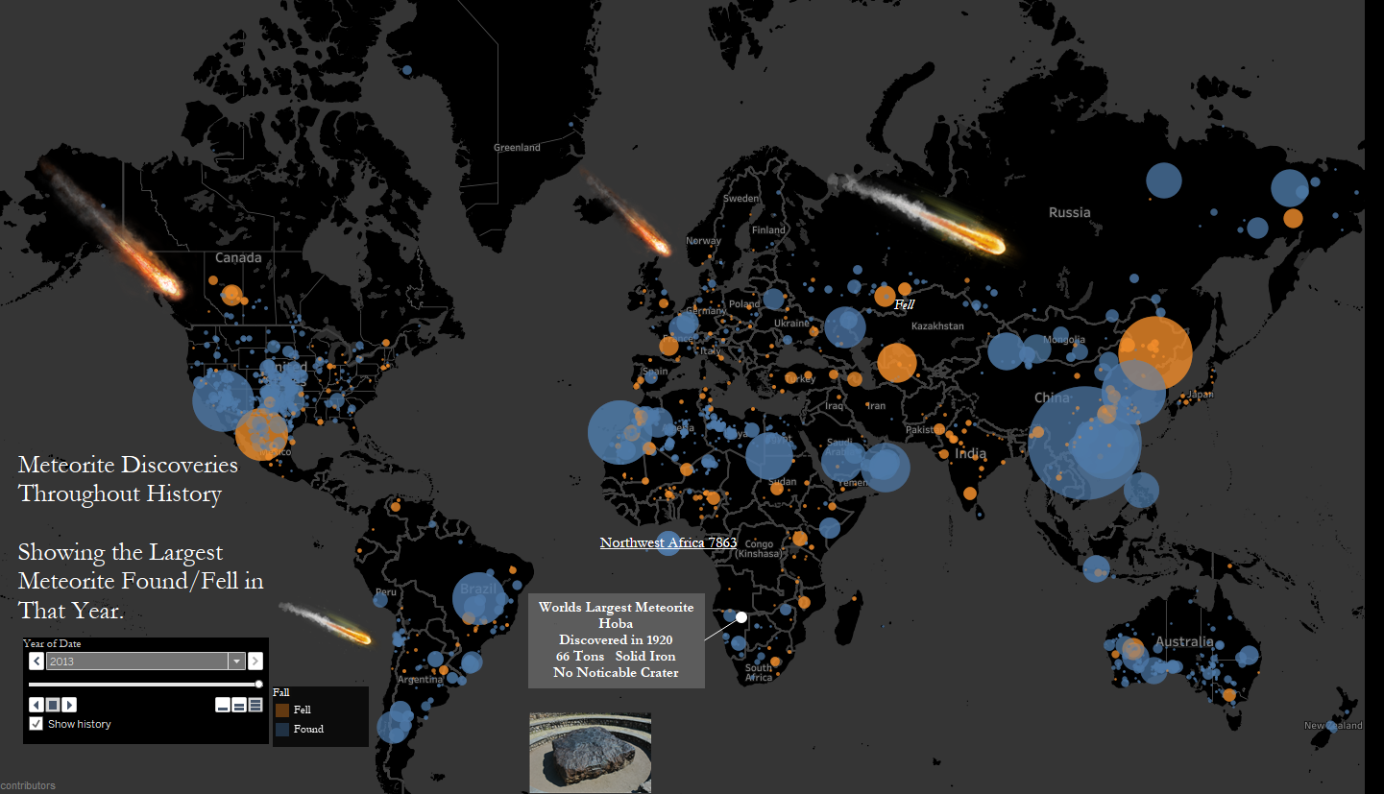
http://tabsoft.co/1UmY2UQ

Slide 27
Worked well:
  Peer review + editing cycle for all design tasks
  “The best of” for each design task
Biggest challenges:
  Teaching creativity (“Take Art 101” in student evaluations)
  Emphasizing insight over data dumping and the curse of the click

Slide 28
THANK YOU!
sbergen@winona.edu

