Slide 1
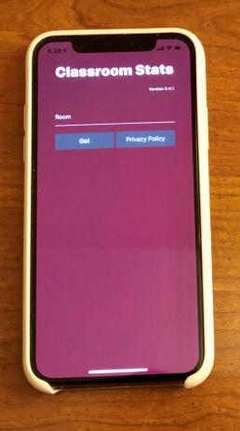
Fun, Flexible, Free Mobile Data Collection and Web-Based Analysis
David Taylor, Roanoke College
Adam Childers, Roanoke College
Classroom Stats
While you are waiting (or before the webinar), please use your iPhone or Android device to download our app from the appropriate store! Go to crs.link in your browser and it will direct you to the app store!

Slide 2
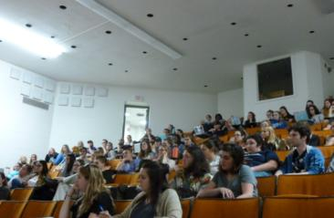
Why Classroom Stats?
Students are invested in data collected from their class.
Collecting data for a modest sized class is tedious, for a large class it’s impossible.
Spontaneity makes the data more fun (in comparison to demographic data collected at the beginning of the semester).
Visualization is key for students to learn understand inference.
The perfect companion for any statistics class.

Slide 3
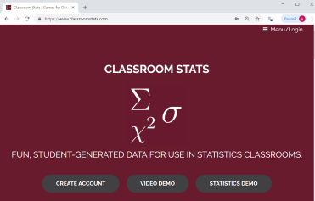
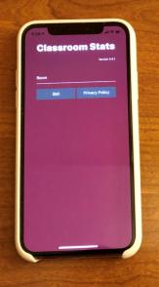
What is Classroom Stats?
Web-Based Analysis at www.classroomstats.com
Free Mobile App for iOS and Android
Enter Data
Play Games
Collect Data
Analyze Data

Slide 4
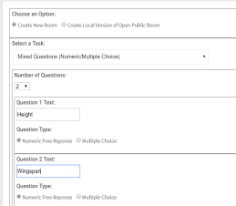
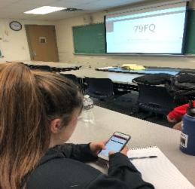
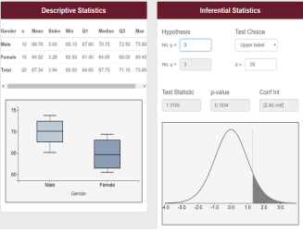
What is Classroom Stats?
Create a Room
Collect Data
Explore Data

Slide 5
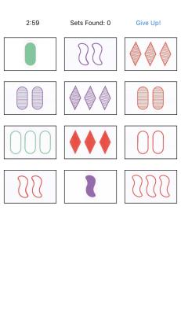
What is Classroom Stats?
Games/Tasks Currently Implemented:
Numerical and Categorical Entry
Mastermind
Set
Arithmetic Quiz
DEMO! (we have a demo video on the
www.classroomstats.com)

Slide 6
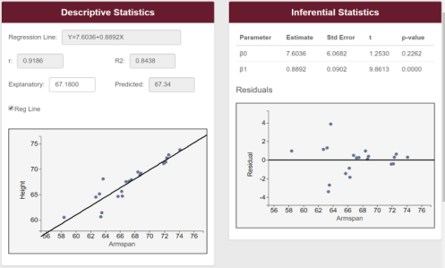
How Can You Use Classroom Stats?
Designed to be used throughout an introductory statistics course.
Descriptive statistics (numerical and graphical)
Correlation and regression
1 sample t-tests
Confidence intervals
Matched pairs
2 sample t-tests
Chi-Square (Fisher’s Exact Test)
Chi-Square Goodness of Fit
ANOVA

Slide 7
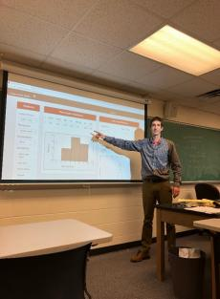
Who is Classroom Stats?
Adam Childers – Associate Professor of Mathematics and Statistics at Roanoke College
David Taylor – Associate Professor of Mathematics and Statistics at Roanoke College
Others? You! Please help up test this and use this; we are looking for more ideas!

Slide 8
Future of Classroom Stats
It’s up to you! If you can dream it, we can do it*. It’s time to build and audience and community.
Currently in development
Public Rooms
Simulation
Even More Online Statistics Integration

Slide 9
Questions?
Sign up for your account today at www.classroomstats.com.
Contact:
David Taylor – david.taylor@classroomstats.com
Adam Childers – adam.childers@classroomstats.com

