Slide 1
Bubble Project
Pamela Fellers
Assistant Professor
Department of Mathematics and Statistics
Grinnell College

Slide 2
Outline
Motivation for project
Overview of project
Two versions
Fall 2015
Spring 2016
Summary of my experiences

Slide 3
Motivation
Beginning content is generally a review for some (most?) students
Data collection methods information might be the exception
Final projects tend to occur during the second half of the semester
The Bubble Project
Introduces a variety of statistical thinking questions into the beginning material
Gives extra exposure to data collection methods
Reference for final project

Slide 4
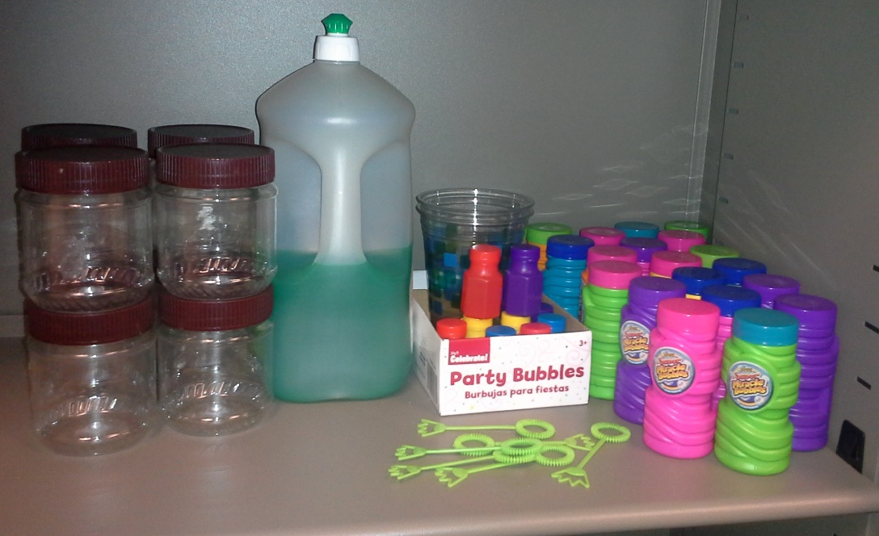
Motivation
Bubbles are fun
Low-cost
Short-term (4 weeks)
Random group assignments

Slide 5
Overview of Project
Randomly assigned teams of 3-5 students
All teams were given the following research prompt:
“What is the best bubble solution?”
Teams were also given one of the following two additional guidelines/restrictions
You will have access to three containers each of two brands of bubble solution.
You will have access to the supplies needed to make bubble solutions based on the recipe below. As a group you will need to choose either the dishwashing liquid or the sugar ingredient to modify creating different version(s) of the recipe. Once recipe you will use to make bubble solution will be the given recipe and then you will need to choose one or two different amounts of the ingredient your group wishes to modify to make additional bubble solution(s).
1 cup of water
¼ cup dishwashing liquid
2 teaspoons sugar

Slide 6
Overview of Project
Research Proposals
1 page maximum
Introduction to the research question
Clearly defined research question
Motivation or rationale for project
Identification of response and explanatory variables
Include explanation and reasoning
Data Collection Plans
3 page maximum
Specifically identify how data will be collected
Outline process including set-up
Incorporate data collection and study design components
Proper use of statistical terminology
Research Proposals
Defining a research question that can be answered through collected data
Variables – response and explanatory, categorical and quantitative, data organization
Data Collection Plans
Reproducible research (from written study design perspective)
Study Design – controlled variables or processes, randomization, treatments, factors, levels
Decisions to be made – consider from a statistical perspective
“What do we do about the bubble wands?”
“How should we mix the solutions?”
“Does it matter how we blow the bubbles?”

Slide 7
Overview of Project
Instructor Guided Steps
Research Proposals (Week 1)
Refine general research question
Clearly defined variables
Data Collection Plans (Week 2)
Elements of a study
Identifying controlled variables
Data collection procedures
Discussed or referenced project each class
Built in occasional 10-15 min. work times

Slide 8
Fall 2015 Timeline
Weeks 1 & 2
Research proposal and data collection plans
Week 3
Teams collected their data – outside of class
Week 4
Organize and summarize data
In-class presentation (8 min.)
During add/drop deadline – flexible groups
Some loved collecting the data, others thought it was unnecessary
Presentations
A little repetitive
Many errors/flaws
Incorporate discussion into future classes

Slide 9
Two Examples

Slide 10
Spring 2016 Timeline
Weeks 1 & 2
Drafted research proposal and data collection plan
Week 3
Peer review of drafted proposals and data collection plans
Week 4
Final research proposal and data collection plans due
Still required some flexibility in groups
Spent a full class prior to peer review
Given two instructor created sample drafts
Brought materials to class
Small group discussion and peer review of the samples
Final research proposals and data collection plans were “higher quality” than in the Fall 2016
Practicality of data collection

Slide 11
Summary of My Experience
Enjoyed using bubbles, potentially other “topics”
Random groups is a must (for me)
Students appreciated discussions in class about project
Peer review was beneficial
Final project ideas, research questions, and overall projects “improved”
No more “I’ve never done this.”
Timeline and add/drop
Collect data?
Use one or two projects as a class lab?
Alterative recipe
Glycerin or corn syrup
Alternative variables
Resting time, type of water, wand, method of blowing the bubble

Slide 12
Students were creative!
Duration
Of all bubbles from a single blow
Of the first bubble from leaving wand to popping
Size
Record with video equipment or iPad
Graph paper
Measure mid-air
Ruler, 3 size cards
Measure on a surface
Pop on colored paper for outline
Blew bubble on surface and measured outline
Reason for popping
Mid-air, floor, on own after contact
Number of bubbles produced
Film length
Seconds until fan breaks bubble film
Effort
Noted whether solution was left over on wand and how many attempts were needed to form bubbles

Slide 13
Thank You! Questions/Comments?
Taylor, L., “A New Approach to Projects in an Introductory Design and Analysis of Experiments Course”, USCOTS 2015 Poster Presentation, May 2015.
Steiner, S. H., Hamada, M., Giddings White, B. J., Kutsyy, V., Mosesova, S., and Salloum, G. “A Bubble Mixture Experiment Project for Use in an Advanced Design of Experiments Class” Journal of Statistics Education, 15(1), 2007)

