Slide 1
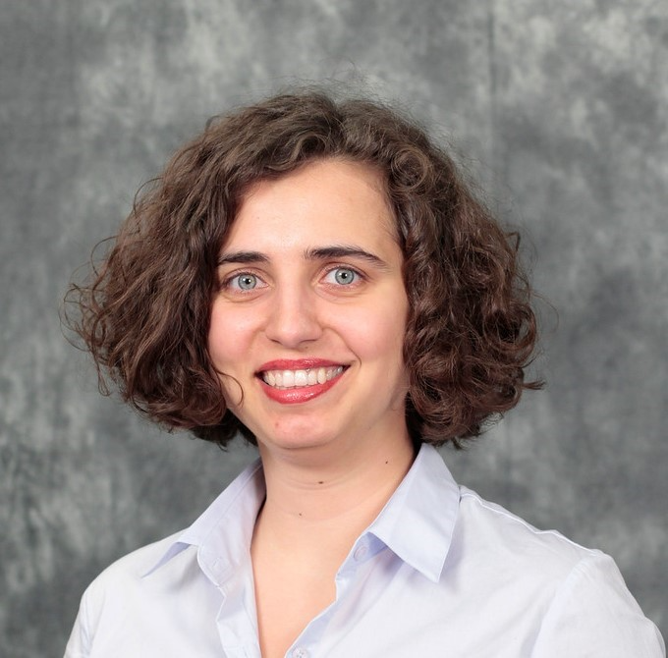
Framework for Accessible and Inclusive Teaching Materials for Statistics and Data Science Courses
Mine Dogucu
University of California Irvine/University College London

Slide 2
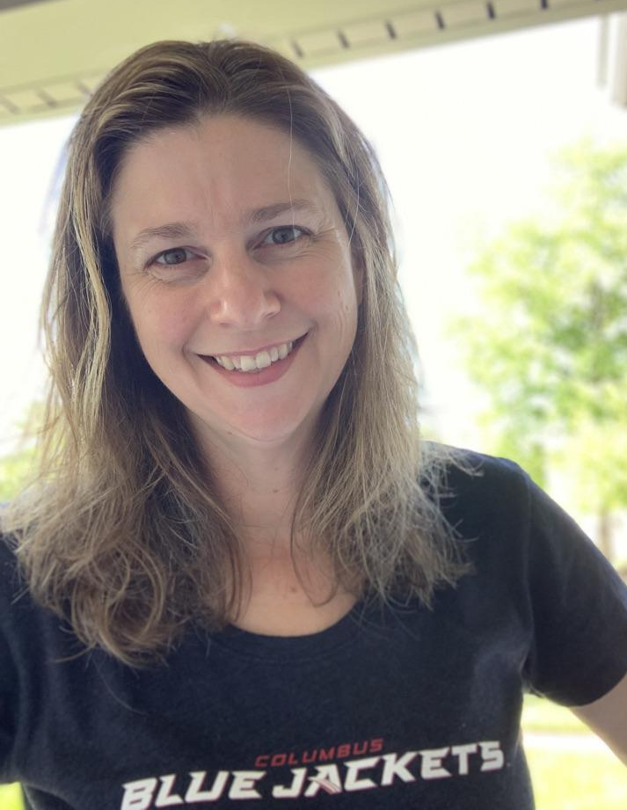
CAUSE/JSDSE webinar series
Welcome!
Host and Moderator:
Leigh Johnson
Capital University
Columbus, OH

Slide 3
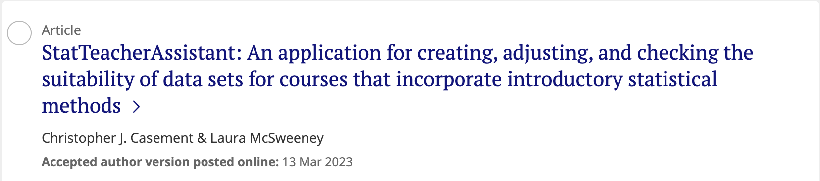
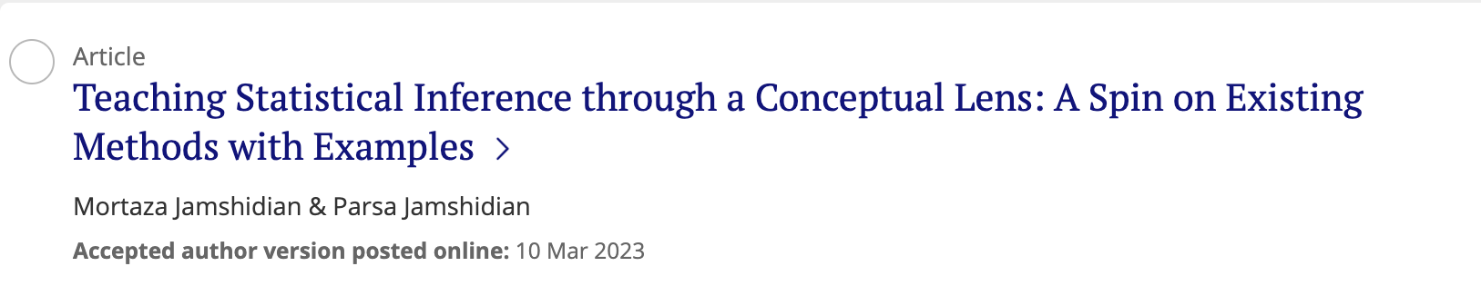
What’s new in the journal?

Slide 4
Upcoming CAUSE/JSDSE Webinars
Designing a Large, Online Simulation-Based Introductory Statistics Course
Erin Blankenship, Ella Burnham, Sydney Brown
April 18, 2023 4 PM EST
Playmeans: Inclusive and Engaging Data Science through Music
Davit Khachatryan
May 16, 2023 4 PM EST

Slide 5


Consortium for the Advancement of Undergraduate Statistics Education
Early Bird Registration (before April 17th) - $225
Standard Registration - $275
Some attendees may be eligible for a CAUSE grant for free or reduced registration.
https://www.causeweb.org/cause/uscots/uscots23

Slide 6
Mine Dogucu
Mine Dogucu is a Lecturer (Teaching) in the Department of Statistical Science at University College London and is on leave from her position as an Assistant Professor of Teaching in the Department of Statistics at University of California Irvine. Her work focuses on modern pedagogical approaches in the statistics curriculum, making data science education accessible, and undergraduate Bayesian education. She is the coauthor of the book Bayes Rules! An Introduction to Bayesian Modeling with R.
Mine Dogucu

Slide 7
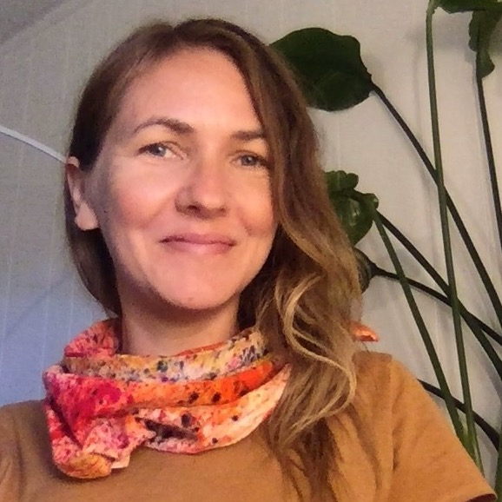
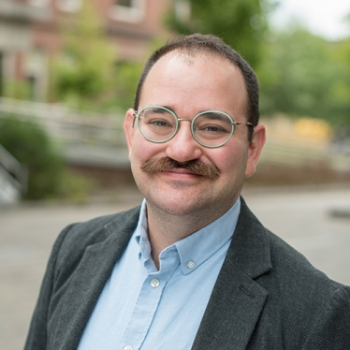
Co-authors
Alicia Johnson
Macalester College
Miles Ott
Tubi

Slide 8

How it all began
Goal 1. Course materials should be physically accessible.
Goal 2. The development and delivery of course materials should be inclusive of a diverse body of learners.
bayesrulesbook.com

Slide 9
Checklist for evaluating accessibility and inclusion of teaching materials.
Accessibility and Inclusion Criteria | Questions
Accessibility | Is the cost affordable for learners from diverse socioeconomic backgrounds?
 | Are plots distinguishable to color blind learners?
 | Is alt text provided for images?
Inclusivity of scholars | Do the cited scholars represent diversity across identities, experiences, and expertise?
 | Are scholars cited using the correct names and pronouns?
Inclusivity of students | Do examples avoid the necessity of specialized knowledge?
 | Do names and pronouns reflect diverse cultural and personal identities?
 | Are there examples that could potentially speak to younger as well as older students?
 | Does the delivery embrace mistakes and critical thinking?
 | Are efforts made to accommodate different academic experiences and create a shared foundation?

Slide 10
Commencement
As our understanding and practice around accessibility and inclusion evolve, we welcome any feedback on these topics through a Google Form (bit.ly/bayesrules-feedback).

Slide 11
QUESTIONS?
Website: minedogucu.com
Twitter: MineDogucu
Mastodon: mastodon.social/@MineDogucu

