Slide 1
Reflections on making the switch to a simulation-based inference curriculum
Panelists: Julie Clark, Lacey Echols, Dave Klanderman, Laura Shultz
Moderator: Nathan Tintle

Slide 2
Structure
Simulation-based inference methods of teaching introductory statistics continue to gain popularity (simulation, bootstrapping and permutation tests)
  Technology
  Active learning pedagogy
  Preliminary evidence improves student learning
I will ask the panelists 5 questions about their ‘switching’ experiences, and they will each give brief (<1 minute) responses;
I’ll conclude with a few resources for continued learning about these approaches and then we’ll have a few minutes for Q+A

Slide 3
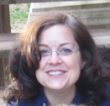


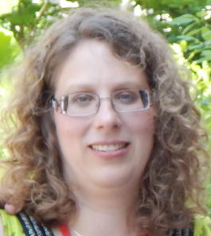
Introductions
Julie Clark
Dave Klanderman
Lacey Echols
Laura Schultz

Slide 4
What made you switch?
Dave
  Attended ISI workshop in summer 2013 and was impressed by the potential of simulation applets in learning inferential statistics
Lacey
  Student confusion and frustration with many formulas and intensive end of course with traditional curriculum
Laura
  I decided to switch when I had the opportunity to teach an Honors section of Statistics I. The simulation-based curriculum was a nice fit for the Honors curriculum at my University.
Julie
  Already was using active learning approach, then heard about SBI at conference and workshop and was intrigued

Slide 5
What have you enjoyed most about the switch?
Lacey
  Hypothesis tests come early, students actively answering questions on their own, reinforcement through the curriculum and less focus on formulas
Laura
  I have enjoyed being able to teach inferential statistics starting from day 1. Also, it is nice having students actually understand what a sampling distribution is!
Julie
  Starting with inference concepts like p-values and confidence intervals; students don’t get bogged down in calculations but do see theory-based approaches
Dave
  Students use their own technology (phone, tablet, laptop) and work in pairs to apply the applets in the context of explorations

Slide 6
What were some challenges?
Laura
  My biggest challenge was the unreliable wi-fi network at my University. Another challenge for the future will be persuading the rest of my department to switch to SBI for the "regular" sections of Statistics I.
Julie
  Learning not to make assumptions about students intuition and understanding of applets; some technical (applet) issues
Dave
  A few technology issues (e.g., one circuit in classroom)
Lacey
  Less time to teach the formulas and reinforce different formula use for different test situations

Slide 7
What will you do different next time you teach with this approach?
Julie
  Hoping to incorporate use of Minitab in addition to applets for graphing and theory-based methods
Dave
  Probably change to a 3-unit exam format; currently students tend to struggle on the 2nd unit exam (Chapters 5-8)
  Might modify data project into two smaller ones
Lacey
  Change format of project, but not much else
Laura
  I am teaching the course for the second time this semester. At this point, I am focusing on fine-tuning the in-class activities and homework assignments that I use for the course

Slide 8
Concluding remarks
Many users of SBI have posted on www.causeweb.org/sbi a blog devoted to reflections on teaching with SBI
Associated listserv
Upcoming workshop: JMM Seattle (and more in spring/summer 2016)
Q+A?

