Slide 1
Teaching Data Science Through Data Hackathons
Rob Gould
rgould@stat.ucla.edu
May 19, 2015

Slide 2
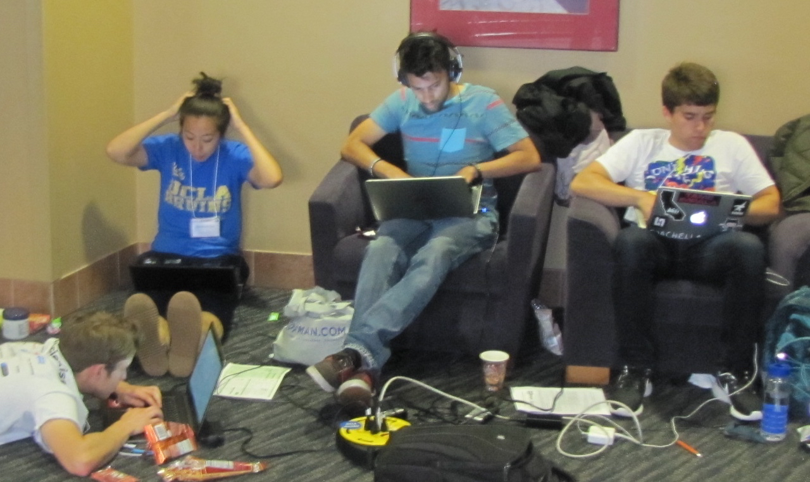
Outline
What is ASA DataFest?
Why did I start ASA DataFest?
What is a DataFest like?
How can you hold your own?

Slide 3
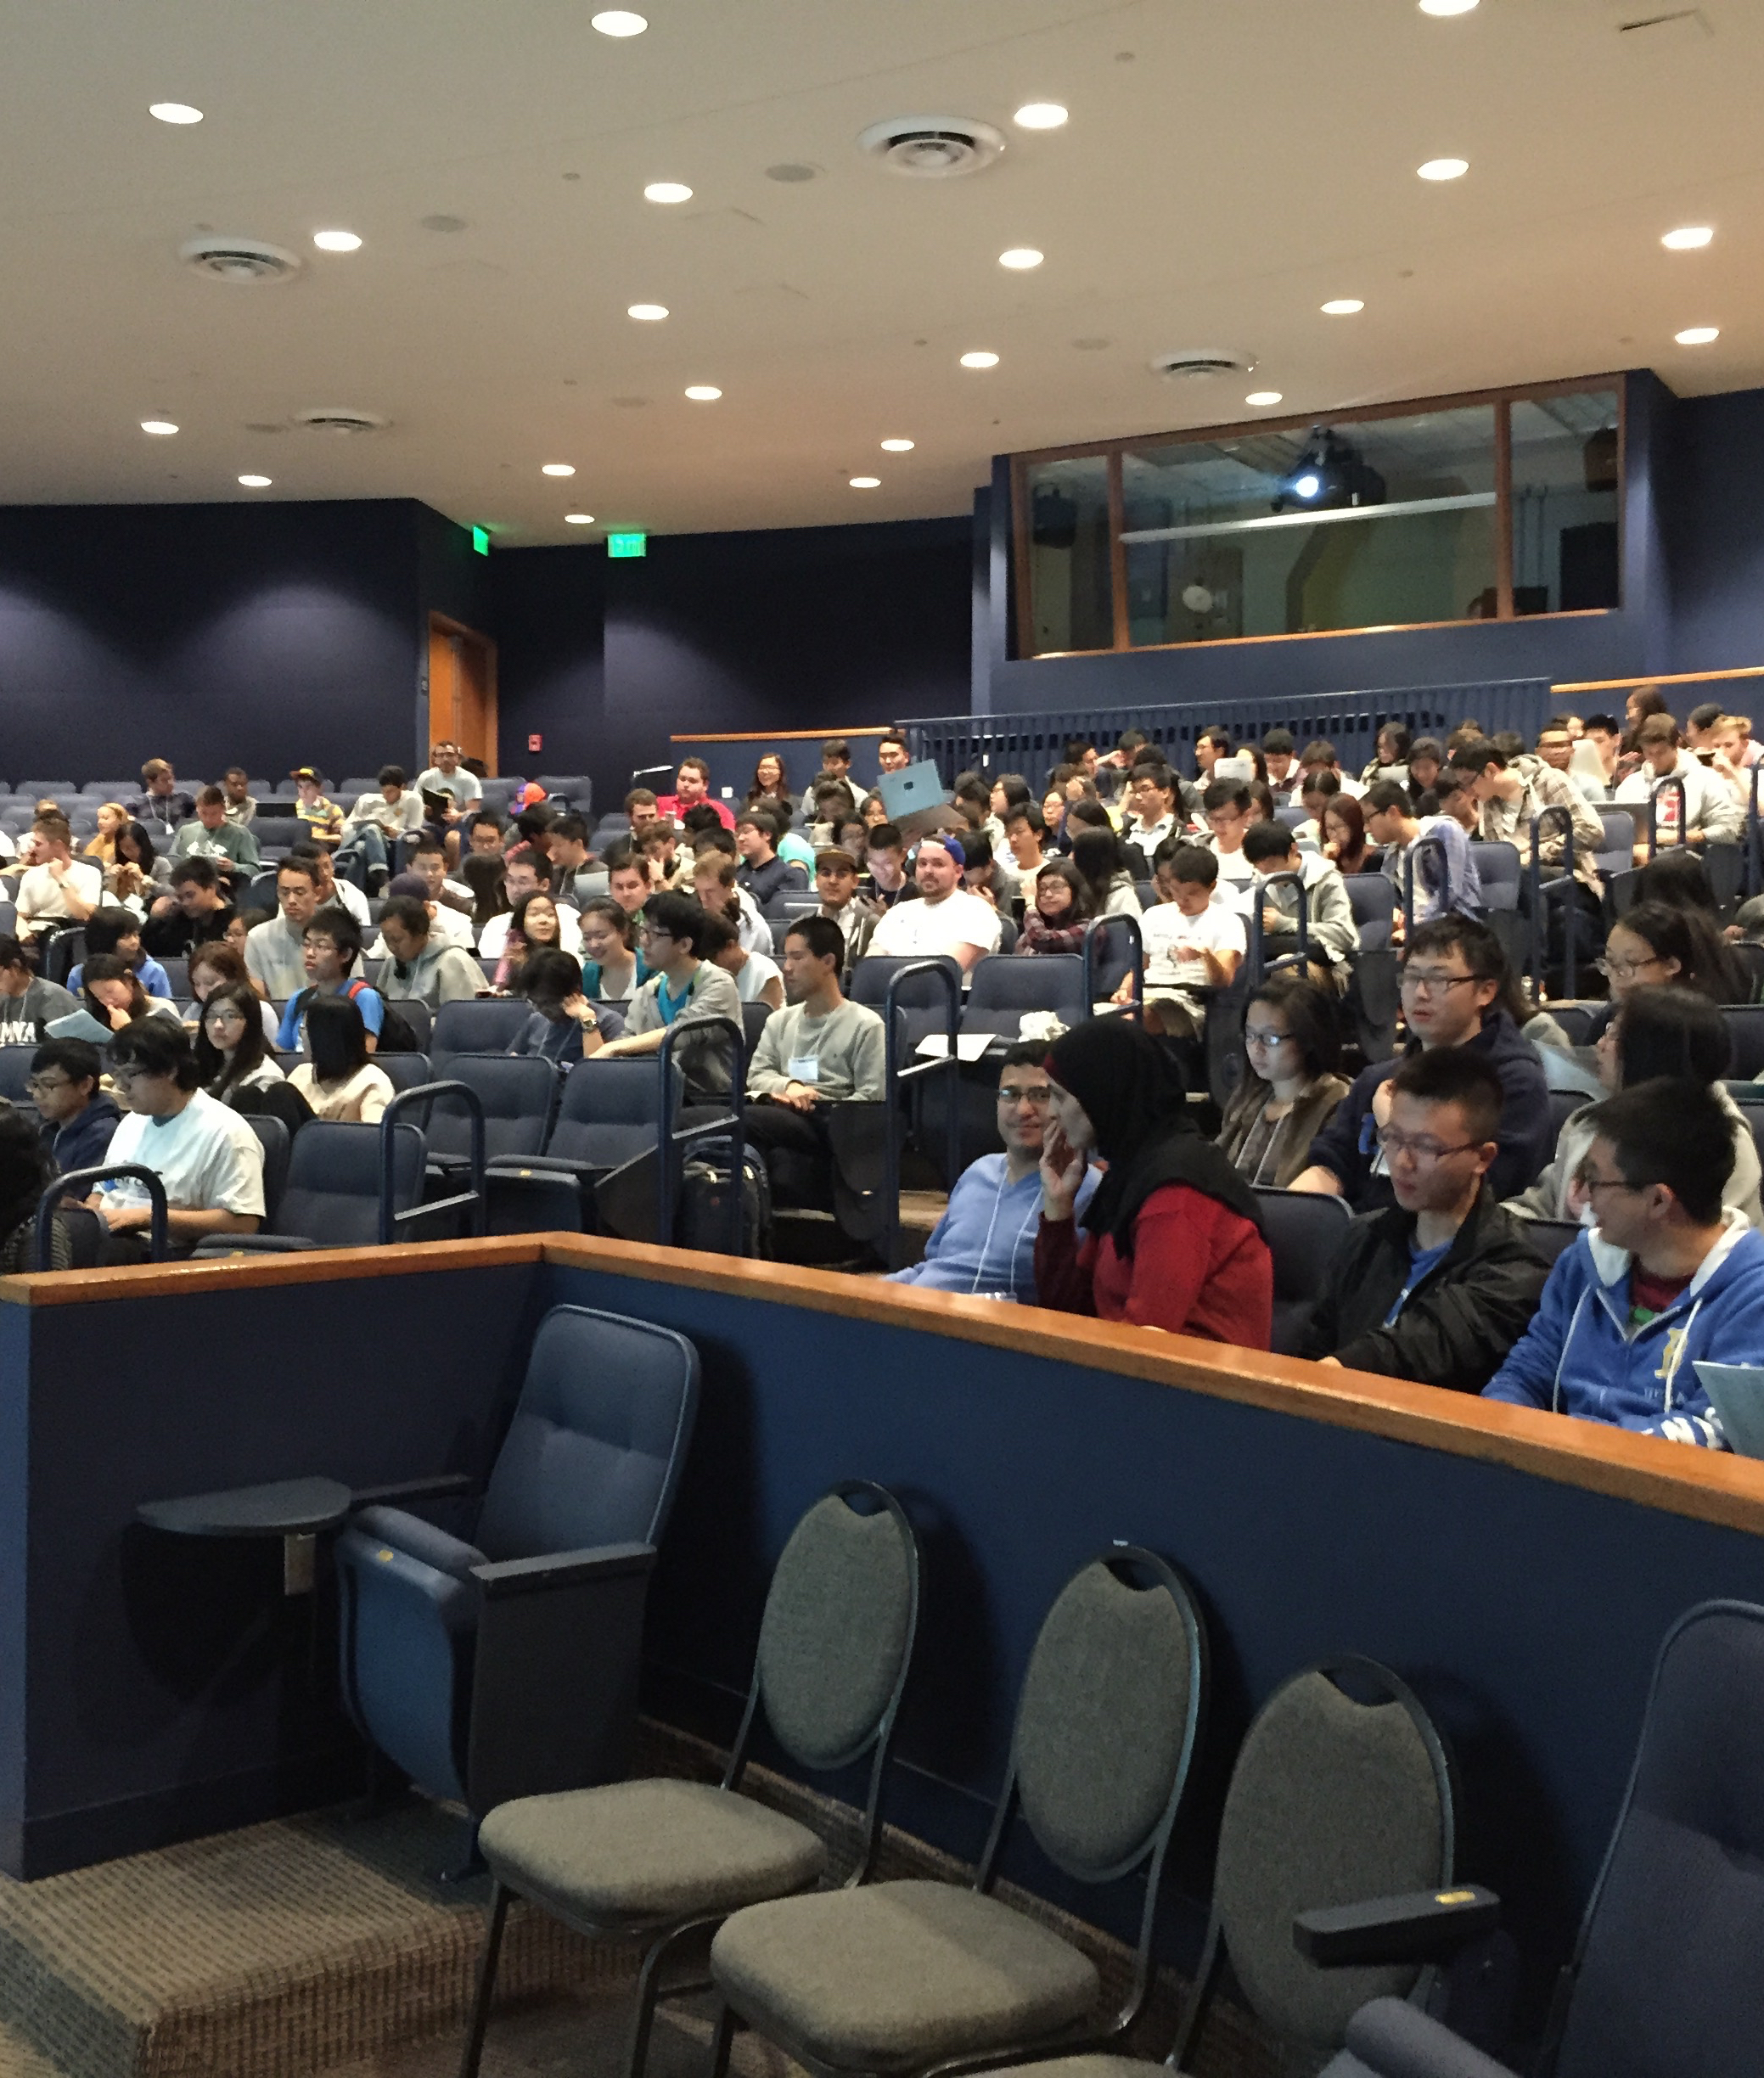
What is ASA DataFest?
It’s a “Big Data” hackathon
A celebration of data
A weekend-long contest in which teams of undergraduates analyze and interpret a rich, complex dataset for fame and glory.
It is NOT a modeling or poster competition.

Slide 4
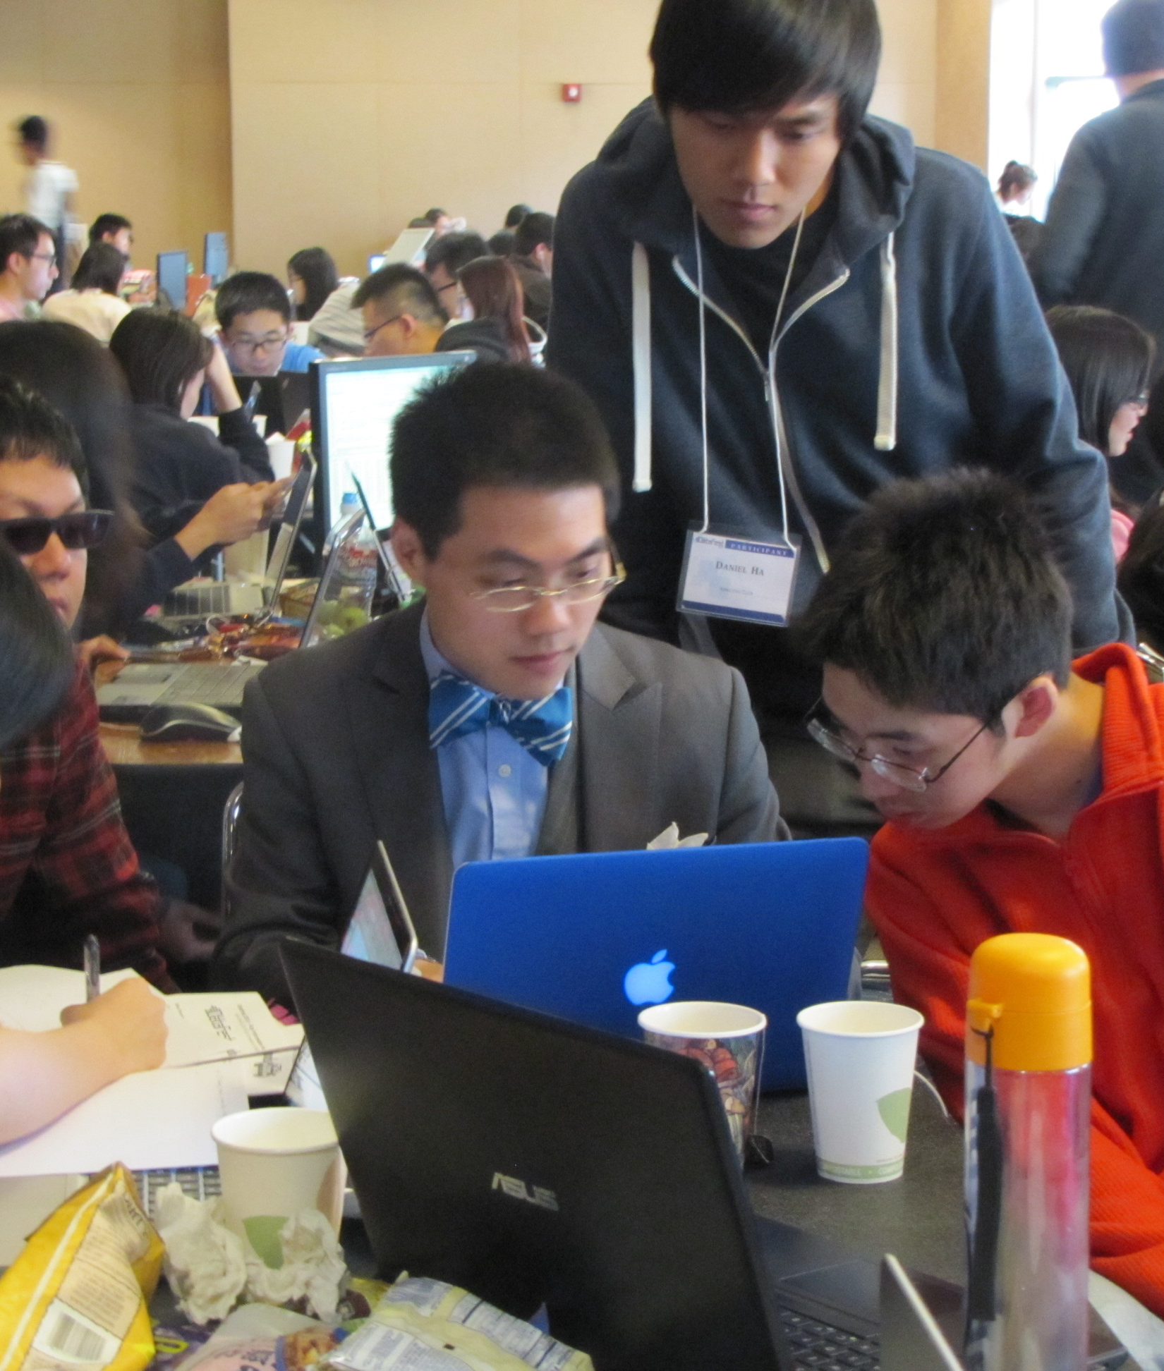
Why?
Access to datasets not usually available in the classroom
Friendly competition can inspire.
Real teamwork required
Cultural indoctrination
Statistics vs. Data Science experiment???

Slide 5
What’s it like?
Friday 6pm: “Meet the data” presentation. Dinner.
Work furiously. Frequent visits by “roaming data professionals”
Sunday: 2pm. Present to judges. 5 minutes!

Slide 6
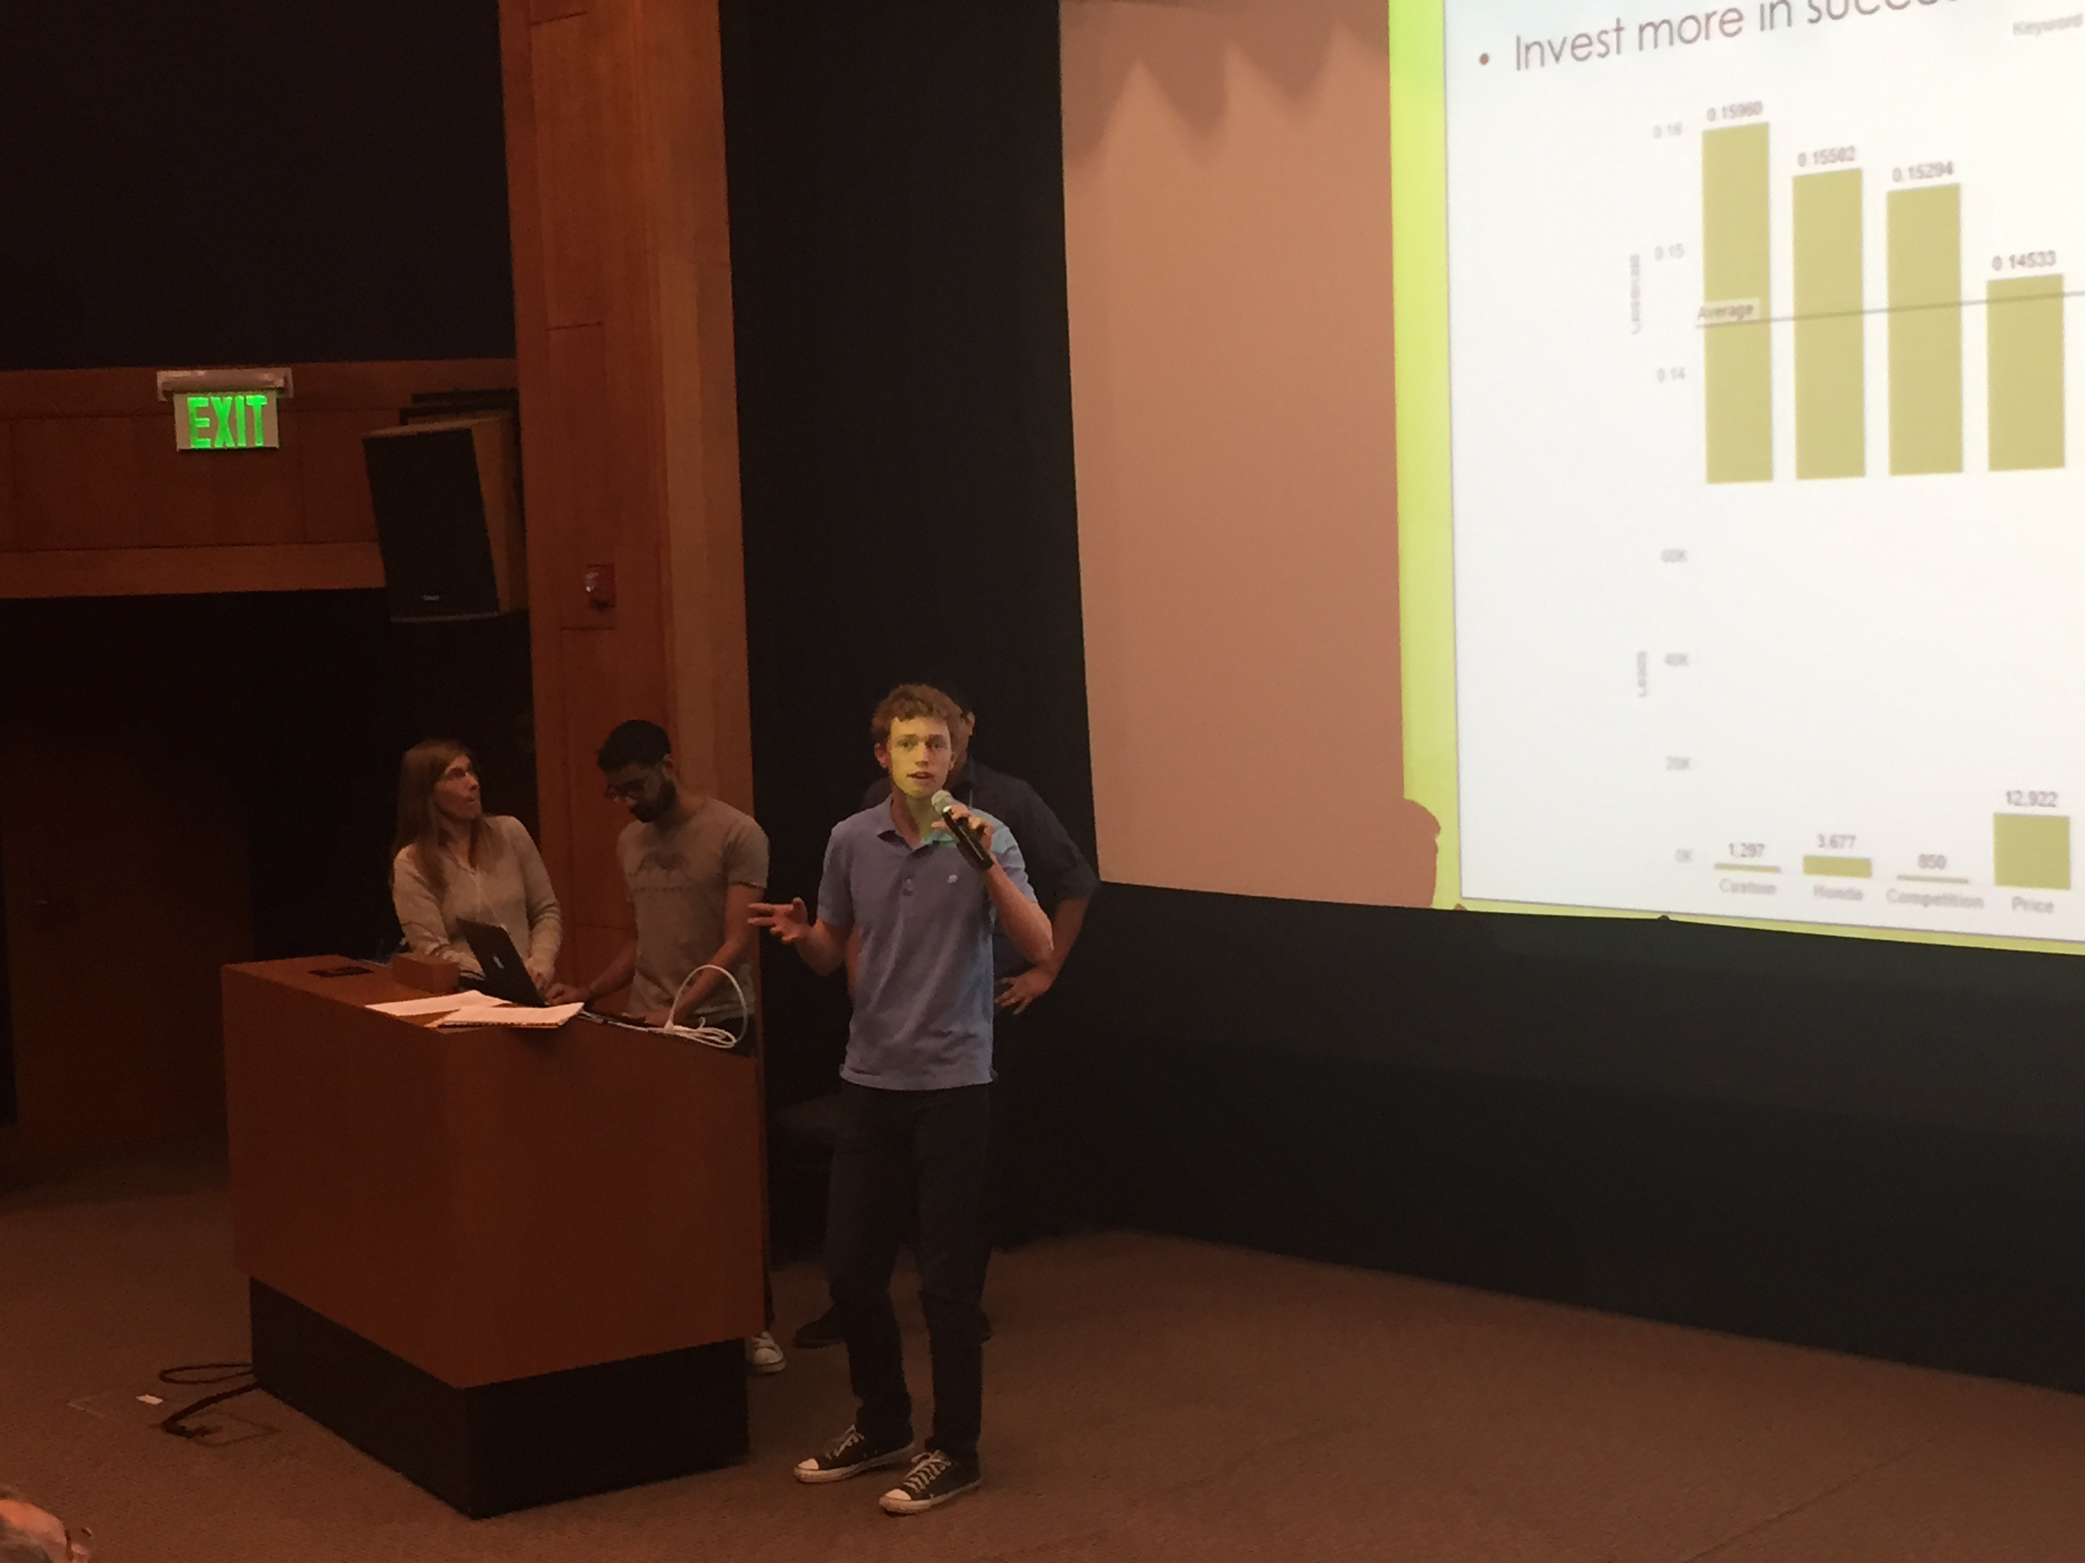
Prizes!
Best Recommendation/Insight
Best Visualization
Best Use of External Data

Slide 7
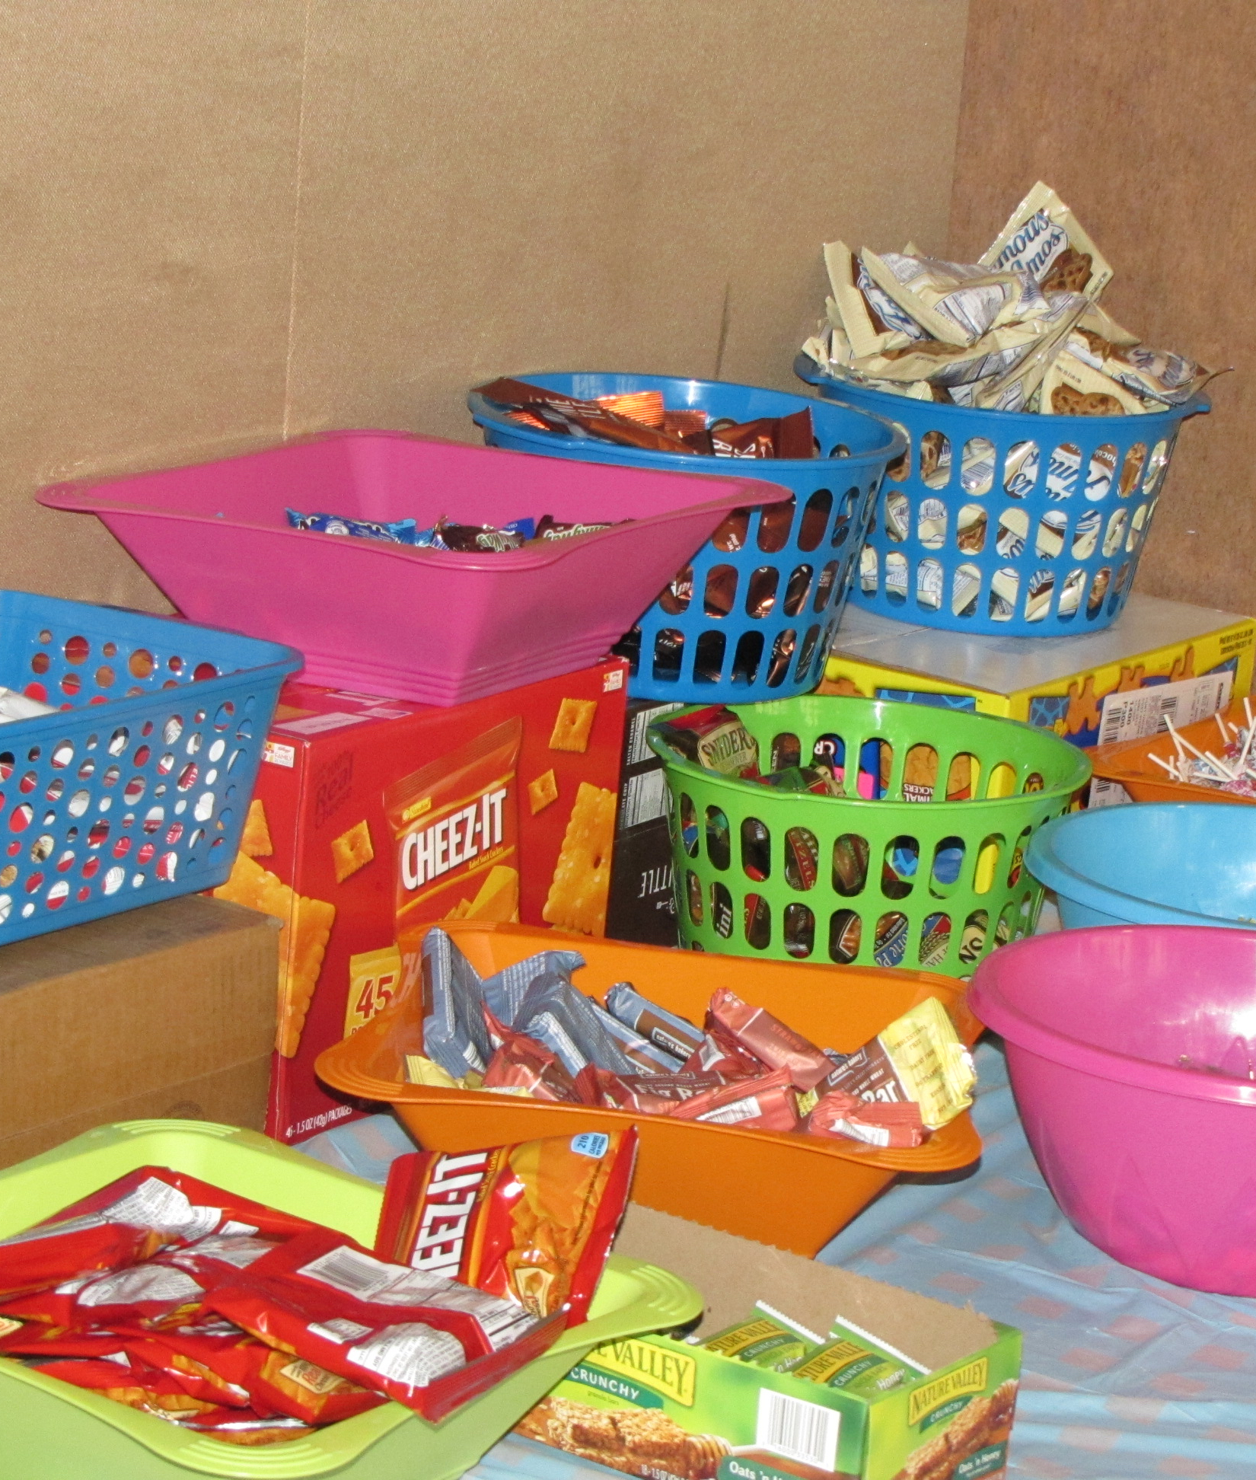
Previous data
LA Police Department
kiva.org
e-Harmony
GridPoint
edmunds.com

Slide 8
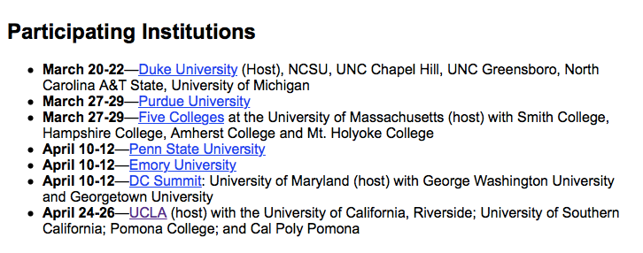

Slide 9
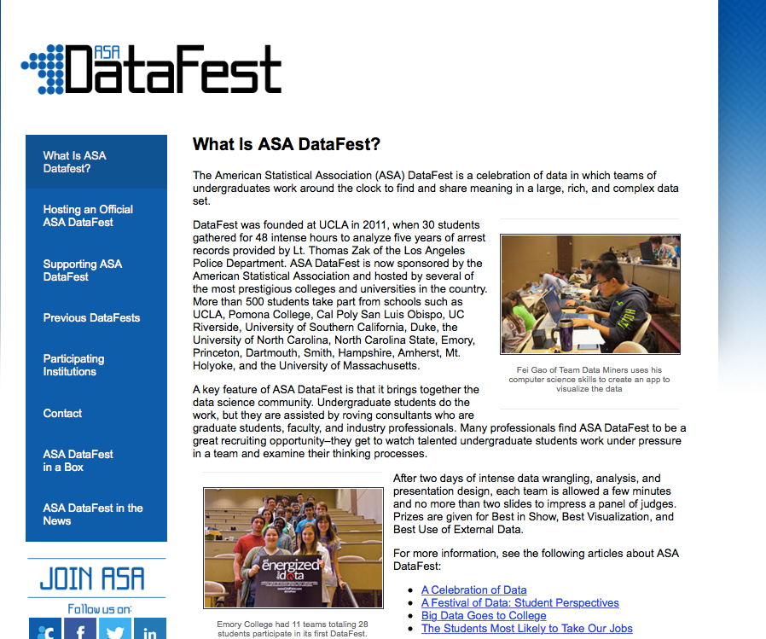
How to get started
amstat.org/education/datafest

Slide 10
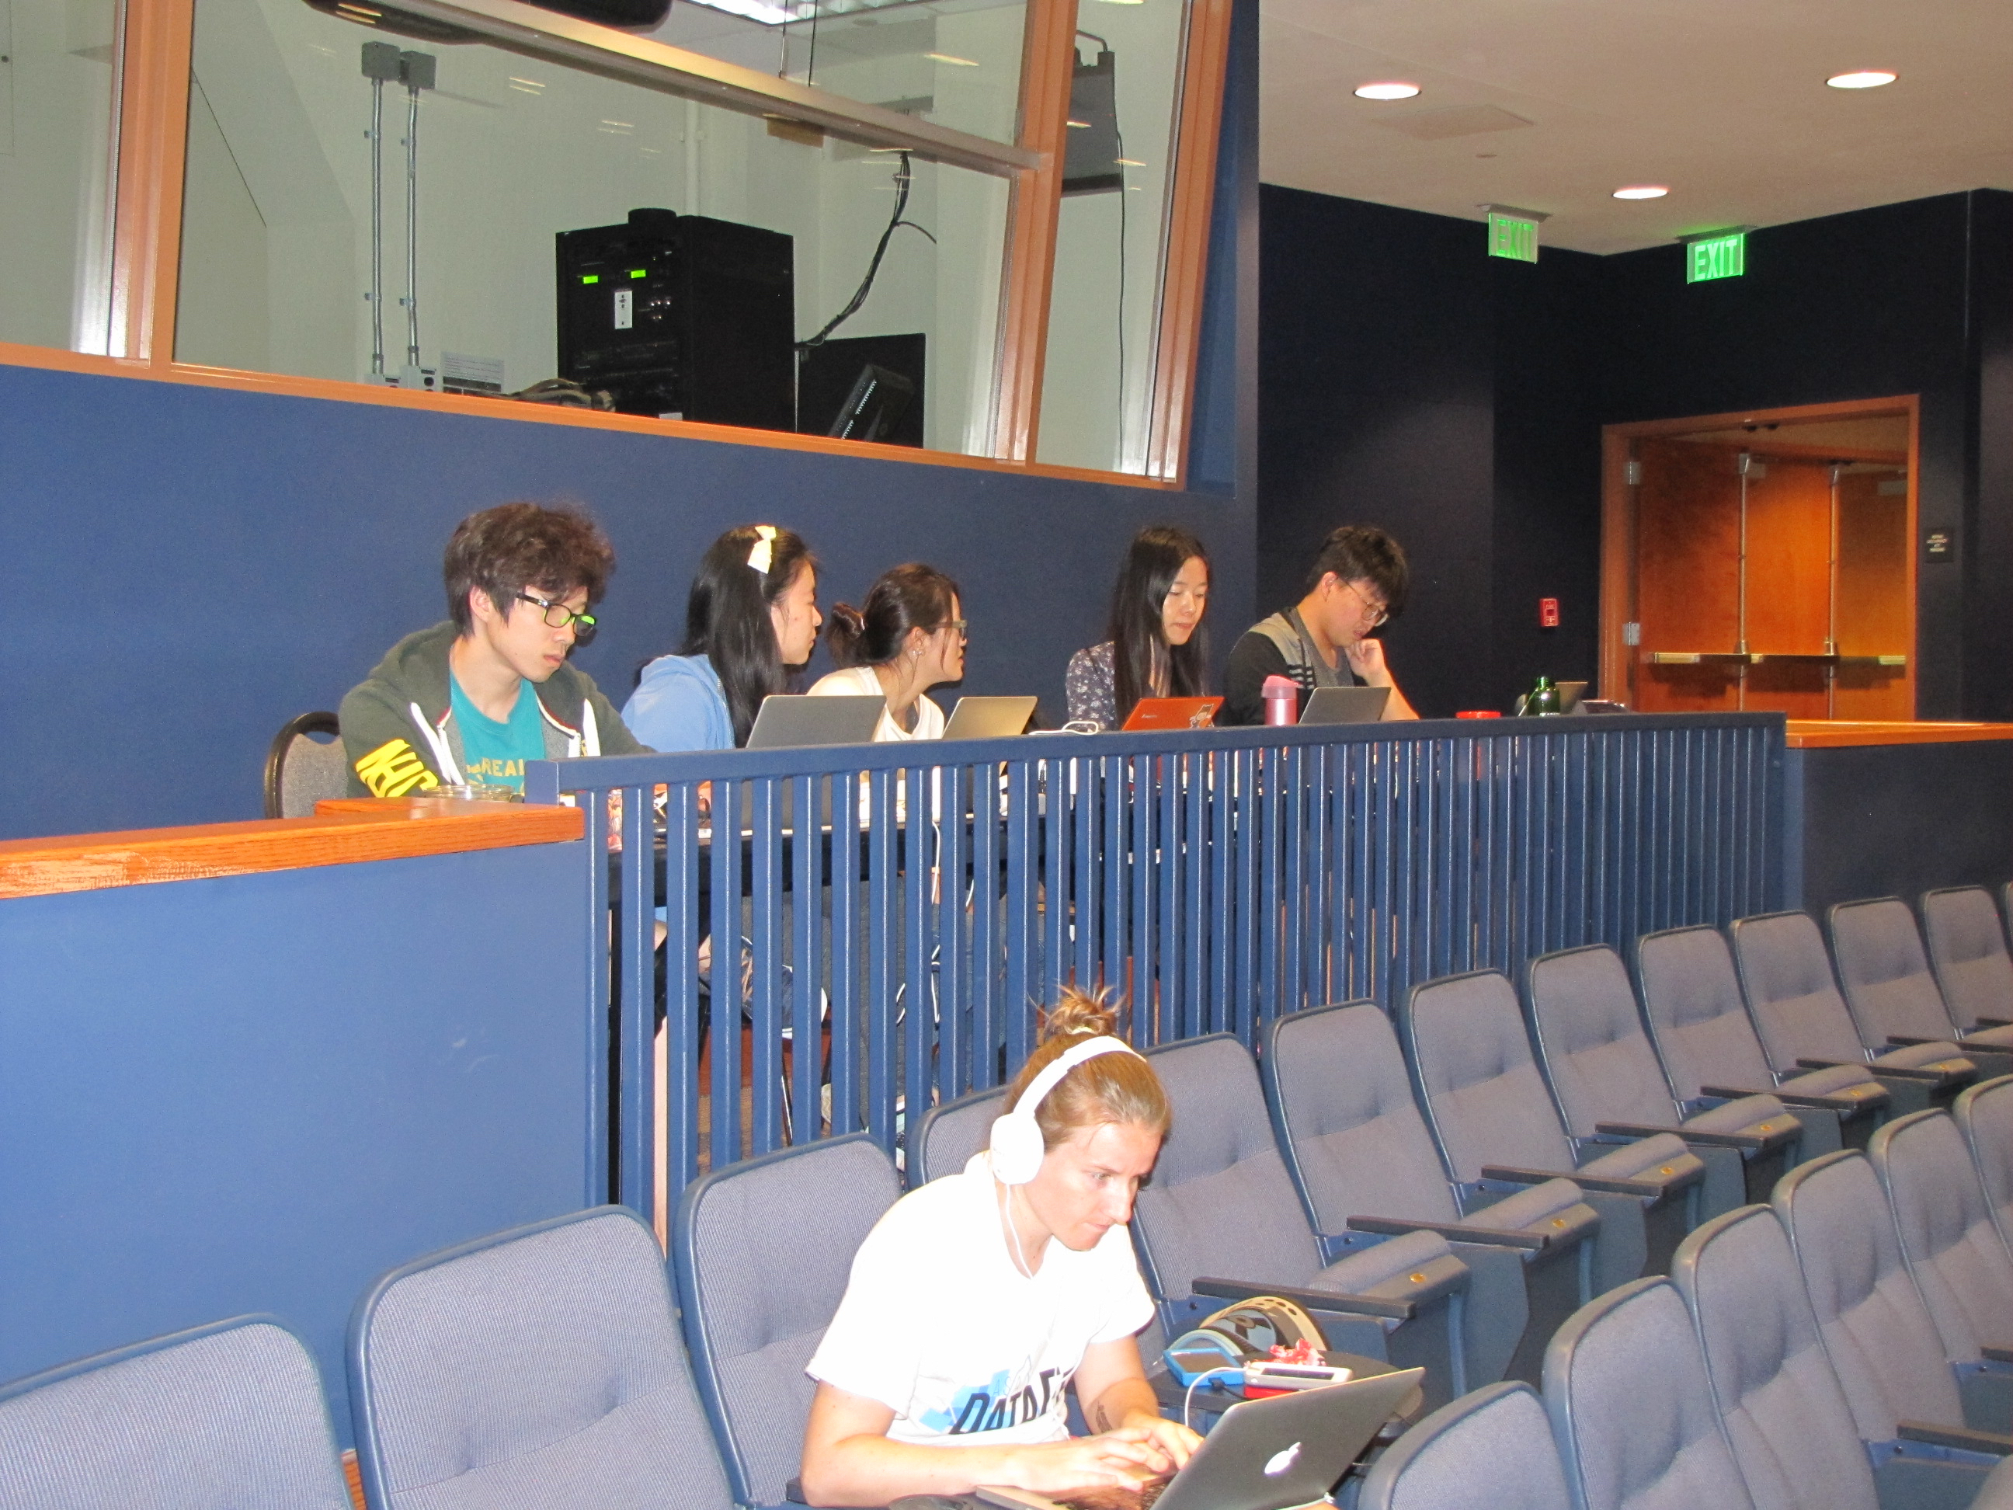
First time
Start small: recruit 20-40 students
Choose a weekend and find a space
Recruit judges (3 is nice).
Recruit visitors
Buy food!

Slide 11
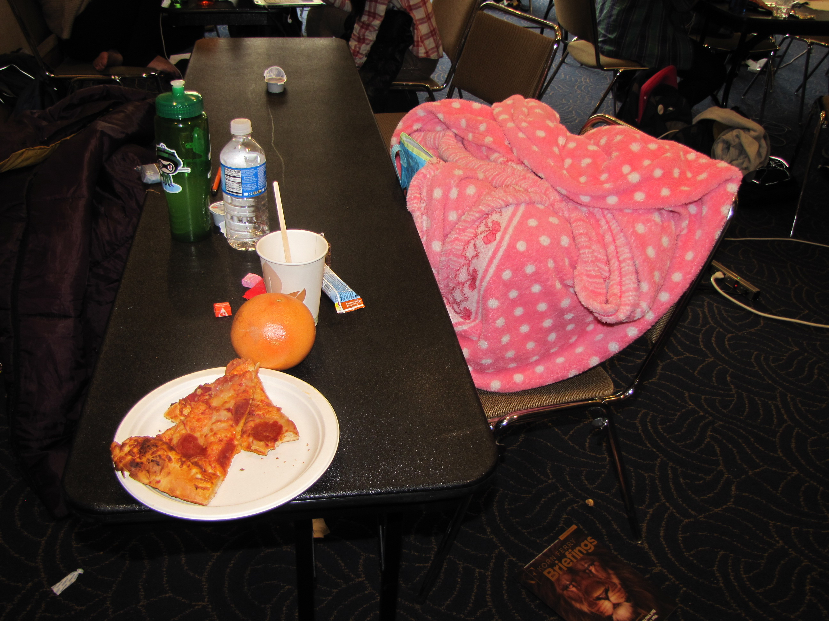
Expenses
Food (about 75% of our budget)
T-shirts, prizes
Facilities (including frequent trash removal, security)

Slide 12
Official DataFest Agreement
The DataFest committee will work long and hard to find a data set that meets as many of our criteria as possible. (Ask about this, if you want to know more.)
In exchange, you agree to hold your event in a six-week window in the Spring AND
agree not to divulge ANY information about the data until the last event is held.

Slide 13
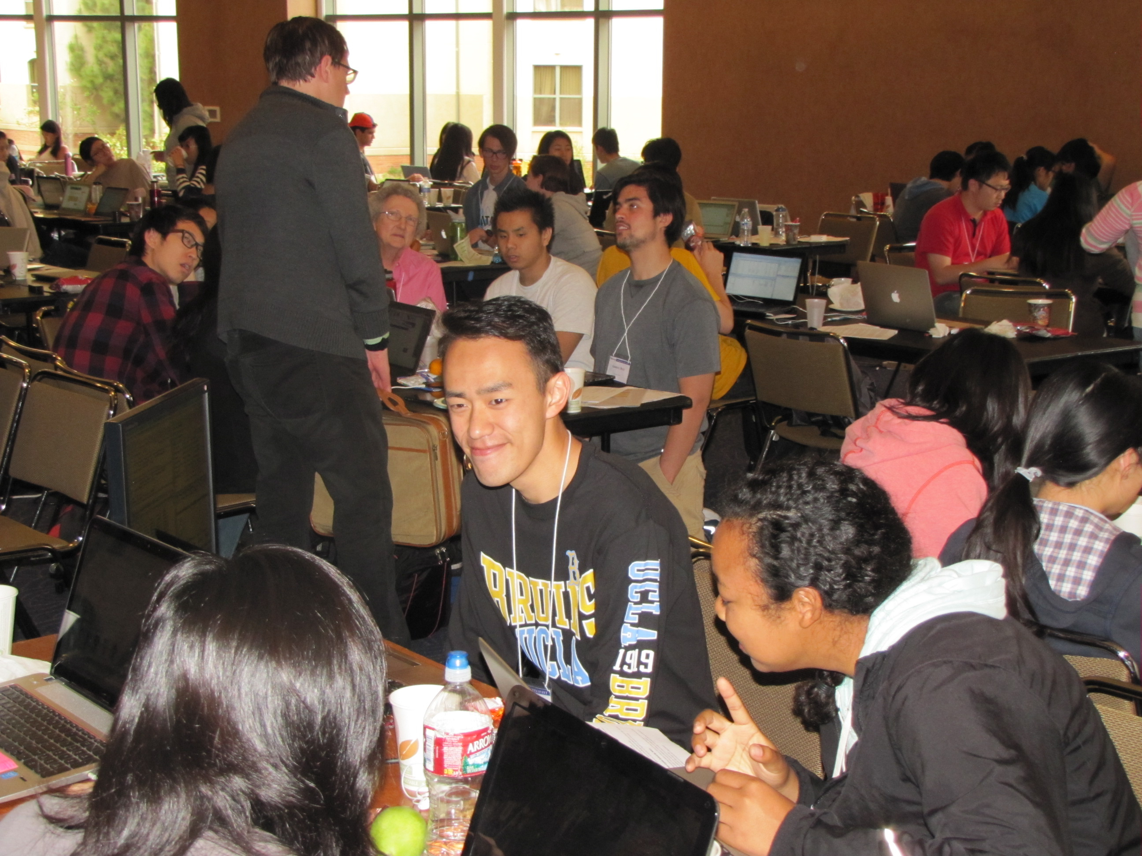
DataFest in a Box
Sample instructions for students, visitors, and judges
Sample budgets
Official logos!
Sample funding request, certificates, suggested prizes.

Slide 14
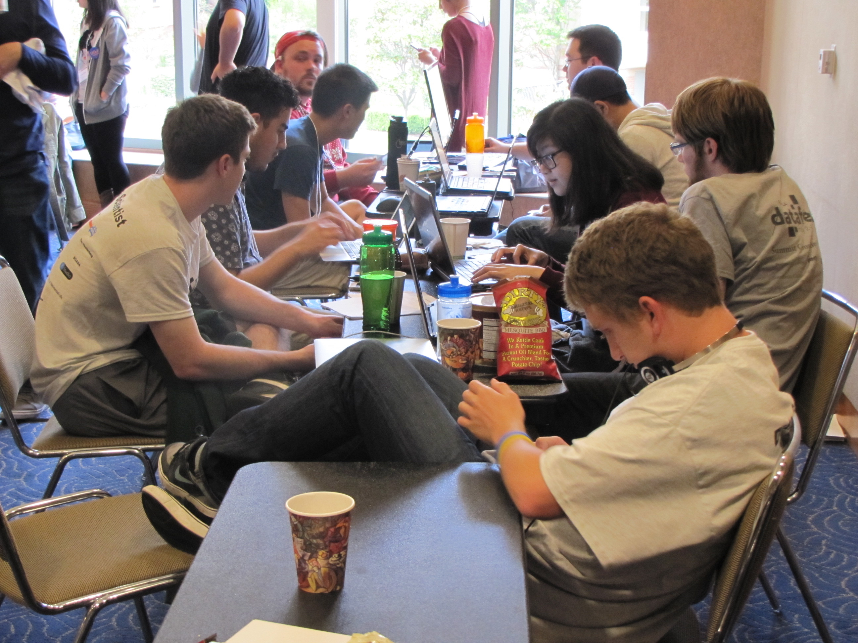
DataFest Core
Rob Gould, Mine Cetinkaya-Rundel, Andrew Bray, Ben Baumer, Jo Hardin, Shannon McClintock Peliggi, Deb Nolan
To join the Box and get added to our listserv, email rgould@stat.ucla.edu

Slide 15
Good data
It comes with a “personality” who wants to listen to the students.
p is more important than n, but big n is nice, too. (Aim for about 1 GB)
Context is key: accessible, interesting , cool
Ideally, data are unique to DataFest.

