Slide 1
Low Tech, Low Cost, Low Time,
High Payoff Activities
André Michelle Lubecke
LANDER UNIVERSITY
Greenwood, SC
alubecke@lander.edu
864-388-8297

Slide 2
My Self-Assigned Task
To offer you
a ‘sampler plate’
of bite-size ideas
that you might use to
create your own
Memorable Classroom Experiences

Slide 3
Be BRAVE!
Act on good ideas.
Developing ‘formal’ activities
is a process
(and not always necessary).
Notes:
Bruce’s advice: Permission to try; Permission to fail.

Slide 4
Have FUN!
If you like something –
find a way to use it.
Enthusiasm is Contagious!
Notes:
Vacation finds.

Slide 5
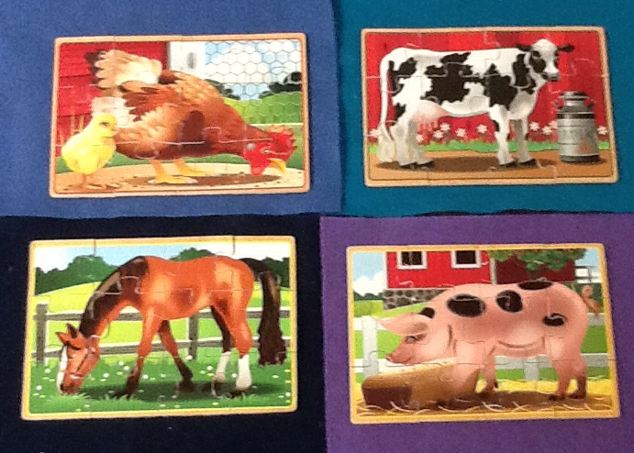
Wooden Farm Animal Puzzles
Notes:
Vacation story.

Slide 6
Wooden Puzzle Activity 1
Experimental Design Issues
The Question:
  I want to know if some of these puzzles are easier to put together than others. What should I do?
  (Follow their lead; prompt only if necessary.)
    What should be measured?
    How should the data be collected?
    What should be randomized?
Notes:
ED: Follow their lead
Prompt when necessary
Run the experiment!
Paired test in: Does Learning Take Place

Slide 7
Wooden Puzzle Activity 2
Comparing Multiple Means
  Data collected during one class period
  I timed all subjects
  Data set posted for students to analyze
  Results discussed the following class
  (Curious Gender Differences)

Slide 8
Wooden Puzzle Activity 3
Does Learning Take Place?
  Data collected during one class period
  Students worked in pairs
    Students were randomized to the puzzle stations and to the individual puzzles
    Those not at the puzzle stations were completing a group assignment
  Data set posted for students to analyze
Notes:
Describe differences in approaches.
State p-values obtained last semester.

Slide 9
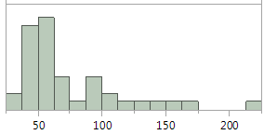
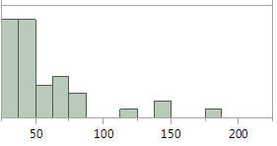
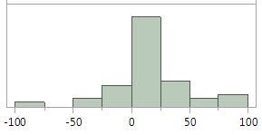
Does Learning Take Place?
(Differences: First – Second)
Average Difference: 18 seconds
Statistically Significant Results
  Individual Times: Right Skewed
First try Second try
Differences: Fairly Symmetric
  Differences

Slide 10
Does Learning Take Place?
Puzzling Statistics
Pig puzzle p-value: 0.003
Chicken puzzle p-value: 0.045
Horse puzzle p-value: 0.060
Cow puzzle p-value: 0.317

Slide 11
Use what you have CREATIVELY!
  Your Students
  Their playfulness
  Their zest for competition
  Handy Items
  Cards, Dice, Tacks, etc.
  Stopwatch: online or on cell phone
  Create some Experiments!
Notes:
Wake them up at 8am !!!!
Use data another day.

Slide 12
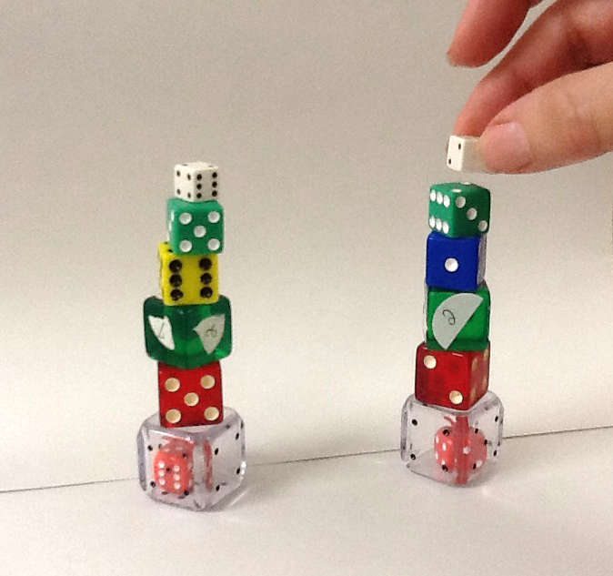
Dice Stacking

Slide 13
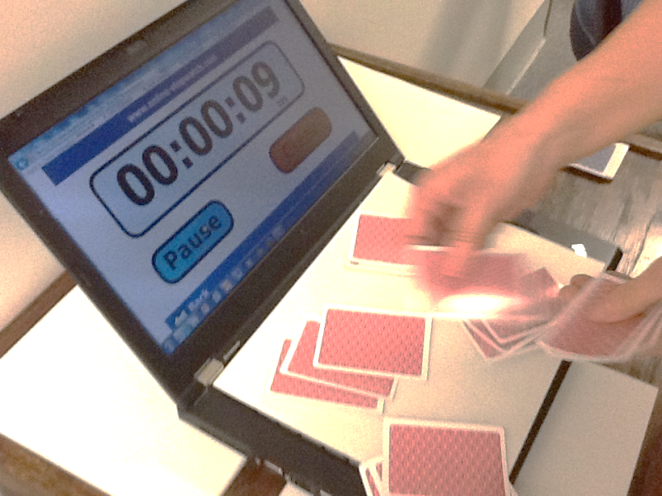
Card Dealing

Slide 14
Three Tasks Experiment
Stack the dice
Deal the cards
Say the alphabet
A b c d E f g
Q r s T u v
H i j k L m n o p
W x Y Z

Slide 15
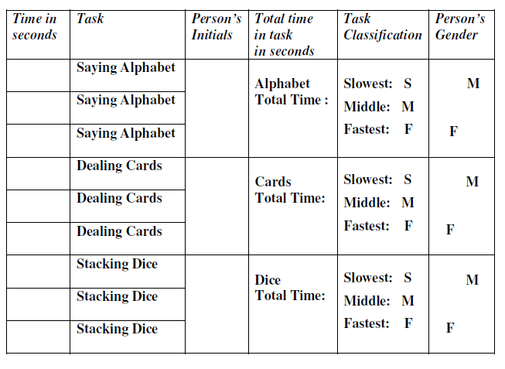
Three Tasks Data Sheet

Slide 16
Three Tasks Experiment
(Less than 10 seconds a task)
Alphabet
Cards
Dice

Slide 17
Use what you have CREATIVELY!
  Campus/Personal Resources
  Pinecones / Textbooks / Stones
  Calipers / Springs / Scales / Resistors
  Bean Bags / Hula Hoops / Balls
  Rulers / Meter Sticks / Tape measures
  Student bodies
Notes:
Make friends across campus.

Slide 18
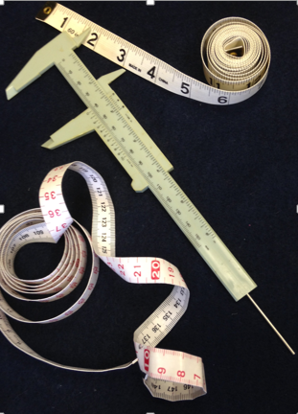
Student Body Experiment 1
What’s Correlated?
  Pretty Woman: Which two of the following six measurements did Julia Roberts compare when talking to Richard Gere shortly after getting into the car with him at the beginning of the movie?
  Forearm Wrist
  Index Finger Height
  Navel to Floor Foot

Slide 19
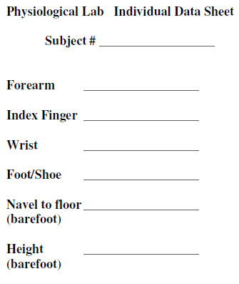
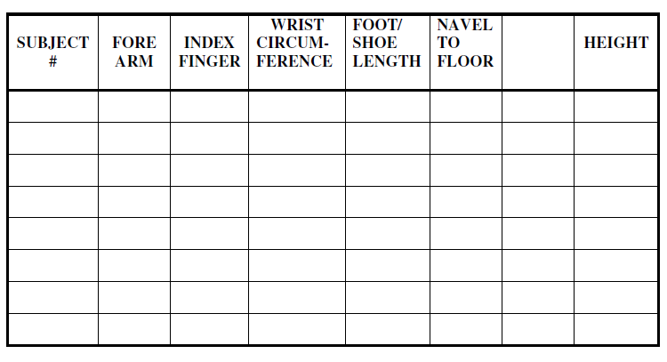
Student Body Experiment 1
Data Sheets

Slide 20
Student Body Experiment 2
The Experiment Presented:
  Today we are going to see how long you stand on one foot with your hands folded in front of you.
  Stand up. Fold your hands in front of your waist. Stand on one foot NOW.
The Question of Interest: What’s Related?
Foot preference Thumb on top
Hand dominance Eye dominance

Slide 21
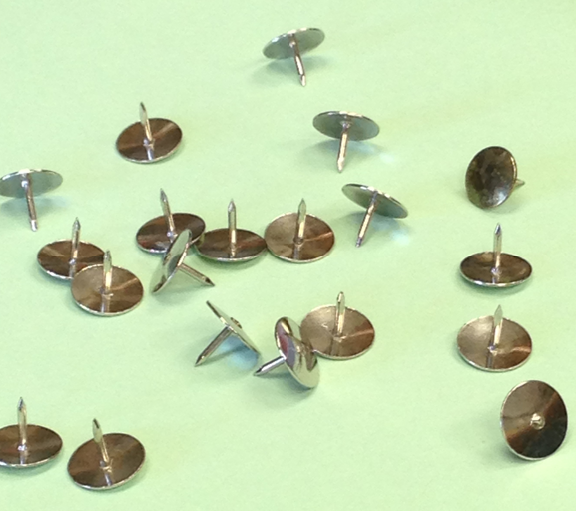
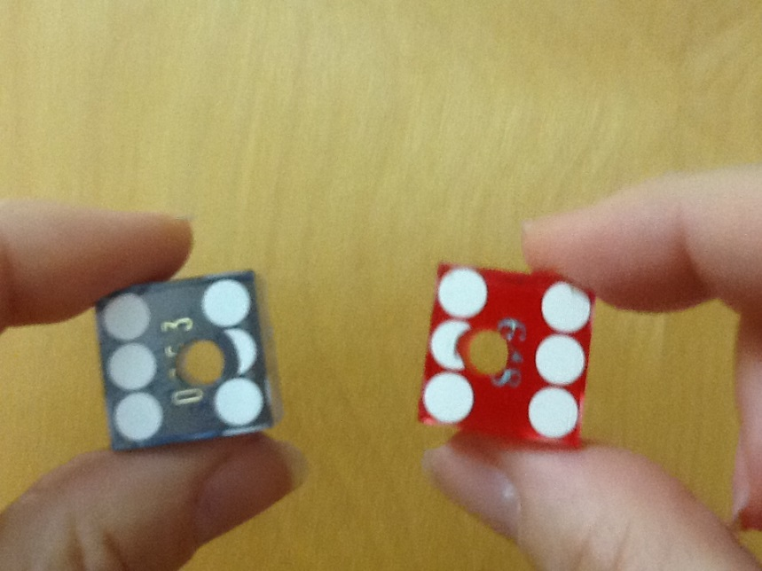
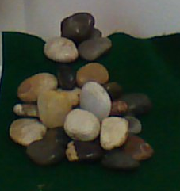
Sampling Distribution Day

Slide 22
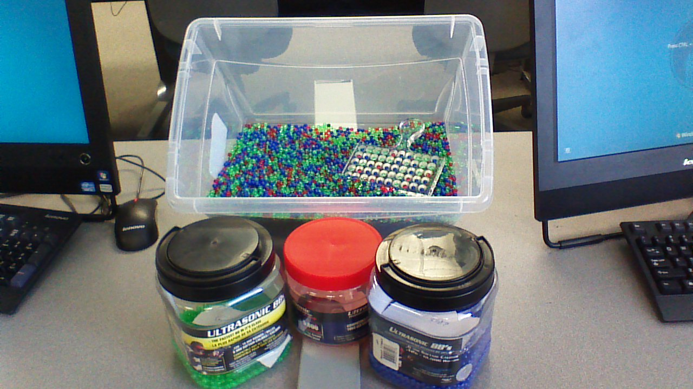
BBs Sampling Bowl
Notes:
20,300 counted by me and Kevin.

Slide 23
Sampling Distribution Stations
(known and unknown distributions)
Tacks (point up)
Casino Dice (3’s and 4’s)
BB Bowl (greens)
Regular Dice (odds) (10 and 20)
Chips (above 1.5)
Mini Dice (6’s)
Sea Shells (avg wt 4 and 9)
Bead Bowl (non-white)
In and Out Dice (both odd)
Stones (avg wt 9)

Slide 24
Sampling Distribution Day
Students work in pairs
4 minutes per station
6-8 rotations
At the end of data collection students take data sheets and compute means and standard deviations of sample means or sample proportions

Slide 25
Data Collection Sheets (very low tech)

Slide 26
Student Data Sheet

Slide 27
Sampling Distribution Day
End of Hour Discussion includes:
Comparing average values of observed proportions to theoretical value of the known distributions
Comparing standard deviations of observed proportions from the same experiment but with different sample sizes
Average value for percentage of tacks landing point up is discussed

Slide 28
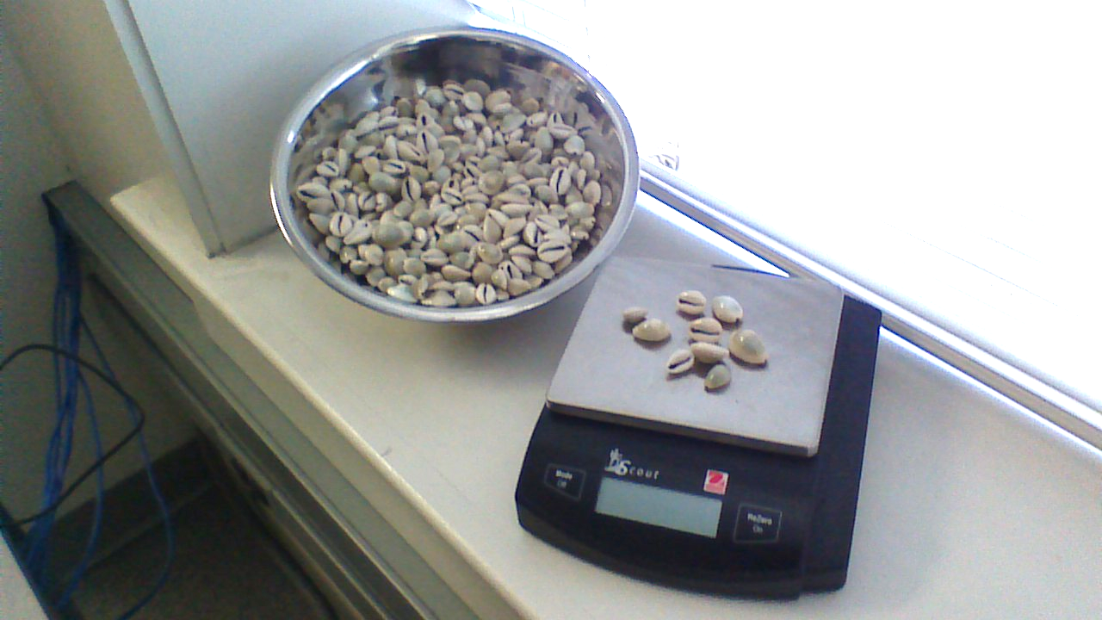
Sea Shells

Slide 29
Sea Shell Average Weights
Average Weight of 4 Shells
Mean of Averages 1.807
Std Dev of Averages 0.46
Mean of Averages 1.781
Std Dev of Averages 0.31
Average Weight of 9 Shells

Slide 30
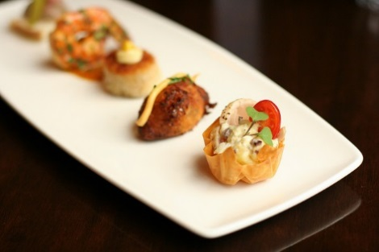
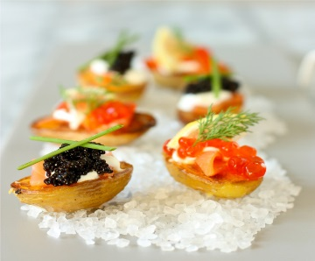
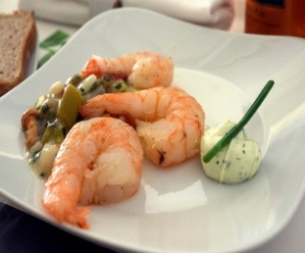
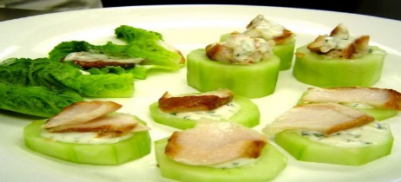
To Summarize:
BE Adventurous!
HAVE Fun!
ENJOY the UnexPecTed.

Slide 31
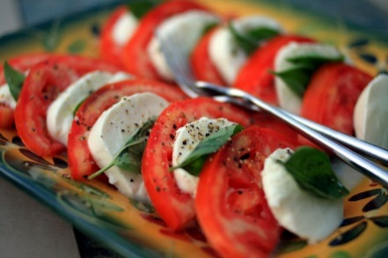
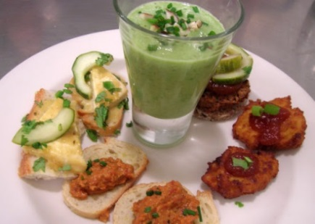
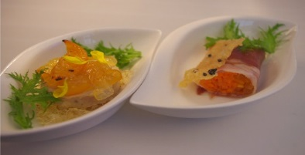
Hope you can use
some of these
bite-size ideas!
André

