Slide 1
The Development and Evolution of an Introductory Statistics Course for In-Service Middle-Level Mathematics Teachers
Kendra K. Schmid*, Erin E. Blankenship*, April T. Kerby, Jennifer L. Green, and Wendy M. Smith
*Presenting Authors

Slide 2
Outline
Math in the Middle Institute
Statistics for Middle-Level Teachers
  Course Goals
  Course content and changes in first cohort
  Subsequent cohorts
  Assessment and Grading
  Examples
Where are we now?
Questions/Comments/Suggestions

Slide 3
Math in the Middle Institute
36 Credit Hour degree program
Through their experience in M², teachers will:
  Build strong mathematics and content knowledge
  Study and practice the art of pedagogy
  Develop the ability to conduct action research about their teaching practices
  Cultivate leadership skills
  Apply this knowledge and skill in their classrooms, schools and districts

Slide 4
Math in the Middle Institute

Slide 5
Statistics for Middle Level Teachers
Course Goals
  Help teachers better understand statistical concepts and how to relay these ideas to their students
  Help teachers improve their statistical reasoning and thinking
  Help teachers understand statistical information on their students and in educational research
  Prepare for action research projects

Slide 6
Statistics for Middle Level Teachers-first offering

Slide 7
Statistics for Middle Level Teachers-cohort revisions

Slide 8
Assessment
Daily Homework
Habits of Mind Problems
Project (Cohort 3 and later)
End of Course Assignment
  Problems
  Lesson Plan
  Super 7 with reflections

Slide 9
Grading

Slide 10
Lesson Plan Example

Slide 11
Lesson Plan Example

Slide 12
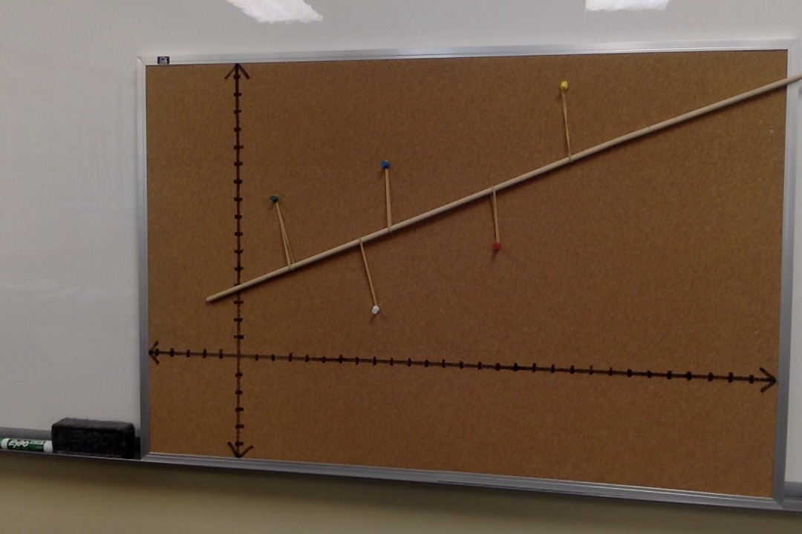
Lesson Plan Example

Slide 13
What made planning and delivering this course different/challenging?
Condensed time period
Background of “students”
Experience of “students”
Balancing between what they needed and our thoughts about what an intro stat class “should” cover
Not being prepared for the personality of the group

Slide 14
What made this course successful?
Instructional Team
Master Teacher
  Extremely important part of the team
  Graduates become Master Teachers for future cohorts
  Some graduates and previous assistants are lead instructors
Flexibility and ability to adapt
Tailoring material to audience through examples, project, and discussion

Slide 15
Where are we now?
Several more courses have been taught for Middle-Level teachers. First 4 cohorts were in Lincoln, additional cohorts in Omaha, and a few more around the state.
Part of Nebraska Math and Science Summer Institute
Other courses have been developed as “spin-offs” of this class
  Statistics for HS Teachers (in-service)
  Statistics for Elementary Teachers (pre-service)

Slide 16
Questions/Comments/
Suggestions
Math in the Middle Institute funded by National Science Foundation, EHR 0412502

