Slide 1
Teaching an Application of Bayes’s Rule for Legal Decision-Making: Measuring the Strength of Evidence
Eiki Satake and Amy Vashlishan-Murray, Emerson College, Boston MA

Slide 2
Research Questions
Research Questions:
1. Does experimental group ( presenting Bayes' Rule through Legal Scenario) perform better than their counterparts in Control Group ( without Legal Scenario)?
2. Is there any significant difference in attitude change between two groups?
3. What are pedagogical merits?

Slide 3
Abstract
Although Bayesian methodology has become a powerful approach for describing uncertainty, it has largely been avoided in undergraduate statistics education. Here we demonstrate that one can present Bayes' Rule in the classroom through a hypothetical, yet realistic, legal scenario designed to spur the interests of students in introductory- and intermediate-level statistics classes. The teaching scenario described in this paper not only illustrates the practical application of Bayes' Rule to legal decision-making, but also emphasizes the cumulative nature of the Bayesian method in measuring the strength of several pieces of the evidence presented at a trial by Bayes’ Factor, as an alternative to p value and hypothesis tests, to determine the defendant’s status of guilt.

Slide 4
Philosophical Foundation
George Polya's heuristics, "examining several consequences in succession," relates to legal decision-making with a Baysian mindset. The main objective of this proposal is to measure the credibility of a certain conjecture A (i.e. "An accused is legally guilty.") based on several pieces of the evidence (B₁, B₂, B₃… of the conjecture A) presented at a criminal trial. Polya argues that the increment of the credibility of A always depends on the strength of the evidence B₁, B₂, B₃, etc. In considering the process followed in examining of consequences of possible actions or in testing the credibility of rival or conflicting conjectures ('Guilty" or "Not Guilty") in a criminal court case, the quantification of probabilities may provide a more explicit demonstration of the predictability of a particular outcome for students.

Slide 5
Relevance of Bayes’ Rule to a Hypothetical Legal Scenario
The body of a 22-year-old woman is found stabbed to death in her Western Massachusetts home. There is sign of a struggle evident in the room and on the body, but there is no evidence of sexual assault. Bloodstains are found in the area surrounding where the body was discovered.
Following interviews with the victim’s family and friends, investigators are without a major lead and are unable to suggest a motive for the crime. DNA is extracted from the skin cells found under the victim’s fingernails that were presumably taken from the perpetrator during the struggle. A DNA search is done against the FBI’s CODIS database and a match is found to a Caucasian male individual, who becomes the primary suspect. During the investigation, a knife of a style and size consistent with the victim’s injuries is found in a near-by dumpster and a partial fingerprint is lifted from the knife.

Slide 6


Equation 1

Slide 7


Equation 2

Slide 8

Equation 3
(Posterior Odds) = (Prior Odds) • (Bayes Factor)

Slide 9
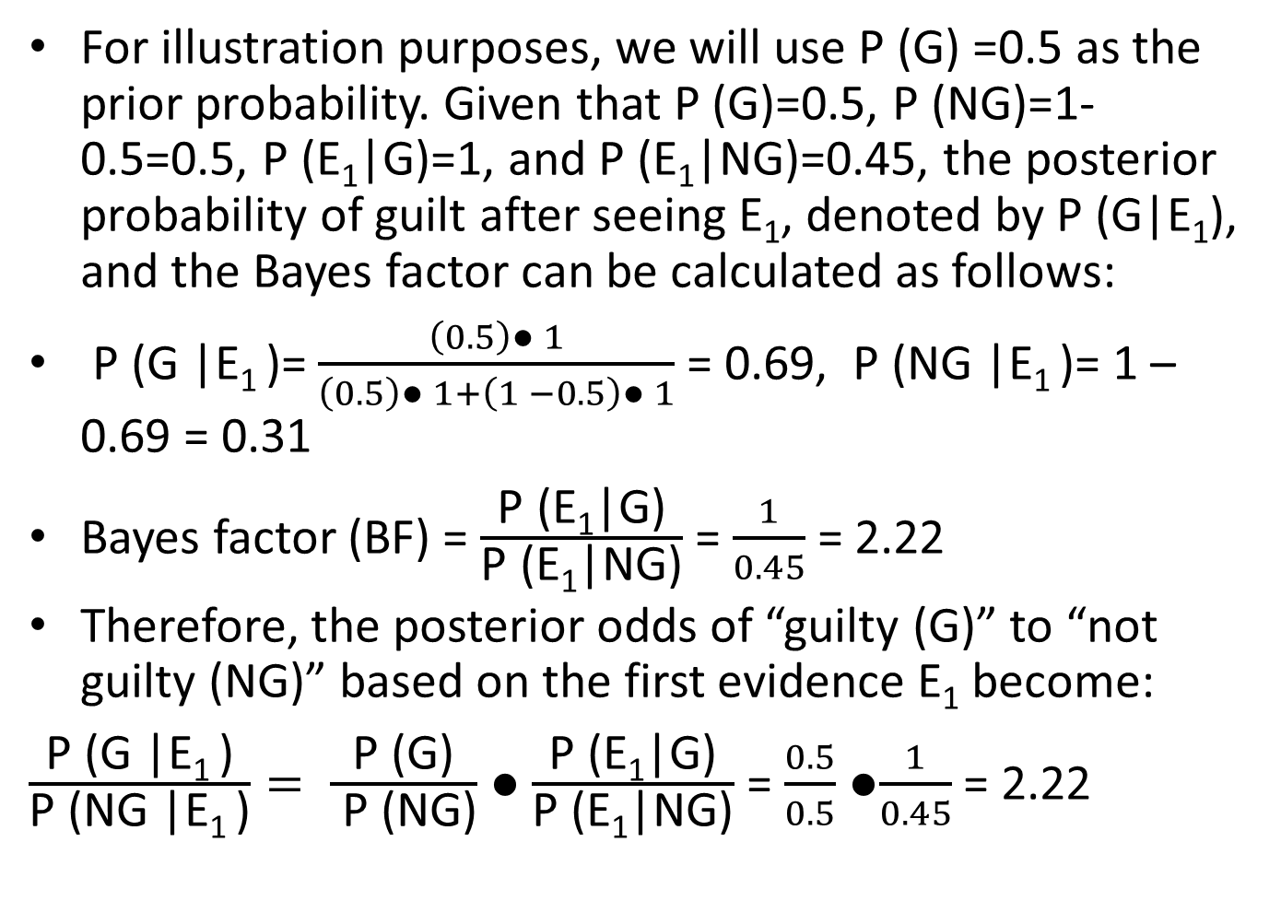

Evidence ($E_{1}$)---Blood Type Matching
For illustration purposes, we will use P (G) =0.5 as the prior probability. Given that P (G)=0.5, P (NG)=1-0.5=0.5, P (E₁|G)=1, and P (E₁|NG)=0.45, the posterior probability of guilt after seeing E₁, denoted by P (G|E₁), and the Bayes factor can be calculated as follows:
P (G |E₁ )= $\frac{\left(0.5\right)● 1}{\left(0.5\right)● 1+\left(1 −0.5\right)● 1}$ = 0.69, P (NG |E₁ )= 1 – 0.69 = 0.31
Bayes factor (BF) = $\frac{\text{P}\text{ (}\text{E}\text{1}\text{|}\text{G}\text{)}}{\text{P}\text{ (}\text{E}\text{1}\text{|}\text{NG}\text{)}}$ = $\frac{1}{0.45}$ = 2.22
Therefore, the posterior odds of “guilty (G)” to “not guilty (NG)” based on the first evidence E₁ become:
$\frac{\text{P}\text{ (}\text{G}\text{ |}\text{E}\text{1 }\text{)}}{\text{P}\text{ (}\text{NG}\text{ |}\text{E}\text{1 }\text{)}}= \frac{\text{P}\text{ (}\text{G}\text{)}}{ \text{P}\text{ (}\text{NG}\text{)}}$ ● $\frac{\text{P}\text{ (}\text{E}\text{1}\text{|}\text{G}\text{)}}{\text{P}\text{ (}\text{E}\text{1}\text{|}\text{NG}\text{)}}$ = $\frac{0.5}{0.5}$ ●$\frac{1}{0.45}$ = 2.22

Slide 10

Evidence ($E_{1}$)---Interpretation
After the presentation of the first piece of evidence, E₁, the probability of the defendant being guilty has increased from 0.5 to 0.69. also, Bayes Factor of 2.22reveals that the credibility of E₁ is 2.22 times greater under the assumption of guilty (G) than it is under the assumption of not guilty (NG). In other words, this shows that the defendant is 2.22 times more likely to be “guilty” than “not guilty.” after seeing the evidence E₁.

Slide 11
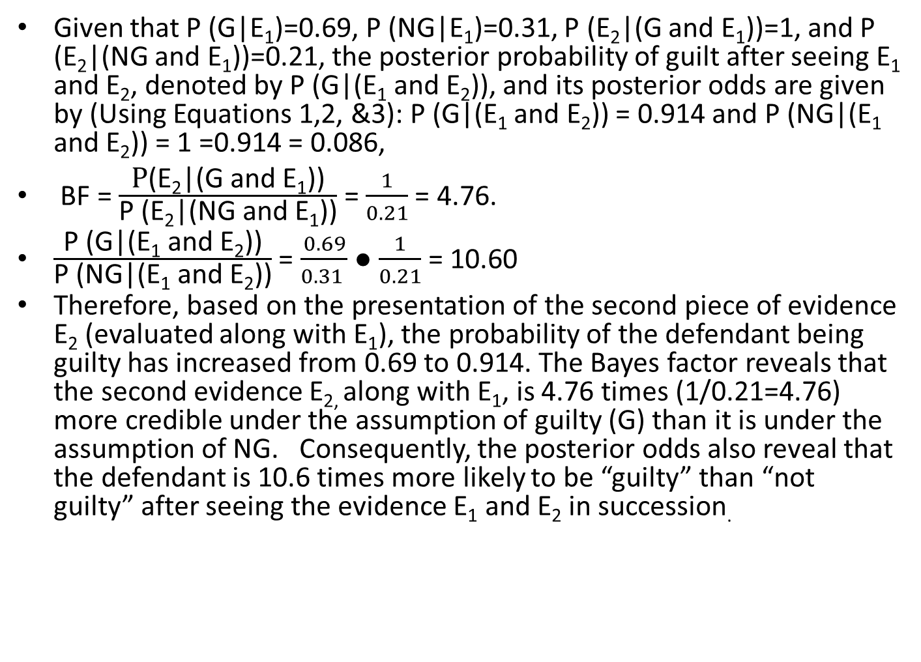
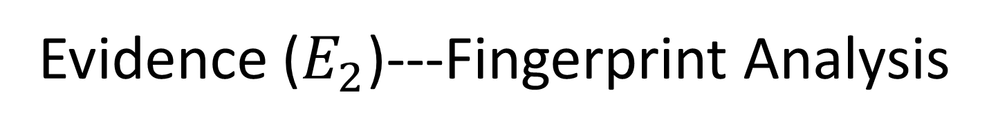
Evidence ($E_{2}$)---Fingerprint Analysis
Given that P (G|E₁)=0.69, P (NG|E₁)=0.31, P (E₂|(G and E₁))=1, and P (E₂|(NG and E₁))=0.21, the posterior probability of guilt after seeing E₁ and E₂, denoted by P (G|(E₁ and E₂)), and its posterior odds are given by (Using Equations 1,2, &3): P (G|(E₁ and E₂)) = 0.914 and P (NG|(E₁ and E₂)) = 1 =0.914 = 0.086,
BF = $\frac{\text{P}\text{(}\text{E}\text{2}\text{|(}\text{G} \text{and} \text{E}\text{1}\text{))}}{\text{P}\text{ (}\text{E}\text{2}\text{|(}\text{NG} \text{and} \text{E}\text{1}\text{))}}$ = $\frac{1}{0.21}$ = 4.76.
$\frac{\text{P}\text{ (}\text{G}\text{|(}\text{E}\text{1} \text{and} \text{E}\text{2}\text{))}}{\text{P}\text{ (}\text{N}\text{G}\text{|(}\text{E}\text{1} \text{and} \text{E}\text{2}\text{))}}$ = $\frac{0.69}{0.31 }$ ● $\frac{1}{0.21}$ = 10.60
Therefore, based on the presentation of the second piece of evidence E₂ (evaluated along with E₁), the probability of the defendant being guilty has increased from 0.69 to 0.914. The Bayes factor reveals that the second evidence E_{2,} along with E₁, is 4.76 times (1/0.21=4.76) more credible under the assumption of guilty (G) than it is under the assumption of NG. Consequently, the posterior odds also reveal that the defendant is 10.6 times more likely to be “guilty” than “not guilty” after seeing the evidence E₁ and E₂ in succession.

Slide 12
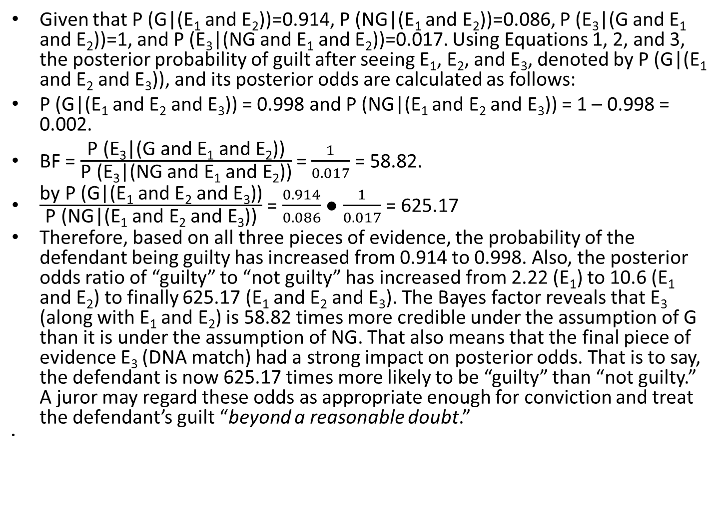

Evidence ($E_{3}$)---DNA Analysis
Given that P (G|(E₁ and E₂))=0.914, P (NG|(E₁ and E₂))=0.086, P (E₃|(G and E₁ and E₂))=1, and P (E₃|(NG and E₁ and E₂))=0.017. Using Equations 1, 2, and 3, the posterior probability of guilt after seeing E₁, E₂, and E₃, denoted by P (G|(E₁ and E₂ and E₃)), and its posterior odds are calculated as follows:
P (G|(E₁ and E₂ and E₃)) = 0.998 and P (NG|(E₁ and E₂ and E₃)) = 1 – 0.998 = 0.002.
BF = $\frac{\text{P}\text{ (}\text{E}\text{3}\text{|(}\text{G} \text{and} \text{E}\text{1} \text{and} \text{E}\text{2}\text{))}}{\text{P}\text{ (}\text{E}\text{3}\text{|(}\text{NG} \text{and} \text{E}\text{1} \text{and} \text{E}\text{2}\text{))}}$ = $\frac{1}{0.017}$ = 58.82.
$\frac{\text{by} \text{P}\text{ (}\text{G}\text{|(}\text{E}\text{1} \text{and} \text{E}\text{2} \text{and} \text{E}\text{3}\text{))}}{\text{P}\text{ (}\text{N}\text{G}\text{|(}\text{E}\text{1} \text{and} \text{E}\text{2} \text{and} \text{E}\text{3}\text{))}}$ = $\frac{0.914}{0.086}$ ● $\frac{1}{0.017}$ = 625.17
Therefore, based on all three pieces of evidence, the probability of the defendant being guilty has increased from 0.914 to 0.998. Also, the posterior odds ratio of “guilty” to “not guilty” has increased from 2.22 (E₁) to 10.6 (E₁ and E₂) to finally 625.17 (E₁ and E₂ and E₃). The Bayes factor reveals that E₃ (along with E₁ and E₂) is 58.82 times more credible under the assumption of G than it is under the assumption of NG. That also means that the final piece of evidence E₃ (DNA match) had a strong impact on posterior odds. That is to say, the defendant is now 625.17 times more likely to be “guilty” than “not guilty.” A juror may regard these odds as appropriate enough for conviction and treat the defendant’s guilt “beyond a reasonable doubt.”

Slide 13
Posterior Probability Matrix Table
Prior P (G) | .0001 | .001 | .01 | .05 | .10 | .25 | .50
After E₁ | .00022 | .00222 | .0220 | .105 | .198 | .426 | .690
After E₂ | .00105 | .0105 | .0968 | .358 | .540 | .779 | .914
After E₃ | .0582 | .384 | .863 | .970 | .986 | .995 | .998
P (G|(∩E_{n})) | .0582 | .384 | .863 | .970 | .986 | .995 | .998

Slide 14
Pedagogical Value
For evaluation of student interest and learning we worked with 88 students enrolled in 3 sections of an undergraduate Introductory Statistics course. Following an uniform introduction to conditional probability, students then spent the following two class meetings either learning Bayesian methods as presented in their class text (Peck, Olsen, and Devore, 2012) (“standard presentation group,” 1 section, 33 students) or via our legal scenario (“case study group,” two sections, 55 students). The same amount of class time was spent covering Bayes’ Rule in both cases and the same instructor taught each group. Students were randomly assigned to sections after having completed four years of high school mathematics at the time of their enrollment and a placement exam. All students are studying or intend to study one of seven fields whose majors that require a statistics course (political science, psychology, sociology, nursing, criminal justice, education, or liberal arts).

Slide 15
Findings (1)
While there was no significant difference between the pre-presentation responses of the two groups, the post-presentation responses of the group exposed to the case study showed a significant increase in agreement (p<0.001 t-test) with all four statements that probed into student interest in the material, engagement in class, and belief that the lesson had real-life applications , as compared to the standard presentation group.

Slide 16
Findings (pre- versus post-attitude) (2)
Additionally, students who were exposed to Bayesian probability through our case study demonstrated a significant increase in agreement with all 4 questions compared to their original survey responses (p<0.001, t-test), while there was no significant change in the responses of students in the “standard presentation” group. These data suggests that learning Bayesian probability via our case study is associated with an increase in student interest in the example used, engagement with the class material, intrigue with the approach, and perception that Bayes’ Rule is applicable to real life situations over a standard textbook presentation.

Slide 17
Findings (competency) (3)
Additionally, to serve as an object metric of how the teaching scenario impacts and promotes student understanding, students in both the “case study group” and the “standard presentation” group completed a quiz at the end of the third class meeting . The quiz was designed to demonstrate the applicability of Bayes’ Rule to a variety of different contexts (medical, mass communication, and politics) utilizing examples from a range of high quality educational materials focused on Bayesian probability. The three-item quiz was graded out of three points using a rubric that awarded partial points for setting up the equation correctly and selecting the appropriate numbers to use in the formula for Bayes’ Rule. Grading was performed blind to whether students learned Bayes’ Rule from the case study or presentation of the text. The average quiz score of the case study group was more than 57% higher than the average quiz score of the standard presentation group (p=0.001, t-test). This suggests that students who learned Bayes’ Rule from the case study were more successfully able to apply what they learned to other settings than those who learned though a traditional approach.

Slide 18
Faculty Feedback—Post Survey (1)
They commented that, in comparison to the standard approach, the case scenario highlights how Bayes’ Rule works in a cumulative, not a terminal way. “We can see how largely the various different prior probabilities influence their posterior probabilities,” said one faculty member, while another faculty member commented on how the case clearly illustrated the usefulness of Bayes’ Rule in calculating the posterior probability of a complex problem. The complexity of the type of problem to which Bayes’ Rule is applied was a source of criticism from one faculty member, who rejected the underlying premise that Bayesian Probability ought to be approached in an introductory statistics course.

Slide 19
Faculty Feedback---Post Survey (2)
All mathematics and statistics faculty members who were open to teaching Bayesian thinking at an introductory level, however, were enthusiastic about an approach that sought to connect to real life examples and make the approach relevant. “It is intellectually challenging and stimulating in every aspect,” concluded one faculty member.

Slide 20
The Authors’ Comment (1)
Lastly, the scenario also showed us that probabilities of guilt fluctuate to a smaller or larger extent, contingent upon the strength of evidence. This means, as the strength of the evidence increases or decreases for or against the defendant’s status of guilt, that the data are more able to convert a skeptic into a believer of the claim “the defendant is guilty.” Furthermore, the manner in which they are determined appears to favor a Bayesian rather than a classical statistics approach. In classical statistics, each event is treated independently with a p-value and/or α value to determine its statistical significance. The methodology used in classical statistics is not designed to consider and further calculate influencing factors that precede an event. Bayesian statistical methods, on the other hand, are designed to determine and evaluate phenomena by revising and updating probabilities in light of current and prior events.

Slide 21
The Authors’ Comment (2)
Regardless of the debate as to what approach to take in legal decision-making processes, the teaching of Bayes’ Rule within a course in introductory statistics has much to offer, particularly in light of the growing interest in Bayesian statistics as a research instrument in a wide range of disciplines and professions, especially the ones that are involved in and closely related to decision-making processes. Such applications have certainly made statistics educators aware that the Bayesian perspective should be emphasized more in introductory statistics courses to help students develop both deductive (general to specific) and inductive (specific to general) statistical reasoning, which are the essential components of statistical inference, and also to deepen their general knowledge about the subject matter of probability and statistical inference.

