Slide 1
Statistics Education: The Wikipedia Makeover
Ethan C. Brown, PhD student
brow3821@umn.edu
(with Dr. Joan Garfield, Elizabeth Fry, and N. Justice)
Department of Educational Psychology

Slide 2
Why Wikipedia?
Online encyclopedia that anyone can edit
Huge reference source
One of the most popular sites on the internet.
Ask your students: “What’s the first thing you do when you are researching a new topic?”

Slide 3
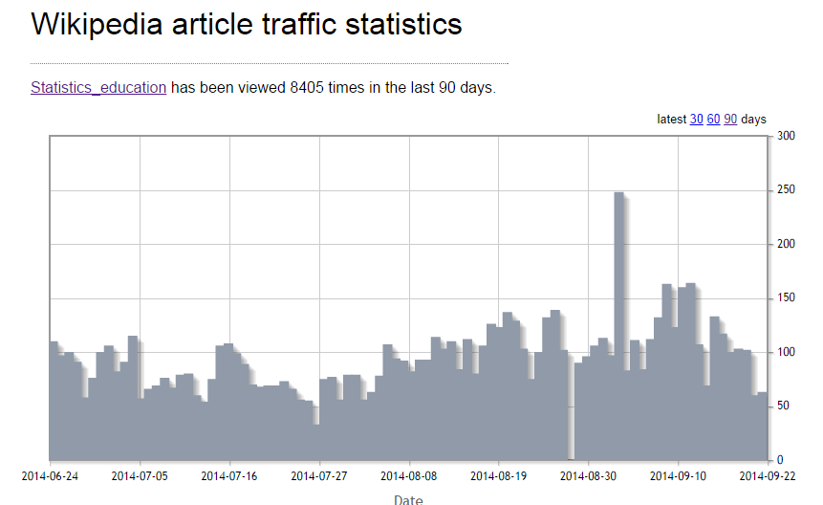
“Statistics education” article

Slide 4
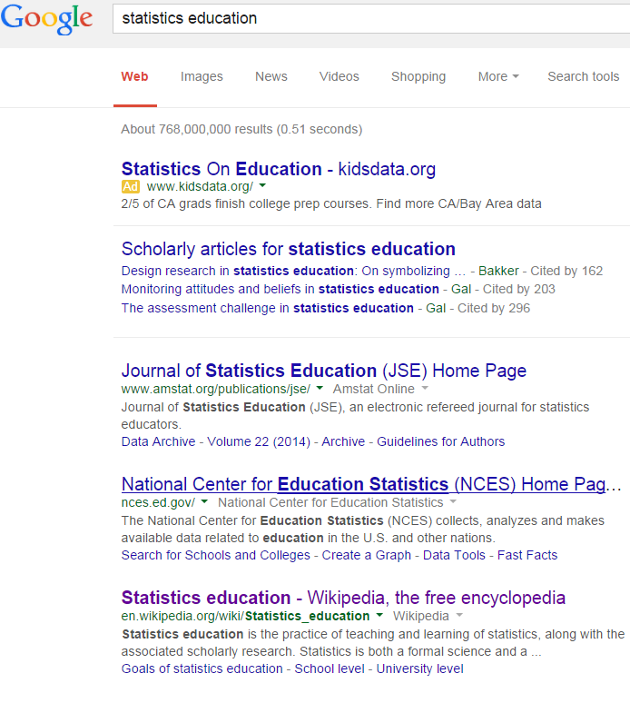
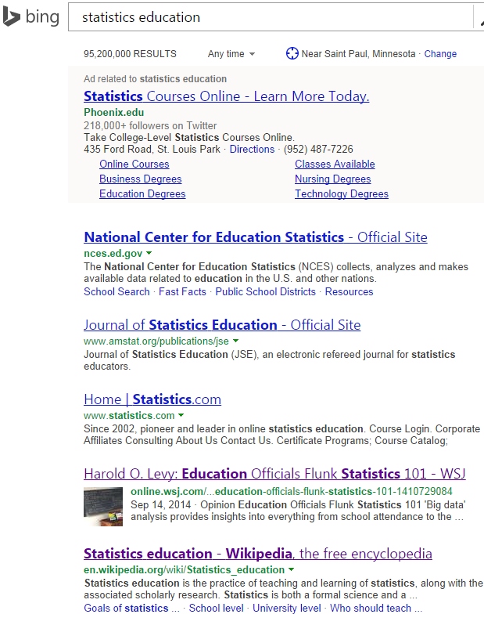
A top search hit

Slide 5
Opportunities
Dissemination. Provide readers with information about of the discipline, its goals, and its contributions.
Resource. Provide a community resource for statistics education.
Outlet. Pulled together some good references or an overview of a topic? Document so that others can find it.

Slide 6
The Makeover
In fall 2012, at the Research in Statistics Education Seminar at the University of Minnesota, we took a look at the article.
Old version of article

Slide 7
Issues we saw
Scattered, gave no idea of discipline
Rambling rant about randomized experiments in math education
Gave little idea of research & practice

Slide 8
Making changes
Team of 4 (Joan Garfield, myself, N. Justice, Elizabeth Fry) met regularly to make & discuss changes
Created outline and divided up work
Made edits & provided feedback on each other’s edits.

Slide 9
Much improved…
Current version
New sections on Goals of statistics education, Professional community, New directions
Removed some irrelevant material
Removed statement that statistics education is a kind of math education ☺

Slide 10
…but still a lot to do
Practices around the world
Standards
Discussion of different levels of statistics education (K-12, non-major intro, statistics majors, graduate training…)
Teacher development
History
etc.

Slide 11
Other relevant Wikipedia pages to look at/edit as well…
Statistical literacy
Informal inference
Representativeness heuristic
…and several others

Slide 12
Wikipedia: a low-hanging fruit
Wikipedia represents an opportunity to reach many internet users and act as a resource for our community
We can’t do this alone: join in!

Slide 13
How to Help
Email me (brow3821@umn.edu) with suggestions or things you’d like to add. Contributions should be accompanied by references.
Dive in and edit article directly
Add posts to the “talk” page of the article or to my Wikipedia talk page

Slide 14
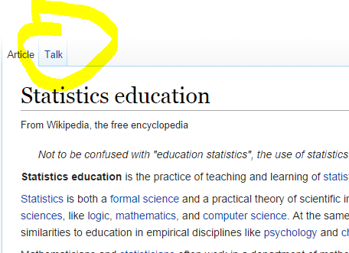
Adding to the talk page
Talk page is where discussions ABOUT the article happen

Slide 15
Caveats
Wikipedia community sometimes takes a bit of navigating. But, it’s better to jump in and ruffle feathers than to do nothing.
Organizations (e.g. CAUSE) are difficult to add pages for because there are higher standards for organizations (to prevent self-promotion)

Slide 16
That said, let’s jump in!
From official Wikipedia policy:
“If a rule prevents you from improving or maintaining Wikipedia, ignore it.”

Slide 17
Questions?
Feel free to contact me for any follow-up questions/comments:
Ethan Brown
brow3821@umn.edu
en.wikipedia.org/wiki/User:Statisfactions

