Slide 1



Everyone can read a histogram, or can they?
Jennifer J. Kaplan, UGA
Journal of Statistics Education (JSE) webinar
16 September 2014
Joint work with:
John Gabrosek, GVSU, Phyllis Curtiss, GVSU, Chris Malone, WSU

Slide 2
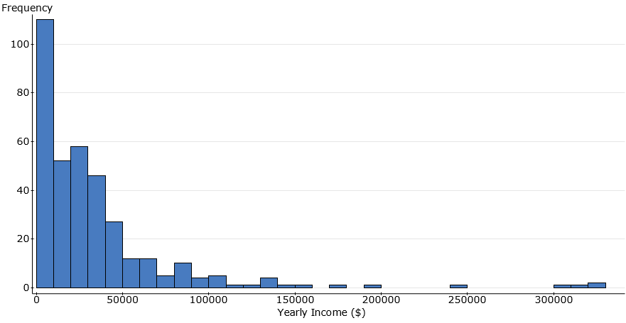
The histogram below shows the distribution of yearly income in dollars for a random sample of 356 adults living in Atlanta, GA.

Slide 3
The histogram below shows the distribution of yearly income in dollars for a random sample of 356 adults living in Atlanta, GA.
What is the purpose of histograms?
What makes a good, complete description of this display?
Notes:
Posing thought questions to discuss later

Slide 4
Common Misconceptions about Histograms
Not distinguishing between a bar chart and a histogram, and why this distinction is important.
Confusing the frequency (y-axis) information with the data values (x-axis).
Thinking that a flatter histogram equates to less variability in the data.
Viewing a histogram as a time plot believing (incorrectly) that values on the left side of the graph took place earlier in time.

Slide 5
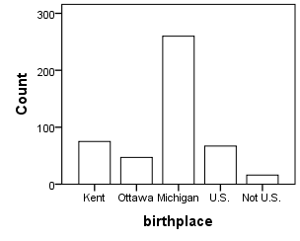
Misconception 1: Students don’t understand the distinction between a bar chart and a histogram, and why this distinction is important.
Can the median of the data be found?

Slide 6
Misconception 1: Students don’t understand the distinction between a bar chart and a histogram, and why this distinction is important.
The following graph shows the birthplace of students in a large introductory statistics course. Circle the letter of your choice.
Answer Choice | Pre | Post
A: The median is Michigan. | 25.5% | 25.9%
B: The median cannot be told from the graph but could be if more information were given. | 35.2% | 24.5%
C: The median cannot be found for this information even if we had the birthplace for each individual student. | 39.3% | 49.6%

Slide 7
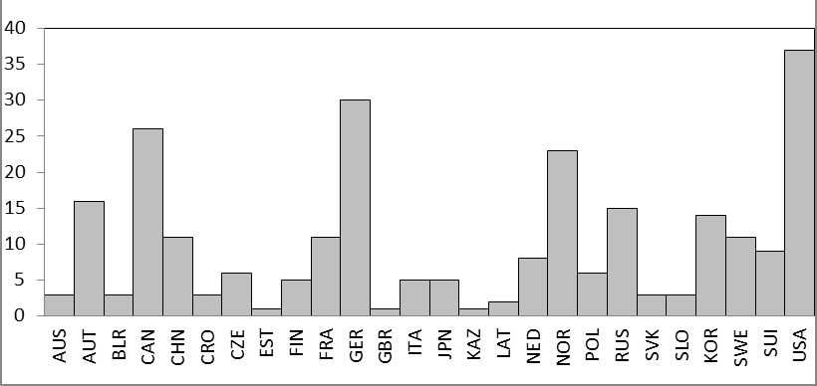
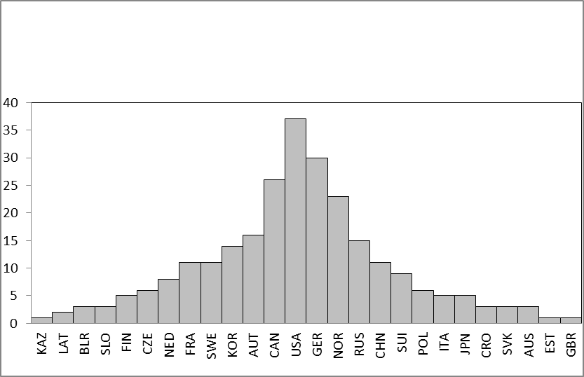
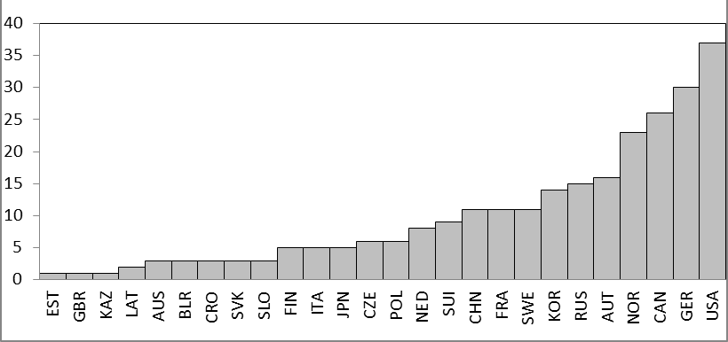
Which of the following graphs gives the best display of the distribution of number of medals won in that it allows the sports fan to describe the shape, center and spread of the variable, the number of medals won by countries that won at least one medal?
Which graph is a histogram?
A.
B.
C.
D.

Slide 8
Which of the following graphs gives the best display of the distribution of number of medals won in that it allows the sports fan to describe the shape, center and spread of the variable, the number of medals won by countries that won at least one medal?
A.
B.
C.
D.
Answer Choice | Pre | Post
A: Case value graph in order of data table | 20.2% | 7.3%
B: Case value graph ordered to look “bell-shaped” | 35.5% | 62.4%
C: Histogram | 10.6% | 16.1%
D: Case value graph ordered to look “increasing” | 33.7% | 14.2%
Notes:
Notice the number of students at the pre-test who now choose the bell-shaped graph as the correct graph.

Slide 9
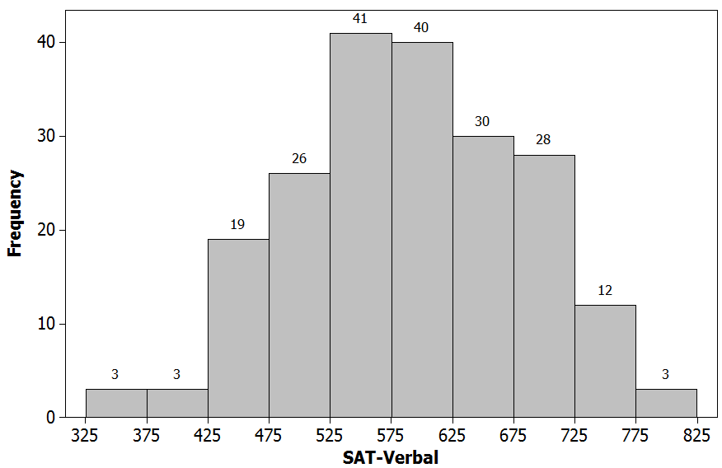
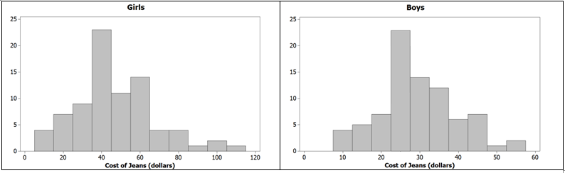
Misconception 2: Students use the frequency (y axis) instead of the data values (x axis) when reporting on the center of the distribution and the modal group of values.
Find the Median SAT score.
Which group has the larger mode?

Slide 10
Misconception 2: Students use the frequency (y axis) instead of the data values (x axis) when reporting on the center of the distribution and the modal group of values.
Find the Median SAT score.
~ 75% correct
Which group has the larger mode?
Notes:
55% Girls, vs. 40% same in pre-test, opposite in post-test. Take home message: these questions did not function well. Need more research on this misconception.

Slide 11
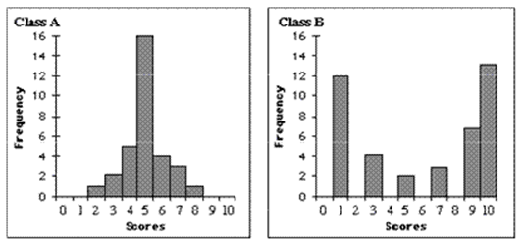
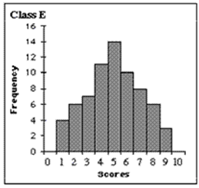
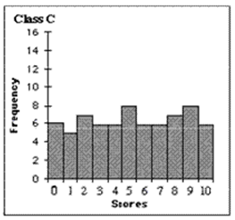
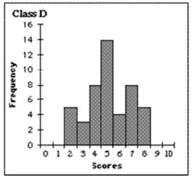
Misconception 3: Students believe that a flatter histogram exhibits less variability than bumpy histograms.
Which data set has the least variability?

Slide 12
Misconception 3: Students believe that a flatter histogram exhibits less variability than bumpy histograms.
Which data set has the least variability?
Answer Choice | Pre | Post
A: The one with the large center peak because it has the most values close to the mean. | 18.5% | 26.2%
B: The U-shaped one because it has the smallest number of distinct scores. | 7.5% | 3.3%
C: The uniform one because there is no change in scores. | 58.8% | 48.3%
D: Either the one with the center peak or the bumpy one, because they both have the smallest range. | 9.2% | 6.3%
E: The bell shaped one because it looks the most normal. | 6.0% | 15.9%
Notes:
While the scores improved to a value higher than that which would occur based on random quessing, notice that nearly 50% of the students are still looking at the tops of the bars for the degree of change and that nearly 16% now choose the bell-shaped graph as the correct response.

Slide 13
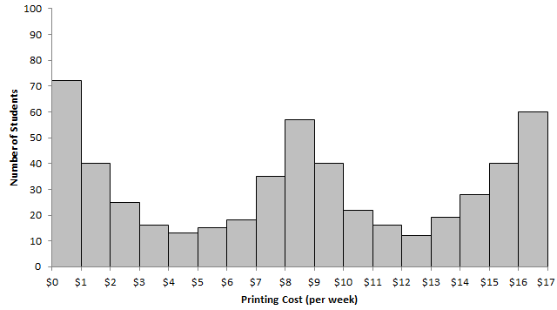
Misconception 4: For data that has an implied (though not collected) time component, students read the histogram as a time plot believing (incorrectly) that values on the left side of the graph took place earlier in time.
Are there three times during the semester in which students spend a lot of money?

Slide 14
Misconception 4: For data that has an implied (though not collected) time component, students read the histogram as a time plot believing (incorrectly) that values on the left side of the graph took place earlier in time.
There appears to be three times during the semester (beginning/middle/end) in which students spend a lot of money on printing at this college.
Answer Choice | Pre | Post
True | 36.3% | 33.8%
False | 63.7% | 66.2%
Notes:
This question did not function well and needs more research.

Slide 15
Common Misconceptions about Histograms
Not distinguishing between a bar chart and a histogram, and why this distinction is important.
Confusing the frequency (y-axis) information with the data values (x-axis).
Thinking that a flatter histogram equates to less variability in the data.
Viewing a histogram as a time plot believing (incorrectly) that values on the left side of the graph took place earlier in time.
Notes:
Evidence for misconceptions 1 and 3, need to do more work on 2 and 4. Some take home messages: Be aware, particularly when working with both categorical and quantitative variables to communicate clearly with clients the differences between data displays (and, perhaps, analyses), when considering displays of quantitative data be sure clients understand what each axis measure and the message in the graph, and be aware that clients who have had statistical training may have come away with the idea that a bell-shaped graph is always the correct answer.

Slide 16
The histogram below shows the distribution of yearly income in dollars for a random sample of 356 adults living in Atlanta, GA.
What is the purpose of histograms?
What makes a good, complete description of this display?
Notes:
Recall thought questions. Discuss purpose here. Statistical consulting graduate students answered “to check model assumptions.”

Slide 17
The histogram below shows the distribution of yearly income in dollars for a random sample of 356 adults living in Atlanta, GA.
What is the purpose of histograms?
What makes a good, complete description of this display?
Notes:
In statistics education, it is a means to get to inference – whether from CLT or randomization perspective.

Slide 18
The histogram below shows the distribution of yearly income in dollars for a random sample of 356 adults living in Atlanta, GA.
What is the purpose of histograms?
What makes a good, complete description of this display?
Notes:
Recall thought questions. Discuss purpose here. Statistical consulting graduate students answered “to check model assumptions.”

Slide 19
The histogram below shows the distribution of yearly income in dollars for a random sample of 356 adults living in Atlanta, GA.
Shape, Center, Variability in Context.
Notes:
How responses were coded, based on AP statistics rubric, but aligned with the work of New Zealand statistics educators.

Slide 20
Student Descriptions of Histograms
Pre-Instruction vs. Post Instruction:
Three Prompts:
Describe as completely as possible the distribution shown in the histogram, being sure to explain what the graph tells you about yearly income for adults in Atlanta.
Describe as completely as possible what the graph tells you about yearly income for adults in Atlanta.
Describe as completely as possible the distribution shown in the histogram.

Slide 21
Student Descriptions of Histograms
Pre-Instruction vs. Post Instruction:
“College students tend to get 6 to 8 hours of sleep at night.”
“The graph is unimodal and symmetric with median 7.”
Notes:
Students seem to lose the story telling aspect and list what they think are the important numeric components.

Slide 22
Student Descriptions of Histograms
Three Prompts:
Describe as completely as possible the distribution shown in the histogram, being sure to explain what the graph tells you about yearly income for adults in Atlanta.
Describe as completely as possible what the graph tells you about yearly income for adults in Atlanta.
Describe as completely as possible the distribution shown in the histogram.

Slide 23
Student Descriptions of Histograms
Three Prompts:
Describe as completely as possible the distribution shown in the histogram, being sure to explain what the graph tells you about yearly income for adults in Atlanta.
Describe as completely as possible what the graph tells you about yearly income for adults in Atlanta.
Describe as completely as possible the distribution shown in the histogram.
More likely to have context.
“The graph is right skewed.”

Slide 24
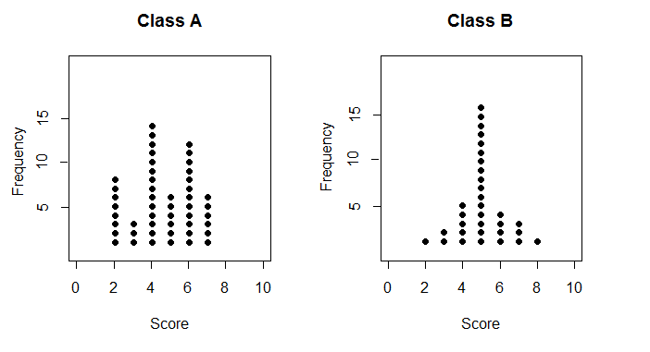
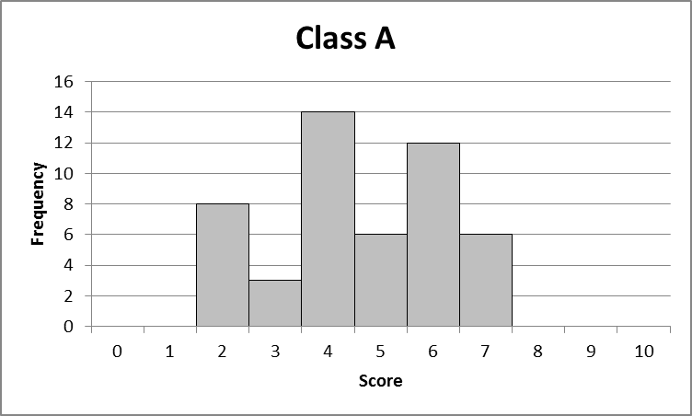
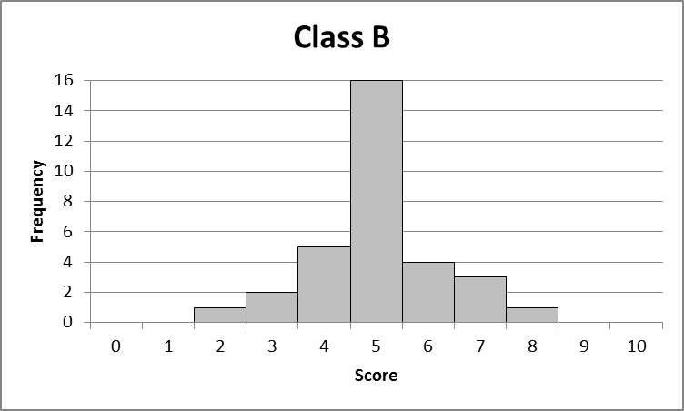
Future Directions
Notes:
We aren’t ready to make suggestions for classroom instruction, though clearly we need to think a bit more about how we are teaching histograms and their importance and use. We have thought about whether making a clearer transition between dot plots, in which all of the data points are evident, and histograms, which aggregate the data, will help students understand and read histograms. We are collecting data this semester to see if students are any better at judging variability in dotplots than they are in histograms.
We are collecting descriptions of histograms with other shapes to see if the findings hold and asking students to answer a questions about the information in the histogram that does not require a description.
We have more data collected on the questions that did not provide good information about student understanding.

Slide 25


Thank You!
for your attention
Research funded in part by NSF DUE 1322962
Questions?
Kaplan, J.J., Gabrosek, J.G., Curtiss, P. & Malone, C. (2014). Investigating student understanding of histograms. Journal of Statistics Education, 22(2). http://www.amstat.org/publications/jse/v22n2/kaplan.pdf

