Slide 1




Discovery Projects in Statistics: Implementation Strategies and Examples of Student Projects
Journal of Statistics Education
Webinar Series
February 18, 2014
This work supported by NSF grants DUE-0633264 and DUE-1021584
Brad Bailey
Dianna Spence

Slide 2


Agenda
Description of Student Projects
  Scope & Distinguishing Features
  Supporting Curriculum Materials
  Implementation Details
  Samples of Student Projects
Impact on Student Outcomes
  Phase I Results (Complete)
  Phase II Results (In Progress)

Slide 3


Projects
Overview
Elementary (non-calculus) statistics course
Topics: linear regression and t-test
Distinguishing Features
Highly student-directed
Intended as vehicle of instruction, not as culminating project after instruction

Slide 4
Projects
Student tasks
Identify research questions
Define suitable variables, including how
to quantify and measure variables
Submit project proposal and obtain approval
Collect data (design method)
Analyze and interpret data
Write a report on methods and results
Present research and findings to class

Slide 5
Available Resources
Student Guide
Instructor Guide
Technology Guide
Appendices
  A – E: for students and instructors
  T1 – T3: for instructors
Available online:
http://faculty.ung.edu/DJSpence/NSF/materials.html

Slide 6


Slide 7

Sources of Data: 3 Categories
Administer surveys
  Student constructs a survey
  and has people fill it out
Find data on the Internet
Physically go out and record data
  e.g., measure items, time events
  with a stopwatch, look at prices,
  look at nutrition labels

Slide 8
Surveys:
Constructs and Instruments
Example: A construct to measure stress
Please mark each statement that is true about you.
__If I could stop worrying so much, I could accomplish a lot more.
__Currently, I have a high level of stress.
__In this point in my life I often feel like I am overwhelmed.
__I have a lot to do, but I just feel like I can’t get ahead or even sometimes keep up.
__I often worry that things won’t turn out like they should.
__I have so much going on right now, sometimes I just feel like I want to scream.
Score “1” for each checked box. Range is 0 to 6, with higher numbers indicating higher levels of stress.

Slide 9
Internet Data Sources
I. Government/Community
Census Bureau:
http://www.census.gov/
Bureau of Justice Statistics: http://bjs.ojp.usdoj.gov/index.cfm?ty=daa
City Data Site:
http://www.city-data.com/
State and county statistics sites
State and national Dept.’s of Education
County tax assessment records

Slide 10
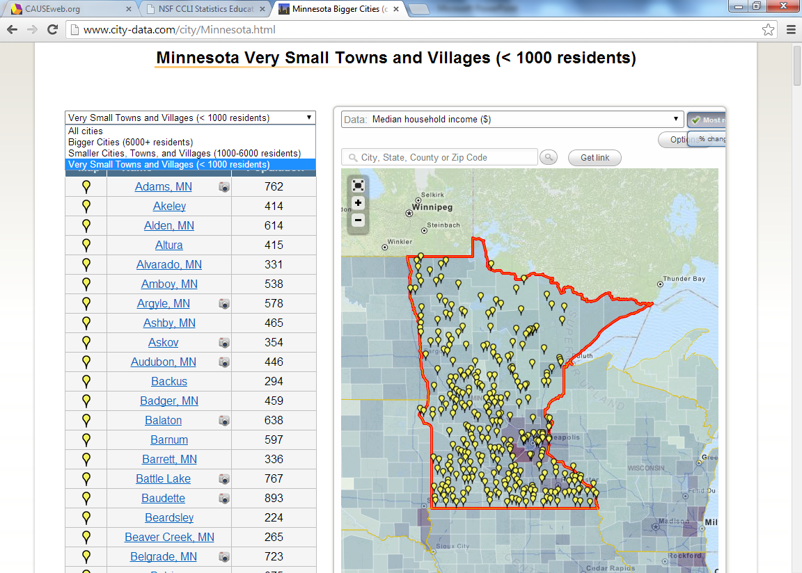
Example: City Data

Slide 11
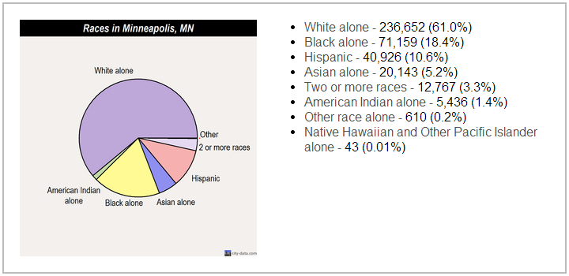
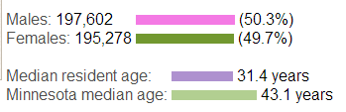
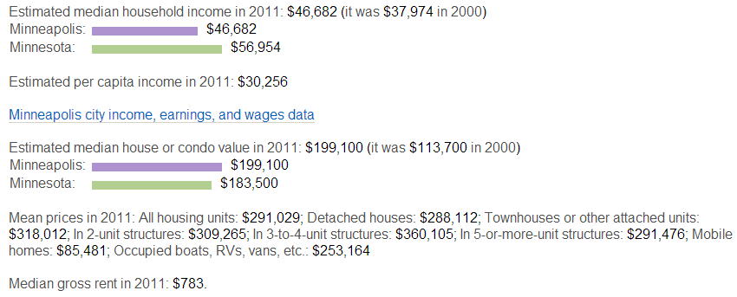
Example: City Data

Slide 12
Internet Data Sources
II. Restaurants: Nutrition Info
Applebees Nutrition Guide
Arby's Nutrition Guide
IHOP Nutrition Guide
KFC Nutrition Guide
Longhorn Nutrition Guide
McDonald's Nutrition Guide
Olive Garden Nutrition Guide
Ruby Tuesday's Nutrition Guide
Subway Nutrition Guide
Taco Bell Nutrition Guide
Zaxby's Nutrition Guide
Google YOUR favorite place to eat!

Slide 13
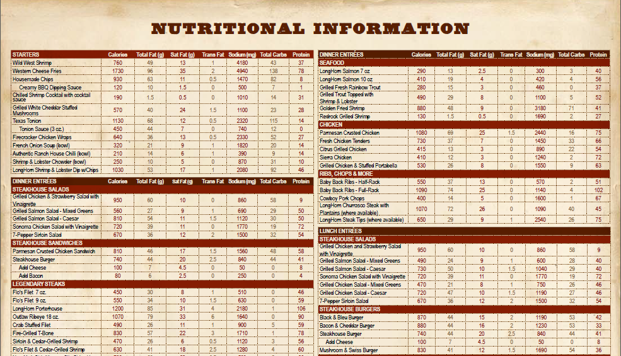
Nutrition Example:
Longhorn

Slide 14


Internet Data Sources
III. Sports Data
Sports Statistics Data Resources (Gateway) http://www.amstat.org/sections/SIS/Sports Data Resources/
General Sports Reference Site
www.sports-reference.com
NFL Historical Stats:
http://www.nfl.com/history
Individual team sites

Slide 15

Internet Data Sources
IV. Retail/Consumer (General)
Cost/Prices
e.g., Kelley Blue Book: http://www.kbb.com/
Consumer Report ratings .
http://www.consumerreports.org/cro/index.htm
Product Specifications
  e.g., size measurements,
  time/speed measurements,
  MPG for cars

Slide 16
Sample Student Projects
(See Appendix D)
Matched Pairs t-Test:
  2-tailed: H_{a} predicting that on average, students’ rating of Coke and Pepsi would be different.
  t statistic =2.62
  P value= 0.0116 (2-tailed)
  Conclusion: Evidence that on average, students rated the two drinks differently (Coke was rated higher)
Participant Coke Pepsi
#1 8 9
#2 7 5
.
.
.

Slide 17

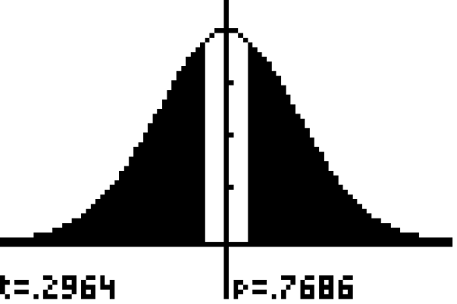
Sample Student Projects
t-Test for 2 independent samples:
  2-tailed: H_{a} predicting that on average salaries of American League MLB players differ from salaries of National League players
  H₀: μ_{AL} = μ_{NL} H_{a}: μ_{AL} ≠ μ_{NL}
  t statistic = 0.2964
  P value= 0.7686
  Conclusion: Sample data did not support H_{a}.
  No evidence that on average,
  salaries differ between
  the two leagues.

Slide 18
Sample Student Projects
t-Test for 2 independent samples:
  1-tailed: H_{a} predicting that on average females register for more credit hours than do males
  H_{o}: μ_{F} = μ_{M} H_{a}: μ_{F} > μ_{M}
  t statistic = 0.3468
  P value= 0.3649
  Conclusion: Sample data did not support H_{a}.
  Insufficient evidence that on average, females register for more hours

Slide 19
Sample Student Projects
t-Test for 2 independent samples:
  1-tailed: H_{a} predicting that on average fruit drinks have higher sugar content per ounce than fruit juices
  t statistic = -0.14
  P value= 0.5555
  Conclusion: Sample data did not support H_{a}.
  No evidence that on average,
  fruit drinks have more sugar
  than fruit juices.

Slide 20
Sample Student Projects
One Sample t-Test :
  1-tailed:
  H_{a} predicting that the average purebred Boston Terrier puppy in the U.S. costs more than $500
  Stratified sample representing different
  regions of the country
  t statistic = 1.73
  P value= 0.0449
  Conclusion: Evidence at 0.05
  significance level that on average,
  purebred Boston Terrier puppies
  are priced higher than
  $500.00 in the U.S.

Slide 21
Sample Student Projects
t-Test for 2 independent samples:
  1-tailed: H_{a} predicting that in local state parks, oak trees have greater circumference than pine trees on average
  t statistic = 4.78
  P value= 7.91 x 10 ^{–6}
  Conclusion: Strong evidence that in local state parks oak trees are bigger than pine trees on average.
  Lurking variable identified
  and discussed: age of trees
  (and possible reasons that
  oak trees were older)

Slide 22
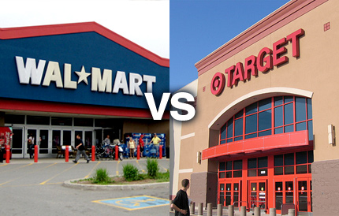
Sample Student Projects
Matched Pairs t-Test:
  1-tailed: H_{a} predicting on average, Wal-Mart prices would be lower than Target prices for identical items
  t statistic =.4429
  P value= 0.3294
  Conclusion: Mean price difference not significant; insufficient evidence that Wal-Mart prices are lower.
Item WalMart Target
64-oz. Mott’s Juice 2.79 2.89
12-oz LeSeur Peas 1.19 1.08
.
.
.

Slide 24
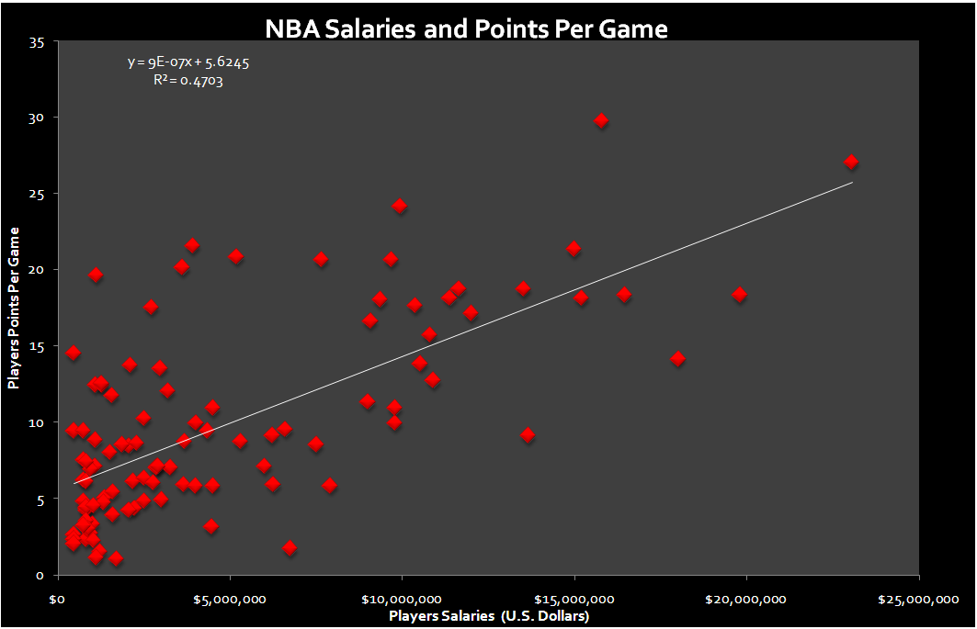
Sample Student Projects

Slide 25
Sample Student Projects

Slide 26
Sample Student Projects

Slide 27
Sample Student Projects

Slide 28
Sample Student Projects

Slide 29
Sample Student Projects
Correlation between MLB Team leadoff hitter’s On Base Percentage
and the team Runs Per Game
y=7.74x+1.96
r=0.46
r²=0.21
Significant at .001 with p=.00045
For every additional .100 in the leadoff hitter’s OBP, the teams RPG is predicted to increase by .774

Slide 30
Assessment
Weight of projects
Scoring rubrics
  Advantages – consistency, manageability, communication of expectations
  See Appendix T3
Team member grades
  Accountability of individual members

Slide 31
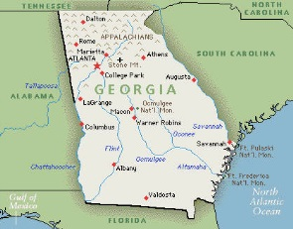
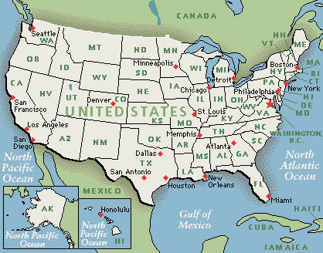
Stages of Testing
Exploratory Study
  At UNG, 4 instructors within department
  2 control, 2 treatment
Phase I Pilot
  Regional
  5 instructors across 3 institutions
  2 colleges, 1 high school (AP)
Phase II Pilot
  National
  8 instructors
  8 colleges/universities

Slide 32
Outcomes Measured and Instruments Developed
Content Knowledge
  21 multiple choice items (KR-20: 0.63)
  Refined to 18 items before Phase I
Perceived Usefulness of Statistics (“Perceived Utility”
  12-item Likert style survey; 6-point scale
  Cronbach alpha = 0.93
Statistics Self-Efficacy
Belief in one’s ability to use and understand statistics
  15-item Likert style survey; 6-point scale
  Cronbach alpha = 0.95

Slide 33
Results: Exploratory Study
Content Knowledge
  treatment group significantly higher (p < .0001)
  effect size = 0.59
Perceived Utility
  treatment group significantly higher (p < .01)
  effect size = 0.295
Statistics Self-Efficacy
  gains not significant (p = .1045)

Slide 34
Phase I Data Collection:
Quasi-Experimental Design
Goal:
Address potential confounding, instructor variability
Method
  Each pilot instructor first teaches “control” group(s) without new methods/materials
  Same instructors each teach “Experimental” group(s) following semester

Slide 35
Phase I Results
Different gains for different instructors
Too much variability among teachers to realize significant overall results (despite gains in mean scores)
  Perceived Usefulness
    Control: 50.42
    Treatment: 51.40
  Self-Efficacy for Statistics
    Control: 59.64
    Treatment: 62.57
  Content Knowledge
    Control: 6.78
    Treatment: 7.21

Slide 36
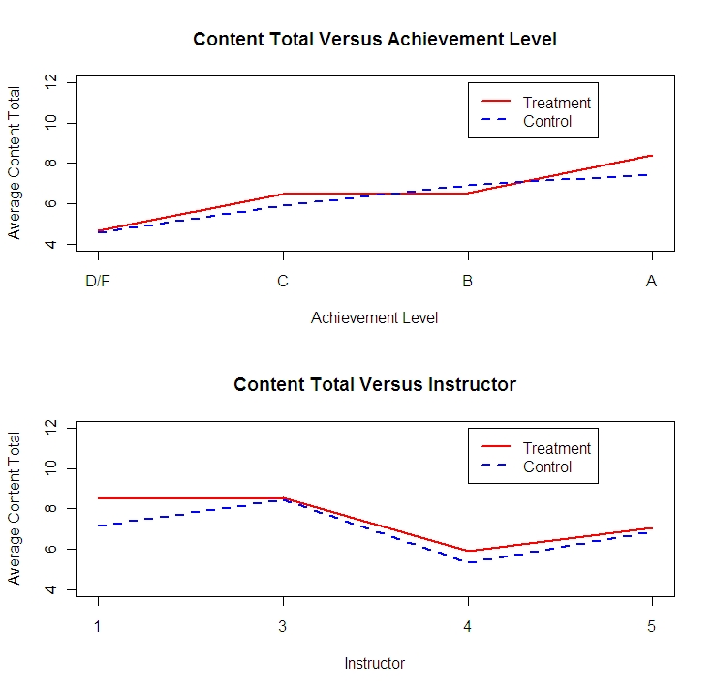
Multivariate Analysis: Content Knowledge

Slide 37
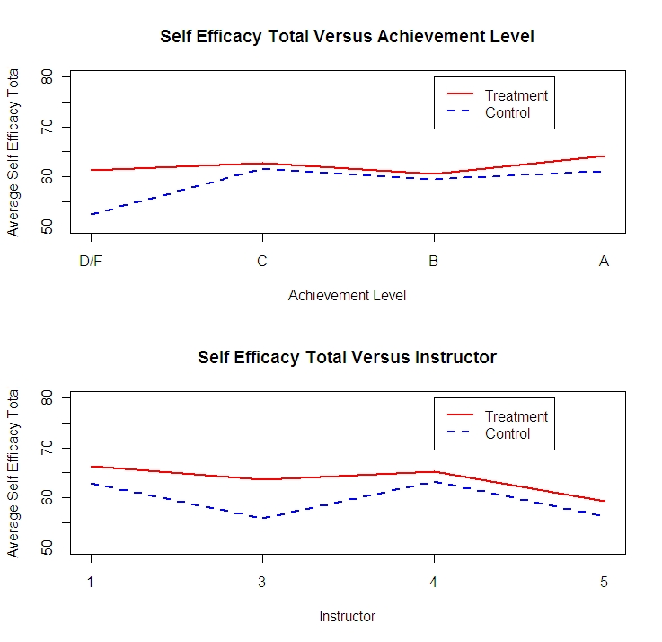
Multivariate Analysis: Statistics Self-Efficacy

Slide 38
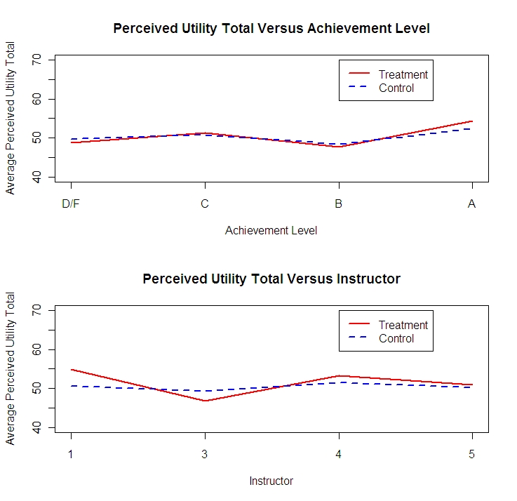
Multivariate: Perceived Usefulness of Statistics

Slide 39
Phase II
8 College/University Instructors
  Nationwide
  Diverse: size, geography, public/private
Revised Curriculum Materials
Revised Instruments
  Better alignment with expected benefits
  More specific sub-scales identified

Slide 40
Sub-scales: Examples
Content knowledge
  Linear regression
  Hypothesis testing
  Sampling
  Identifying appropriate statistical analyses
Self-efficacy
  Linear regression
  Hypothesis testing
  Data collection
  Understanding statistics in general

Slide 41
Preliminary Results – Phase II
Some gains across all instructors
  *Represents data collected to date
Variable | Grp | N | Mean (s.d.) | t | p
Content Knowledge – Identifying Analysis | C T | 353 295 | 1.33 (0.889) 1.51 (0.996) | 2.365 | .009
Self-Efficacy – Collecting Data | C T | 353 295 | 19.12 (3.293) 19.77 (3.044) | 2.594 | .005

Slide 42
Preliminary Results – Phase II
Many benefits vary by instructor
Variable | Instr | Grp | N | Mean (s.d.) | t | p
Content Knowledge – Linear Regression | #4 | C T | 18 21 | 1.83 (1.29) 2.81 (1.44) | 2.232 | .016
Content Knowledge – Sampling | #4 | C T | 18 21 | 1.28 (0.83) 1.81 (0.40) | 2.489 | .010
 | #6 | C T | 36 16 | 1.53 (0.56) 1.88 (0.34) | 2.745 | .005

Slide 43
Preliminary Results – Phase II (cont’d.)
Variable | Instr | Grp | N | Mean (s.d.) | t | p
Self-Efficacy – Linear Reg | #5 | C T | 56 31 | 26.54 (3.24) 27.65 (1.96) | 1.990 | .025
Self-Efficacy – Hypothesis Testing | #1 | C T | 42 40 | 21.14 (5.64) 24.00 (4.66) | 2.506 | .007
 | #2 | C T | 33 37 | 15.94 (5.85) 21.95 (5.24) | 4.503 | .000
 | #3 | C T | 58 55 | 21.74 (5.41) 23.69 (4.54) | 2.078 | .020
 | #5 | C T | 56 31 | 23.70 (3.95) 26.26 (3.27) | 3.239 | .001
Self-Efficacy – General | #5 | C T | 56 31 | 10.21 (1.36) 10.94 (1.15) | 2.619 | .005

Slide 44

Discussion / Q&A

