Slide 1
Does My Baby Really Look Like Me?
Using Tests for Resemblance to Teach Topics in Categorical Data Analysis
Amy G. Froelich and Dan Nettleton
Iowa State University
JSE Webinar, November 2013

Slide 2
Background
“Your baby looks just like you.”

Slide 3
Background
This claim is heard by many parents, us included.
We were skeptical. Can we design a study to test for resemblance between a parent/child pair?

Slide 4
Literature on General Resemblance
Many studies on general resemblance between parents and their children.
Highlight two studies
Christenfeld and Hill (1995)
Alvergne, Faurie, and Raymond (2007)

Slide 5
Christenfeld and Hill (1995)
Parent/child resemblance for 24 families
Father, mother, and child
Judges shown picture of child and asked to identify mother, father from 3 choices.
Only statistically significant resemblance found was between one-year old children and their father.
Hypothesized helps to enhance paternal involvement in child care.
Assure father baby is his.

Slide 6
Alvergne, Faurie, and Raymond (2007)
Identified problems with previous studies
Picture quality.
Fixed set of foils (incorrect parents).
Conclusions based on own study
Children resemble parents more than expected by chance.
Stronger resemblance associated with age and gender of child.

Slide 7
Study Design
Goals
Test for resemblance between Amy and her daughter and Dan and his son.
Motivate topics in categorical data analysis in several courses.
Avoid some of the difficulties in other studies of resemblance.

Slide 8
Study Design
Pictures
Parent and four babies (child and three foils)
Parent picture
Current picture
Plain background
Baby pictures
Same gender
Studio pictures
Babies all around same age (3 – 6 months)
Fixed set of foils
Placement determined at random and then fixed throughout.

Slide 9
Study Design
Judges
Students in introductory statistics courses
Served as motivation for project
Able to “easily” obtain needed sample sizes.
Demographic Variable
Gender

Slide 10
Research Questions
Q1a: Do judges detect a resemblance between the parent and any of the babies pictured?
Q1b: Is the gender of the judge associated with the baby selected?

Slide 11
Research Questions
Q2a: Do judges detect a resemblance between the parent and his/her baby?
Q2b: Does the probability of selecting the correct baby depend on the gender of the judge?

Slide 12
Research Questions
Q3: Do judges select the correct baby more frequently than each of the other babies pictured?

Slide 13
Research Questions
Q4a: Do judges make consistent baby selections when viewing a picture of the first author as an adult, versus when viewing a picture of the first author as a baby? Which selection, if either, is more accurate?
Q4b: Are judges influenced by a factor present in the baby pictures (e.g., baby wearing a hat) other than resemblance to the parent?

Slide 14
Surveys
Surveys MD1 and FS1
Research Questions 1a, 1b, 2a, 2b, 3
Surveys MD2 and FS2
Research Questions 4a and 4b
Each survey asked respondent’s gender.
Respondents received two surveys, one for each parent/child pair.
Determined by last number of University ID.

Slide 15
Surveys
Administered through course management system.
Three introductory statistics courses at ISU.
Questions administered one at a time.
Not allowed to revisit previous questions.
IRB approval for project
Students did not receive compensation for completing surveys.
Instructors did not receive information about participation.

Slide 16
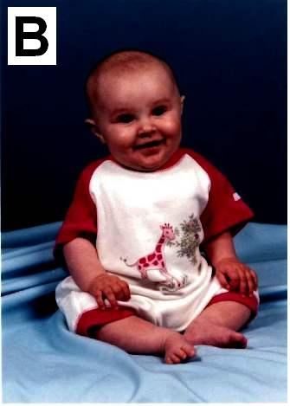
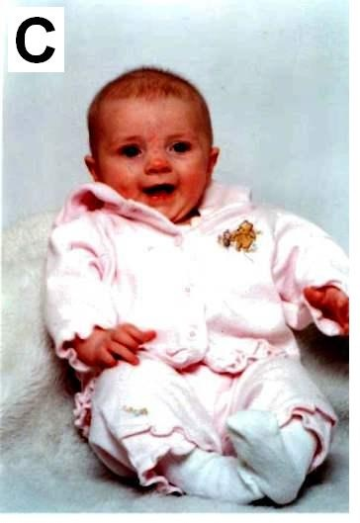
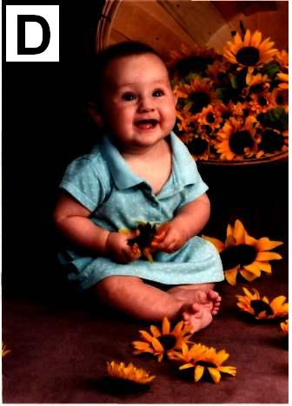
Survey MD1
Below is the mother of one of the babies pictured at right. Select the correct baby.

Slide 17
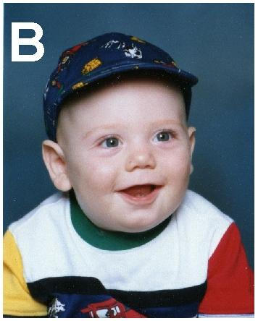
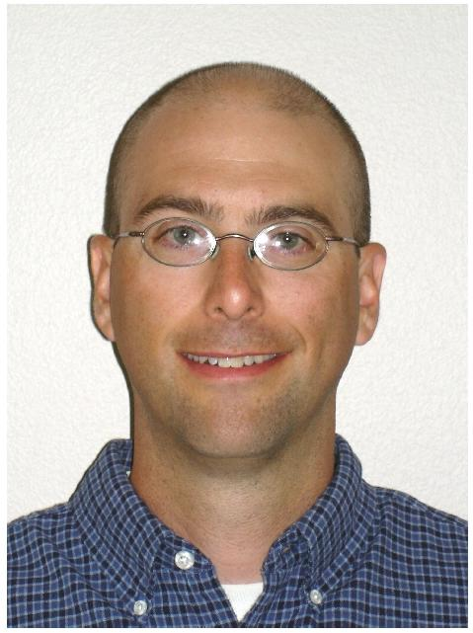
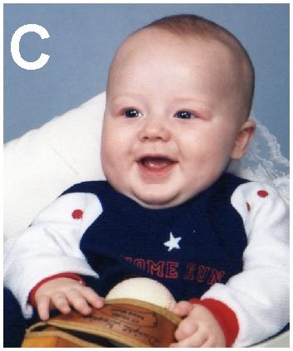
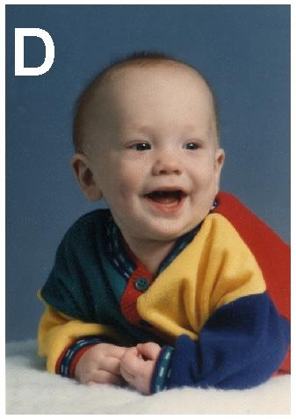
Survey FS1
Below is the father of one of the babies pictured at right. Select the correct baby.

Slide 18
Survey MD2 – Question 1
Below is the mother of one of the babies pictured at right. Select the correct baby.

Slide 19
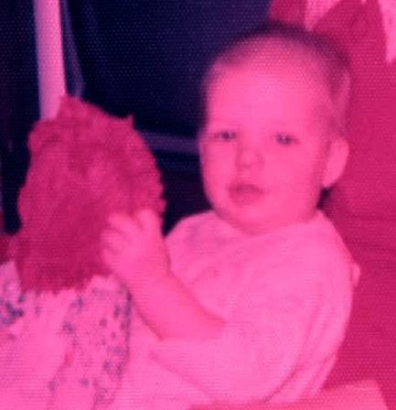
Survey MD2 – Question 2
Below is a picture of the mother at about the same age as the babies. Select the correct baby.

Slide 20
Survey FS2 – Question 1
To the right are four babies. Select the baby you think is the baby of the parent. The parent is NOT pictured.

Slide 21
Survey FS2 – Question 2
Below is the father of one of the babies pictured at right. Select the correct baby.

Slide 22
Data – Research Question 1a, 2a, 3
Survey MD1
Baby | A | B | C* | D | Total
Number | 19 | 82 | 89 | 30 | 220
Survey FS1
Baby | A | B* | C | D | Total
Number | 25 | 33 | 24 | 58 | 140

Slide 23
Research Question 1a
Goodness of Fit Test
Under $H_{0}$, probability each baby is selected is 0.25.
$n_{j}$= number of respondents who selected baby j.
$n=$total number of respondents.
Test Statistic:
$$X^{2}=\sum_{j=A}^{D}{\frac{{\left(n_{j}−0.25n\right)}^{2}}{0.25n}}$$
Distribution under $H_{0}$: $χ_{3}^{2}$ for our sample sizes

Slide 24
Research Question 1a
Survey MD1
$X^{2}=74.4132$, p-value $≈0$
Judges detect a resemblance between Amy and at least one of the babies (baby B and baby C)
Survey FS1
$X^{2}=21.5429$, p-value $≈0.00008$
Judges detect a resemblance between Dan and at least one of the babies (baby D)

Slide 25
Research Question 2a
One-sample z-test for a binomial proportion
$H_{0}:p=0.25$ vs. $H_{a}:p>0.25$
$\hat{p}=$ proportion of respondents who select correct baby.
Test Statistic:
$$z=\frac{\hat{p}−0.25}{\sqrt{\frac{0.25(0.75)}{n}}}$$
Distribution under $H_{0}$: N(0,1) for our sample sizes

Slide 26
Research Question 2a
Survey MD1
$\hat{p}=\frac{89}{220}$
$z=5.2938$, p-value $≈0$
Judges detect a resemblance between Amy and her daughter.
Survey FS1
$\hat{p}= \frac{33}{140}$ < 0.25
Judges do not detect a resemblance between Dan and his son.

Slide 27
Research Question 3
Survey MD1
Judges selected Amy’s daughter at a rate significantly higher than expected based on chance.
Do the judges think Amy looks more like her daughter than any of the other babies?
No, baby B was selected with proportion ${\hat{p}}_{B}=\frac{82}{220}$. This proportion is not significantly different from ${\hat{p}}_{C}=\frac{89}{220}$.
Details of test in Froelich & Nettleton (2013) and Nettleton (2009).

Slide 28
Data – Research Question 4a
Survey MD2
 | Question 2
Question 1 | Correct | Incorrect | Total
Correct | 22 | 32 | 54
Incorrect | 14 | 55 | 69
Total | 36 | 87 | 123

Slide 29
Data – Research Question 4b
Survey FS2
 | Question 2
Question 1 | Correct | Incorrect | Total
Correct | 14 | 52 | 66
Incorrect | 20 | 109 | 129
Total | 34 | 161 | 195

Slide 30
Research Questions 4a and 4b
McNemar’s test for the equality of two binomial proportions ($p_{1}=p_{2}$).
${\hat{p}}_{1}=$ proportion of respondents correctly answering Question 1.
${\hat{p}}_{2}=$ proportion of respondents correctly answering Question 2.
${\hat{p}}_{1}$ and ${\hat{p}}_{2}$ are dependent since same respondents provided data for both.

Slide 31
Research Questions 4a and 4b
McNemar’s test for the equality of two binomial proportions ($p_{1}=p_{2}$).
$n_{IC}$ = number of respondents who answered incorrect on Question 1 and correct on Question 2.
$n_{CI}=$ number of respondents who answered correct on Question 1 and incorrect on Question 2.
Test Statistic:
$$z_{0}^{2}=\frac{{\left(n_{IC}−n_{CI}\right)}^{2}}{\left(n_{IC}+n_{CI}\right)}$$
Distribution of Test Statistic: $χ_{1}^{2}$ for our sample sizes

Slide 32
Research Question 4a and 4b
Survey MD2
$z_{0}^{2}=7.0435$, p-value $≈0.0080$
Probabilities of correct response on two questions are different.
Respondents chose Amy’s daughter more often when Amy was pictured as an adult versus when she was pictured as a baby.
When pictured as adult, results were similar to Survey MD1.
When pictured as a baby, respondents did not select Amy’s daughter at a rate higher than chance ($\hat{p}=\frac{36}{123}=0.2927$).

Slide 33
Research Question 4a and 4b
Survey FS2
$z_{0}^{2}=14.2222,$ p-value $≈0.0002$
Probabilities of correct response on two questions are different.
Respondents chose Dan’s son more often when NOT shown Dan’s picture.
Outside factor (wearing a hat) may have influenced respondents baby selection when they didn’t see Dan’s picture; they chose Dan’s son more often than expected by chance.
Outside factor does not appear to affect baby selection when they saw Dan’s picture; they chose Dan’s son less often than expected by chance ($\hat{p}=\frac{34}{195}<0.25$), similar to Survey FS1.

Slide 34
Classroom Uses
Students respond well to study.
Everyone likes babies ☺
Research Questions covered depend on topics in course.
Introductory and AP Statistics – Research Questions 1a, 1b, 2a, 2b
Undergraduate Course in Categorical Data Analysis – add Research Questions 4a, 4b
Graduate Course in Categorical Data Analysis – Add Research Question 3

Slide 35
Classroom Uses
Our Surveys
Collect your own data using our study design and pictures.
Pool with our data if sample size is of concern.
Your Own Surveys
Collect your own data using our study design but your own pictures.
Your Own Design and Surveys
Collect your own data using your own study design and pictures.
Vary number of babies (3, 4 or 5).
Vary placement of babies for each judge.

Slide 36
Conclusions
We were right to be skeptical of claims of resemblance.
No evidence of resemblance between Dan and his son.
Some evidence of resemblance between Amy and her daughter, but respondents also saw resemblance between Amy and one of the other babies.
Interesting Example
Motivates methods for categorical data analysis.

