Slide 1
Making the Grade: A Cross-National Analysis of Teacher Training on Student Achievement Across 52 Nations
Natalie Bold
USRESP Webinar
October 22, 2013

Slide 2
“Every system is perfectly designed to produce the results it gets” – Paul Batalden

Slide 3
PISA- Program for International Student Assessment
Years administered: 2000, 2003, 2006, 2009, 2012
Participating countries: 41-65
Students assessed each testing year : ~200,000
Subjects assessed: mathematics, language, science

Slide 4
Caveats
Self-selection of countries
Self-reporting to databases
Outdated and lack of comprehensive databases

Slide 5
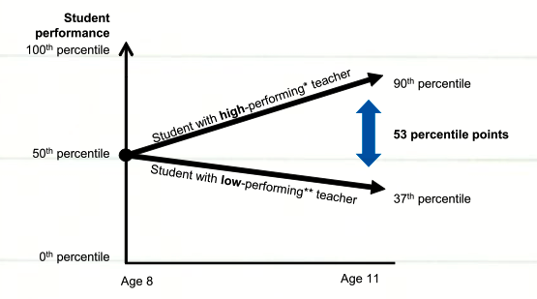
The importance of teachers on student achievement

Slide 6
Teacher training on student achievement
Pedagogical
Subject specialization
Classroom experience

Slide 7
Variation in professional teachers

Slide 8
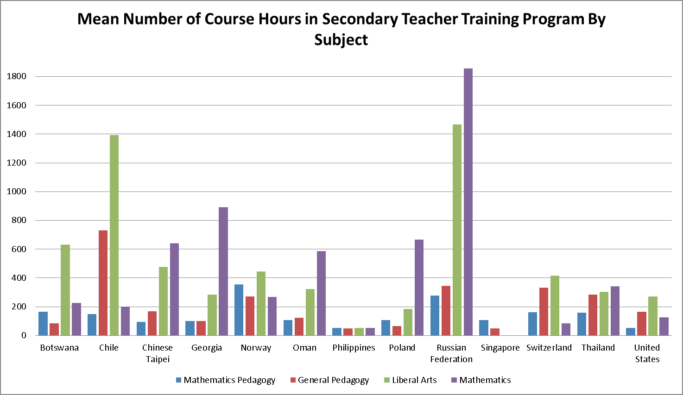

Slide 9
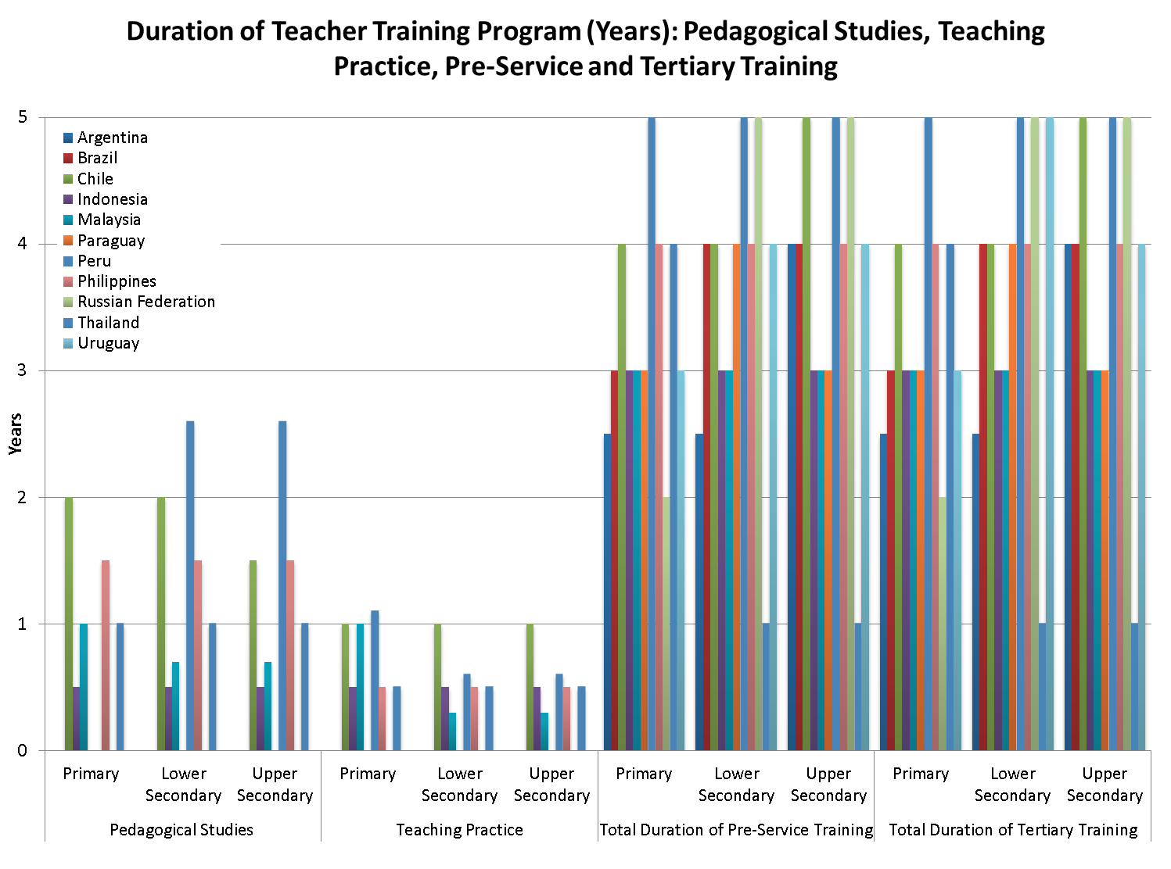
Notes:
Teachers for tomorrow's schools (2001)

Slide 10
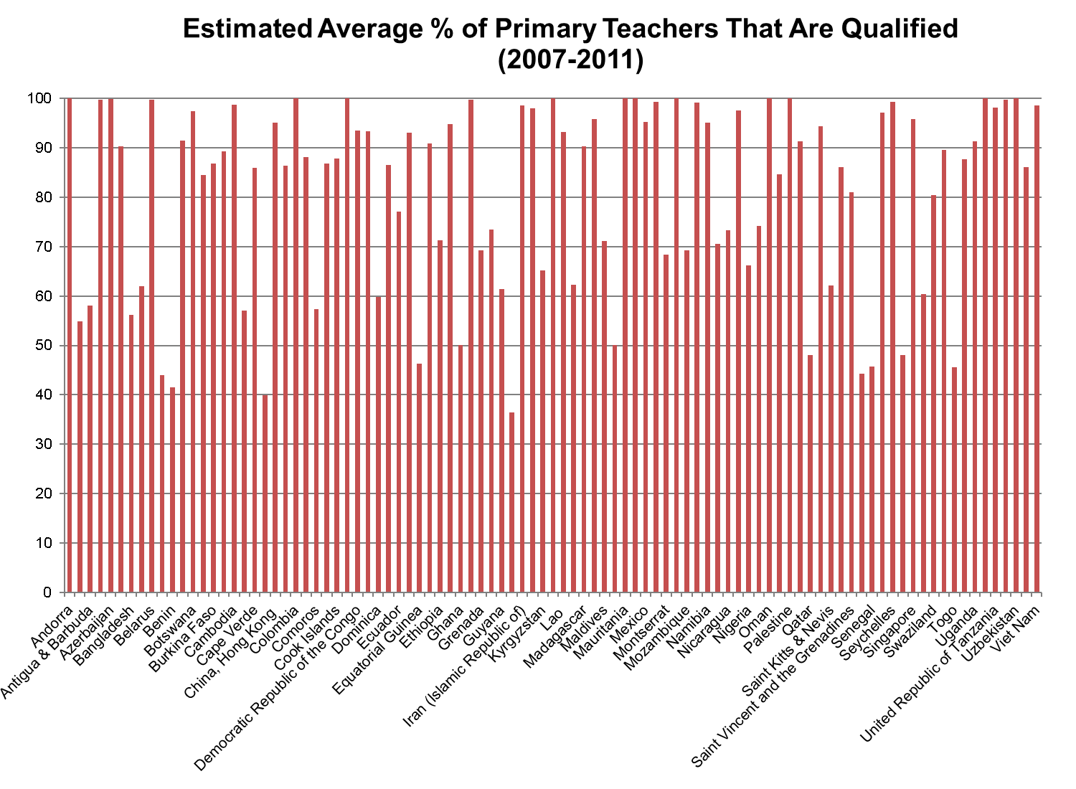
Notes:
UNESCO institute for statistics

Slide 11
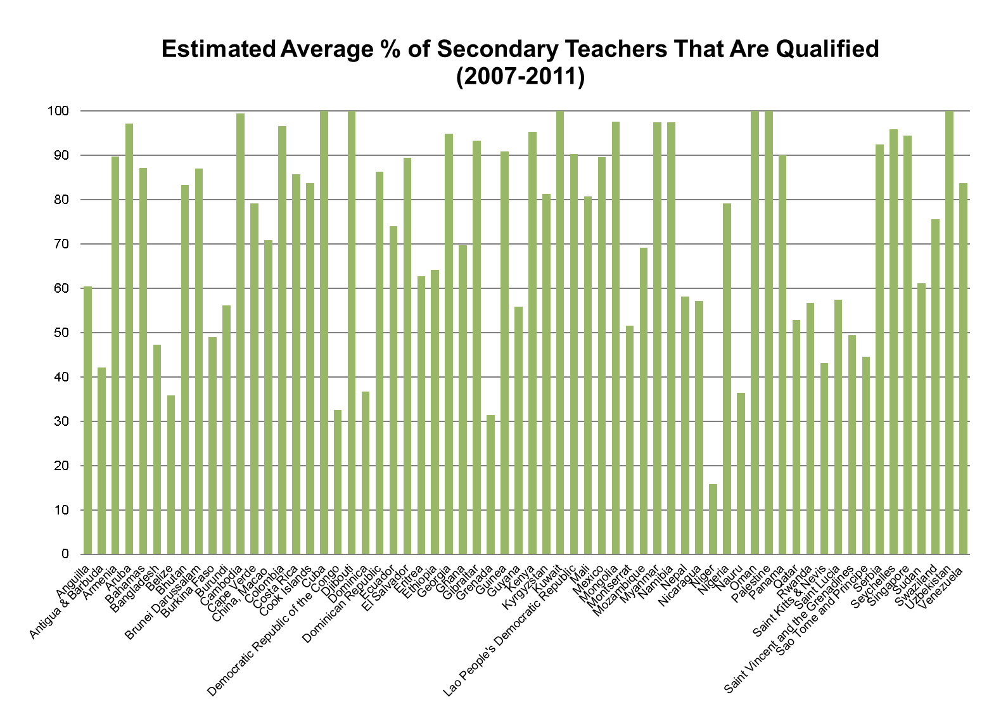
Notes:
UNESCO institute for statistics

Slide 12
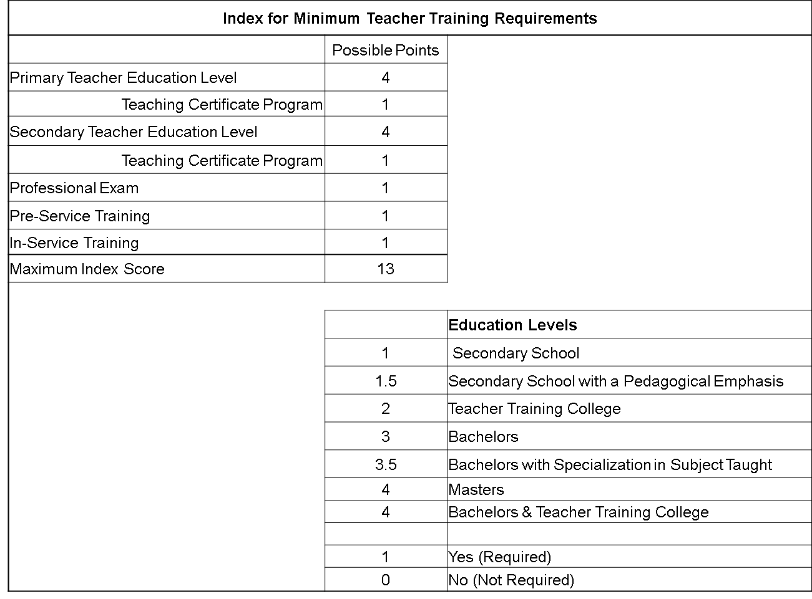

Slide 13
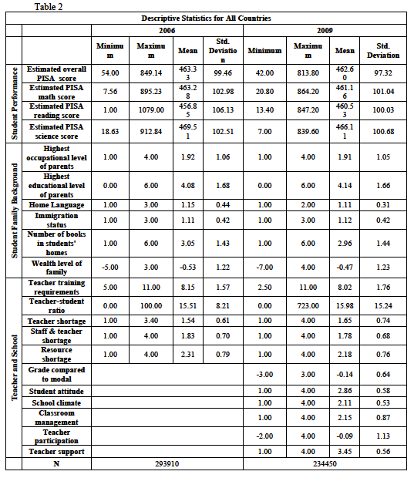

Slide 14
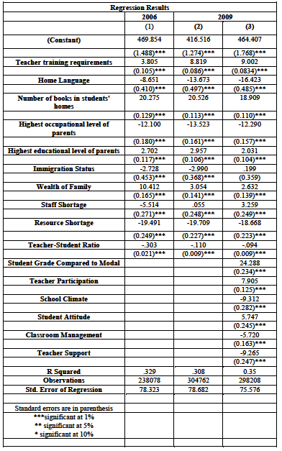

Slide 15
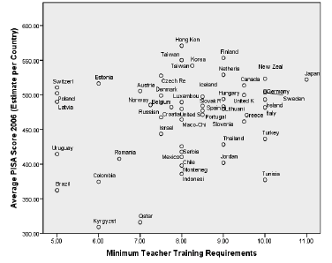
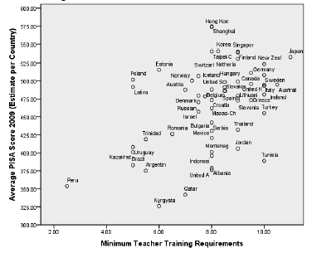
Correlation Between student performance and minimum teacher training requirements

Slide 16
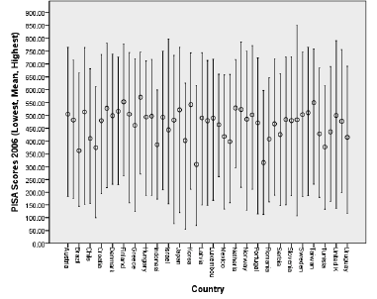
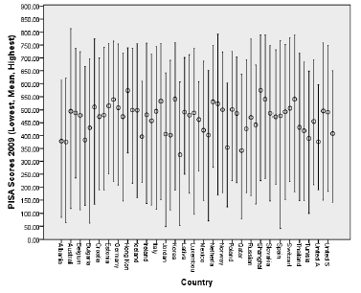
Variance in Student Performance by Country

Slide 17
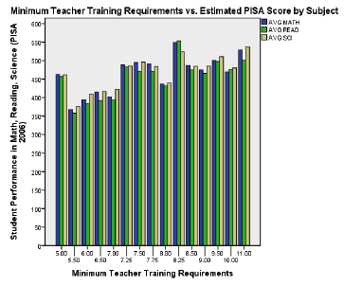
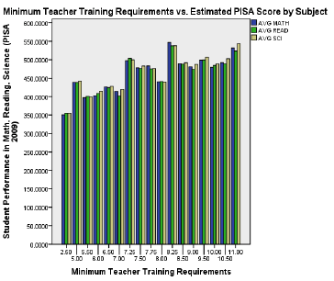
Minimum teacher training requirements vs. student performance by subject

Slide 18
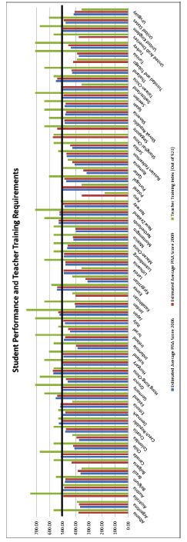
Student performance on the PISA & teacher training requirements

Slide 19
Thank you!
Any questions?

