Slide 1
Distinguishing Between Binomial, Hypergeometric & Negative Binomial Distributions http://www.amstat.org/publications/jse/v21n1/wroughton.pdf
Jacqueline Wroughton

Slide 2
The Binomial Distribution
There are n set trials, known in advance
Each trial has two possible outcomes (success/failure).
Trials are independent of each other.
The probability of success, p, remains constant from trial to trial.
The random variable, Y, is the number of successes out of the n trials.
Note: p vs. “conditional p”

Slide 3
The Binomial Distribution
Probability Mass Function
Expected Value & Variance

Slide 4


The Hypergeometric Distribution
All but condition 3 of the Binomial Conditions hold. (Without replacement)
Probability Mass Function
Expected Value & Variance

Slide 5



The Negative Binomial Distribution
All but condition 1 and 5 of the Binomial Conditions hold.
Probability Mass Function
Expected Value & Variance

Slide 6
Activity Development Motivation
Students appeared to conceptually “get it”.
Anecdotal evidence suggested that they could not recognize the differences in context.

Slide 7
Activity Goals
Supplement conceptual understanding with hands-on learning.
Improve students’ ability to distinguish between these three distributions.
Reinforce ideas of theoretical vs. empirical probabilities.
Develop deeper understanding of variance.

Slide 8
Activity Design
Used a standard deck of playing cards.
Students go through three different set-ups, one for each distribution.
Students are given a goal for each set-up.
  Example: Keep doing this until you get two hearts.
Students record data on the board to get class-wide data.

Slide 9
Student Activity
Asked to simulate data (via cards).
Calculate theoretical and empirical probabilities to compare.
Calculate the expected value and standard deviation (and interpret).
Create a write-up to address (and for me to assess) their understanding.

Slide 10
Assessment of Activity
Goals:
  Does the activity seem to improve students’ ability to distinguish between these three distributions. (Formally assessed through pre-post test).
  How well do students believe that this activity fosters their understanding. (Anecdotally assessed through student conversations and course evaluations).

Slide 11
Pre- & Post-Tests
Each test consisted of eight multiple choice questions where answers were the three distributions.
  Students were told that if they were unsure, to leave the question blank.
Half of students took version one as pre-test; other half took version two as pre-test.
Assessment would be done to see if this ordering had a significant impact.

Slide 12
Scoring of Tests
Correct Answer: 1 point
Blank Answer: 0 points
Incorrect Answer: -0.5 points
  Note: Based on SAT scoring method

Slide 13
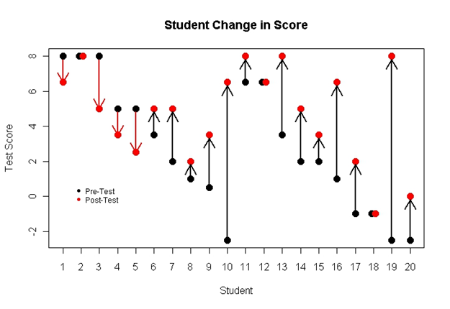
Results

Slide 14
Results
Wilcoxon Signed Rank Sum Test Results:
  Pre- vs. Post-Test: p-value = 0.0092
  Version 1 vs. Version 2: p-value = 0.1161

Slide 15
Conclusions/Future
Promising results with small sample
  Expand to other teachers, schools, etc.
  Compare to alternative time on task such as more example problems.
Include explanations with choice of distribution
  See where students reasoning was confused
  See if correct answer was found based on correct reasoning.

