Slide 1
Which traits attract women: Appearance, Intelligence, Wealth or Strength? A presentation on the logistics behind, and summary of, the winning USPROC project from 2013
Nathan Tintle Associate Professor of Statistics Dordt College
Josh Nymeyer Class of 2014, Dordt College

Slide 2
Overview
Nathan
An overview of stat ed to get where we are today
A model for a second course in Statistics
Integrating a national project competition; future of USPROC
Josh
An overview of the winning project
Time for questions

Slide 3
background
Where we’ve been—consensus Stat 101 curriculum; Birth of Stat Ed; GAISE
Where we are
Embracing GAISE Pedagogy
Societal changes (Expert→Data)
Research changes (Switzer and Horton)
Terminal Stat 101 course
Cobb challenge
Where we’re headed
Incremental content change in first course
Breaking down barriers to entry to the second course (Mult regression, ANCOVA, ANOVA, General Linear Models)—Theme “What is a statistical model and how do you use it?”
Books: Stat 2 (Cannon et al.), Kuiper and Sklar, Ramsey and Schafer

Slide 4
Our approach to stat ed
Two versions of a first course
Both use randomization/simulation (see http://math.hope.edu/isi) for details of curriculum
One is regular, full semester (16 weeks, 3 hours p/week) course (3 credits)
Other is accelerated ½ semester (8 weeks, first half of semester) course for students who’ve (a) had substantial math (e.g., Calculus—but we don’t use calculus!) or (b) Had prior experience with stats (e.g., AP Statistics or other HS course in statistics) (2 credits)
The course is identical to the regular full length version EXCEPT is goes twice as fast; learning outcomes are the same
We attempt to place students into the correct place based on their background
This replaced the traditional “calculus based” statistics course

Slide 5
Our approach to stat ed
Second course
½ semester (2nd half); 4 hours p/week; 2 credits
Immediately follows accelerated first course
Students place into it by successfully completing EITHER first course

Slide 6
Our approach to stat ed
Content and Pedagogy
A full description can be found here:
Challenging the State of the Art in Post-Introductory Statistics: Preparation, Concepts, and Pedagogy (Talk/paper at ISI/IASE, Hong Kong, August 2013) http://www.statistics.gov.hk/wsc/IPS032-P1-S.pdf
Outcomes: Multiple regression models; general linear models; logistic regression
Approach: Hands-on, discovery pedagogy, judicious use of simulation; Emphasis on big ideas of CONFOUNDING and UNWANTED VARIABILITY
Instead of letting models be the goal, models are a means to an end, not an end in and of themselves
How can design and analysis strategies account for unwanted and/or previously unexplained variation?
How can confounding variables be controlled by design and analysis?

Slide 7
Our approach to stat ed
Projects in second course
Two projects
Service learning---work with an on or off-campus client to apply a multiple regression/general linear model to their data (Data already collected; observational)
The client drives research questions
I pre-screen (collect topics all year when people knock on my door!)
Oral poster presentation at undergraduate research conference on campus
Multi-factor experiment with blocking
Student designed; must have at least 3 factors and at least one blocking variable
One page proposal; Oral presentation in class (feedback); Final written report (peer-reviewed journal article format), appendix of details and dataset

Slide 8
USPROC
Biennieal (may be changing!) national competition
Two tracks: Class projects and undergraduate research projects
Told students part of their final exam (50 out of 200 points) was for submitting one of their two projects to USPROC
Reformatting; addressing my feedback; I gave a few pointers on how to give a bit more detail on some things for stat prof’s vs. students in a class, but fairly “ready to go” from class
Josh will now share with you his winning project, after which time for questions about class, his project, USPROC, etc!

Slide 9
Which Traits Attract Women: Appearance, Intelligence, Wealth, or Strength?

Slide 10
Background
Men have always wondered what women find attractive
One study suggests intelligence attracts women (Moore et. al)
This study manipulated intelligence through change in physical appearance, rather than a written description
As single, intelligent men we wanted to look into this hypothesis
Our goal was to see if intelligence, wealth, appearance, or strength had a significant impact on level of attractiveness to women at a small college
Null Hypothesis: There is no relationship between intelligence, wealth, appearance, or strength and attractiveness

Slide 11
Methods
Variables
Explanatory: Strength, Wealth, Intelligence, Appearance
All treated as indicator variables when conducting analysis
Blocking: Age (Split into upper and underclassmen)
Response: Attractiveness Rating
Quantitative Variable
Study Design
Designed a hypothetical dating survey complete with picture, description, and attractiveness scale
Description was altered to include indicators of strength, intelligence, wealth, or a combination of these attributes
Created a 2^4 factorial design with a single dichotomous blocking variable. Our sample size was 64, meaning we had two individuals in each treatment-block group
Participants were asked to rate the attractiveness of the man in the profile they viewed

Slide 12
Survey
Participants were given a survey containing: instructions, brief profile, a rating scale, and a photo, These are shown in the following slides.
Instructions:
Imagine you are participating in an online dating service and the service has returned a "match" to you based on personality, characteristics, spirituality and general likes/dislikes. You have now received a brief paragraph description of a guy-- who has expressed an interest in going out on a first date with you. Based on the information provided (picture and brief bio) how attractive do you find this potential suitor?

Slide 13
Survey
Below is an example of the profile listed on the survey. This particular profile contained all three indicator sentences. Each profile was also accompanied by a picture (shown on next slide).
Hi my name is Kenny Smith. I am twenty years old and I attend ***** College, but I am from Colorado Springs, Colorado. I have two siblings that I am close to. I enjoy hanging out with friends and many other activities. Donut runs late at night are one of the things I especially enjoy. My roommates enjoy going out with me, not just because I’m a good time, but because I’m often willing to foot the bill. I’ve got to spend my inheritance somewhere! One reason I choose to attend ***** is the athletic scholarship I received. This requires a sizable time commitment between practice and workouts, but it is something I really enjoy. Despite the fact school has always come naturally to me, I do reserve some time for studying. Getting good grades is something that is important to me. I would love to get to know you better. If you are interested please contact me at knnysmth@*****.edu
Wealth Indicator Sentence
Strength Indicator Sentence
Intelligence Indicator Sentence
Note: Indicator sentences were not colored for the experiment, done here for illustrative purposes. The college name has also been removed
For profiles in which a variable had a value of zero, the correlating indicator sentence was omitted from the bio.

Slide 14
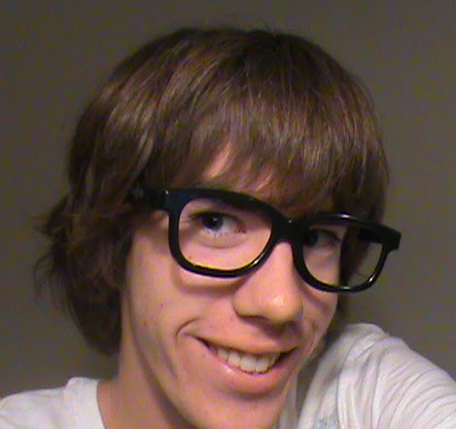
Attractiveness Scale & Appearance Variable
1 | 2 | 3 | 4 | 5 | 6 | 7 | 8 | 9
I am repulsed by this man. I am deleting my online profile |  | If our paths crossed I would try to avoid him |  | I feel neither attraction nor repulsion. |  | I would go out of my way to interact with him |  | My blood boils with affection for this man
A 9 point rating scale was used to measure participants’ perceived attractiveness of the hypothetical man.
Unattractive Photo
Attractive Photo

Slide 15
Analysis
Analyzed data with a Univariate Linear Model
SPSS used to build a custom model
Began by adding all 5 variables: Appearance, Intelligence, Wealth, Strength, and Class as main effects in model
All 4-way, 3-way, and 2-way interactions were added to model
Performed Backwards Stepwise Regression on Interactions
Linear model run and 4-way interaction determined insignificant
3-way interactions eliminated one by one beginning with interaction that had the highest p-value (least significant)
2-way interactions eliminated one by one beginning with interaction that had the highest p-value (least significant)

Slide 16
Analysis Results
One significant 2-way interaction was found: Wealth and Intelligence
P-Value of .052
Significance level set at 10%
Low enough to indicate significance in exploratory study (Small Sample Size)
A coefficient of -1.250 indicated a significant difference in attractiveness
Intelligence without wealth increased attractiveness by .75
Intelligence with wealth decreased attractiveness by .5

Slide 17
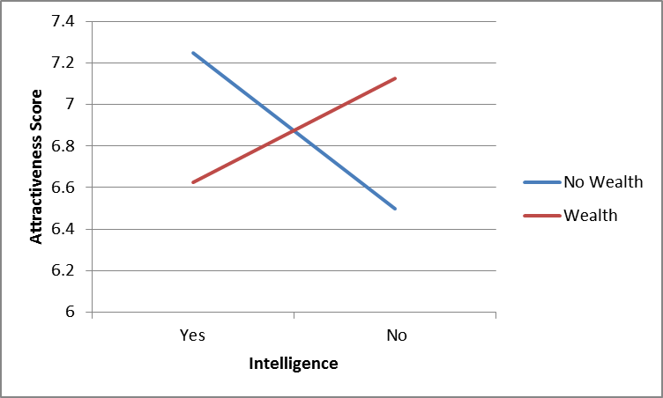
Interaction between wealth and Intelligence
The best combination of traits is to be intelligent and not wealthy. Surprisingly, the worst combination of attributes was to be both wealthy and intelligent. We attribute this to the “Too Good to be True” Effect. A man who is both rich and intelligent is off-putting to women.
We have sufficient evidence (at the 10% level) to reject the null hypothesis that there is no interaction between wealth and intelligence: i.e. Effect of Wealth with Intelligence is equal to the Effect of Wealth without Intelligence

Slide 18
Analysis Results
In addition to the one significant two-way interaction, one of the other experimental factors was significant with a p-value of 0.035 .
Single factors tested for significance using Backwards Stepwise Elimination
All five variables included in Univariate Linear Model
Analysis run, and variable with highest p-value (least significance) eliminated
All variables eliminated until only Appearance remained as significant
Appearance determined to be significant at 5% level
Appearance has a significant effect on attractiveness, regardless of other factors
Coefficient of 0.688 indicated a score increase of 0.688 when the attractive picture was used, regardless of values of other variables

Slide 19
Conclusions
One Interaction determined to be significant at 10% level
Wealth and Intelligence have a significant interaction on attractiveness rating
Having one or the other increased attractiveness over having neither
The presence of both wealth and intelligence had a negative impact of attractiveness score. We refer to this phenomenon as the “Too Good to be True” effect
One single variable determined to be significant at 5% level
Appearance had a positive effect on attractiveness, regardless of other variables
Regression Equation:
Score = 6.5 + .688*Appearance + .625*Wealth + .75*Intelligence - 1.25*Wealth*Intelligence

Slide 20
Conclusions (cont)
“Too Good to be True” Effect
It is possible too have too much of a good thing, the presence of both wealth and intelligence had a negative effect, contrary to our intuition
We hypothesized the presence of these two traits made the hypothetical man seem unattainable, he was perceived as being too good to try and date
We would like to explore this effect further through more experimentation. The next step would be to create an experiment where the only variables are wealth, intelligence, and appearance. Testing the interaction of wealth and intelligence on a larger number of picutres would help determine if this is a general principle, or a phenomenon specific to these two photos
Broader Implications
Due to the study design, we should be careful about generalizing our findings to the entire population of female students at this college
Further experiments, such as the one suggested above, could give us a better idea if these results can be generalized to the whole population, or are unique to this sample

Slide 21
Limitations
Study Design
It was difficult to indicate the presence of various non-physical traits through a paragraph in a clear yet subtle manner
Sampling
A convenience sample was used rather than a random sample, so we must be very careful about generalizing results to the population of all female students at this college
A rather small sample size was used in this survey, giving us less accurate data with which to run our analysis
Survey
The attitude of survey takers can have a significant impact on results. We faced some difficulty with participants who had little interest or concern for the survey
Another limitation of the survey is that 5 (the middle) value was a very common rating in survey responses. This could be addressed by using a ten point rating scale; however, we feel there would still be significant bunching around the middle of the scale

Slide 22
References
Moore, F. R., Filippou., D. D., & Perrett, D. I.
(2011). Intelligence and attractiveness in the face: Beyond the attractiveness halo effect. Journal Of Evolutionary Psychology, 9(3), 205-217. doi:10.1556/JEP.9.2011.3.2

