Slide 1
StatKey
Online Tools for Teaching a Modern Introductory Statistics Course
Robin Lock
Burry Professor of Statistics
St. Lawrence University
rlock@stlawu.edu
CAUSE Webinar- August 27, 2013

Slide 2
What is it?
StatKey
A set of web-based, interactive, dynamic statistics tools designed for teaching simulation-based methods such as bootstrap intervals and randomization tests at an introductory level.
Freely available at
lock5stat.com/statkey
Runs in (almost) any browser.
Also available as a Google Chrome App.

Slide 3

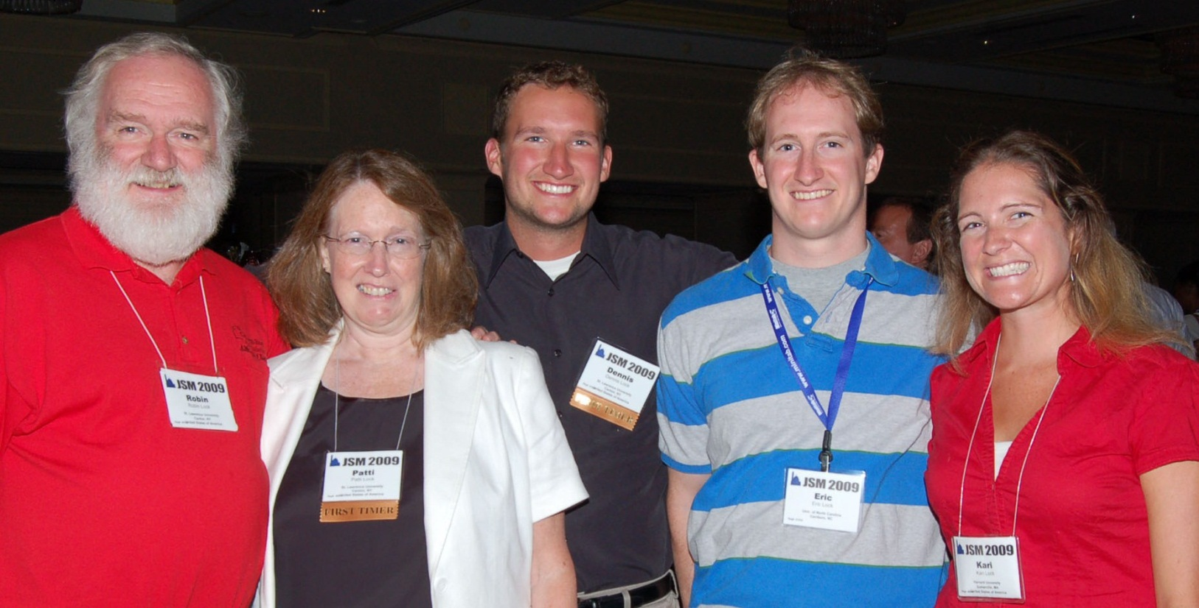
Who Developed StatKey?
The Lock⁵ author team to support a new text:
Statistics: Unlocking the Power of Data
Dennis
Iowa State
Kari
Harvard/Duke
Wiley (2013)
Eric
UNC/Duke
Robin & Patti
St. Lawrence

Slide 4



Programming Team
StatKey
Rich Sharp
Stanford
Kevin Angstadt
St. Lawrence
Ed Harcourt
St. Lawrence
StatKey is programmed in JavaScript

Slide 5
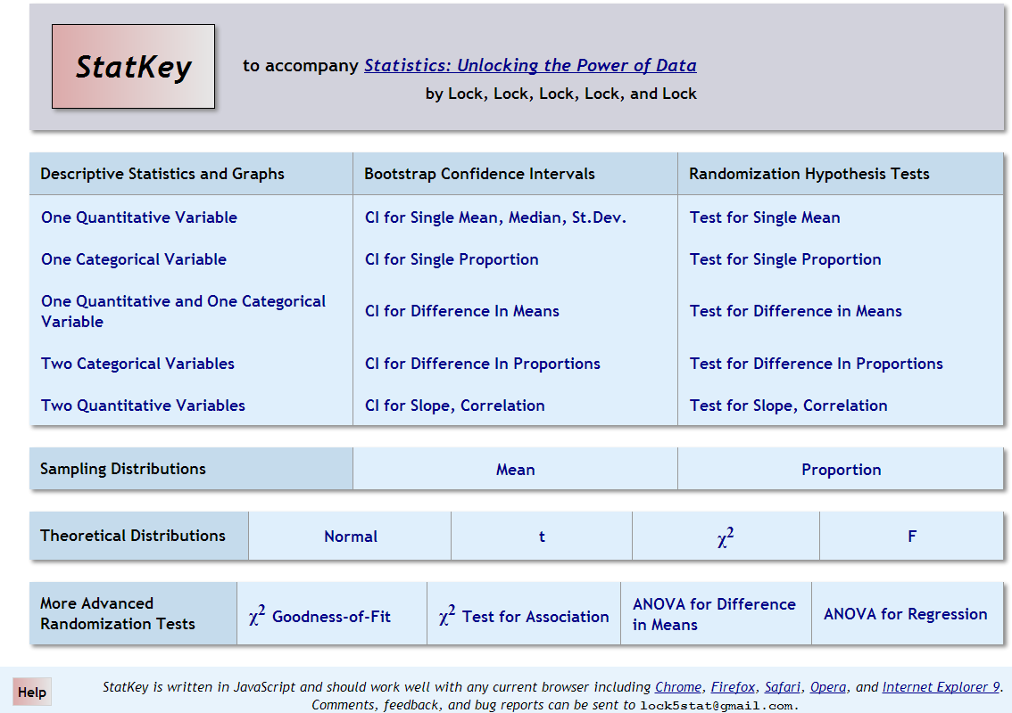

Slide 6
Examples
1. Mean price of a used Mustang
(Bootstrap CI for a mean)
Does drinking beer attract mosquitoes?
(Randomization test to compare means)
3. Pulse rate: Athlete vs. non-athlete
(Enter own data)
4. Sandwich ants
(ANOVA for means)

Slide 7
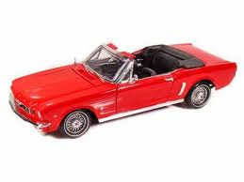

What is the average price of a used Mustang car?
Select a random sample of n=25 Mustangs from a website (autotrader.com) and record the price (in $1,000’s) for each car.
$$n=25 \overline{x}=15.98 s=11.11$$
Key concept: How much can we expect the sample means to vary just by random chance?

Slide 8
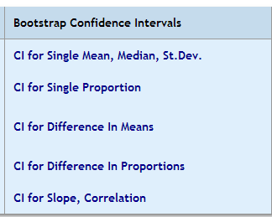
StatKey
lock5stat.com/statkey

Slide 9
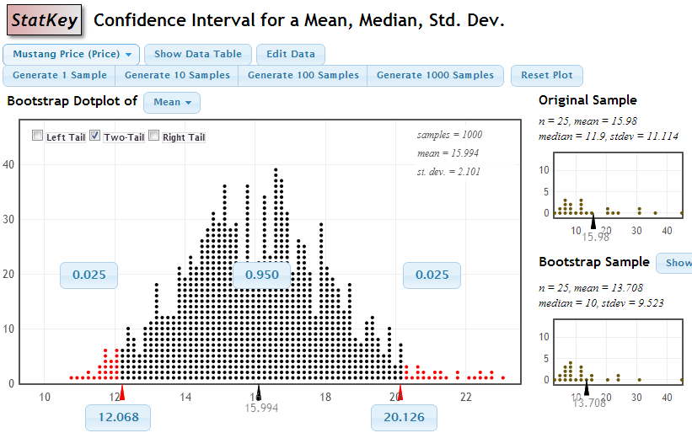
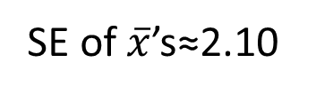
SE of $\overline{x}$’s≈2.10
We are 95% sure that the mean price for Mustangs is between $12,068 and $20,126

Slide 10
Beer and Mosquitoes
Does consuming beer attract mosquitoes?
H₀: μ_{B}=μ_{W}
H₀: μ_{B}>μ_{W}
Experiment:
25 volunteers drank a liter of beer,
18 volunteers drank a liter of water
Randomly assigned!
Mosquitoes were caught in traps as they approached the volunteers.¹
¹ Lefvre, T., et. al., “Beer Consumption Increases Human Attractiveness to Malaria Mosquitoes, ” PLoS ONE, 2010; 5(3): e9546.
Beer mean = 23.6
Water mean = 19.22

Slide 11
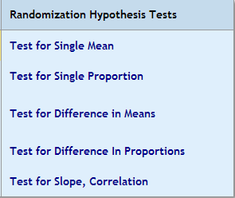
StatKey
lock5stat.com/statkey

Slide 12
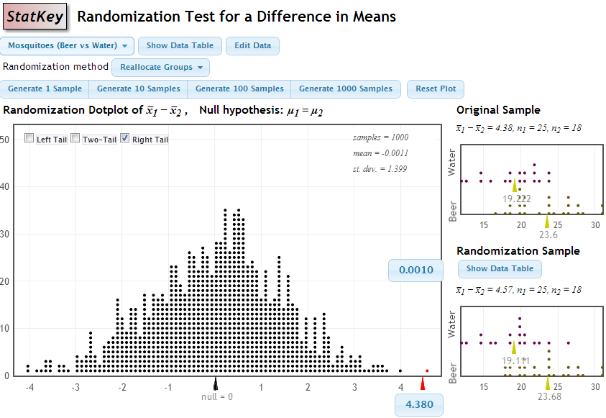
p-value = proportion of samples, when H₀ is true, that are as (or more) extreme as the original sample.
p-value

Slide 13
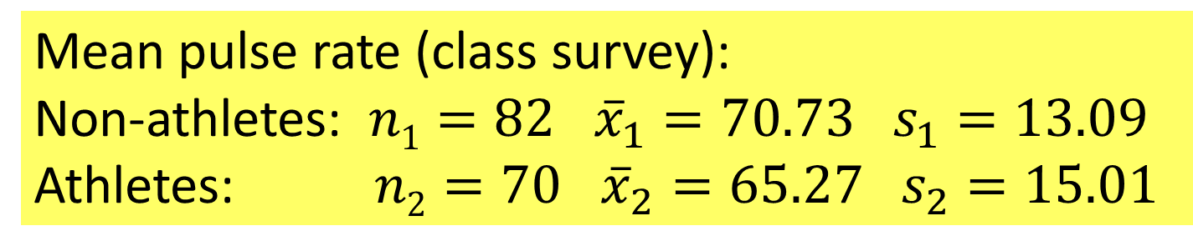
Example: Pulse Rate by Athlete Status
Mean pulse rate (class survey):
Non-athletes: $n1=82$ ${\overline{x}}_{1}=70.73 s_{1}=13.09$
Athletes: $n2=70$ ${\overline{x}}_{2}=65.27 s_{2}=15.01$
Is the mean pulse rate higher for non-athletes?
Find a 95% CI for the difference in mean pulse rate between athletes and non-athletes

Slide 14
StatKey
lock5stat.com/statkey
Data are in a spreadsheet
⇒ Copy/paste into StatKey (Edit Data)

Slide 15
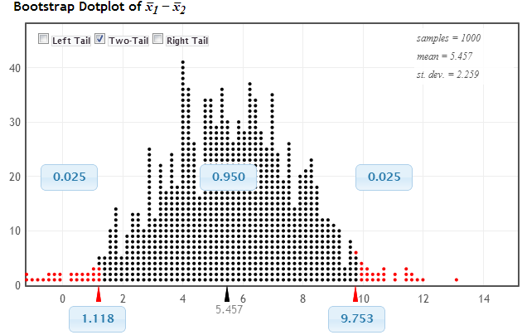
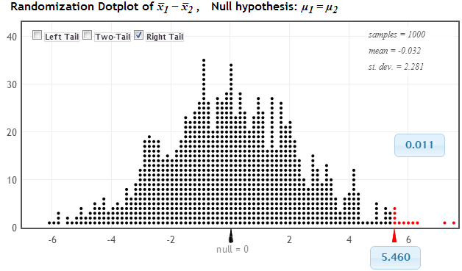

Slide 16
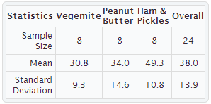
Example: Sandwich Ants
Experiment:
Place pieces of sandwich on the ground, count how many ants are attracted. Does it depend on filing?
Favourite Experiments: An Addendum to What is the Use of Experiments Conducted by Statistics Students? Margaret Mackisack
http://www.amstat.org/publications/jse/v2n1/mackisack.supp.html

Slide 17
StatKey
lock5stat.com/statkey

Slide 18
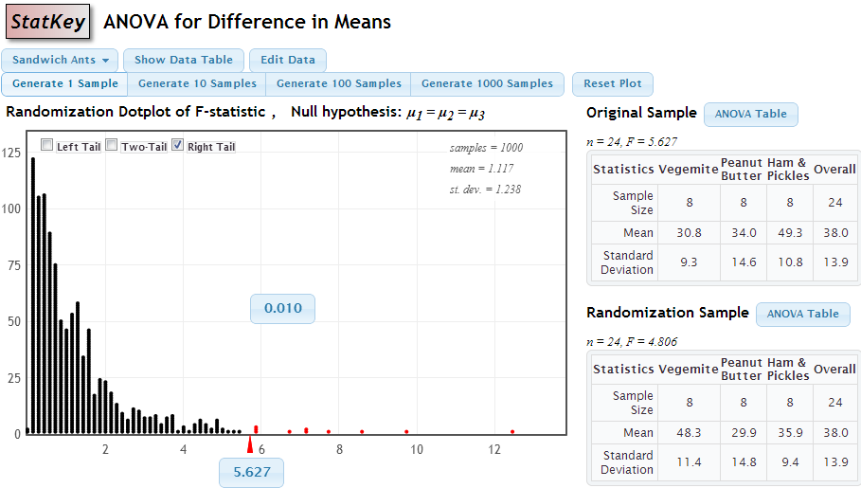

Slide 19
StatKey
lock5stat.com/statkey

Slide 20
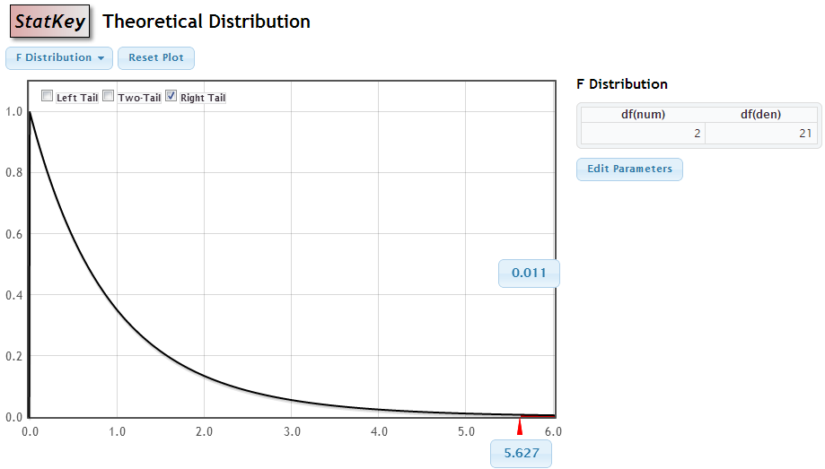

Slide 21
StatKey
lock5stat.com/statkey
Give it a try!
Questions?
rlock@stlawu.edu

