Slide 1
Welcome to the August 20, 2013 Journal of Statistics Education webinar
based on the March 2013 JSE paper
http://www.amstat.org/publications/jse/v21n1/lesser.pdf
“Using fun in the statistics classroom: An exploratory study of college instructors’ hesitations and motivations” by
Lesser, L.M.; Wall, A.; Carver, R.; Pearl, D.K.;
Martin, N.; Kuiper, S.; Posner, M. A.; Erickson, P.; Liao, S.-M.; Albert, J.; Weber, J.J.
who express appreciation to CAUSE (CAUSEmos grant from NSF, DUE #0618790)
and to JSE Editor Michelle Everson

Slide 2
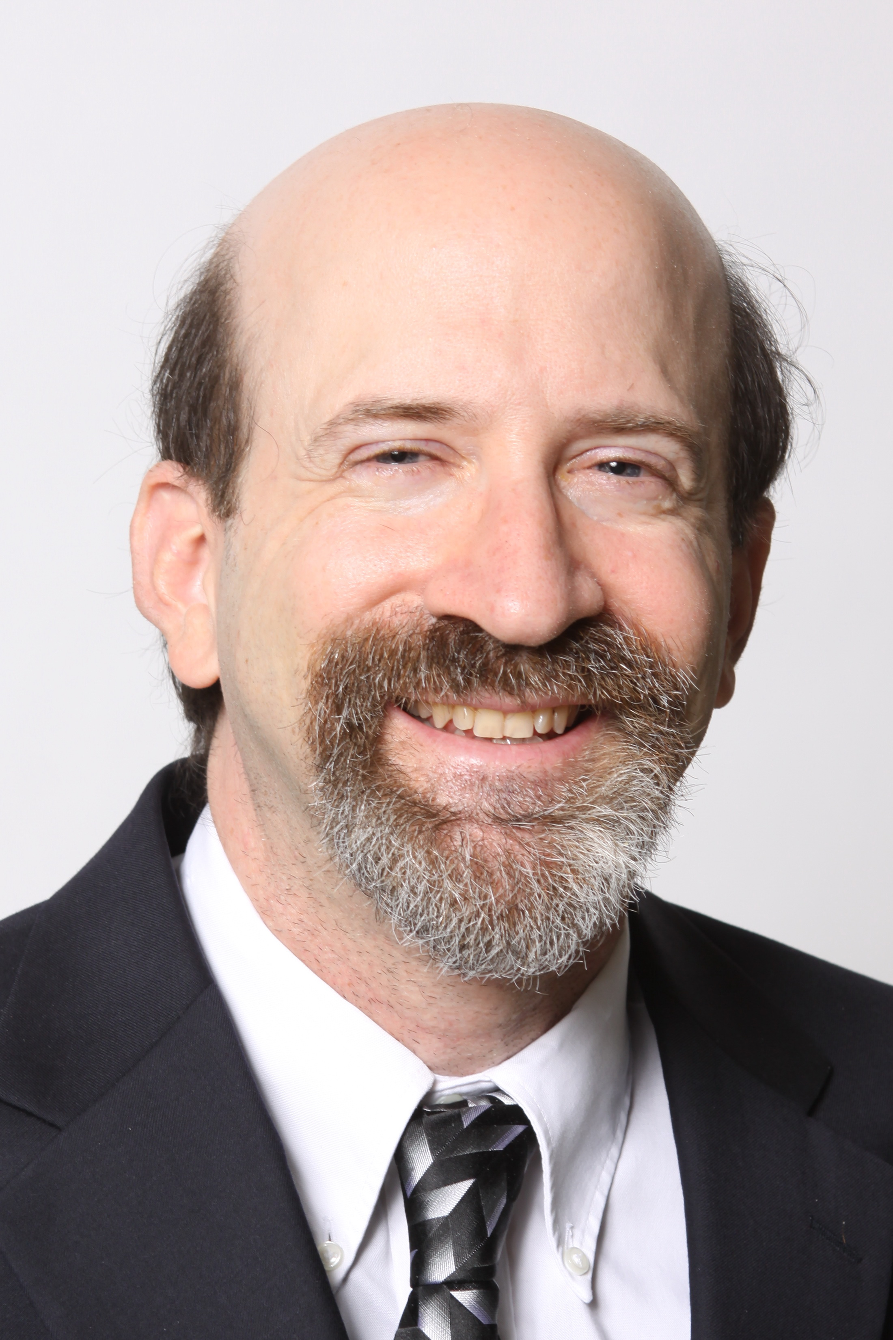
Presented by:
Lawrence Lesser (The University of Texas at El Paso)
Rob Carver (Stonehill College)
Patricia Erickson (Taylor University)

Slide 3
How do 11 authors co-write??
CAUSE-supported conference calls
Research retreat in Chicago (Oct. 28-29, 2011)
DropBox
Formed subgroups:
Literature/overview: Lesser, Pearl
Quantitative: Albert, Carver, Kuiper, Liao, Posner
Qualitative: Erickson, Martin, Wall, Weber

Slide 4
The USCOTS Fun connection
2007: Lesser & Pearl give breakout on “fun” that yields review paper in Nov. 2008 JSE
2009: CAUSE Study of Fun cluster launched, presents posters on fun modalities
2011: cluster membership grows; cluster conducts survey of USCOTS attendees, yielding USCOTS poster (in 2011 & 2013) and March 2013 JSE paper
2013: two members offer banquet fun; cluster offers “birds of a feather” lunch, presents poster

Slide 6
Outline of the JSE Paper
1. Introduction
2. Methods
3. Setting, Sample and Population
4. Results
5. Discussion
Appendix: Survey
Appendix: Interview Protocol
References (98!)

Slide 7
Fun can have SERIOUS benefits (Lesser et al. 2013, citing Berk & Nanda, 1998, 2006; Garner, 2006; Neumann, Hood & Neumann, 2009)
“experimental studies of the pedagogical impacts of humor have shown significant positive outcomes in
student ratings of the lesson,
student ratings of the instructor,
student anxiety,
student attitudes towards statistics, and
student recall and retention of information”

Slide 8
Types of fun: 20 & counting… (Lesser & Pearl, 2008; Lesser et al., 2013)
Cartoons
Celebration Days
Clothing
Comic Strips
Food
Games (commercial, cultural, other)
Game Shows
Humor/Jokes
Kinesthetic Activity
Literature
Magic
Media Bloopers, Strange (but true) news/research, satirical/fake research reports
Movies
Music, Raps/Songs
Poems
Quotations
Fun books
Striking Examples
Videos
Wordplay
Notes:
Items in blue were those featured in the survey

Slide 9
Research Goals
* to understand better the current usage of fun in statistics education, including reasons why some instructors use or do not use modalities of fun in their courses
* to examine if instructor’s gender, typical class size, institution type, and years of experience relate to motivations and/or hesitations for using fun in statistics teaching
* to assess awareness of resources for finding statistics fun items

Slide 10
SURVEY (in Appendix A of our paper)
Survey from the CAUSE Study of Fun Cluster Group
Please respond to this anonymous survey as you reflect on the last time you taught an introductory statistics course. Put the completed survey in the box located on the registration table (on Thursday) or at USCOTS Central by 4:30 pm on Friday to receive a “Study of Fun” notepad. When you return your survey, you can also drop your raffle ticket in the bowl for a chance to win a Nook Color e-Reader. Stop by our table at the Posters and Beyond session on Saturday at 9:30 a.m. and you can see the aggregate survey results and demonstrations of Statistics Fun!
BACKGROUND INFORMATION (fill in the blank or check your responses)
# of years teaching statistics ____ typical class size ____ Gender: ⁫□ Male ⁫□ Female
Institution: ⁫□ high school ⁫□ 2-yr college ⁫ □ 4-yr college ⁫ □ research institution ⁫ □ other
USAGE
Check each modality of fun that you have used in your statistics teaching:
⁫□ Poems/Songs ⁫ □ Cartoons ⁫ □ Games ⁫□ Jokes/Humor ⁫ □ Other:_____________
Check each modality of fun that you have NOT used, but are open to using
⁫ □ Poems/Songs ⁫ □ Cartoons ⁫ □ Games ⁫□ Jokes/Humor ⁫ □ Other:_____________
Check each modality of fun that you are not open to using:
⁫ □ Poems/Songs ⁫ □ Cartoons ⁫ □ Games ⁫□ Jokes/Humor ⁫ □ Other:_____________
MOTIVATIONS
Which of the following are your main motivations for using (or considering the use of) fun in your statistics teaching? (check all that apply)
⁫□ increases student learning/retention ⁫□ reduces student anxiety
⁫□ helps my popularity/ratings with students ⁫□ builds classroom community
⁫□ makes teaching more enjoyable for me ⁫□ increases student engagement
⁫□ other (please specify):_______________________
HESITATIONS
Which of the following are your main hesitations about using fun in your statistics teaching? (check all that apply)
□ no skills/talent □ can’t quickly find good examples
⁫□ weak evidence of helping student learning □⁫ uses too much class time
□ need to be perceived as serious by students □⁫ size of class
⁫□ need to be perceived as serious by colleagues/supervisor
⁫□ incompatibility with students’ cultures
□ other(please specify):________________________
CAUSEWEB.ORG
Have you used items from the “fun” resources collection at www.causeweb.org/resources/fun?
□ many times ⁫□ a few times ⁫□ once or twice □ no, but I’ve browsed
□ no, and I haven’t browsed ⁫□ no, and I didn’t know about this collection
I am open to being interviewed by phone about this topic ⁫□ no □ yes (print e-mail)______________
THANK YOU!

Slide 11
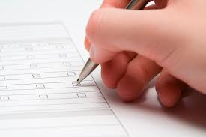
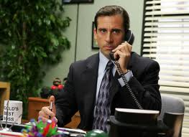
Methods
Survey (informed by literature on hesitations and motivations, as well as on completion inducements) at 2011 USCOTS, where
249 (66%) of 380 attendees participated
Post-USCOTS interviews needed to help contextualize and interpret survey data, especially given difficulties in defining fun

Slide 12
Survey and Interview Results

Slide 13
SURVEY (in Appendix A of our paper)
Survey from the CAUSE Study of Fun Cluster Group
Please respond to this anonymous survey as you reflect on the last time you taught an introductory statistics course. Put the completed survey in the box located on the registration table (on Thursday) or at USCOTS Central by 4:30 pm on Friday to receive a “Study of Fun” notepad. When you return your survey, you can also drop your raffle ticket in the bowl for a chance to win a Nook Color e-Reader. Stop by our table at the Posters and Beyond session on Saturday at 9:30 a.m. and you can see the aggregate survey results and demonstrations of Statistics Fun!
BACKGROUND INFORMATION (fill in the blank or check your responses)
# of years teaching statistics ____ typical class size ____ Gender: ⁫□ Male ⁫□ Female
Institution: ⁫□ high school ⁫□ 2-yr college ⁫ □ 4-yr college ⁫ □ research institution ⁫ □ other
USAGE
Check each modality of fun that you have used in your statistics teaching:
⁫□ Poems/Songs ⁫ □ Cartoons ⁫ □ Games ⁫□ Jokes/Humor ⁫ □ Other:_____________
Check each modality of fun that you have NOT used, but are open to using
⁫ □ Poems/Songs ⁫ □ Cartoons ⁫ □ Games ⁫□ Jokes/Humor ⁫ □ Other:_____________
Check each modality of fun that you are not open to using:
⁫ □ Poems/Songs ⁫ □ Cartoons ⁫ □ Games ⁫□ Jokes/Humor ⁫ □ Other:_____________
MOTIVATIONS
Which of the following are your main motivations for using (or considering the use of) fun in your statistics teaching? (check all that apply)
⁫□ increases student learning/retention ⁫□ reduces student anxiety
⁫□ helps my popularity/ratings with students ⁫□ builds classroom community
⁫□ makes teaching more enjoyable for me ⁫□ increases student engagement
⁫□ other (please specify):_______________________
HESITATIONS
Which of the following are your main hesitations about using fun in your statistics teaching? (check all that apply)
□ no skills/talent □ can’t quickly find good examples
⁫□ weak evidence of helping student learning □⁫ uses too much class time
□ need to be perceived as serious by students □⁫ size of class
⁫□ need to be perceived as serious by colleagues/supervisor
⁫□ incompatibility with students’ cultures
□ other(please specify):________________________
CAUSEWEB.ORG
Have you used items from the “fun” resources collection at www.causeweb.org/resources/fun?
□ many times ⁫□ a few times ⁫□ once or twice □ no, but I’ve browsed
□ no, and I haven’t browsed ⁫□ no, and I didn’t know about this collection
I am open to being interviewed by phone about this topic ⁫□ no □ yes (print e-mail)______________
THANK YOU!

Slide 14
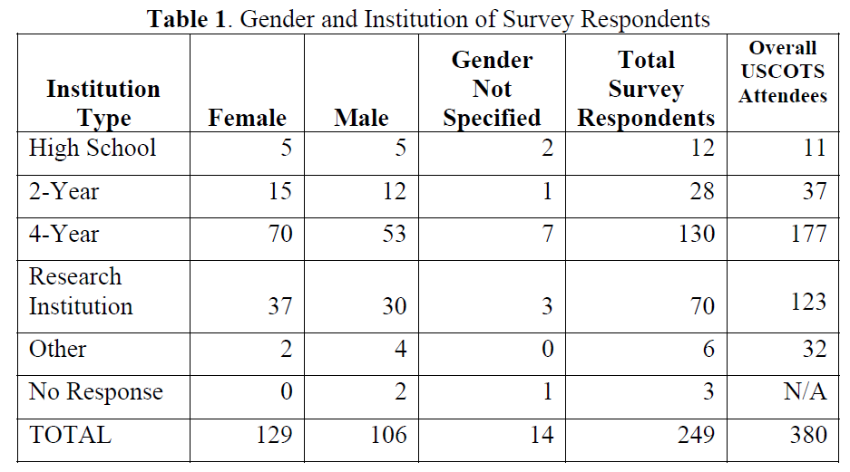
249 (66% of 380) USCOTS ‘11 attendees responded

Slide 15
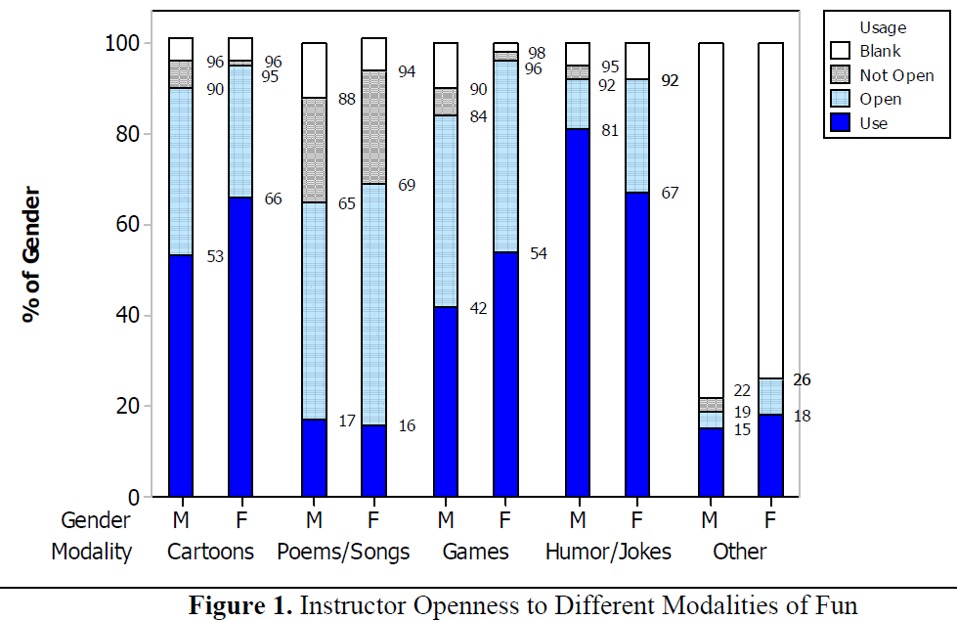
Openness to using fun (N = 249 statistics instructors)

Slide 16
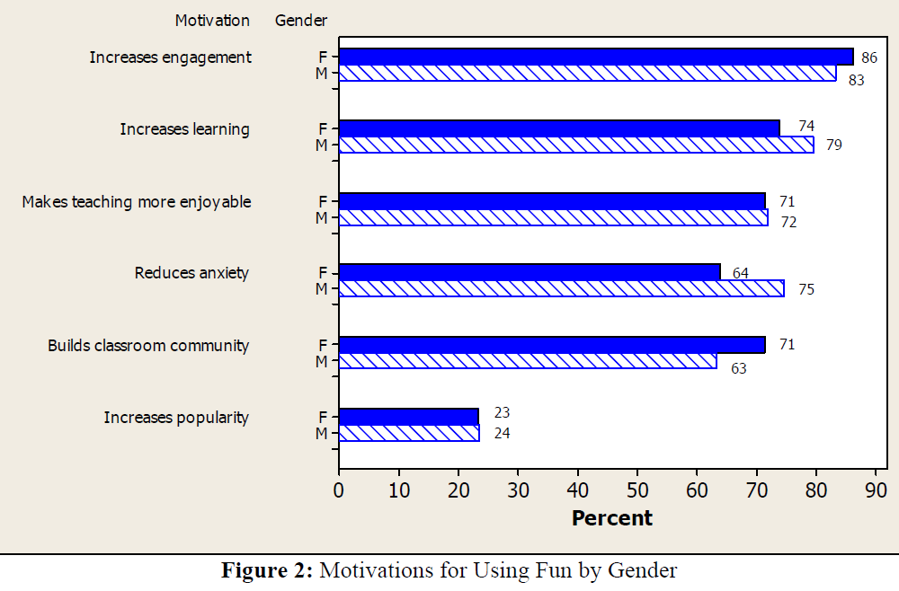
Motivations for using fun (N = 249 statistics instructors)

Slide 17
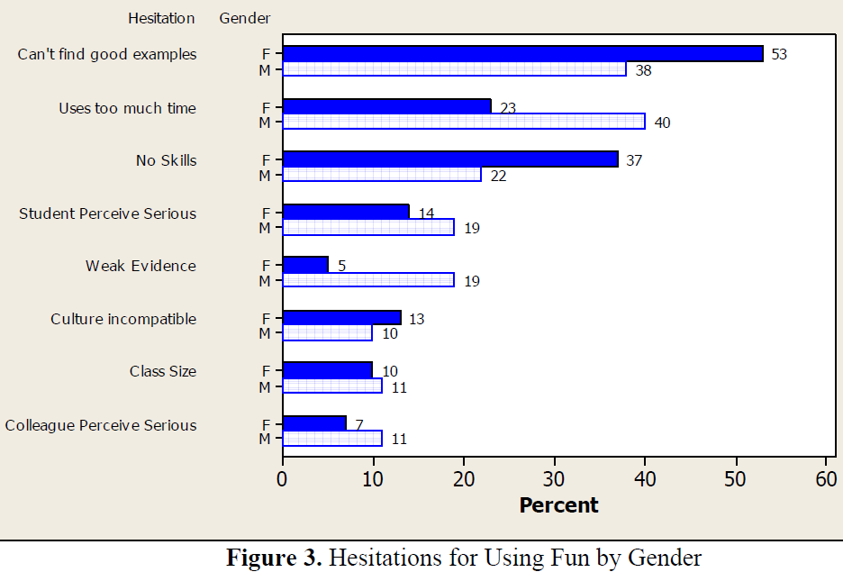
Hesitations for using fun (N = 249 statistics instructors)
?
Notes:
Potential gender differences to highlight:
1) Where females demonstrate greater hesitation than males.
Can’t find good examples [although here the gender difference is not as interesting as pointing out the CAUSE resources]
No skills [internalization of stereotype that men are more humorous? – See paragraph below.]
Vs.
2) Where males demonstrate greater hesitation than females.
Uses too much time
Weak evidence [Is that the real excuse or just convenient skepticism?]
In our article: “While females and males have concerns about being able to quickly find good examples, females tend to be more concerned about lacking the skills needed to use fun and males tend to be more concerned about using up class time.”
From: http://ssweb.cityu.edu.hk/download/RS/E-Journal/journal2.pdf (Not a top-tier journal, but useful info nonetheless…)
“Gender and humor styles
Generally, males consider themselves to be more humorous than females. Men have higher likelihood to joke, tease, and kid than women (Wong 2010). Women like to act in an appreciative way and rather be a listener to the jokes. They are less likely to produce humor by themselves (Freud 1905, Ehrenzweig 1957, McGhee 1979a). Males and females are different in using and responding to both adaptive and maladaptive styles of humors (Svebak 1974, Ziv 1984, Aries 1987, Eagly and Johnson 1990). Studies showed males obtain significantly higher scores than females on the two maladaptive humor styles (Martin et al. 2003). The trend was more obvious when the humor was related to sexual or aggressive issues (Spiegel et al. 1969).
Gender role and social status are important on the perception on humor. Men may establish dominance and social control by using humor (Martin et al. 2003). Females are more careful about their responses on humor to avoid being derisive or immodest. Because of the appropriate behavior assigned on women, they are less likely to show their enjoyment on humors. Some women may not be brave enough to pay the cost since some humors may carry risks (Brown and Levinson 1987).”

Slide 18
Post-USCOTS semi-structured interviews
Of 249 survey respondents, 77 agreed to a personal interview. We were able to complete 16.
A qualitative subgroup member conducted telephone interviews (20-30 min. call) in August-October 2011
“Who, What, Where, When, Why, How” Interview Protocol (in Appendix B)

Slide 19
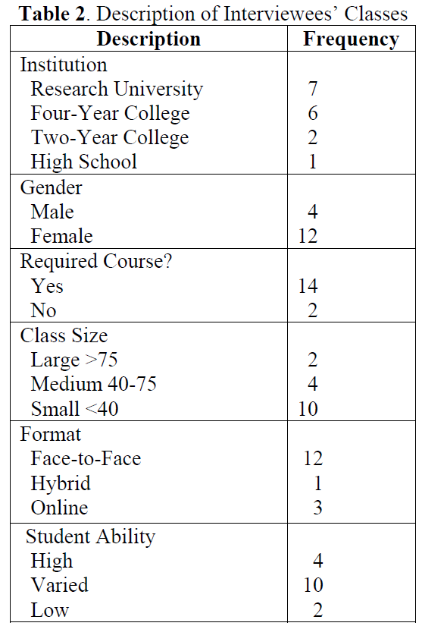
16 post-USCOTS semi-structured interviews
16 respondents (Table 2 in Section 3.2)
Interviewees were diverse
Participants located in many states (e.g., CA, VA, MN, TX)
Varied delivery styles for fun modalities used
Printed on handouts
Projected in class
Ad lib humor by instructor
Organized class activities

Slide 20
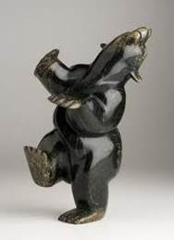
16 post-USCOTS semi-structured interviews
Results largely agreed with quantitative data
Motivations
Student centered
Cognitive and affective
“I use surveys to find student interests, and pick fun elements relevant to the students.”
“Student-generated fun elements stay with them more.”
“A point is best made with humor. It is better remembered.”
“Fearful students relax and believe they can do it.”
Notes:
In our article: “In terms of gender, only two of the four interviewed males mentioned student-centered motivation, whereas eleven out of twelve females did. In contrast, of the five interviewees who mentioned using fun elements for their own motivation, three were males.”

Slide 21
16 post-USCOTS semi-structured interviews
“Do students learn better if they are having fun? Not necessarily.”
Hesitations
Student centered
Instructor centered
Personal comfort with modalities
“Some students don’t want humor.”
“I don’t trust my judgment about poems and songs.”
“Some activities take too much class time.”
“I haven’t found relevant examples.”
“I do not use group singing because students are not comfortable with it.”
I can’t sing.”
Notes:
*From article and worth mentioning: “In fact, interview data distinguished between taking the time to search (n = 5) and taking the time to use (n = 4), a distinction that was not distinguishable from the survey.”

Slide 22
Some sources of fun in statistics

Slide 23
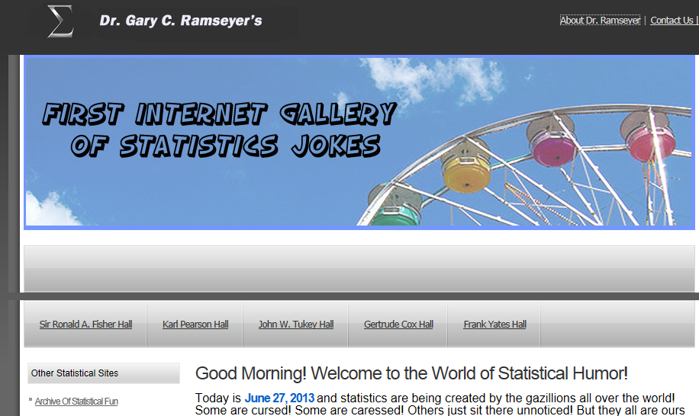
http://my.ilstu.edu/~gcramsey/Gallery.html (since 1996)
Notes:
Ramseyer’s page is a great source of jokes and one of the first large collections, but it lacks most of the other modalities and is not fully searchable.

Slide 24
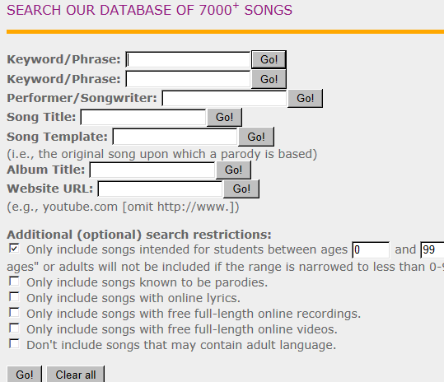
http://singaboutscience.org/
Notes:
This is a massive collection is very nicely searchable, but is only one modality: songs, and statistics is a very very small part of the coverage of many STEM subjects

Slide 25
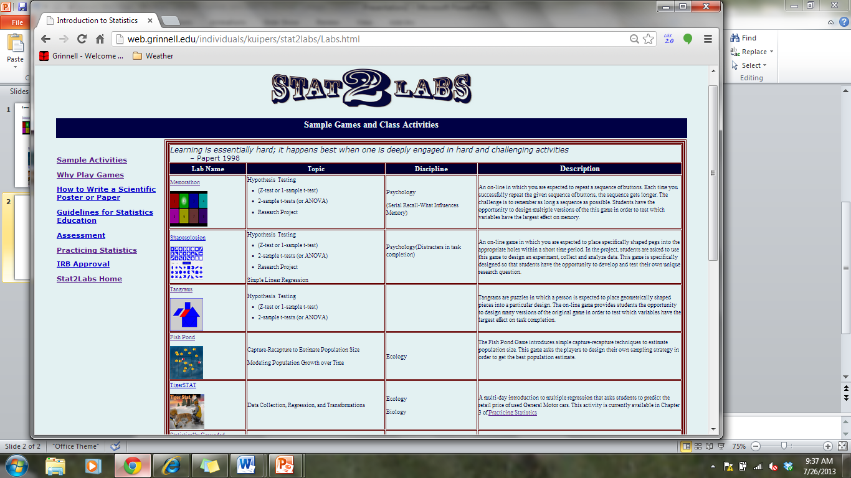
free online stats games http://web.grinnell.edu/individuals/kuipers/stat2labs/Labs.html http://economics-files.ponoma.edu/StatSite/statgame.html

Slide 26
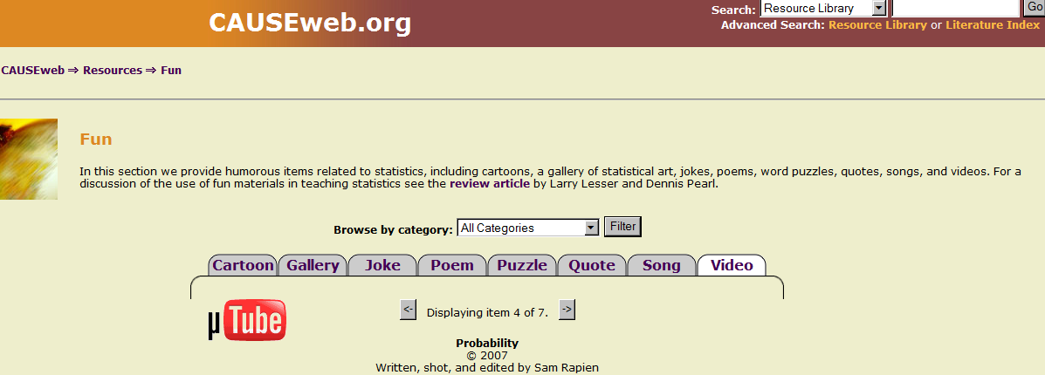
https://www.causeweb.org/resources/fun/
Notes:
The CAUSE collection is searchable, statistics-specific, and contains many modalities (with more to come)!

Slide 27
the CAUSE fun resources collection, one of the most-visited resources of CAUSEweb, part of NSF’s NSDL system
As of now, the collection’s 500+ items include:
Cartoons
Annotated quotations
Jokes
Poems
Songs
Mu-tube videos
Wordplay items
Gallery of statistics-related works of art
New categories to be added (magic, games, etc.)

Slide 28
Thank you for listening – let’s hear your reactions and questions!
Lawrence Lesser (Lesser@utep.edu)
Rob Carver (rcarver@stonehill.edu)
Patricia Erickson (pterickson@tayloru.edu)

Slide 29
Thanks for attending! Please let us know if…
You have any items (or ideas for items) for the CAUSEweb fun collection
You are interested in helping index or enhance existing items in the CAUSEweb fun collection
You are interested in helping with the research or professional development endeavors of our Study of Fun cluster
Questions about our paper occur to you after the webinar is recorded and archived

