Slide 1

Teaching Principles of
One-Way Analysis of Variance Using M&M’s Candy
Todd A. Schwartz
Department of Biostatistics, Gillings School of Global Public Health
and School of Nursing
University of North Carolina at Chapel Hill

Slide 2
M&M’s in the Statistics Classroom
Used to illustrate a variety of topics
  frequencies and proportions
  probability functions
  sampling distributions
  design of experiments
  chi-square goodness-of-fit statistics
  correlation/linear regression
Advantages
  edible reward at the conclusion of the experiment
  intuitive basis on which instructors can build
  fun activities
  active learning
  reducing students’ anxiety
  enhancing student engagement and learning
  follows recommendations of the GAISE College Report

Slide 3
M&M’s in the Statistics Classroom
Straightforward illustration of one-way ANOVA
Discussion of many relevant considerations
Instructor may not know a priori what the results will yield
Several alternative response variables for analysis
  likely to provide a variety of scenarios from which the instructor may select
    classroom demonstrations
    homework exercises
    examination questions

Slide 4
Context
12 to 15 students
Doctoral-level nursing program
Easily adaptable
  undergraduate students
  various disciplines
  variety of classrooms

Slide 5
Materials
Classroom computer
  spreadsheet software (e.g., Excel)
  statistical software
  projected onto a screen in the classroom
Classroom configured to allow the students to align themselves into pre-assigned groups
  students do not need access to individual computers during this exercise
These students have had previous, introductory exposure to one-way ANOVA
  demonstration also suitable for novice students without any prior ANOVA experience

Slide 6
Materials
Sequencing
  exercise occurs after two-independent group t-tests
  need for an extension to those methods for comparing more than 2 groups
Discussion
  the types of research questions that ANOVA can address
  issues of within- and between-group variability
  influence of sample size

Slide 7
Materials
Preparation
  minimal
  create student groupings
    approximately one-third of the total class size
  each group will receive only one type of M&M’s (e.g., peanut M&M’s)
  each member of the group receives his or her own packet of that type of M&M’s

Slide 8
Materials
Unpopulated spreadsheet
  record the data from the students in real-time
  gives the students experience in how to structure their primary data collection
  facilitate analysis after the data are collected
  first column
    each student’s name in a separate row, grouped according to their assignment (ID)
  second column
    group assignment (independent variable)

Slide 9
Materials

Slide 10
Materials
Prepare M&M’s for distribution
  choose three different varieties of M&M’s
    could easily extend to more than three types
  Plain (milk chocolate in a brown wrapper)
  Peanut (yellow wrapper)
  many more varieties on store shelves
    Peanut Butter
    Coconut
    Dark Chocolate
    Pretzel
    Almond
Goal: have roughly the same colors represented across all types of M&M’s

Slide 11
Materials
Cost will vary
  retail price per packet is approximately $1.20
  achieve cost savings
    store promotions
    buying in bulk
Packets for all types should all be approximately the same size or weight
  invokes variability among the types due to the varying sizes of the individual M&Ms
    a single milk chocolate M&M is smaller (and weighs less) than its peanut M&M counterpart

Slide 12
Materials
I tend to choose two of the types to have individual candies of similar size; 3rd substantially different
  e.g., peanut and pretzel M&M’s are similarly sized; both substantially larger than milk chocolate M&M’s
Facilitates illustrations of varying patterns of statistically significant findings that are intuitive
  despite potentially small sample sizes

Slide 13
Methods
Start in-class demonstration by announcing the groupings of the students
Rearrange themselves into their groups
Distribute the corresponding packets of M&M’s to each group
Caution them not to “eat the data” until the conclusion of the demonstration
  their interest is piqued
  “breaks the ice”
  lowers their guard (anxiety) so learning can occur

Slide 14
Methods
Research question: “Do different types of M&M’s have a different number of candies inside similarly-sized packages?”
  question may be repeated for each color under consideration
  6 traditional colors of M&Ms are red, green, blue, yellow, orange, and brown
Context: want to know which type to purchase at the store in order to maximize the total number of M&M’s (or the number of a certain favorite color)

Slide 15
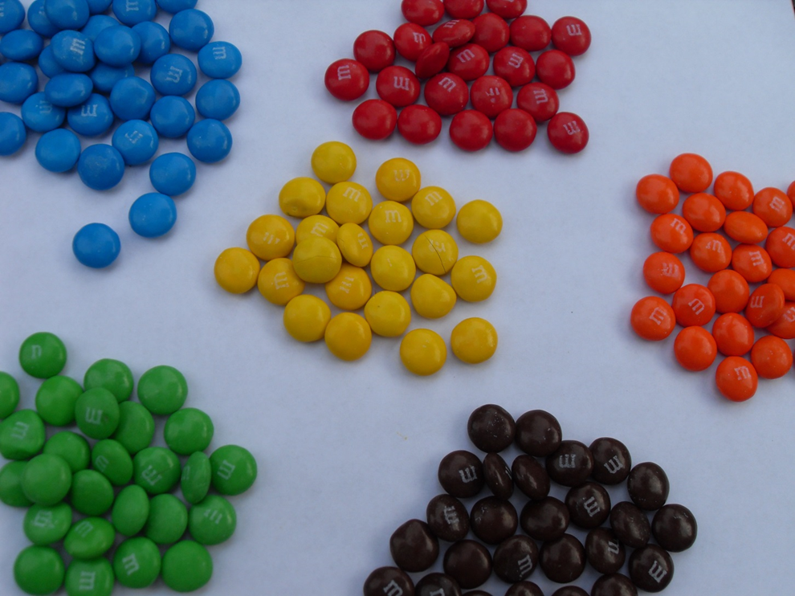
Methods
Instruct the students (individually) to count the total number of M&M’s in their packets
  sort them by color and to count the number of each color.
Give the students a few minutes to complete this task and to record their numbers
Project the unpopulated spreadsheet onto the classroom screen
  discuss the structure of how we will record the data and organize it for analysis
  rows for observations, columns for variables

Slide 16
Methods
At this point, I can present a brief review of key concepts of one-way ANOVA
  overall null hypothesis of testing all group population means equal to one another
  how that specifically relates to our data
Based on intuition, students can guess whether the null hypotheses will be supported or rejected for the data
  provide the rationale for their responses

Slide 17
Methods
Identify important concepts to the dataset
  identifying the dependent and independent variables
  how they are represented in the spreadsheet
Populate the spreadsheet
  call on the students in the order their names appear in the spreadsheet
  each student will then orally recite his or her data values in the order of the columns of the spreadsheet
  I have the final column pre-programmed to sum across the color subtotals to verify that the student’s total matches the sum of the color subtotals
    lesson on data integrity
    easier to take precautions to detect data errors as they are entered

Slide 18
Methods
When spreadsheet is completely populated
  save the spreadsheet file
  make it available to the class
    course management system
    email attachment
Primary source dataset
  students have been involved from beginning to end
  seven different potential one-way ANOVAs
    one for the mean total number
    one for the mean of each color’s subtotal
Useful for
  in-class demonstration
  subsequent assignments
  projects
  examinations

Slide 19
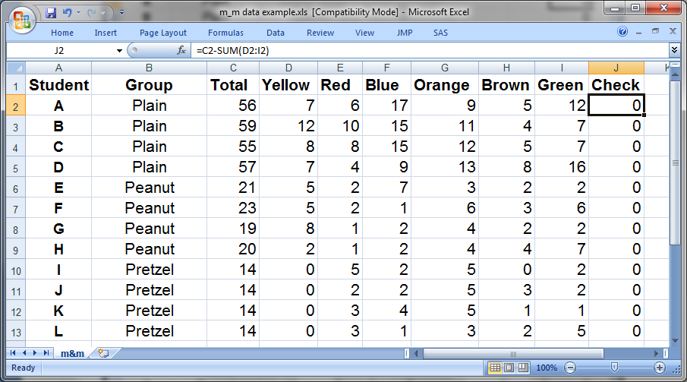
Methods

Slide 20
Results (1 replication of exercise)
Also teaching students to use statistical software
Preliminary analyses separately for each type of M&M’s
  computation of univariate statistics
    means and standard deviations
  information on the distributions
    e.g., through boxplots
Tie together numerical results with visual impact of plots
Table Selected descriptive statistics for the subtotal of brown M&M’s
GROUP N Mean Std Dev Minimum Maximum
Plain 4 5.5 1.7 4.0 8.0
Peanut 4 2.8 1.0 2.0 4.0
Pretzel 4 1.5 1.3 0.0 3.0

Slide 21
Results

Slide 22
Results
Inferential statistics
Can review the two-sample t-test
  compare and contrast results from those two approaches
  generalize the one-way ANOVA from k=2 groups to k=3 groups
  motivate the advantages of analyzing all of the groups in a single analysis, rather than as pairs through separate t-tests
Depending on the nature of the course, different aspects of the ANOVA may be emphasized

Slide 23
Results
For my students, I focus on the
  ANOVA (sums of squares) table
  parameter estimates (especially their interpretations; data not shown)
  least squares group means
    how these values are exactly the same as the descriptive statistics (means)
  formal testing of each of the pairwise comparisons
Table ANOVA table for the mean subtotal of brown M&M’s
Source DF Sum of Squares Mean Square F Value Pr > F
Model 2 33.50 16.75 9.00 0.0071
Error 9 16.75 1.86
Corrected Total 11 50.25

Slide 24
Results
Issue of multiple comparisons
  some of the more commonly used methods, with their advantages
  Bonferroni, Tukey, etc
Below, the Bonferroni approach provides p>.05 for the comparison of Plain vs. Peanut, while the Tukey approach yields p<.05.
Discussion of strategically selecting the multiple comparisons technique a priori
  depending on study objectives
Bonferroni-adjusted pairwise comparisons for testing row versus column means (subtotal of brown M&M’s)
Row/Column Plain Peanut Pretzel
Plain 0.0572 0.0075
Peanut 0.0572 0.6819
Pretzel 0.0075 0.6819
Tukey-adjusted pairwise comparisons for testing row versus column means (subtotal of brown M&M’s)
Row/Column Plain Peanut Pretzel
Plain 0.0456 0.0063
Peanut 0.0456 0.4321
Pretzel 0.0063 0.4321

Slide 25
Results
7 different possible ANOVAs
  interesting configurations inevitably arise
    one color might provide a significant p-value for the overall null hypothesis, with a mixture of significant and nonsignificant pairwise differences
    Another color might give a counter-intuitive pattern of a significant p-value for the overall null hypothesis , with all pairwise differences being nonsignificant
    yet another color might lead to the scenario of a nonsignificant p-value for the overall null hypothesis, but one or more significant pairwise differences
  discussion of such paradoxical findings
  my choice of having at least one of the types to be significantly smaller or larger than the others
    facilitates the existence of interesting findings in at least one of the ANOVAs
    I do not know a priori what the findings will be

Slide 26
Discussion
Demonstration need not be conducted in a computer lab
  nor do the students need to have access to their own computers during the demonstration
Can also discuss a myriad of considerations
  issues of random assignment to groups
  within- versus between-person factors
  effect size
  within- and between-group variability
  equal versus unequal group sample sizes
  sample size and power considerations
  importance of preliminary descriptive analysis to confirm or debunk investigators’ intuition
  difference between the hypothesis of equality of all group means versus pairwise comparisons
  multiple comparisons
  understanding of the various components of the software output
  proper interpretation of computer output
  appropriate reporting of findings

Slide 27
Discussion
At the conclusion of the exercise
  can generalize the one-way ANOVA from k=3 groups to an unspecified number of groups
  to help the students crystallize their thinking, can ask students to describe how this experiment could be repeated with k=4 or k=5
    by adding additional types of M&M’s
Later in the course, I can illustrate one-way ANCOVA
  examining one of the color subtotals, while covariate adjusting for the total counts
  More focused research question for each color
  “Do different types of M&M’s have a different number of candies of a specific color when the total number in the packages is the same?”
After two-way ANOVA
  can reinforce concepts by asking how we might have extended the M&M’s experiment to include a second factor
    e.g, repeating the process with a different sized bag of each type

Slide 28
Discussion
Limitation
  subject matter of M&M’s does not naturally translate to the subject matter of interest to the students
  can be offset by having the instructor explicitly bridge the gap from the foundational knowledge built using the M&M’s to variables that would be relevant to the students’ area of study
    useful examination question: contextualize the material
    ask students to express a dependent variable matched with an independent factor that would be relevant to their particular field of interest
    ensures the students are engaging with the material at an appropriate level

Slide 29
Discussion
Another drawback
  this exercise does not easily provide a rationale for the use of random assignment as might be expected in an experimental design context
  allows for that discussion
    randomization is not always possible for ethical or other reasons
    quasi-experimental or observational designs

Slide 30
Discussion
Larger classes
  costs will increase directly with class size
  logistics of data collection
    could be reduced by segmenting a large class into smaller sections of the classroom
  benefit: increased sample size
Anecdotal evidence that this exercise conveys the relevant concepts in a lasting fashion
  former student commented that during her dissertation research, she would return to our example and ask herself how elements of her dissertation dataset translated to the M&M’s demonstration!

Slide 31
Discussion
Overall, this exercise has proven to be a useful, fun, and memorable learning tool
In-class demonstration can easily be completed in one hour or less, or it can span more than one class period
  depending on the depth of coverage desired by the instructor
Out-of-class preparation
  not time- or labor-intensive
  relatively inexpensive

Slide 32
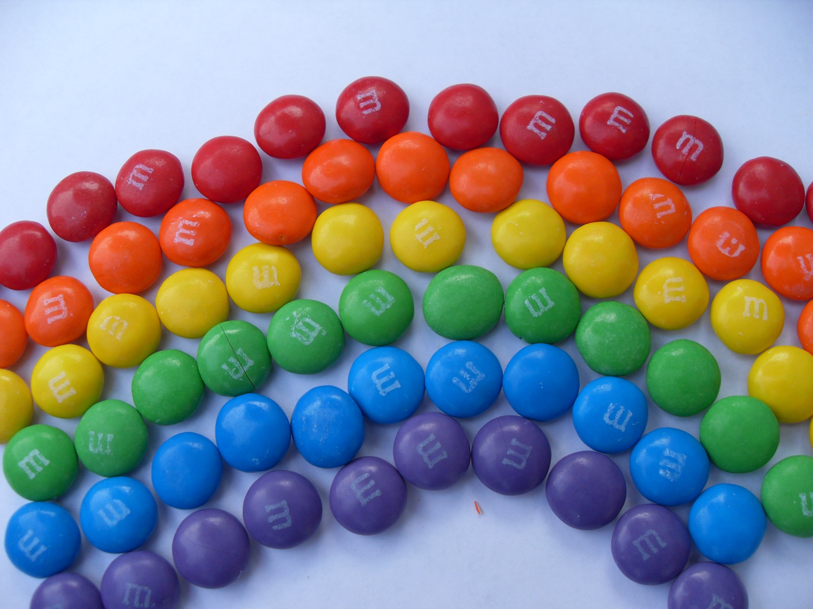
Questions?

