Slide 1
Using Simulation to Introduce Inference for Regression
By Josh Tabor
Canyon del Oro High School
Oro Valley, AZ
joshtabor@hotmail.com

Slide 2
Using Simulation to Introduce Inference for Regression
Randomization tests are growing in popularity as an alternative to traditional tests, but also as a way to help students to understand the logic of inference. In this webinar, we will use Fathom software and online applets to introduce inference for the slope of a least-squares regression line.

Slide 3
Does seat location affect grades?
Many people believe that students learn better if they sit closer to the front of the classroom. Does sitting closer cause higher achievement, or do better students simply choose to sit in the front? To investigate, an AP Statistics teacher randomly assigned students to seat locations in his classroom and recorded the test score for each student at the end of the chapter.
Why was it important to randomly assign the seats?

Slide 4
Does seat location affect grades?
The explanatory variable in this experiment is which row the student was assigned (Row 1 is closest to the front) and the response variable is the test score. Here are the data:
  Row 1: 76, 77, 94, 99
  Row 2: 83, 85, 74, 79
  Row 3: 90, 88, 68, 78
  Row 4: 94, 72, 101, 70, 79
  Row 5: 76, 65, 90, 67, 96
  Row 6: 88, 79, 90, 83
  Row 7: 79, 76, 77, 63

Slide 5
Does seat location affect grades?
Here is a scatterplot of the data, along with the least-squares regression line:
Is there evidence that sitting closer helps?

Slide 6
Does seat location affect grades?
What are the two explanations for the evidence we have?
Sitting closer really does help.
Sitting closer doesn’t help—the observed association was due to the chance variation in the random assignment.

Slide 7
Does seat location affect grades?
Is there convincing evidence that sitting closer helps? In other words, can we rule out random chance as a plausible explanation?
To answer this question, we need to determine what slopes could occur just due to the random assignment, assuming that seat location doesn’t matter.
Let’s simulate!

Slide 8
Does seat location affect grades?
Round 1: By hand
Write each of the 30 test scores on a notecard.
Shuffle the cards.
Put the cards into the 7 rows at random.
Calculate and record the slope.
Repeat.

Slide 9
Does seat location affect grades?
Round 2: Using Fathom
Fathom is designed to help teach statistics and is great for simulations.
More information at www.keypress.com
Let’s give it a try…

Slide 10
Does seat location affect grades?
Just in case, here are the results…

Slide 11
Does seat location affect grades?
In the simulation, 109 of the 1000 simulated slopes were less than or equal to -1.12.
Because it isn’t unusual to get a slope this small or smaller by random chance alone, we do not have convincing evidence that sitting closer causes higher tests scores.

Slide 12
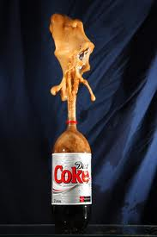
Mentos and Diet Coke
When Mentos are dropped into a newly opened bottle of Diet Coke, carbon dioxide is released from the Diet Coke very rapidly, causing the Diet Coke to be expelled from the bottle. Will more Diet Coke be expelled when there is a larger number of Mentos dropped in the bottle?

Slide 13
Mentos and Diet Coke
Two statistics students, Brittany and Allie, decided to find out. Using 16 ounce bottles of Diet Coke, they dropped either 2, 3, 4, or 5 Mentos into a randomly selected bottle, waited for the fizzing to die down, and measured the number of cups remaining in the bottle. Then, they subtracted this measurement from the original amount in the bottle to calculate the amount of Diet Coke expelled (in cups).

Slide 14
Mentos and Diet Coke
The equation of the least-squares regression line is:
Is there evidence that more Mentos = more mess? What are the two explanations for the evidence we see? Which is more likely?

Slide 15
Mentos and Diet Coke
Again, let’s use simulation to determine what slopes could happen just by chance, assuming that the number of Mentos does not affect the amount expelled.
Method 3: Using an Applet
www.lock5stat.com/statkey
Test for Slope, Correlation (lower-right)
Change to slope and click “Edit Data”

Slide 16
Mentos and Diet Coke
Here are the data
Mentos | Amount | Mentos | Amount
2 | 1.125 | 4 | 1.25
2 | 1.25 | 4 | 1.3125
2 | 1.0625 | 4 | 1.25
2 | 1.25 | 4 | 1.375
2 | 1.125 | 4 | 1.3125
2 | 1.0625 | 4 | 1.25
3 | 1.1875 | 5 | 1.25
3 | 1.125 | 5 | 1.4375
3 | 1.25 | 5 | 1.3125
3 | 1.1875 | 5 | 1.3125
3 | 1.3125 | 5 | 1.375
3 | 1.1875 | 5 | 1.4375

Slide 17
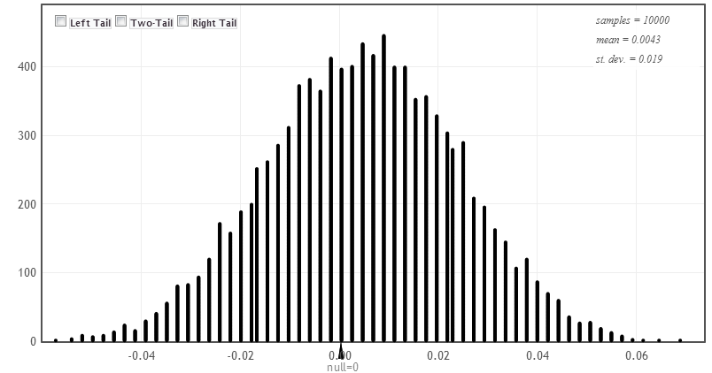
Mentos and Diet Coke
Just in case….here are the results of 10,000 repetitions

Slide 18
Mentos and Diet Coke
In the simulation, 0 of the 10,000 simulated slopes were greater than or equal to 0.071.
Because it is very unusual to get a slope this large or larger by random chance alone, we have convincing evidence that adding more Mentos to Diet Coke creates a bigger mess.

Slide 19
Using Simulation to Introduce Inference for Regression
Closing Thoughts:
Using simulation (randomization tests) helps students understand the logic of inference and the meaning of p-values.
Simulate by hand first, then use technology.
Transition to traditional t tests by investigating the shape, center, and spread of the randomization distribution of the slope.

Slide 20
Using Simulation to Introduce Inference for Regression
Questions?
Contact Information:
Josh Tabor
joshtabor@hotmail.com

