Slide 1
Evaluating Innovative Courses in Introductory Statistics: Resources from the eATLAS Project
Elizabeth Fry and Rebekah Isaak
University of Minnesota
eATLAS funded by NSF DUE 1044812 & 1043141

Slide 2
Overview
Principles of Curriculum Evaluation
Example: Evaluation of CATALST Project
Instruments developed for CATALST that became part of eATLAS
Additional instrument developed for eATLAS
Recommendations for future curriculum evaluations

Slide 3
Why evaluate?

Slide 4
Why evaluate?
Evaluation produces information that can be used to improve the project
Evaluation can document what has been achieved, and to what extent the desired goals and impacts have been attained

Slide 5
Guidelines for Evaluating Curriculum
One size does not fit all (Frechtling, 2010)
Clearly define the purpose
  Formative vs. summative
  “The purpose of an evaluation should derive in part from the project, what it is intended to achieve, and the questions it is addressing.” (Frechtling, 2010, p. 114)
Use multiple methods
Document well

Slide 6
Guidelines for Evaluating Curriculum
Tradeoffs depend on:
  Evaluation Purpose
  Degree of confidence needed
Work smart, not hard:
  Choose evaluation activities that cover multiple purposes
Breadth
Cost
Time
Rigor

Slide 7

The CATALST Project
http://www.tc.umn.edu/~catalst/
5 year project
Purpose:
  To create and implement innovative learning materials for an introductory, non-calculus based statistics course
  To assess student achievement

Slide 8
The CATALST Project
http://www.tc.umn.edu/~catalst/
Evaluation
  Ongoing formative evaluation
  Final summative evaluation
  External evaluator: Rob Gould (UCLA)

Slide 9

CATALST Goals & Evaluation Questions
    Goal 1: Create innovative learning materials for an introductory, non-calculus based statistics course based on modeling and simulation
Evaluation Question:
  Has the project succeeded in this goal?

Slide 10

CATALST Goals & Evaluation Questions
    Goal 2: Implement the Educational Innovations
Evaluation Question:
  What is the feasibility of implementing the CATALST materials and approach in an undergraduate statistics course?

Slide 11

CATALST Goals & Evaluation Questions
    Goal 3: Assess Student Achievement
Evaluation Question:
  Has this been accomplished?

Slide 12

CATALST Goals & Evaluation Questions
    Goal 4: Conduct Research on Undergraduate Statistics Education
Evaluation Question:
  Have these studies taken place and what has been learned from these studies?

Slide 13

CATALST Goals & Evaluation Questions
    Goal 5: Develop Faculty Expertise (to teach a CATALST course)
Evaluation Questions:
  What is the impact on teachers who attend CATALST workshops and implement aspects of the CATALST curriculum?
  What are the barriers for teachers who want to adapt aspects of this approach, and what are effective ways of overcoming these barriers?
  What is the feasibility of other instructors adopting the methods and materials developed by this project?

Slide 14

CATALST: Formative Evaluation
Constant changes, updates & improvements
  Curriculum
    Content
    Contexts
    Activities
  Pedagogy
    Scaffolding
    Inverted classroom
    Cooperative learning
    Group assessments

Slide 15

CATALST: Formative Evaluation
Implementation
  Workshops and gatherings
  Lesson plans
  Implementer visits
  Feedback from implementers

Slide 16
Summative Evaluation
What was the impact of CATALST?
Clinical interviews with students
Retention Study 2012
Instruments
  To compare with non-CATALST courses across different institutions
  Both qualitative and quantitative components

Slide 17
Summative Evaluation Data
Gathered Fall 2011/Spring 2012
14 instructors at 8 institutions
CATALST
Spring 2012
289 students taught by
8 instructors
Non-CATALST
Fall 2011/Spring 2012:
440 students
taught by
6 instructors

Slide 18

Instruments developed for CATALST
For assessing student outcomes:
Goals and Outcomes Associated with Learning Statistics (GOALS), 2 versions:
    TRAD: for students in traditional courses
    RAND: for students in randomization-based courses
Models of Statistical Thinking (MOST)
For assessing student attitudes:
Affect Survey (Attitudes and beliefs about statistics)
  These instruments were developed for evaluation of CATALST, but can also be used in other settings

Slide 19
Goals and Outcomes Associated with Learning Statistics (GOALS)
27 forced-choice items
Items assess statistical reasoning in a first course in statistics
Two versions
  TRAD: Items 19-22 assess traditional approach to statistical inference
  RAND: Items 19-22 assess randomization-based approach to statistical inference
  23 items common to both versions

Slide 20
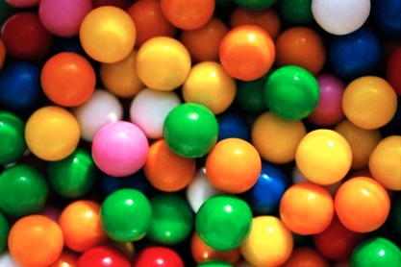
GOALS: Example Item
A certain manufacturer claims that 50% of the candies they produce are brown and that candy pieces are randomly placed into bags. Sam plans to buy a large family size bag of these candies and Kerry plans to buy a small fun size bag.
Which bag is more likely to have more than 70% brown candies?
  Sam’s, because a larger bag is more likely to have a larger proportion of brown candies.
  Kerry’s, because there is more variability in proportions of colors among smaller samples.
  Both have the same chance because the bags they buy are both random samples of candy pieces.

Slide 21

Models of Statistical Thinking (MOST)
4 real-world contexts
4 open-ended items that ask students to explain how they would set up and solve a statistical problem that involves a statistical inference
7 forced-choice follow-up items
Used in both traditional and randomization-based courses

Slide 22
MOST: Example Item
Consider a random sample of 50 breakups reported on Facebook within the last year. Of these 50, 20% occurred on Monday.
Explain how you could determine whether this result would be surprising if there really is no difference in the chance for relationship break-ups among the seven days of the week.
Be sure to give enough detail that someone else could easily follow your explanation in order to implement your proposed analysis and draw an appropriate inference (conclusion).

Slide 23
Affect Survey
12 questions
  4 items assess experience in an introductory statistics course
  4 items assess use of statistical software
  4 items assess beliefs about statistics
4 response categories
Strongly Disagree
Disagree
Agree
Strongly Agree

Slide 24
Affect Survey: Example Items
This course helped me understand statistical information I hear or read about in the media.
I would be comfortable using software to test for a difference between groups after completing this class.
I feel that statistics offers valuable methods to analyze data to answer important research questions.

Slide 25

Information Provided by Evaluation
CATALST can be taught successfully by a variety of instructors in a variety of settings
Data are still being analyzed , but preliminary results suggest that CATALST students seem to show higher levels of:
    Statistical thinking
    Positive attitudes and beliefs
    Understanding and interpreting p-values and confidence intervals
  than students in comparison courses

Slide 26
Information Provided by Evaluation
Even though CATALST students did not study a lot of traditional content, they did not score lower on the 23 common items on GOALS
Weakest areas: understanding how sample size affects sampling variability
Several months after the course: positive attitudes remain about what students have learned, and good understanding of modeling and inference is retained.

Slide 27

eATLAS Instruments
e-ATLAS (Evaluation and Assessment of Teaching and Learning About Statistics) grant from NSF 2011-2013
Developed instruments to use in large scale assessments across introductory statistics classes in USA as well as in evaluations of new curricula
Assessments of student outcomes: GOALS, MOST and Affect Survey
Assessment of teacher practice and beliefs: Statistics Teaching Inventory (STI)

Slide 28
Statistics Teaching Inventory (STI)
4 versions
Online classes
Face-to-face classes
(2 versions)
Hybrid classes
One instructor per section
Lecture/recitation format (lecturer plus TA)

Slide 29

Statistics Teaching Inventory (STI)
Six different sections:
Pedagogy
Curricular Emphasis
Technology
Assessment
Beliefs
Course Characteristics

Slide 30
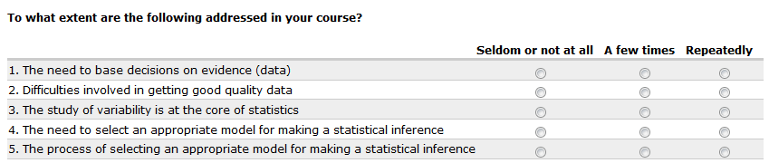
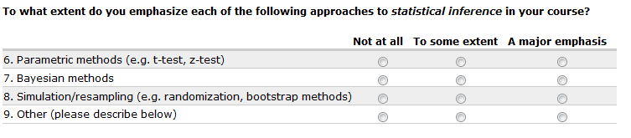
STI: Example Items
From Curricular Emphasis section

Slide 31
Next Steps for eATLAS
Statistics Teaching Inventory will be given to a national random sample to track change over time and provide baseline data
Subset of STI respondents to administer student instruments (GOALS, MOST, Affect) for their courses
STI can also be used in evaluations of projects that seek to impact instructors

Slide 32
Recommendations for Designing Curriculum Evaluations
  Clarify purpose and goals for the project
  Have clear, focused evaluation questions and identify what types of information can be used to answer each question
  Clarify processes for gathering both formative and summative data
  Use good assessment instruments!
  Have a good external evaluator to provide critical feedback
  Gather different types of information to continually improve materials

Slide 33

Thank you!
Contact Information
fryxx069@umn.edu
Elizabeth Fry
isaak009@umn.edu
Rebekah Isaak
jbg@umn.edu
Joan Garfield

Slide 34
References
Frechtling, J. (2010). The 2010 User-Friendly Handbook for Project Evaluation. Retrieved from: http://www.westat.com/pdf/projects/2010ufhb.pdf

