Slide 1
Guided Discovery Using Applets and Video Tutorials in Statistics
Lisa Green: Mathematical Sciences
Scott McDaniel: University Studies
Middle Tennessee State University
February 26, 2013.

Slide 2
I-cubed Modules
Independent Interactive Inquiry-Based (I³) Modules
Combine audio-visual instruction with interactive inquiry-based lessons that guide students to discover and visualize important concepts in statistics.

Slide 3
Eight Modules
Binomial - What happens to the shape of the binomial distribution as the parameters of the distribution change.
Confidence Intervals - The difference between two confidence intervals for the mean: the one based on the normal curve, and the one based on the t-distribution.
Statistical Significance (p-value) - how likely the observed outcome would be if there were actually no difference between the groups.
Randomization^{* -} The purpose of randomization in experiments.

Slide 4
Eight Modules
Sampling Variability 1 - The long-term patterns that occur in the sampling distribution of sample proportions.
Sampling Variability 2 - The number of outcomes that are within one, two, and three standard deviations from the mean.
Sampling Variability 3 - How the sample size and the probability of success affect the behavior of the sampling distribution.
Sampling Variability 4 - Whether a particular outcome can be considered surprising.

Slide 5
Pretest and Posttest Results
McDaniel, Scott N. & Green, Lisa B. (2012). Using Applets and Video Instruction to Foster Students' Understanding of Sampling Variability. Technology Innovations in Statistics Education, 6(1). Retrieved from: http://escholarship.org/uc/item/1nh4n607
McDaniel, Scott N. & Green, Lisa B. (2012). Independent Interactive Inquiry-Based Learning Modules Using Audio-Visual Instruction In Statistics. Technology Innovations in Statistics Education, 6(1). Retrieved from: http://escholarship.org/uc/item/322385kq

Slide 6
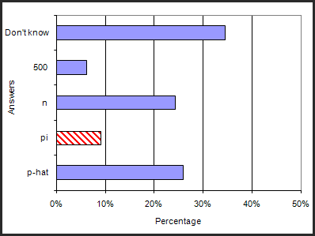
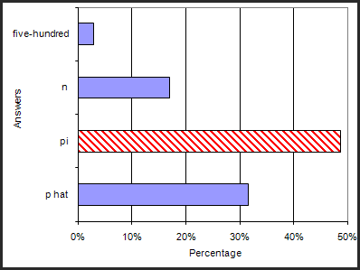
Sampling Variability Part 1
Pretest question: The center of the sampling distribution of proportion with the sample size of 25 with 500 replications will be the same value of: ( ).
Posttest question: The mean of the sample proportion values will approach ( ) when we have 500.
n = 177

Slide 7
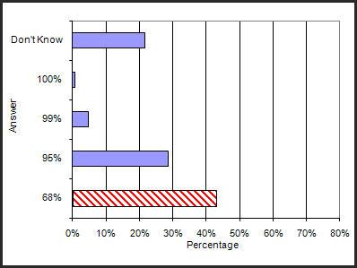
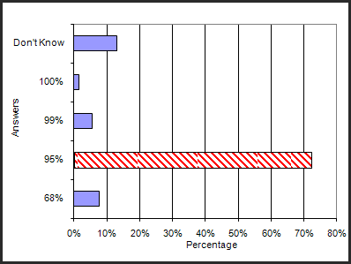
Sampling Variability Part 2
Pretest question: The percentage of sampling distribution of proportion which will be included by the interval around the mean with one SD will be about:
( ).
Posttest question: The mean of the sample proportion values will approach ( ) when we have 500. The percentage of sampling distribution of proportion which will be included by the interval around the mean with two SD will be about: ( ).
n = 130

Slide 8
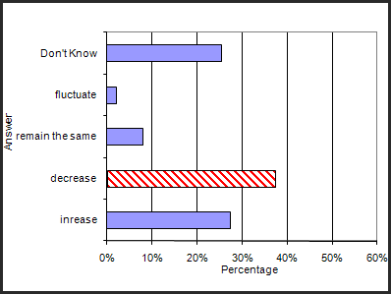
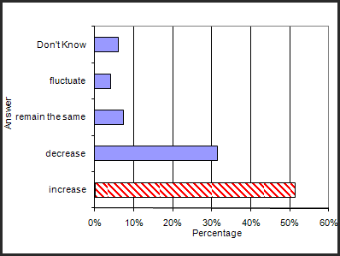
Sampling Variability Part 3
Pretest question: If we increase sample size from 25 to 45 for the sampling distribution of proportion in building an interval around the sample proportion, the standard deviation of the sampling distribution of proportion will: ( ).
Posttest question: If we reduce sample size from 45 to 25 for the sampling distribution of proportion in building an interval around the sample proportion, the standard deviation of the sampling distribution of proportion will: ( ).
n = 150

Slide 9
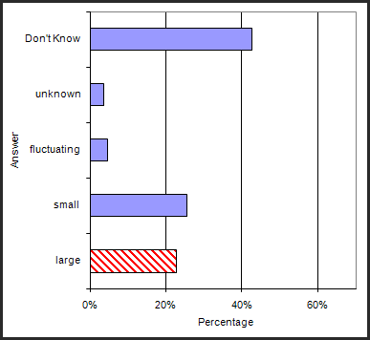
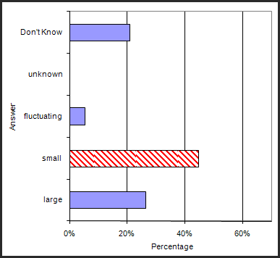
Sampling Variability Part 4
Pretest question: If the computed z-value is small, the tail probability of the z-distribution cut off by the z-value will be:
Posttest question: If the computed z-value is large, the tail probability of the z-distribution cut off by the z-value will be ( ).
n = 110

Slide 10
Exploring the Site
http://icubedmodules.wordpress.com/

Slide 11
Suggestions for Using the Modules
In computer lab, don’t forget headphones.
Homework.
Supplement for someone who missed class.
Best to have time between the modules, not to assign all four Sampling Variability at once.
Original intention was to use them for upper-level, Calculus-based classes.

Slide 12
Questions?

Slide 13
Acknowledgements
Dr. Ginger Holmes Rowell
Marisella Castro, Kai Guo, Megan Hall and Kacie Kleja
Carla Adamson, Dr. Curtis Church, Christine Snearly, and Dr. Dennis Walsh
National Science Foundation (NSF CCLI –0443088)

