Slide 1
Experiences with & Assessments of an Open-Access, Online Course
for Introductory Statistics
Marsha Lovett (presenter)
Carnegie Mellon University
Oded Meyer
Georgetown University

Slide 2
Technology-Enhanced Learning is in the news…

Slide 3
The motivation behind our work is different:
Access, Effectiveness, Efficiency
Notes:
Talk it thru: TA worked indi’lly with students giving ind’l feedback, presenting more problems to each student, and aggregated that info to give you a sense of what students got didn’t get…

Slide 4
Typically,
students in introductory lecture courses spend 100+ hours across the semester, and yet show only moderate learning gains.
Lovett, Meyer, & Thille (2008). Journal of Interactive Media in Education
Notes:
Now you may be thinking (hoping) that this was true because the course was taught by a rather poor lecturer who gave very dry and passive .

Slide 5
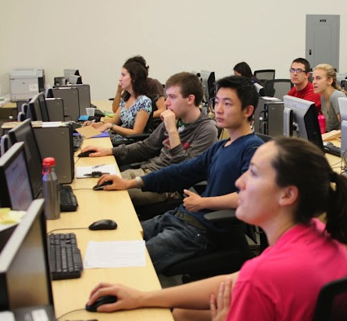
3%
Lovett, Meyer, & Thille (2008). Journal of Interactive Media in Education
Notes:
Award-winning professor in a class with 3 active lectures & computer-based lab sessions with hands-on practice

Slide 6
We can do better…
Notes:
Imagine the following scenario…
Effective course design
Judicious use of technology
Ongoing assessment & improvement

Slide 7
Punchline…
Students learning with a hybrid of face-to-face teaching and our online statistics course demonstrated learning gains equal to or better than the traditional class, in half the time.
Six months later, students in this hybrid course retained the material just as well as the traditional class.
Lovett, Meyer, & Thille (2008). Journal of Interactive Media in Education

Slide 8
Carnegie Mellon’s Open Learning Initiative (OLI) and the OLI Statistics Course
Goal of OLI: Produce scientifically-based online courses and course materials that enact instruction, support instructors, and are designed to improve the quality of higher education.
Notes:
CREATING…
Should mention:
Not collections of materials to support teaching
MUCH HARDER CHALLENGE
Courses that will be Complete enactment of instruction.
Designed to support learners who do not have the benefit of an instructors.
In practice: Used more in the Hybrid (Blended) mode – combined with face to face.
Because they were designed as stand alone courses they work so well in the blended mode.
Promoting coherence means teaching students how the discrete skills they are learning fit together in a meaningful big picture. Although the conceptual structure of knowledge in a domain is clear to experts, it is not to novices. The array of new ideas and unfamiliar terminology in introductory courses tends to overwhelm students into memorizing a set of isolated facts without understanding the underlying common principles (Chi, 2005; diSessa, 1993).
Studies have shown that students learn new material better when it is presented in a structured manner that provides the conceptual framework or “big picture”. For students to benefit from a conceptual framework that organizes the material they are learning, instruction needs to make that framework salient, and students need to practice making connections between related ideas (Eylon & Reif, 1984).
<Demo Stat Course> mean/median/boxplot section.
Main points in Demo:
Big Picture and structure of course
Effective Use of Media Elements: Course follows well researched principles to minimize cognitive load imposed by the learning design.
Immediate and Targeted Feedback:
Studies: immediate feedback → students achieve desired level of performance faster. Throughout the course immediate and tailored feedback is given.
mini tutors embedded in the material.
self assessments activities (Did I get this?)

Slide 9
Educational Mission of Funder
(The William and Flora Hewlett Foundation)
Provide open access to high quality post-secondary education and educational materials to those who otherwise would be excluded due to:
Geographical constraints
Financial difficulties
Social barriers
To meet this goal:
A complete stand-alone web-based introductory statistics course.
openly and freely available to individual learners online.

Slide 10
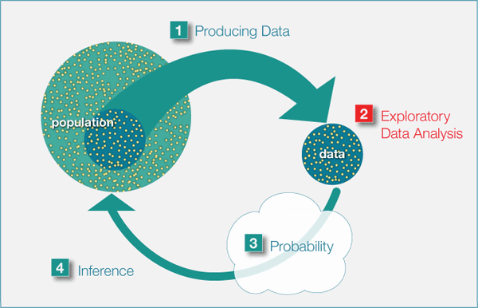
Key Feature of the OLI Statistics Course
High level of scaffolding in the course structure:
The course is based on the “Big Picture” of Statistics
Rigid structure throughout the material hierarchy
Smooth conceptual path
Notes:
A few examples of how we applied learning science principles.
Goal: Show our students how the discrete skills fir together in a meaningful big picture.
Especially important in intro classes where they are introduced to new ideas and terminology.
Studies have shown that if you do not make this big picture salient, the students
Understanding will be more about memorizing isolated facts without understanding the underlying common
Priciples.

Slide 11
Key Features of the OLI Statistics course
Immediate and Targeted Feedback
Studies: immediate feedback → students achieve desired level of performance faster.
Throughout the course immediate and tailored feedback is given.
mini tutors embedded in the material.
self assessments activities (Did I get this?)
Notes:
After this slide - demonstration

Slide 12
Key Features of the OLI Statistics course
Feedback to the instructor about students’ learning → Learning Dashboard
Presents the instructor with a measure of student learning for each learning objective.
More detailed information:
Class’s learning of sub-objectives
Learning of individual students
Common misconceptions
Notes:
After this slide - demonstration

Slide 13
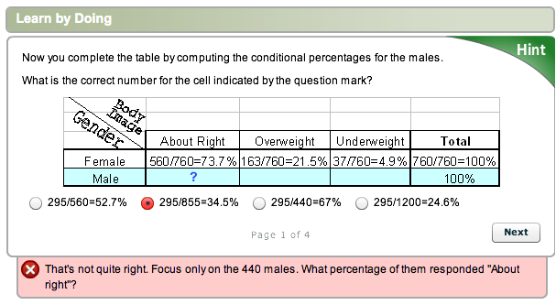
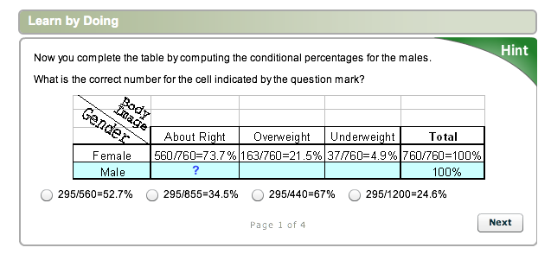
Learning activities are instrumented to continuously assess student learning
Feedback to Student
Feedback to Instructor

Slide 14
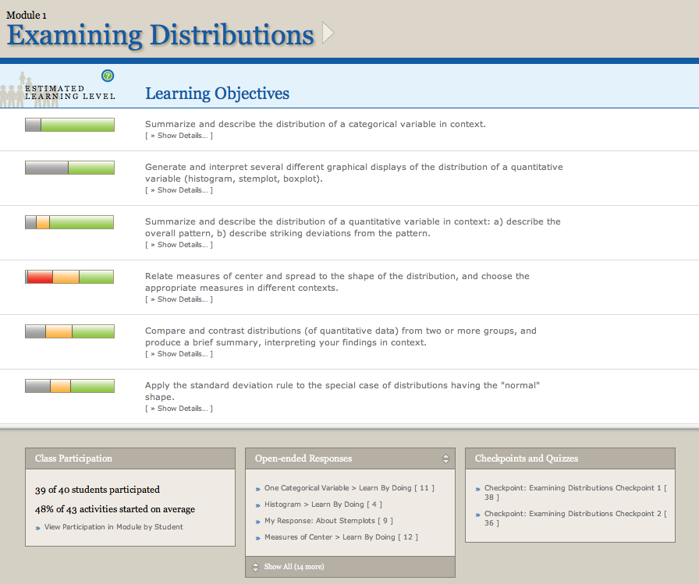
Learning Dashboard Team led by Dr. Marsha Lovett

Slide 16
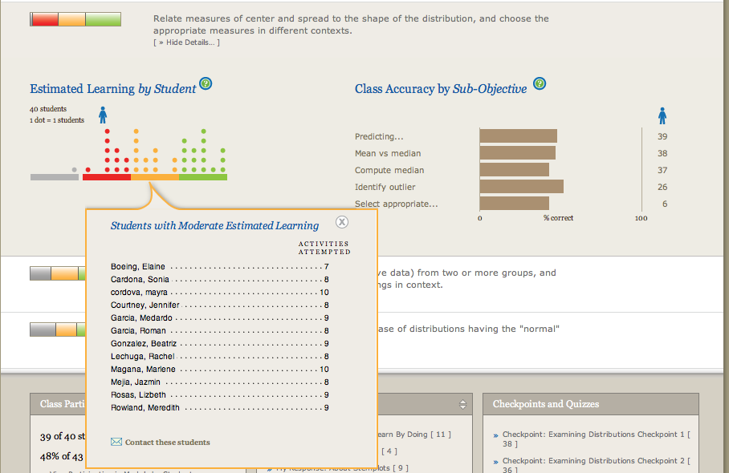

Slide 18
How instructors use the Learning Dashboard

Slide 19
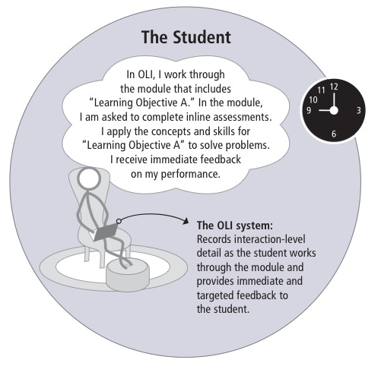
Notes:
The student prepared for class by going over learning objective A and B.
System – targeted feedback + records students interaction with the system

Slide 20
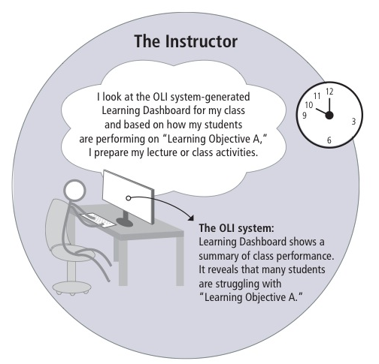
Notes:
Prepares class based on how students do on the different learning objective.
Learning Dashboard reveals that students are struggling with learning objective A.

Slide 21
Notes:
I see that you all got learning objective B, so we’ll focus on
Giving more examples on learning objective A.

Slide 22
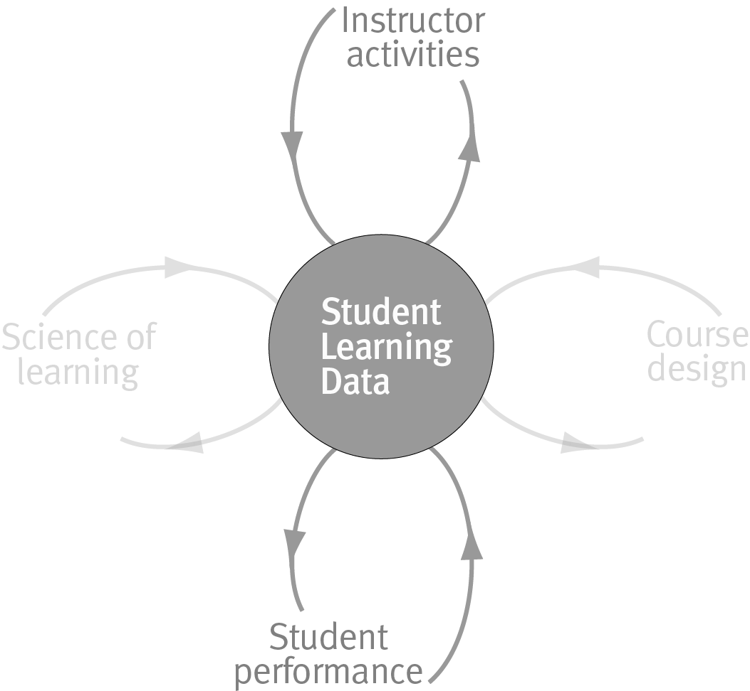
The Key…. Feedback Loops
Notes:
NO
The most powerful feature of web-based instruction is that it allows us to embed assessment into every instructional activity and use the data from those embedded assessments to drive powerful feedback loops for continuous evaluation and improvement.
By “feedback” we mean information derived from student activities that is used to influence or modify further performance.
Feedback to students:
In the case of feedback to students, we refer to corrections, suggestions and cues that are tailored to the individual’s current performance and that encourage revision and refinement. Many learning studies have shown that students’ learning improves and their understanding deepens when they are given timely and targeted feedback on their work (Butler & Winne, 1995; NRC, 2004.) Regarding the timing and frequency of feedback, the best learning outcomes occur when feedback comes immediately after the students’ response but not before the student is ready to revise his or her understanding (Corbett & Anderson, 2001).
Feedback to Instructors
In traditional face-to-face classrooms, the feedback loop between student learning activities and instructor activities is always cycling unmediated by technology. The traditional instructor-student feedback loop works well in classrooms that have an expert teacher and a not unreasonably heterogeneous class. For example, the instructor recognizes a need for additional explanation or practice by listening students' questions or by seeing confused looks on students' faces. In an online environment, this dynamic feedback loop is broken. The richness of the data we are collecting about student use and learning provides an unprecedented opportunity for keeping instructors in tune with the many aspects of students’ learning.
Ideally, OLI courses can assist instructors in addressing the challenges they confront as a result of the increasing variability in their students’ background knowledge, relevant skills and future goals. Creating an effective feedback loop to instructors using the OLI courses is our current area of research. Some of the research questions we are exploring in this area are: What measures best capture when students “get it” ? How do we construct an accurate representation of students’ knowledge? What is the most effective way to present this information to instructors? How can we best support instructors in making use of such information?

Slide 23
Accelerated Learning Hypothesis
Hypothesis: With this kind of adaptive teaching and learning, students can learn the same material as they would in a traditional course in shorter time and still show equal or better learning.
(Lovett, Meyer, & Thille, 2008)

Slide 24
Three Accelerated Learning Studies
#1 Small class, expert instructor
Collect baseline data on standard measures
Test new dependent measures
#2 Replication with larger class
With retention & transfer follow-up 4+ months later
#3 Replication and extension to a new instructor
These studies were conducted in the context of the Open Learning Initiative (OLI) Statistics course.

Slide 25
Adaptive/Accelerated vs. Traditional
Two 50-minute classes/wk
Eight weeks of instruction
Homework: complete OLI activities on a schedule
Tests: Three in-class exams, final exam, and CAOS test
Four 50-minute classes/wk
Fifteen weeks of instruction
Homework: read textbook & complete problem sets
Tests: Three in-class exams, final exam, and CAOS test
Same content but different kind of instruction

Slide 26
Adaptive/Accelerated vs. Traditional
<
Four 50-minute classes/wk
Fifteen weeks of instruction
Homework: read textbook & complete problem sets
Tests: Three in-class exams, final exam, and CAOS test
Two 50-minute classes/wk
Eight weeks of instruction
Homework: complete OLI activities on a schedule
Tests: Three in-class exams, final exam, and CAOS test
<
<
=
Same content but different kind of instruction

Slide 27
Final Exam Performance
92%
82%
81%
Adaptive/Accelerated had highest exam scores, but they were not statistically different from Traditional.

Slide 28
Standardized Test Results
Chance
Adaptive/Accelerated group gained significantly more pre/post than the Traditional Control group, 18% vs. 3%
Notes:
delMas, R., Garfield, J., Ooms, A., & Chance, B. (2007)
(CAOS = Comprehensive Assessment of Outcomes in a first Statistics course)

Slide 29
Follow-up: Retention & Transfer
Goal: Study students’ retention and transfer in both groups
Students were recruited at the beginning of the following semester
Follow-up Begins
Trad’l Ends
Adapt/Acc Ends
Jan Feb Mar Apr May Jun Jul Aug Sep Oct

Slide 30
Follow-up: Retention & Transfer
Goal: Study students’ retention and transfer in both groups
Students were recruited at the beginning of the following semester
Follow-up Begins
Trad’l Ends
Adapt/Acc Ends
Jan Feb Mar Apr May Jun Jul Aug Sep Oct
Adapt/Acc Delay

Slide 31
Follow-up: Retention & Transfer
Goal: Study students’ retention and transfer in both groups
Students were recruited at the beginning of the following semester
Follow-up Begins
Trad’l Ends
Adapt/Acc Ends
Jan Feb Mar Apr May Jun Jul Aug Sep Oct
Adapt/Acc Delay
Trad’l Delay

Slide 32
Retention: Standardized test
Chance
At 6-month delay, Adaptive/Accelerated group scored higher on CAOS than Traditional Control, p < .01.

Slide 33
Transfer: Open-Ended Data Analysis
Adaptive/Accelerated group scored significantly higher than Traditional Control.

Slide 34
To Summarize…
With the OLI Statistics course, the Accelerated students:
Completed the course in half as many weeks with half as many class meetings per week
Spent the same amount of time in a given week on coursework outside of class as traditional students
Gained much more on the CAOS test than did the traditional controls
Retained their knowledge and maintained an advantage over traditional students in retention tests given 1+ semesters later.

Slide 35
Community of Use
This semester, the OLI statistics course is used by a diverse groups of 54 institutions (total of 5060 students)
Liberal Arts Colleges (Wesleyan University, Grinnell College)
Community Colleges (Nassau Community College, Santa Ana College)
High schools (Winchester Thurston School)
International (Singapore Management University)
State Schools (UC San Diego, University of Illinois Chicago)

Slide 36
Instructors’ Experiences
“Using OLI, we’ve developed what we think is a really innovative, inquiry-based approach to teaching stats”
“ There is generally a third of the class that hates statistics and doesn’t want to be there. Before [I used OLI], I didn’t know who those students were or how to support them”
“ The software not only taught procedures but helped students understand their possible applications. It answers the ‘Why do I care?’ question”

Slide 37
Instructors’ Experiences
“As an adjunct math professor, I was able to jump into a brand new course at my college ONLY because I had access to OLI materials”
“The learning curve is sharp and managing the resources was difficult at first but having access to what students are really learning and not is excellent…..Great for both instructors and students have access to the ‘truth’ and not just the perceived truth about the learning. This has given me an opportunity to grow as an instructor out of my usual comfort zone”

Slide 38
Students’ Experiences:
End of the course survey:
85% Definitely Recommend
15% Probably Recommend
0% Probably not Recommend
0% Definitely not Recommend
Student Quote: "This is so much better than reading a textbook or listening to a lecture! My mind didn’t wander, and I was not bored while doing the lessons. I actually learned something.“

Slide 39
Adaptation Projects
CC-OLI (Community College OLI)
Statway (Statistics Pathway)
(The Carnegie Foundation for the Advancement of Teaching)
University of Maryland University College Business School
Georgetown University School of Foreign Service

Slide 40
“Improvement in post-secondary education will require converting teaching from a ‘solo sport’ to a community-based research activity”
Herbert Simon,
Last Lecture Series, Carnegie Mellon, 1998

Slide 41
Contact Information
Marsha Lovett (Cognitive Scientist, Learning Dashboard developer): lovett@cmu.edu
Oded Meyer (Statistics Professor, Course content author): ogm@georgetown.edu
To access the course: www.cmu.edu/oli

