Slide 1



Engaging Business Students in the Statistics Classroom
Jane E. Oppenlander, Ph.D.
Participating Professor
School of Management
Union Graduate College
oppenlaj@uniongraduatecollege.edu

Slide 2

“Statistical Models for Management”
Required course for MBA students
Class meets for 11 weeks, once a week in the evening for 3 hours, 20 minutes
Typical class sizes from 15-25
Pre-requisite – Introduction to probability
Taught in an electronic classroom (with WiFi); nearly all students bring laptops
Student population:
  Full-time: 50% Part-time: 50% Average Age: 25
  Motivation: Career change, job advancement, direct from undergraduate studies
  Diversity in undergraduate majors, prior exposure to statistics, work experience

Slide 3
Issues Observed with Modern Students
Distractions
  In the classroom: Laptops, cellphones, WiFi
  Outside the classroom: Jobs, business trips, family, other courses
Prior perception of the class (3.65/5 from course evaluations)
Learning for the test
Preference for the soft subjects in the business curriculum
Reluctance to participate in class (grows as class size increases)
Resistance to learning a statistical software package (JMP)
Preference for on-line interactions

Slide 4
How We Engage Business Students
Demonstrate the value of statistics to business decision-making
  Problem solving approach
  Relevant data and problems
  Interpret statistical concepts in the terms of business, e.g., standard deviation is a measure of risk
Integrate to other courses in the MBA curriculum

Slide 5
Course Approach
Problem-oriented
Managers need to understand how to apply statistical methods to business problems and interpret results.
Rely on statistical software (JMP) to perform calculations.
Statistical concepts are presented in plain English or graphically. Use of formulas is minimized.
Each method is illustrated by an example using the framework:
  Problem statement
  Data requirements
  Implementation in JMP
  Discussion of JMP results
  Interpretation of results to address the problem statement

Slide 6
Learning Objectives
  Effectively communicate the use of and results from statistical methods as applied to business problems and decision making.
    Focus on clear, concise writing and data presentation via technical reports, memos, and presentations.
  Synthesize numerical and graphical results of statistical analysis and communicate them in written reports.
  Identify problems and analyze data that require simple comparisons of means, two-sample, paired and ANOVA designs.
  Estimate and evaluate simple and multiple regression and time series models, especially for forecasting, to find important predictor variables to change or control a response variable.
  Identify problems and analyze data using measures of association to establish empirical “cause and effect.”

Slide 7
A Typical Class
Review of previous week’s assignment and study problems
Introduction of methods and their use in a business setting
Presentation of a detailed example illustrating a statistical method
  Problem is straightforward.
  Instructors walks the students through the problem formulation, data requirements, analysis in JMP, identification of key results from output.
  Brief class discussion of how the results are applied to the business problem.
Small Group Exercise
  Problem may have a small complication (outlier, missing data, violation of assumption, unclear problem statement)
  Class discussion

Slide 8
Icebreakers for Motivating the Subject/Concept
Hans Rosling’s video “200 countries, 200 years, 4 minutes”
Assignment on managerial responsibility
  Find an article pertaining to the role of mathematical models in the 2006 financial crisis.
  Write a paper summarizing the article and give lessons learned for managers.
  Classroom discussion of lessons learned
Problem formulation – “What is a good apple?”
Model building – Sketch possible relationships between sales and amount of advertising.

Slide 9
Classroom Activities
Small group problem solving
Role playing, manager and analyst
Team modeling competition – given a data set which team can find the best model.
Review PowerPoint slides and memos that contain errors

Slide 10
A Taste of Reality
Collect Your Own Data for Multiple Regression
  Learn the importance of having a range of independent variables
  Appreciate the importance of well-designed data collections
Data sets with outliers or missing values
Problems with insufficient information or vague problem statements
  Require students to make assumptions
  Recommend additional data/analysis needed to draw conclusions
Research the topic
  Learn about the business context in order to solve the statistical problem
    Property tax assessment methods for a real estate problem
    Investment strategies for capital asset pricing model

Slide 11
Student Evaluation
Papers – 60%, Tests – 40%
  One page business memo – descriptive statistics for a data set
  Two case studies prepared in technical report format
    One-way ANOVA and multiple regression
  Capital asset pricing model analysis for a stock of their choice, summarized as a technical report
  Two tests – short answer, emphasizing explanation and interpretation of statistical results
    Do not use statistical software for the test, output provided

Slide 12
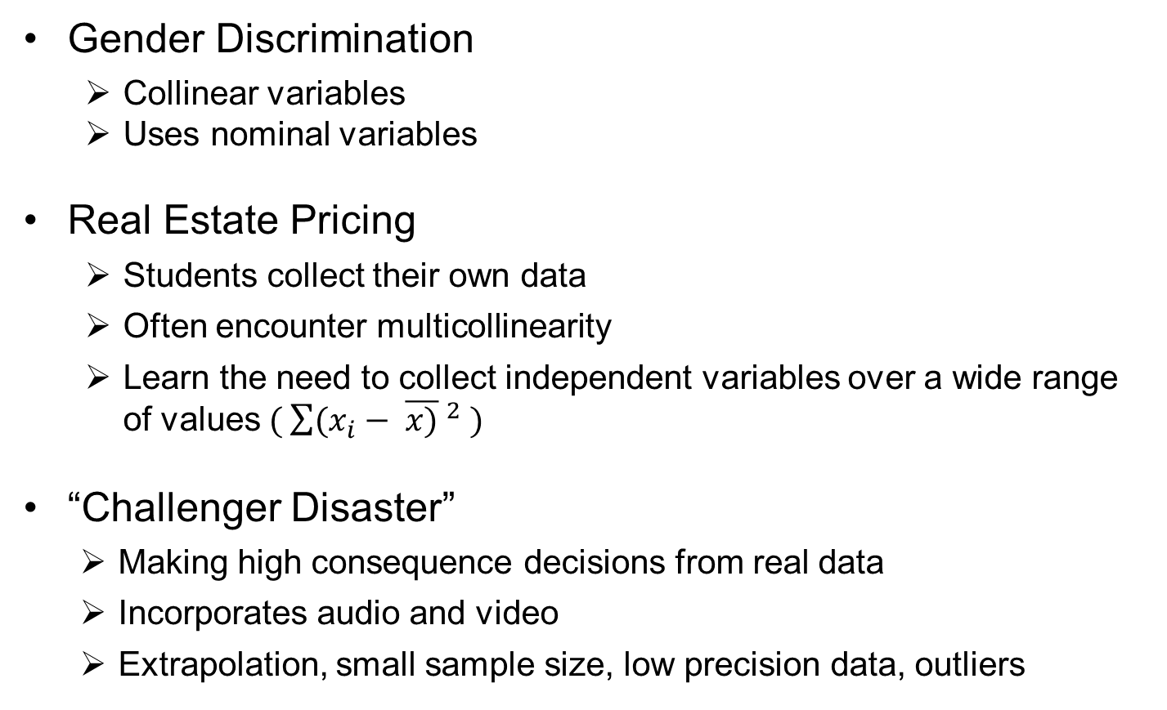
Regression Case Studies
Gender Discrimination
  Collinear variables
  Uses nominal variables
Real Estate Pricing
  Students collect their own data
  Often encounter multicollinearity
  Learn the need to collect independent variables over a wide range of values $( \sum{{(x_{i}− \overline{x)} }^{2}} )$
“Challenger Disaster”
  Making high consequence decisions from real data
  Incorporates audio and video
  Extrapolation, small sample size, low precision data, outliers

Slide 13
Sample Rubric
Grading Criteria | Weight (%)
Introduction to business situation and clear problem statement | 10
Statistical data summary | 10
Correct analysis method applied, methods discussion - technical quality of multiple regression analysis – equation, evaluation of model quality, VIFs, Std. Betas, and residuals | 20
Interpretation of statistical results | 25
Conclusions, recommendations, and discussion of results as applied to business situation | 25
Completeness and presentation quality - Appropriate amount of JMP output included with the text, all questions addressed, within page limit, writing quality including structure, organization, clear and concise writing, and correct grammar | 10

Slide 14
Course Resources
Textbook that integrates JMP software
Supplemental material – how to write and format a technical report, getting started with JMP, how to obtain data from yahoo finance.
Sample tests with solutions
Worked study problems for each method
On-line reference gallery of examples
  Effective data description formats
  Abstracts from journal articles illustrate the essential elements of statistical inference
  Papers and reports that apply statistical methods to real-world problems

Slide 15
Finding Business Data
All problems, test questions, case studies, and class exercises are based on general business or consumer applications.
  Use data from national, regional and local current events or issues
  Occasionally students will supply data sets from work, thesis, other courses
Avoid problems that require specialized knowledge or are controversial (engineering, sports, politics)
Good sources for business data/problems
  State government websites – Departments of labor, health, agriculture and markets
  Federal government websites – fuel economy, FCC, Bureau of Labor Statistics, Bureau of Economic Analysis, Census Bureau
  Publications – AARP, USA Today, local weekly business digest
  Commercial websites - Yahoo finance, commodities exchanges (CMEGroup), trade associations, nutritional information for food products and restaurants, local newspapers’ websites (restaurant inspections), realtors

Slide 16
Integration in the MBA Curriculum
Application | Statistical Method | MBA Courses
Capital Asset Pricing Model | Simple Linear Regression | Finance/Investing
Process Capability | Probability | Operations Management
Price Elasticity | Curvilinear Regression | Economics
Portfolio Mix | Probability | Finance/Investing
Monte Carlo Simulation | Probability | Finance Operations Management
Break Even Analysis | Linear Regression with Indicator variables | Managerial Economics

Slide 17
Linear Regression – Capital Asset Pricing Model
The “beta coefficient” (β) measures the risk of an individual stock compared to the broad market. β = 1 → same risk as market, β < 1 → less risk, β > 1 → more risk
R_{Individual} = R_{Risk-free} + β (R_{Market} - R_{Risk-free}) = R_{Risk-free} + β (Risk Premium)
Individual Stock Standardized Return = α + β (Market Index Standardized Return)
Obtain the adjusted closing daily returns from the last 3 months from yahoo finance for Goodyear stock. Is Goodyear stock a riskier investment than the market?
Goodyear = -0.002173 + 1.949*S&P500
β = 1.949
Hypothesis test: β = 1
95% CI [1.437, 2.461]
Goodyear is riskier than the market.

Slide 18
Curvillinear Regression - Price Elasticity
Price elasticity (E_{p}) measures the responsiveness of demand to changes in price.
Total Revenue = Price * Quantity Demanded
Log(Q) = b₀ + b₁log(P)
A fast food restaurant is introducing a new line of flavored coffee targeted at the breakfast market. The coffee was test marketed in 10 different regions. Calculate the elasticity of the new coffee line by relating Quantity (cups) demanded to Price.
Log(Quantity) = 7.49 - 1.05*Log(Price)
E_{p} = -b₁ = 1.05
E_{p} = 1 ➔ Unitary Demand
Hypothesis test: b₁ =1 p = 0.7032
Coffee demand is unitary

Slide 19
Discrete Probability – Portfolio Mix
Standard deviation measures the risk associated with an investment. For a portfolio of two stocks (A and B) with proportions a and (1-a), respectively and returns Y_{A}, Y_{B} :
Expected return: E[aY _{A}+ (1-a)Y_{B}]
Standard deviation: √Var[aY_{A}+ (1-a)Y_{B}] = √a²Var[Y_{A}]+ (1-a)²Var[Y_{B}] +2a(1-a)Cov(Y_{A} , Y_{B})
An investor has a portfolio of two stocks (A and B) with 30% invested in stock A and 70% in stock B. Find the expected return and risk associated with stocks A and B and the portfolio Could you recommend a portfolio mix that is less risky given the probability distribution of returns below?
Returns | Stock B
Stock A | -1 | +1
-2.5 | 0.10 | 0.275
+1.5 | 0.40 | 0.225
 | Expected Return | Risk (Std Dev)
Stock A | 0 | 1.94
Stock B | 0 | 1.00
Portfolio | 0.86 | 1.15

Slide 20
Use of Technology
Students are responsible for learning the statistics software (JMP). Rely on webinars, on-line tutorials, podcasts, knowledge base, and tech support provided by the software vendor.
All course material available the first day of class on the Moodle-based platform. No paper handouts.
Chat room is used for virtual office hours in addition to in-person office hours.
An on-line reference gallery of example abstracts, data presentations, etc.
Students use the Internet to:
  Obtain stock returns data from finance.yahoo.com for simple linear regression project.
  Learn about property tax assessment methods in preparation for multiple regression project on local residential home values.

Slide 21
What Works/What Doesn’t Work
What works
  Allowing them to self-organize for small group activities
  Virtual office hours (participation ratio ~4:1 compared to in-person).
  Students value emphasis on business writing (reflected in course evaluations)
What doesn’t work
  Calling on individuals to answer questions in class
  Assigning students to small groups or forcing the loners to work in groups
  Graded group assignments
  Giving them a sample technical report to use as a guide

Slide 22
Challenges
How do we integrate “big data”?
Tension between using statistical software and using Excel
Alternate teaching formats
  Hybridizing → completely on-line
  Block scheduling
Transition students from a test focused classroom to a problem-solving classroom.
Adding more audio and video content.
Is a 2nd elective course viable?
Finding current business-focused datasets
The coming of e-books

Slide 23
Acknowledgements
Dr. Josef Schmee, Kenneth B. Sharpe Professor of Management (Emeritus), Union College
Dr. Dean F. Poeth, Adjunct Professor, Union Graduate College

Slide 24
References
Poeth, D. F., “The Challenger Disaster,” The First Biennial Electronic Conference On Teaching Statistics, http://www.causeweb.org/ecots, May, 2012.
Oppenlander, J. E., “Techniques for Engaging Business Students in the Statistics Classroom,” The First Biennial Electronic Conference On Teaching Statistics, http://www.causeweb.org/ecots, May, 2012.
Schmee, J. and J.E. Oppenlander, JMP Means Business: Statistical Models for Management, SAS Press, 2010.
Parr, W.C. and M.A. Smith, “Developing Case-based Business Statistics Courses,” The American Statistician, Vol. 52, No. 4, November 1998.
Rosling, H., “200 countries, 200 years, 4 minutes,” http://www.youtube.com/watch?v=jbkSRLYSojo&noredirect=1

