Slide 1
Lessons Learned from Teaching Introduction to Statistics to Learning Disability Classes
Megan Mocko
University of Florida

Slide 2
Overview
Difference between regular and LD option of our Introduction to Statistics Course
Type of Disabilities in the class
Taking a journey to look at Learning Disabilities
Tactics

Slide 3
Structure
 | STA 2023 Regular | STA 2023 LD
Number of Students | 1800 to 2500 students | Max 25 students per section
Lecture | Online with option to attend live sections | Live
Tutoring | Office Hours of Instructor 40 hours a week tutoring room time | Office Hours of Instructor Private Tutoring by appointment Review Sessions 2 hours 2x a week
TA to student ratio | 1 TA for 120 to 160 students | 1 TA for 25 students

Slide 4
Assignments
 | STA 2023 Regular | STA 2023 LD
Exams | 3 multiple choice exams | 3 long answer exams
Labs | 10 labs | 14 labs
Quizzes | Online | 10 to 12 Paper in class quizzes
Homework | Suggested assignments, check answers in tutoring room | Graded by hand
Other |  | Project

Slide 5
How do students get into the special section?
Students have to have a registered learning disability with the Disability Resource Center on campus.
Disabilities have included:
Hearing/Vision impairments
Dyslexia
Reading Comprehension
Trouble remembering mathematical symbols
ADD/ADHD

Slide 6
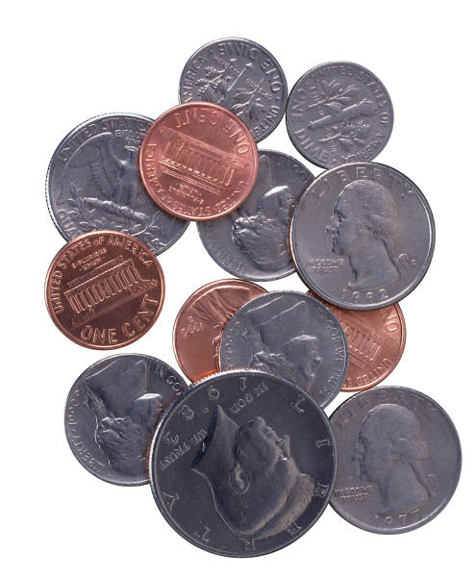
Looking at the world differently.

Slide 7
Coins

Slide 8
Shapes
Rectangle
Triangle
Circle

Slide 9
Coins
Circle
Circle
Circle

Slide 10
Coins
dime
dime
dime

Slide 11
What is the important characteristic?
It was not the color of the metal.
It was not the shape of the metal.
It was the size and the image on the metal.

Slide 12
Tactics

Slide 13
The problems with words
Experimental units
Experimental units
Explanatory variables
Explanatory variable

Slide 14
Trouble with Symbols
If p stands for population proportion, why doesn’t “n” stand for “no’s”.
Why does “r” stand for correlation rather than “residual”?

Slide 15
Minimize Theory
Maximize Examples

Slide 16
Lots of Scaffolding
Introduce new idea.
Give at least 3 examples.
Review previous days topic using clicker questions.
Homework problems assigned weekly usually 5 to 10 pages long. Some problems similar to class and others from the textbook.
2 – two hour homework review sessions a week
Quiz on returned graded homework.
Labs are tied to material in class.
Practice questions before test: 23 to 34 questions.
Exam

Slide 17
Teach them to Read Word Problems
Suppose that IQ scores are normally distributed with a mean of 100 and a standard deviation of 16. Find the probability that the someone’s IQ score is more than 120.
Suppose that a professional basketball player gets 70% of the baskets from the free throw line. Suppose that each of his shots can be considered independent. Suppose that he makes 10 free throw shots. Let X = the number of shots made. What is the probability that he makes 8 or more shots?

Slide 18
Miscues
Suppose that IQ scores are normally distributed with a mean of 100 and a standard deviation of 16. Find the probability that the someone’s IQ score is more than 120.
Suppose that a professional basketball player gets 70% of the baskets from the free throw line. Suppose that each of his shots can be considered independent. Suppose that he makes 10 free throw shots. Let X = the number of shots made. What is the probability that he makes 8 or more shots?

Slide 19
Miscues
Suppose that IQ scores are normally distributed with a mean of 100 and a standard deviation of 16. Find the probability that the someone’s IQ score is more than 120.
Suppose that a professional basketball player gets 70% of the baskets from the free throw line. Suppose that each of his shots can be considered independent. Suppose that he makes 10 free throw shots. Let X = the number of shots made. What is the probability that he makes 8 or more shots?

Slide 20
Providing Structure
Significance Test for Population Proportion
Assumptions Met?: random samples np_{o} greater than or equal to 15 n(1-p_{o}) greater than or equal to 15 Categorical data
Null Hypothesis: Ho
Alternative Hypothesis: Ha
Test Statistic: z-score summarizes the info from the sample
p-value: "corner" area Probability that the test statistic will take on values at least as extreme as the one observed if Ho is true.
Interpretation

Slide 21
Descriptions and Interpretations
Normal Distribution.
Sampling Distribution Problems.
Two Sample Confidence Intervals
We are ___% confident that the population mean/proportion {context} for Group 1 is between ____ more/less to ____ more/less than the population mean/proportion for Group 2. (adapted from Agresti/Franklin)

Slide 22
Use Graphs as much as possible.
Every time, draw out the curve of the Normal Distribution marking off the following
mean,
mean ± 1 standard deviation
mean ± 2 standard deviations
mean ± 3 standard deviations
For at least 3 examples, make a graph of possible values of X and its probabilities for a Binomial Distribution.

Slide 23
Student with Hearing Disability
Transcribe lectures
After lecture
In real time
Numbers are very hard to lip read.
During office hours, use a word program to discuss problems.

Slide 24
Student with Visual Disability
Use light color paper – not white for tests.
Use very large t or z table, if using tables.

Slide 25
Students with ADD/ADHD
Lectures are very much like discussions.
Lots of back and forth.
Encourage lots of questions.
Encourage Focus.
Occasionally call on a student or stand near a student to try and get them to focus better.
Working in groups is sometimes successful. However, one-on-one tutoring sessions has been the most successful.

Slide 26
Students with Math Anxiety
Some students are certain that they are going to fail before they even begin.
“The support system is there to support them, if they take advantage and work they will pass. As long as they are putting forth the effort to learn, I will spend as much time as necessary explaining the material until they get it.”

Slide 27
Students with Math Anxiety
Some students have a fear of math instructors, so try to make them as comfortable as possible.
Test anxiety.

Slide 28
Patience
Every student is an individual with different past experiences and skills.
Sometimes it takes multiple tries, examples and explanations to have it “click” in their mind.

Slide 29
Questions ??

