Slide 1


Simulation Activities for Large Classes: Using Clickers to Collect Data
Jennifer J. Kaplan
CAUSE Activity Webinar
24 Apr 2012

Slide 2
Course Background
Institution: Michigan State University
Type of Class: Algebra-based Introduction to Statistics, fulfills University mathematics requirement.
Class Size: 120 students, 3 hours of lecture/week + smaller recitation section with a graduate student TA, 1 hour/week; clicker used in lecture only
Student Population: Diverse majors with pre-nursing as the largest represented, also a number from criminal justice, journalism, communications, psychology lecture. 30 - 35% freshman and 25 - 35% sophomores. The remainder mostly juniors with a handful of seniors.

Slide 3
Clicker Implementation
Students paid for the clickers; i>clicker one of two supported systems on campus
Medium stakes assessment: To earn points for the day students must answer 75% of all questions asked. Students could miss up to three classes without penalty. Clicker points accounted for 10% of the semester grade.
Daily Use: The distribution of the number of clicker questions per class was bimodal: “low-clicker” days had 2 to 5 questions, “high-clicker” days, 9 to 12 questions with approximately equal number of each type of day

Slide 4
GAISE College Report Recommendations:
Emphasize statistical literacy and develop statistical thinking
Use real data
Stress conceptual understanding rather than mere knowledge of procedures
Foster active learning in the classroom
Use technology for developing conceptual understanding and analyzing data
Use assessments to improve and evaluate student learning

Slide 5
GAISE College Report Recommendations:
Emphasize statistical literacy and develop statistical thinking
Use real data
Stress conceptual understanding rather than mere knowledge of procedures
Foster active learning in the classroom
Use technology for developing conceptual understanding and analyzing data
Use assessments to improve and evaluate student learning

Slide 6
GAISE College Report Recommendations:
Emphasize statistical literacy and develop statistical thinking
Use real data
Stress conceptual understanding rather than mere knowledge of procedures
Foster active learning in the classroom
Use technology for developing conceptual understanding and analyzing data
Use assessments to improve and evaluate student learning
Notes:
Stop here for questions

Slide 7
Developing Conceptual Understanding of Inference
 | Activity Name | Course Topic | Conceptual Goals for Students
Weeks 1 and 2 | 1. Gettysburg Address | Sampling Bias | To understand that random sampling provides unbiased estimates when compared to judgment sampling.
 | 2. 2008 New Hampshire Primary | Sampling Variability | To understand that values from samples vary and that sampling variability decreases as sample size increases.
 | 3. Cereal Toys | Simulations | To understand how simulations can be used to answer probabilistic questions
 | 4. Magic Lottery | Simulations | To confront the myth of the unusual event
Weeks 5 and 6 | 5. Tiger Woods Card (1) | Probability Models | Provide an example of the geometric model
 | 6. Tiger Woods Card (2) | Probability Models | Provide an example of the binomial model
 | 7. Rolling a Die | Probability Models | Provide an example of the uniform model
 | 8. Rolling 10 Dice | Sampling Distributions | Provide an introduction to the Central Limit Theorem
 | 9. Basketball Shooting | Sampling Distributions | Provide an introduction to the normal approximation of the binomial distribution
.

Slide 8
Developing Conceptual Understanding of Inference
 | Activity Name | Course Topic | Conceptual Goals for Students
Weeks 7 - 9 | 10. Coin Flipping | Confidence Intervals | Show that level of confidence is the approximate percent of samples that produce CIs that cover the true value regardless of sample size.
 | 11. Cell Phone Drivers (1) | Hypothesis Testing | Provide an example of the reasoning behind hypothesis testing and the meaning of the p-value of a test.
 | 12. Cell Phone Drivers (2) | Hypothesis Testing | Show how Type I and II errors occur based on random sampling and how power and the probability of errors can be estimated.

Slide 9
Sampling Variability
You should have noticed that not all students obtained the same average from their sample
Also, not all of the averages of the samples matched the average of the population
This is okay; we know that values from different samples will be different - this is called sampling variability
Luckily, sampling variability is predictable - either through mathematics, or simulation
9
Notes:
9

Slide 10

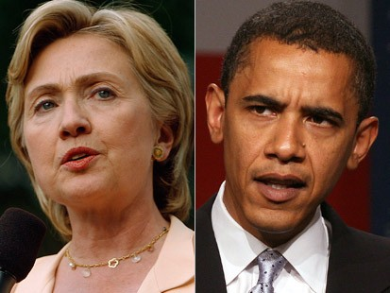
2008 New Hampshire Primary -Sampling Variability
The polls prior to the 2008 New Hampshire Democratic primary showed Obama having a large lead on Clinton, possibly more than 10%. In the actual primary, 39% of voters voted for Clinton and 36% voted for Obama. Could the poll results have been
due to sampling variability?
10
Notes:
10

Slide 11
2008 New Hampshire Primary -Sampling Variability
Obama - 36%; Clinton 39%
To simulate one sample of 50 likely voters use: randint(1, 100, 50)
Numbers 1- 36 are votes for Obama, 37 - 75 are votes for Clinton, anything over 75 is a vote for neither (or for someone else)
Count the number of votes for each candidate
11
Notes:
11

Slide 12




2008 New Hampshire Primary -Sampling Variability
Obama - 1 - 36; Clinton 37 - 75
To make the counting easy, store the results in L₁ and then sort L₁.
STAT menu:
12
Notes:
12

Slide 13
What percent of the 50 “people” polled said they would vote for Obama?
18% or more but less than 24%
24% or more but less than 32%
32% or more but less than 40%
40% or more but less than 48%
48% or more but less than 56%
Notes:
13
Follow up discussion illustrating sampling variability

Slide 14
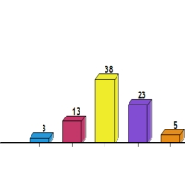
What percent of the 50 “people” polled said they would vote for Obama?
18% or more but less than 24%
24% or more but less than 32%
32% or more but less than 40%
40% or more but less than 48%
48% or more but less than 56%
Notes:
14
Follow up discussion illustrating sampling variability

Slide 15
2008 New Hampshire Primary -Sampling Variability
Obama - 36%; Clinton 39%
Sample 100 likely voters: Use randint(1, 100, 100), store in L₂ and sort L₂
Numbers 1 - 36 are votes for Obama, 36 - 75 are votes for Clinton
15
Notes:
15

Slide 16
What percent of the 100 “people” polled said they would vote for Obama?
18% or more but less than 24%
24% or more but less than 32%
32% or more but less than 40%
40% or more but less than 48%
48% or more but less than 56%
Notes:
16
Follow up discussion illustrating sampling variability

Slide 17
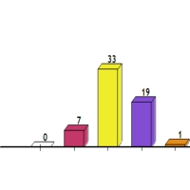
What percent of the 100 “people” polled said they would vote for Obama?
18% or more but less than 24%
24% or more but less than 32%
32% or more but less than 40%
40% or more but less than 48%
48% or more but less than 56%
Notes:
17
Follow up discussion illustrating sampling variability

Slide 18
Comparing Sampling Variability in Samples of Different Sizes
Samples of 50 voters
Samples of 100 voters
Notice that the values in larger samples are more clustered around the true value of 36%, but that both graphs are symmetric
Notes:
18

Slide 19

But wait, don’t they usually poll more than 100 people?
19
Notes:
19

Slide 20
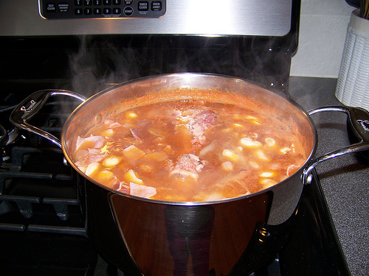
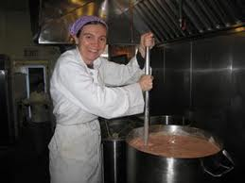
Notice that margin of error has nothing to do with population size.
Imagine that I make a pot of soup at home for myself and my sister, the professional chef makes a vat of soup for 180 people at a dinner.
If I taste a spoonful of my soup to check the seasoning, does my sister need to taste a whole ladle of her soup?
No, as long as her soup is well mixed.
MIXING is important in selecting samples; population size is not!
20
Notes:
20

Slide 21
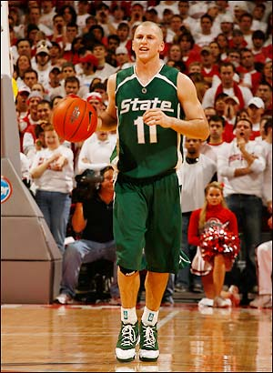
Basketball Shooting - binomial random variable
Drew Neitzel had a 41% shooting average in his career at MSU
If he takes 20 shots per game, on average, how many would we expect him to make?
We are going to simulate many, many games to see the distribution of the made shots

Slide 22
Basketball Shooting - binomial random variable
Drew Neitzel had a 41% shooting average in his career at MSU
To simulate one game of 20 attempted shots use: randint(1, 100, 20)
Numbers 1 - 41 are made shots, 42 - 100 are missed shots
To make the counting easier, you can store the data in a list and then sort the list.

Slide 23
How many shots did Neitzel make in your simulated game?
1 to 3
4 to 6
7 to 9
10 to 12
13 to 15

Slide 24
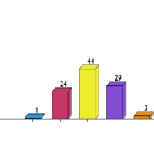
How many shots did Neitzel make in your simulated game?
1 to 3
4 to 6
7 to 9
10 to 12
13 to 15

Slide 25
What is the distribution of simulated made shots?
Unimodal and roughly symmetric with mean about 8 and standard deviation about 2
Unimodal and roughly symmetric with mean less than 8 and standard deviation about 2
Unimodal and roughly symmetric with mean greater than 8 and standard deviation about 2

Slide 26
What is the distribution of simulated made shots?
Unimodal and roughly symmetric with mean about 8 and standard deviation about 2
Unimodal and roughly symmetric with mean less than 8 and standard deviation about 2
Unimodal and roughly symmetric with mean greater than 8 and standard deviation about 2

Slide 27
Two more thought questions
I made the slides last week. How did I know:
  What choices for number of shots made to give you?
  What the shape, center and variability of the distribution would be?
Hint: I’m still not psychic

Slide 28
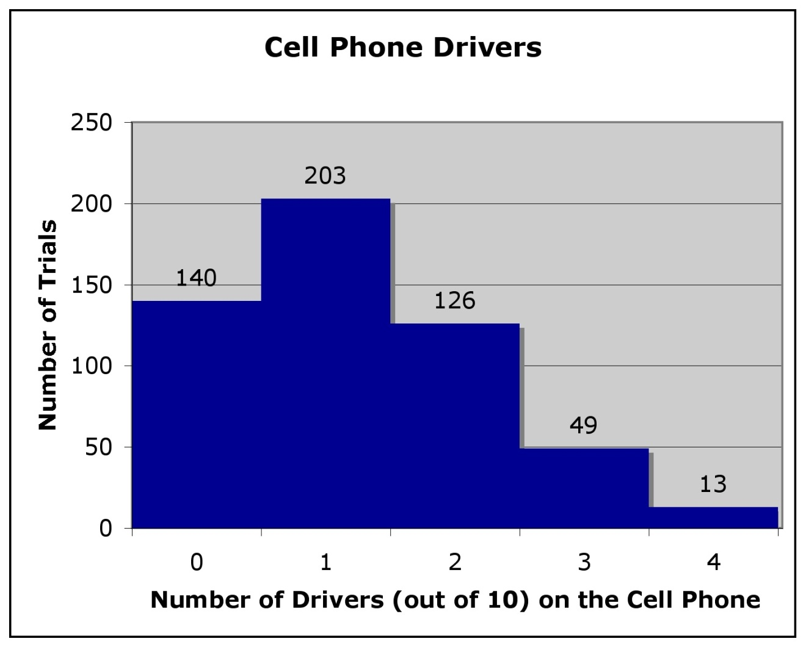
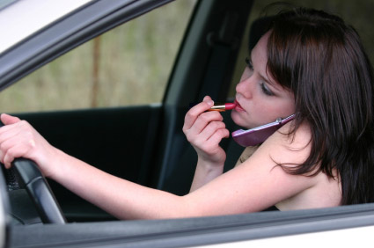
Cell Phone Drivers I - hypothesis testing
A congressman claims that only 12% of drivers talk on their cell phone. Standing at a bus stop someone noticed 4 out of 10 drivers on a cell phone. Is this
evidence that the
congressman is
wrong?

Slide 29
Cell Phone Drivers I - hypothesis testing
A congressman claims that only 12% of drivers talk on their cell phone. Standing at a bus stop someone noticed 4 out of 10 drivers on a cell phone. Is this evidence that the congressman is wrong?
From our simulation results, if 12% of drivers talk on their cell phone, we would expect to see 4 out of 10 drivers on their phone about 13/531 = 2.4% of the time.
The unusual observation
DOES call into question the
congressman’s claim.

Slide 30
Is the sample size large enough condition met?
No, there are only 4 successes and 6 failures - in hypothesis testing we use the hypothesized value so this answer is incorrect.
No, we expect only about 1 success and 9 failures
Yes, the sample is size 10
Yes, the sample size is smaller than 10% of the population

Slide 31
Is the sample size large enough condition met?
No, there are only 4 successes and 6 failures - in hypothesis testing we use the hypothesized value so this answer is incorrect.
No, we expect only about 1 success and 9 failures
Yes, the sample is size 10
Yes, the sample size is smaller than 10% of the population - this is the 10% condition and needs to be checked as well, but this response is NOT about sample large enough

Slide 32

Cell Phone Drivers I - hypothesis testing
Notice that the results have a unimodal distribution with right skew. If the sample size condition were met, the distribution would be symmetric
based on the Central
Limit Theorem

Slide 33
Which sample size is the smallest that meets the “large enough” condition?
50
75
100
125
150
Congressman claims 12% of drivers talk on their cell phone

Slide 34
Which sample size is the smallest that meets the “large enough” condition?
50
75
100 - because it gives 12 expected successes and 88 expected failures
125
150
Congressman claims 12% of drivers talk on their cell phone

Slide 35
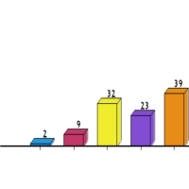
If the congressman is correct that only 12% of drivers talk on their cell phone, how many drivers out of 100 would have to be talking on their cell phones for you to think it was an unusually high number?
Fewer than 15
15 or 16
17 or 18
19 or 20
More than 20
Just your gut reaction without calculation

Slide 36
Cell Phone Drivers I - Simulation
Assume that population proportion is 12%
To simulate 100 drivers use:
  randint(1, 100, 100)
Numbers 1 - 12 are drivers on their cell phone, 13 - 100 are drivers not on their cell phone
Count the number of drivers in your sample who are on their cell phone
Remember that you can store the results in a list and then sort the list to make it easier to count.

Slide 37
How many drivers out of 100 were on their cell phone?
4 - 6
7 - 9
10 - 14
15 - 17
18 - 20
Notes:
This is the difficult slide to make

Slide 38
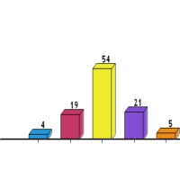
How many drivers out of 100 were on their cell phone?
4 - 6
7 - 9
10 - 14
15 - 17
18 - 20
When the conditions are met, the results are unimodal and roughly symmetric!!!
Notes:
This is the difficult slide to make

Slide 39
But you said no more simulations……
Okay, so instead of a simulation, we will do a formal hypothesis test
A congressman claims that only 12% of drivers talk on their cell phone. We take a random sample of 100 drivers and find that 19 of them are talking on their cell phone.
Does this provide evidence
against the congressman’s
claim?

Slide 40
Formal Hypothesis Test: A congressman claims that only 12% of drivers talk on their cell phone. We take a random sample of 100 drivers and find that 19 of them are talking on their cell phone. Does this provide evidence against the congressman’s claim?
Step 1: Write Hypotheses
Step 2: Check Conditions
Step 3: Draw the Expected Sampling Distribution
Step 4: Calculate the Test Statistic and p-value
Step 5: Write a Conclusion

Slide 41
Hypothesis Test
Specify the hypothesis being tested
  - H₀: p = .12
  - H_{a}: p > .12
Check Conditions
  Random sampling is specified so we also have plausible independence
  100 drivers is fewer than 10% of all drivers
  .12(100) = 12, .88(100) = 88, both are greater than 10 so sample size is large enough
### Draw the expected distribution of the sample statistic ####
  N(.12, .032)
Calculate the probability of obtaining the sample statistic we did (or one more unsual)
  Using normcdf(.19, 100, .12, .032), P(p-hat>= .19) = .014
Use the probability to make a conclusion
  If 12% of drivers use their cell phone, 1.4% of samples of size 100 would have 19 or more drivers on their cell phones. This low p-value gives strong evidence to reject the null hypothesis. The percent of drivers who talk on their cell phone is probably higher than 12%

Slide 42
If we take a random sample of 100 drivers and find 19 drivers on their cell phone. What conclusion might we make?
The sample we observed was very unlucky.
The congressman’s figure might be wrong.
There is no reason to question the congressman’s figure.
No conclusion can be made from one sample.
No conclusion can be made from a sample that small.

Slide 43
For More Information
How Clickers Can Facilitate the Use of Simulations in Large Lecture Classes. Webinar, i>clicker/Macmillan New Ventures. February 2012. https://iclicker.webex.com/iclicker/lsr.php?AT=pb&SP=TC&rID=31546862&act=pb&rKey=291f5b12b9de2adf
Kaplan, J.J. (2011). Innovative Activities: How Clickers can Facilitate the Use of Simulations in Large Lecture Classes. Technology Innovations in Statistics Education,5. http://escholarship.org/uc/item/1jg0274b
Kaplan, J.J. (March, 2009) Promoting active learning in introduction to statistics using personal response systems (clickers). Webinar, Consortium for the Advancement of Undergraduate Statistics Education (CAUSE). http://www.causeweb.org/webinar/teaching/2009-03/
Kaplan, J.J. & Urban-Lurain, M. (2008). Personal Response Systems in Statistics: Using clickers to foster active learning and address student misconceptions. Proceedings of the Inaugural Conference on Classroom Response Systems: Innovations and Best Practices. http://iclicker.com/dnn/UserCommunity/ConferencePapers/tabid/171/Default.aspx

