Slide 1

Reading and Writing in an Inquiry-Based Introductory Statistics Course
Presented by
Adam Childers and Jeff Spielman
Roanoke College

Slide 2
Outline
Intro stat in the new curriculum
Course themes
Inquiry-based statistics
Reading assignments
Writing assignments
Grading
Conclusions

Slide 3
Statistics in the Core Curriculum
Introductory statistics is the only required “math”
STAT 101 is replaced by Intellectual Inquiry 240 Statistical Reasoning
Writing is to be emphasized across the curriculum

Slide 4
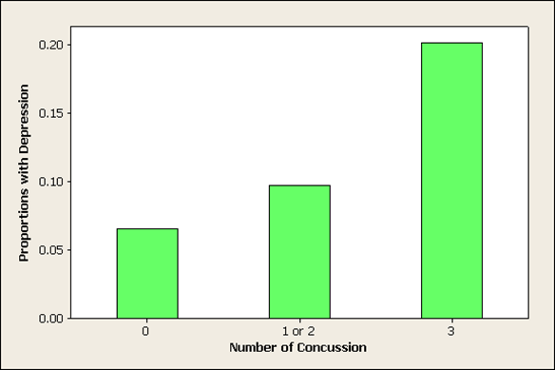
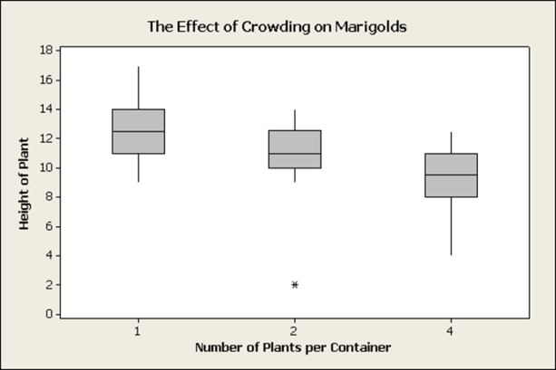
Statistical Content
Descriptive Statistics
Graphical Methods
Estimation
Elementary Probability
Tests of Hypothesis
Confidence Intervals
Analysis of Variance
Correlation and Regression
*This course is primarily a statistics course!

Slide 5
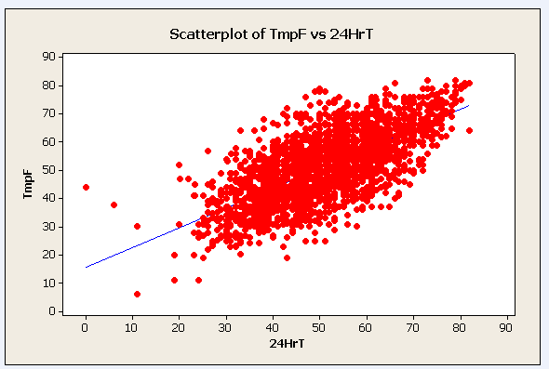
Themes
Statistics for Social Justice
Statistics and Botany
Statistics and the Sports Industry
Does Gun Control Save Lives?
Here’s to Your Heath
Statistics and Weather

Slide 6
Feedback on Themes
[Most Helpful Aspect] I love how the course incorporated sports with statistics, being able to see how certain statistical methods were used definitely helped me understand the material.
Most Helpful Aspect] Social justice topic. As a non-math major it brought the mathematical concepts down to earth for me.
[Project Response] Overall, [the class] was very helpful in terms of learning to look at the weather and forecasting from a different perspective.
48/50 students in Sports Industry course were interested in the sports industry

Slide 7

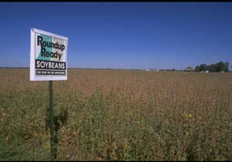
Inquiry-Based Courses
Central questions motivate the statistical content
Social Justice
Are minorities ticketed at higher rates?
How much does funding improve education?
Sports Industry
How do we assess the value of a player?
What are the risks of full contact sports?
Courtesy of Greenpeace UK
Botany
Is using genetically modified seeds ethical or economical?
What are the connections between probability and plant reproduction?

Slide 8
Motivation for Using Reading and Writing
Helps with math or statistics anxiety
Improves students’ articulation of statistical content
Reading gives students concrete examples
Motivates the students to learn material

Slide 9



Reading: Supplementary Texts

Slide 10
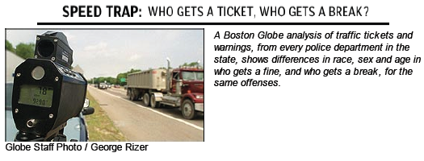
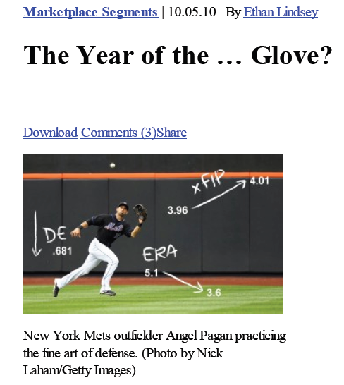

Reading: Magazines, Podcasts and Newspapers
http://www.boston.com/globe/metro/packages/tickets/
http://freakonomicsradio.com/the-year-of-the-glove.html
http://www.newyorker.com/reporting/2008/12/15/081215fa_fact_gladwell

Slide 11
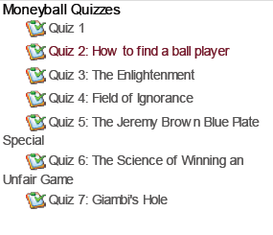
More on Reading
“This book is actually good!”
Careful selection is key
Online quizzes
In class discussion

Slide 12
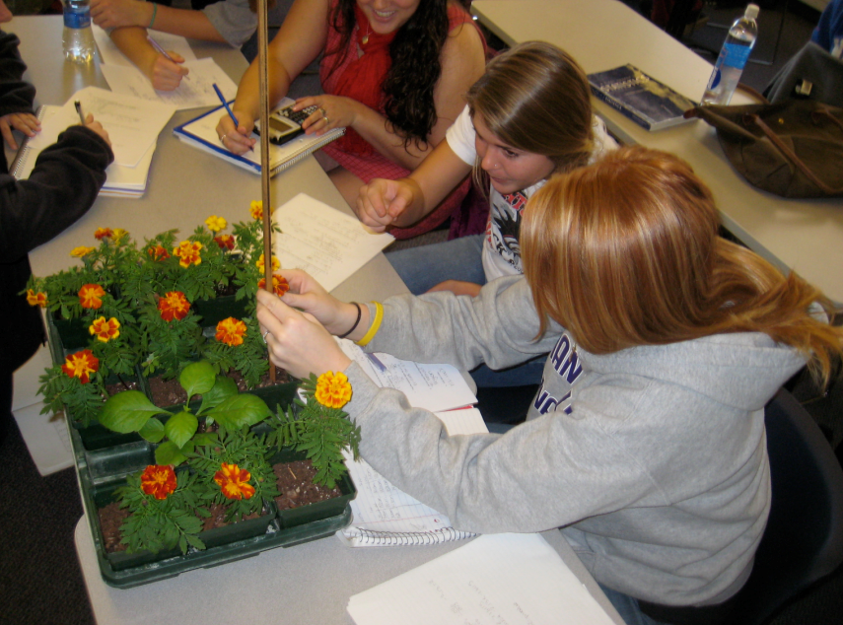
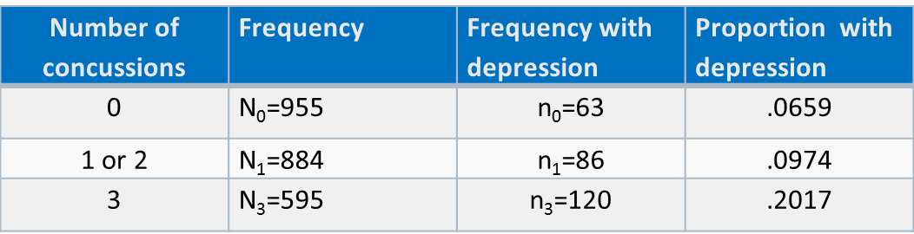
Writing: Long Form
Student designed projects
Head injuries and football

Slide 13
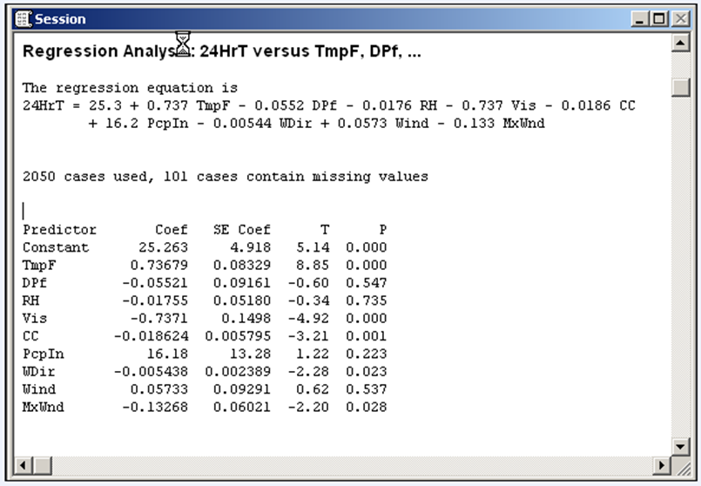
Writing: Long Form
Changing views on gun control
Predicting the weather with linear regression

Slide 14
Writing: Short Form
Responses to reading
Homework questions
Statistical reasoning vs statistical methods

Slide 15


Grading: Challenges
How do I grade a writing assignment?
Assistance from other departments
Time commitment

Slide 16
Grading: Impact
15%-30% of students’ grade from reading and writing assignments
STAT 101 average GPA 2.460
INQ 240 average GPA 2.561

Slide 17
Conclusions: From the Students
[How Course Differed from Expected] I was under the impression that it would be excruciatingly difficult; Roanoke stats classes have this reputation. I think that the sports related theme and [the instructor] both helped me to achieve a high level of success regardless of this stereotype.
[Most Helpful Aspect] The subject matter could actually be applied to real life--shocking!!
[Project Response] The semester project was interesting and helped me translate a lot of the concepts we learned into practical skills
Mixed reviews on adding reading and writing to the course

Slide 18
Conclusions: From the Faculty
More challenging
More rewarding
Engaged students
Constantly evolving
Finding a balance

Slide 19
The End
Questions?
Contact Information
Adam Childers: childers@roanoke.edu
Jeff Spielman: spielman@roanoke.edu

