Slide 1
Pinochle Poker: An Activity to Solidify Concepts in Counting and Probability
Jacqueline Wroughton
Joseph Nolan
Northern Kentucky University

Slide 2
Background
Students have been taught definitions and basic uses for:
Sample Spaces / Events
Basic Probability Rules
Multiplication Rule
Permutations
Combinations
But….

Slide 3
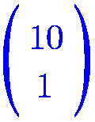
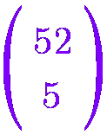
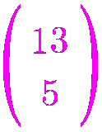
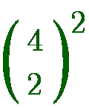
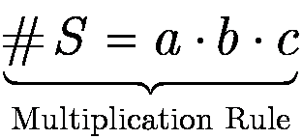
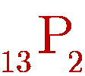
Combinatorics: A Jumbled Mess?

Slide 4
Counting Hurdles for Students
Deciding between Permutations & Combinations
Implementing multiple counting methods in the same problem
Recognizing Overlap (and accounting for it appropriately)
Relying too much on complementation

Slide 5
General Observation
Students seem to want a 30-second answer to every problem! They have trouble recognizing that they need to think about the problem before diving into a solution.
They also become consumed by specific problems and seem not to easily generalize the methods beyond the specific problem they are looking at.

Slide 6
Activity Design
Day 1 (or homework, depending on level)
For a standard 52-card deck, calculate probabilities for all of the poker hands assuming 5-card stud rules (i.e. you get five cards in your hand and nothing more)

Slide 7
Activity Design (2)
Day 2
Provide students with 48-card Pinochle Decks. In groups they are to calculate probabilities for all of the poker hands (again assuming 5-card stud rules) using this very different deck of cards.

Slide 8
Pinochle Deck
48 cards
4 suits
6 ranks (9 to ace)
2 of each rank
and suit
Up Next:
Examples of Classroom Implementation

Slide 9
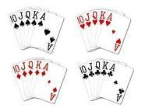
Royal Flush
Students Initially See…
# Royal Flushes = 8 ???

Slide 10
Royal Flush (2)

Slide 11
Full House
Original Deck
Pinochle Deck

Slide 12
Flush
Original Deck
Pinochle Deck

Slide 13
Two Pair
Original Deck
Pinochle Deck

Slide 14
Two Pair
Original Deck
Pinochle Deck

Slide 15
Comments on Level
Lower Level Classes
Do regular poker hands as a class (but with lots of class participation)
Be very helpful as they get started on the Pinochle Poker hands in groups of 2-3
Upper Level Classes
May choose to do a few examples with regular deck and have them do the rest as homework prior to doing the Pinochle Poker as groupwork in class
Give hints that are a nudge in the right direction, but make sure to let them explore to figure out the correct answer.

Slide 16
Suggestions for Follow-Up
Groups put together a paper comparing the ranking of poker hands for a pinochle deck to the rankings for a regular deck.
Homework / Exam questions containing an D-denomination, C-colored, N-duplicated deck

Slide 17
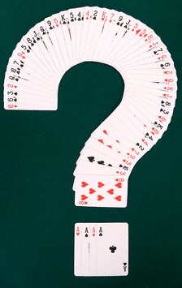
Questions/Comments

