Slide 1
Online Homework + e-Textbook = Integrated Online Learning
Brenda Gunderson, Statistics
bkg@umich.edu
and
Perry Samson, AOSS
samson@umich.edu
The University of Michigan
LectureBook
CAUSE Webinar August 9, 2011

Slide 2
Outline
Stats 250 Course Background
Why LectureBook?
LectureBook Today
e-Textbook
Online HW Instructor View
Online HW Student View
Online HW Grader (GSI) View
Share Feedback and Survey Results
Lecturebook Future Plans

Slide 3
Course Background
~1500 students/term
5 lectures (200-400 each)
55 GSI-led computer labs (~25 each)
Strong desire to take course?
… No
Notes:
So I teach … Statistics … I have about 1500 students enrolled each term.
It is a coordinated class across … they all use the same materials, take the same exams, do the same HW.
It is a large course, often required, and for many students it is the only statistics course they will take.
So when they answer the end of term evaluation question of Did you have a strong desire to take this class? – well that is my lowest rating.
Thus, they also don’t have a strong desire to buy the readable, fairly well-written expensive textbook.
I am going to spend just a couple minutes sharing/showing the project that is currently being used in my Stats 250 …

Slide 4
Picture of the Day
Stat 100!
Stat 250!

Slide 5
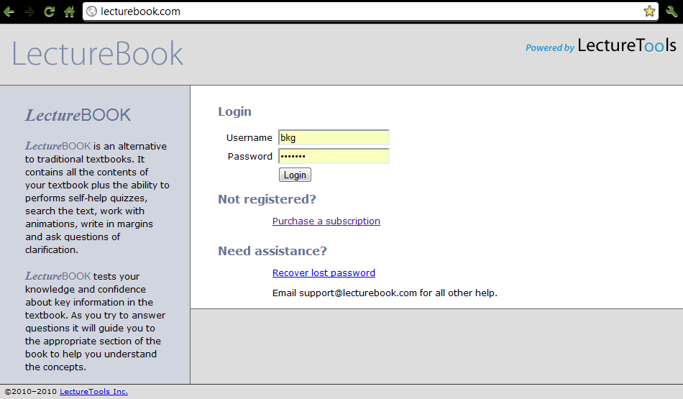
LectureBook: OnLine HW Tool Linked to e-Text
Notes:
Lecturebook… I have always been interested the educational technology – the considered implementation of appropriate pedagogical tools, techniques, processes, both in and out of the classroom, to create a guided continuous learning experience.
… that interest led to meeting and working with Perry Samson who is well known for his LectureTools. We began working on LectureTools model that converted the Stats 250 Textbook to an online version … available for students since Fall 2009 and that has been a learning experience.
Since this past Spring 2010, I have been the first to pilot and guide the development of a new component that facilitates creating and grading of homework online that is linked to the Stats 250 e-textbook.
So Lecturebook is this on-line homework tool + e-textbook put together to provide an integrated online learning experience.

Slide 6
Why LectureBook?
Two problems:
Grading homework by hand is prone to problems.
Students do not read textbook in synch with class.
Two solutions:
Pose free-response and multiple-choice questions in large classes that are answered and graded on-line. Questions authored by instructor or selected from on-line textbook.
Pose multiple-choice homework that students must answer prior to class with links to on-line textbook to read supporting material (i.e. trick them into reading prior to class)
Notes:
My students need practice and opportunities for productive struggle outside the classroom
They need practice performing statistical techniques, practice interpreting results, and HW is one way they get to practice.
But managing the HW process for coordinated class of 1500 students … (lots of paper, issues with collecting (when/how), grading (by GSI) and returning to students (without losing) … and how to handle late HW?)
How about … connect this tool with the TEXT so it can be a good resource but in the same media
There are other online systems … but not often able to let the instructor easily author questions, or easily customize solutions.
Led to Lecturebook … which has played a role in my students’ continuous learning experience with statistics.
And we continue to learn how this pedagogical tool can be improved.

Slide 7
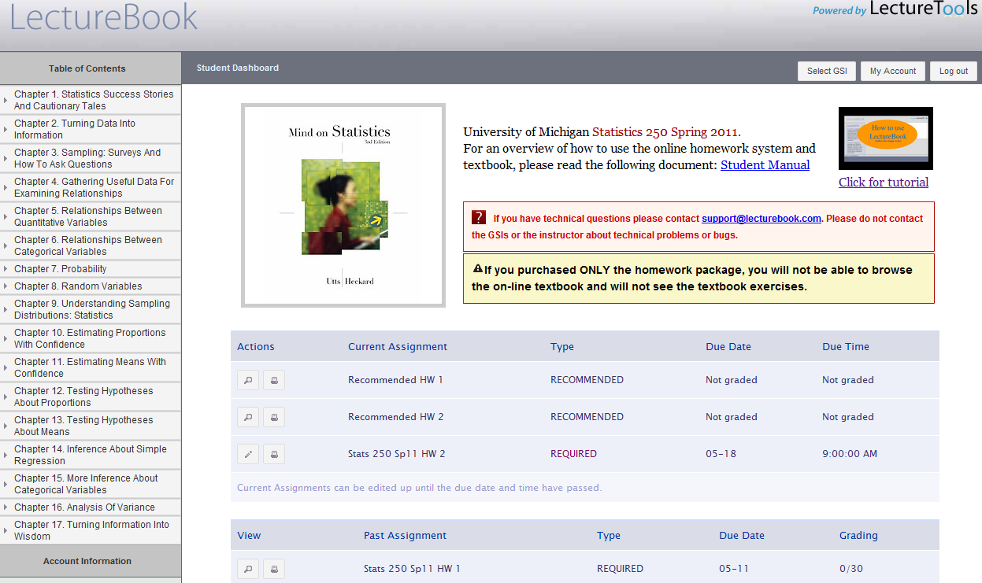
OnLine HW Tool + e-Textbook
OnLine HW Tool plays lead role:
gives students needed practice and opportunities for productive struggle
Direct access to e-Textbook plays supporting role: doing HW and need a hint about confounding versus lurking variables? Go directly to your searchable e-Text.
All HW (required vs recommended, current vs completed) in one place for handy reference (no more lost HWs)
Notes:
With LectureBOOK … the inquiry-based online homework plays the more important role and the textbook is a resource/ a supplement to the HW questions. Doing questions on-line makes sense, having access to the book in the same media makes sense.
So here is the Home Page for students … textbook with TOC on the left, each chapter and then section can be expanded and selected to have the content appear on the right handside.
The listing of HW sets (required or recommended) are in one place for bringing up to review at any time.

Slide 8
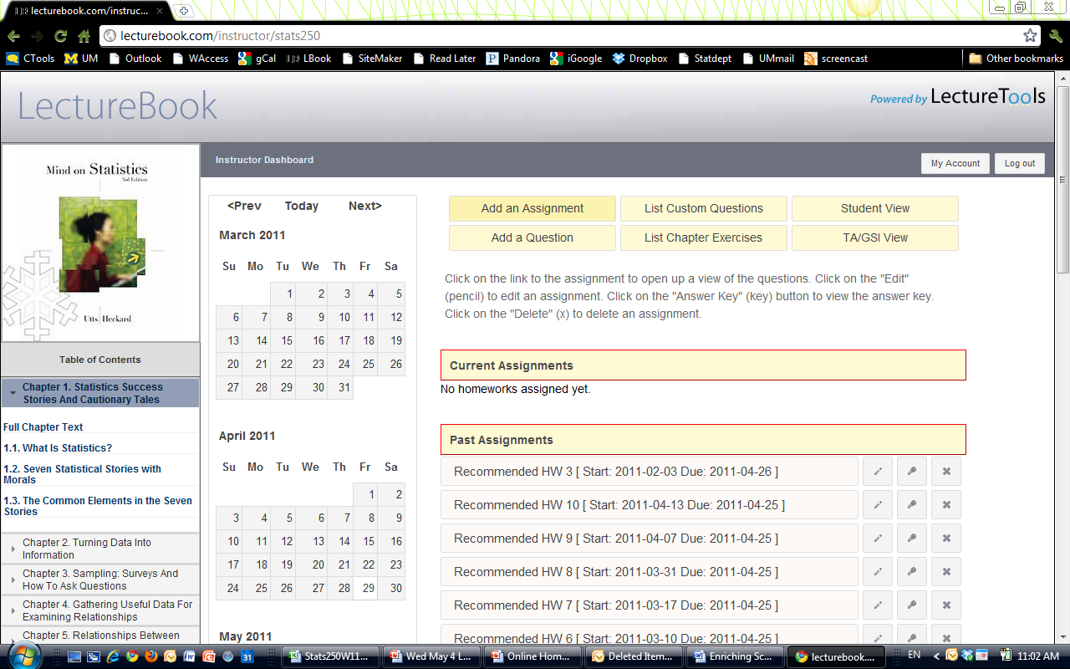
e-Textbook → expanding view
Notes:
textbook with TOC on the left, each chapter and then section can be expanded and selected to have the content appear on the right handside.

Slide 9
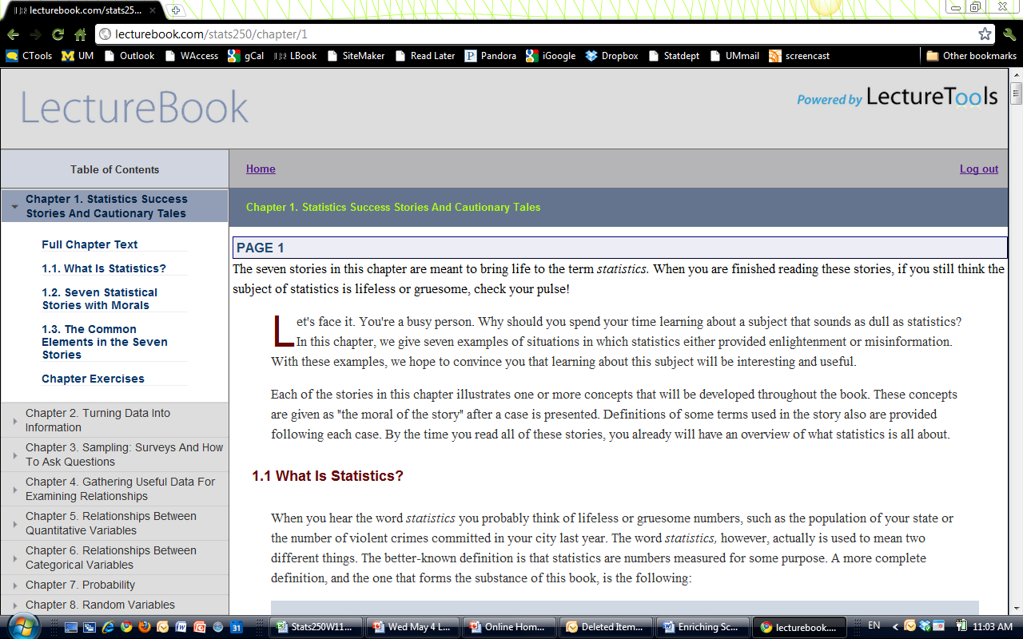
e-Textbook → full chapter
Notes:
Full chapter …
So if they are working on a HW problem that is linked to chapter 3, section 4 … and they are trying to remember the difference between selection bias and response bias, they can go to that section of the e-text to review it.

Slide 10
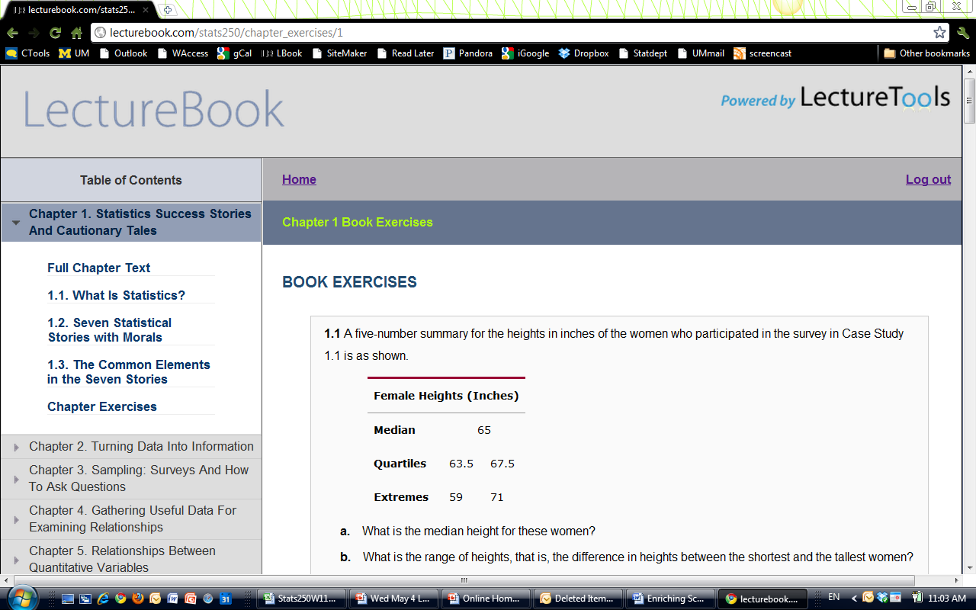
e-Textbook → chapter exercises
Notes:
And all of the exercises are available – the ones that had the ‘solutions’ in the back of the text have those solutions right here (initially hidden but a click would show them).
So lets turn to that online HW side of Lecturebook next …

Slide 11
Online HW
Instructor View

Slide 12
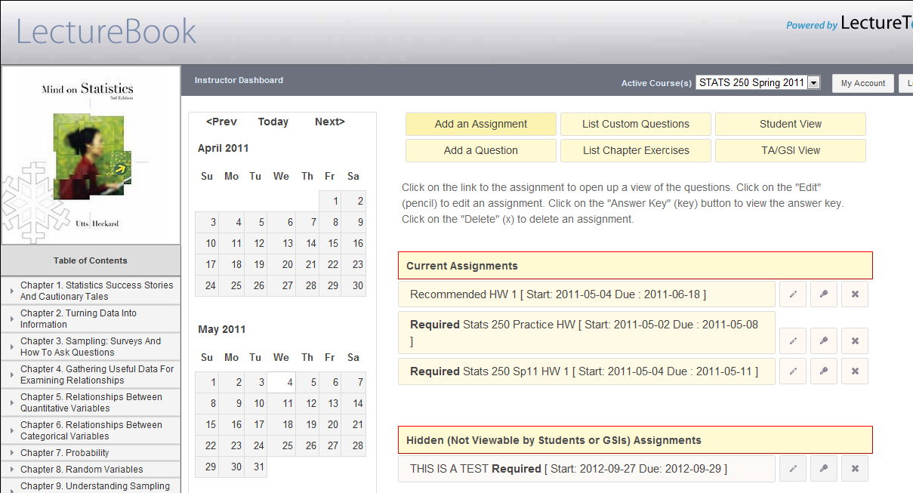
Instructor View → Dashboard
Start creating a HW or add more custom questions
Quickly see text or your custom questions
Pretend to be a Student or a Grader
View, Edit, or Remove Current HWs
Set up HWs and keep hidden until ready … to preview or try things out
Notes:
You are the instructor and you log in and this is your dashboard … you have the list and links to the current assignments that you have set up and are open for your students to work on.
You can set up homeworks and keep them ‘hidden’ until ready to make visible for your students … to try things out.
At the top you can pretend to be a student … pretend to be a GSI (the GRADER view) … you can quickly go look at chapter/text exercises that you may want to pick from or that bank of custom questions you were able to put in by ADDING a question.
And of course you can set up that next assignment.

Slide 13
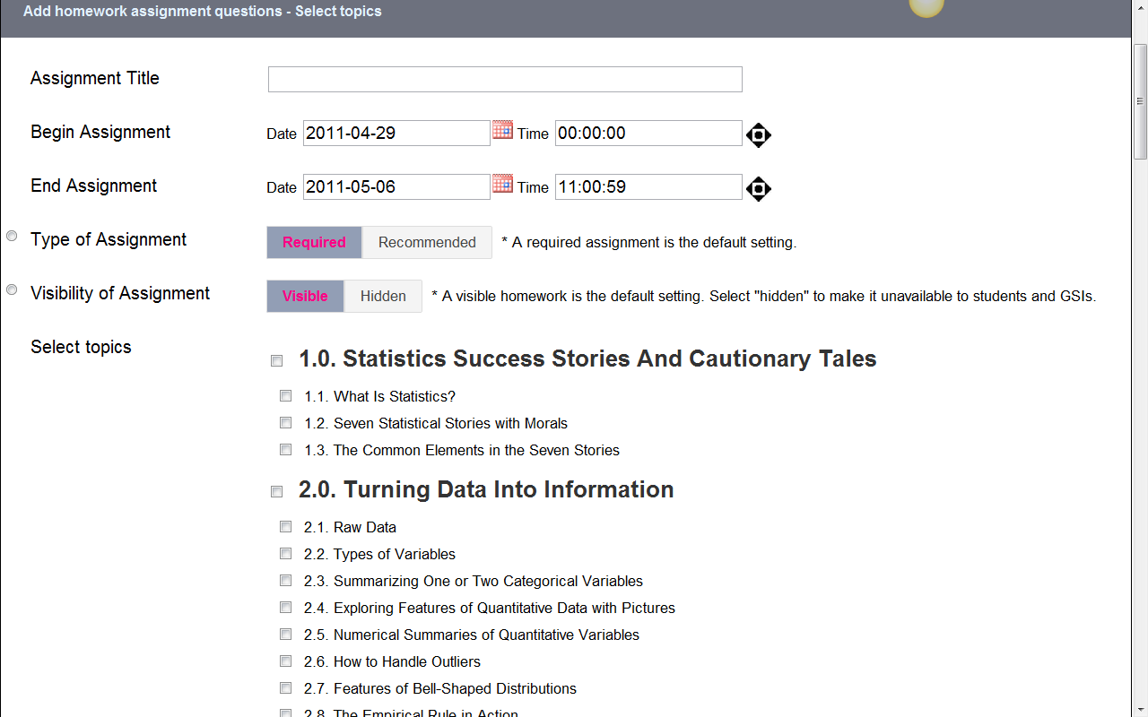
Instructor View → Creating a HW
Set HW Details (title, open/close day/times, type and visibility)
Then select topic(s) for HW …
if linked to text, by chpt/section
Notes:
Title, open and closing dates and times
Required or recommended (soln are available, initially hidden so students have to click to see them to check answer after they try them), and visible or not.
Then you select the topics (mine correspond to the chapters of the textbook).

Slide 14
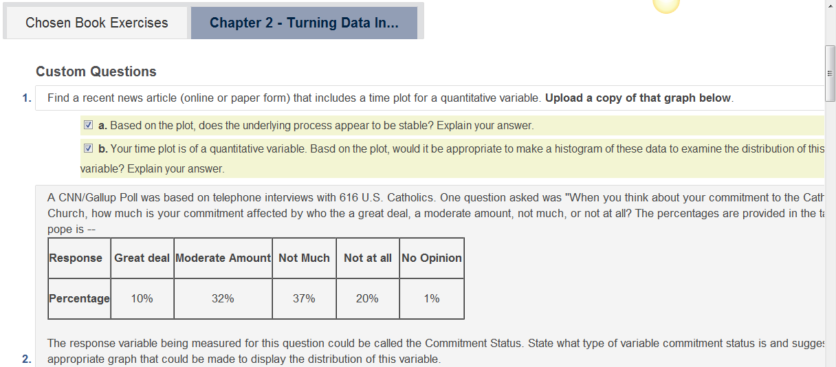
Instructor View → Selecting Questions
If HW tool connected to text, first select any textbook questions (click on “View Chapter Exercises” if need to remember which ones)
Submit the (none, one, many) textbook questions and move on to select from your customized bank of questions
Notes:
Can select just 1, a few, or even none of the textbook questions, submit to go to the custom questions that go with that chapter/topic.

Slide 15
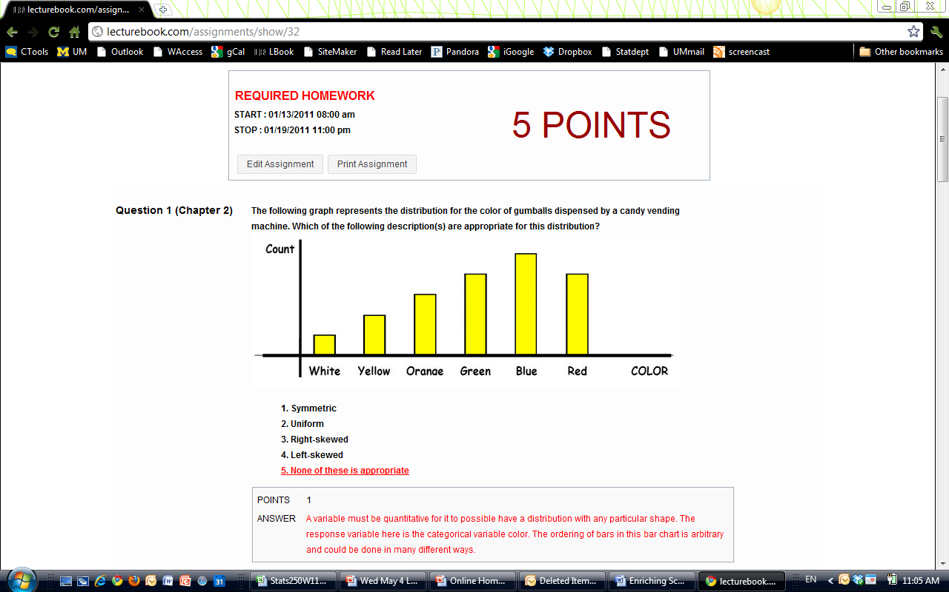
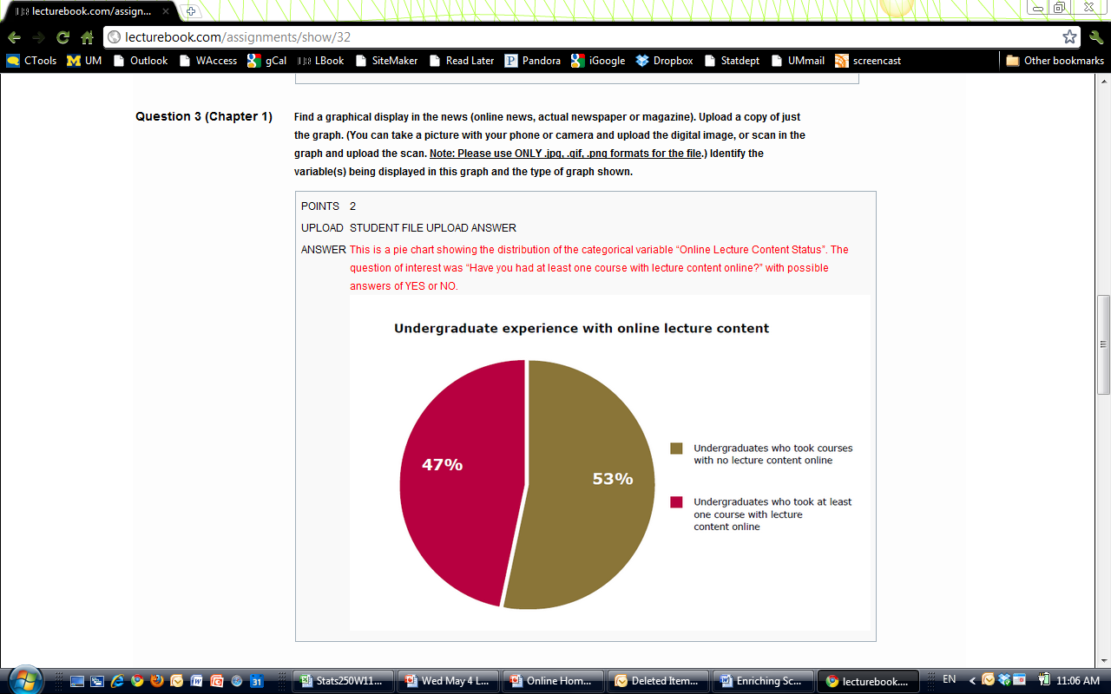
Instructor View → full HW view
Notes:
Full HW view (with solutions and default points)
Clicking on the EDIT ASSIGNMENT here or the PENCIL icon if you are at the instructor HOME screen puts you in to EDIT mode

Slide 16
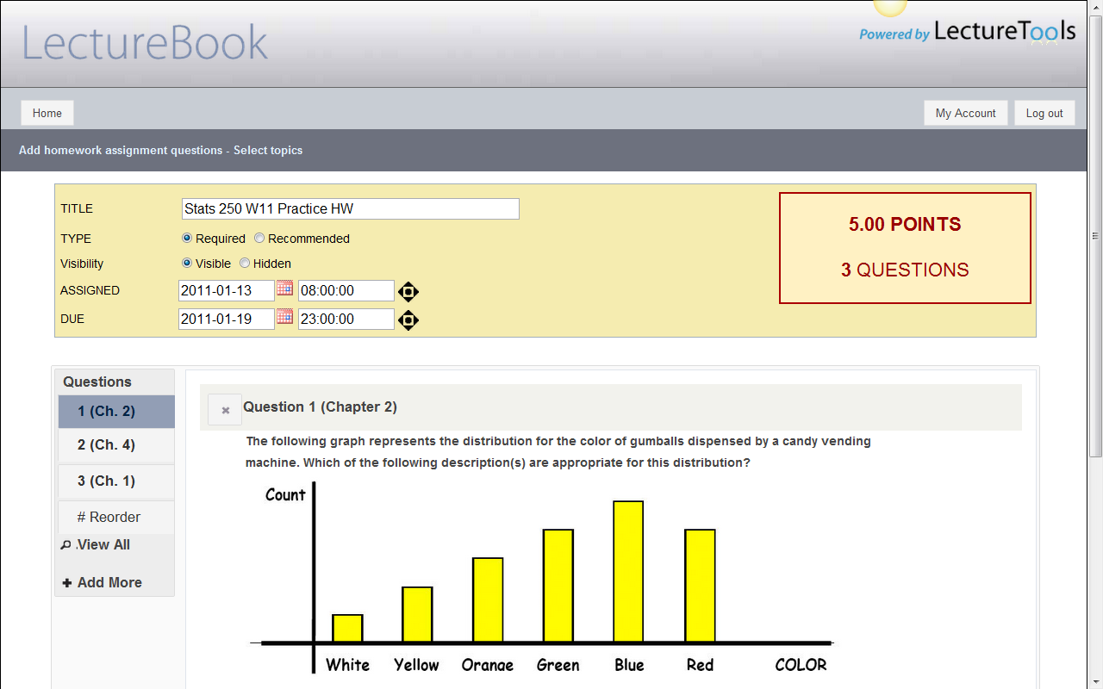
Instructor View → Edit HW Mode
See current # questions and points
Change any basic settings
Select any question to view: edit points, solutions, remove part (b)
Here is a multiple choice question: correct answer shown in red, and instructor can create, edit, enhance solutions to go beyond just providing correct answer.
Can be short answer, require upload, multiple choice or multiple mark.
Reorder questions, go back to add more, get full HW view
Notes:
EDIT HW mode
Change basic settings/title/due date
Reorder questions (want students to go through questions in specific order that builds in complexity)
Add more questions, select a question to move to edit details about it (solutions, the points, remove part(b) if you wish)

Slide 17
Instructor View Summary
Select from exercises that come with text
Can create bank of customized HW questions that link back to e-textbook content (by chapter/section)
Various formats for customized questions: short answer, require upload, multiple choice & multiple mark (auto-graded)
Can create, edit, enhance solutions to go beyond just providing correct answer.
Notes:
In SUMMARY … instructor side …
I am able to select from the exercises that come with the text, but I have also created a bank of customized homework questions that I can have linked back directly to e-textbook content (by chapter / section).
These customized questions can be of various formats from short answer, can require upload (of computer results or a sketch a student draws or a graph they find in the news) … to multiple choice to multiple mark that are auto-graded.
I am able to create and edit solutions that go beyond just providing the correct answer.
I can enhance the solutions for my students.
VERY FLEXIBLE … lets me do a lot of what I used to do on paper form but now online.

Slide 18
Online HW
Student View

Slide 19
Student View → Homepage
Notes:
First week of class on their first GTD list they are asked to go in and watch the video tutorial for a click overview on using this online tool. They will be able to see any assignments (current or past) and also on their GTD checklist, they have to go in to select their GSI …

Slide 20
Student View→ Selecting GSI
Notes:
In the Fall/Winter there are about 30 GSIs and the HWs won’t be graded if they are not ‘sent’ to their GSI.
And yet, there were still a couple of students that never checked their grades either on lecturebook or on the ctools gradebook to see all the 0’s until after they took the final exam.

Slide 21
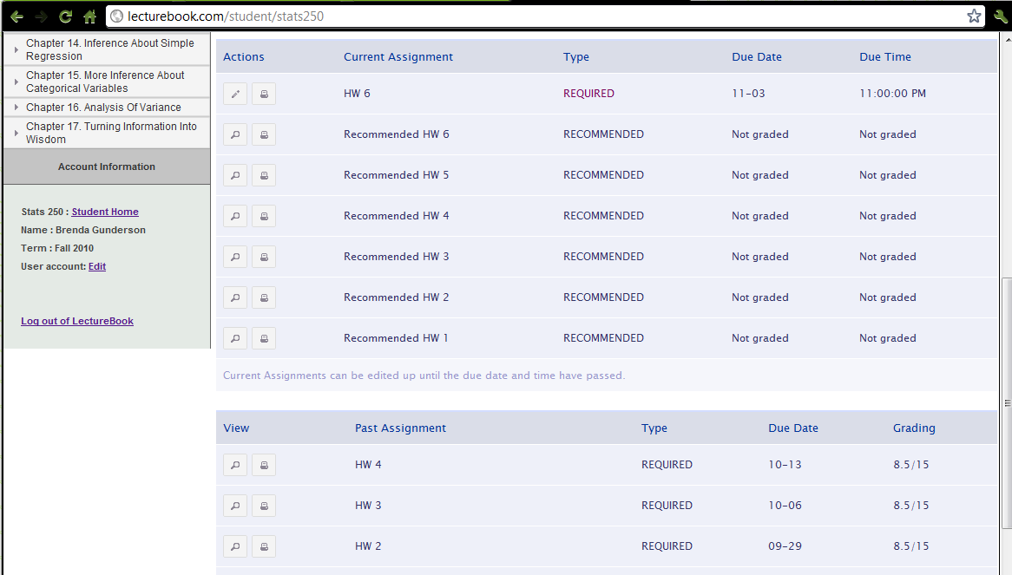
Student View → Homepage later in term
All assignments in one place, graded with feedback for later review/reference.
Notes:
So their homepage … later on in the term, might look something like this … the current required HW at the top …
The recommended ones stay ‘current’ as I set their due date after the final exam is over.
And Past assignments, already graded, at the bottom – ALL IN ONE PLACE, no lost papers, all of their answers, the solutions and the customized feedback, that they can pull up and review throughout the term.
The student clicks on the edit (pencil) icon by the current required HW and takes them to a page …

Slide 22
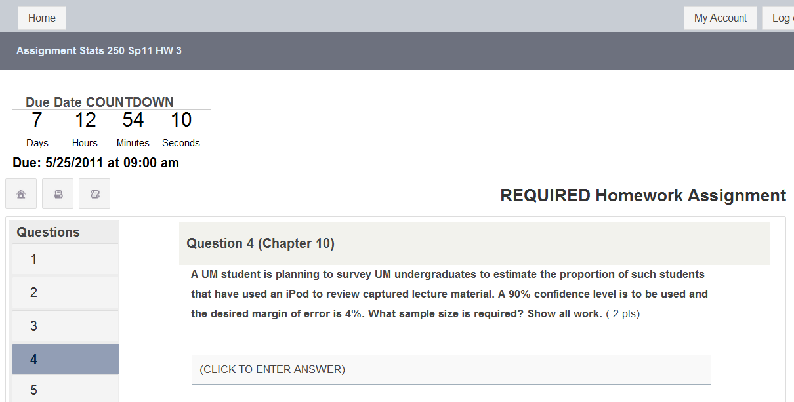
Student View → Working on that HW
Countdown to due date and time and AUTOMATIC submission!
Icons allow print view with or without students’ answers.
Questions can be linked back to e-Text by Chapter and/or Section
Click through to select a question, read question, go back to e-Text section if need review, begin entering answer. Can enter first thoughts and go back to edit anytime before auto-submitted.
Notes:
…and takes them to a page where they can work through the instructor-selected weekly homework questions online, typing in or in some cases uploading their answers
… the questions are tied back to the e-textbook material (by chapter and/or by section) if a review is needed.
The submission of the paperless homework is automatic and at a common time (NOTE the countdown timer)
for all students (no more ‘I lost my homework’ or ‘I forgot to bring my homework to lab’).
For a student that does want to print out the HW then can do so with their answers or without (so just questions).

Slide 23
Student View → Types of Questions/Answers
Question can require upload of graph or image, with or without additional text answer.
Multiple Choice questions will be automatically graded.
Short Answer questions brings up text box to enter answer.
Notes:
Clicking on Q2 in the menu takes you there where there are two parts … (a) is MC and AUTO-GRADED (1 plus and 2 wishes)
(b) Is a typing in the answer.
And they can see the points for each part.

Slide 24
Student View → Print with student answers

Slide 25
Student View → Print Questions only

Slide 26
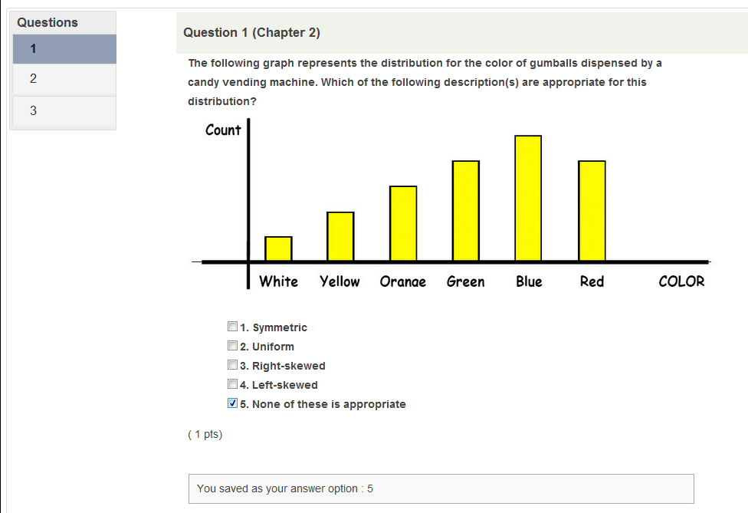
Student View → Selected MC saved

Slide 27
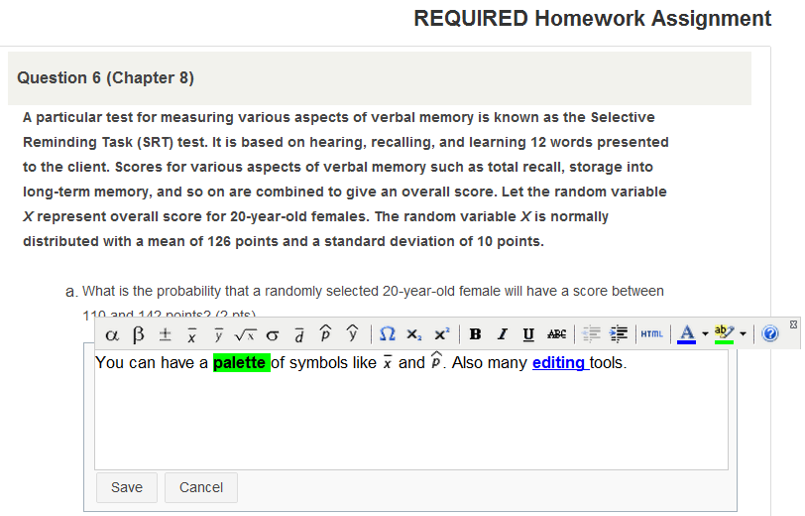
Student View → Editing Tools/Symbols
Start typing and a palette of symbols and tools pops up. Can be customized with most common ones.
Every answer entered, uploaded, and SAVED … is submitted automatically at the due day/time.
No more “I forgot to turn in my HW.”
Notes:
We are customizing the palette my students will see to be a better fit for statistics!
Every answer they enter/upload/select is SAVED … and at the due day/time submitted automatically.

Slide 28
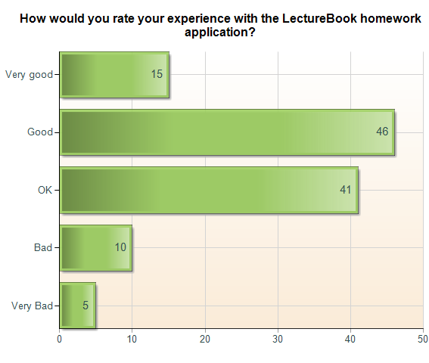
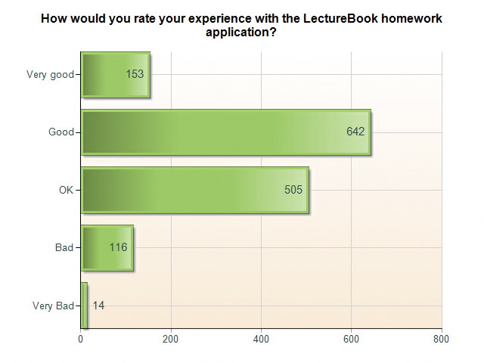
Rate OnLine HW Tool Experience… “good or very good”
Spring 2010: 52% Fall 2010: 55%

Slide 29
LectureBook Pluses from Students
I liked it, since we did not have to turn in anything.
At first, I was skeptical, but within the first week I became greatly appreciative of its features. It allows GSIs to provide feedback on individual responses, and allows students to quickly identify and understand their mistakes.
The complete set of answers to each HW assignment were great to review and work through problems before exams.
The online homework tool is fundamentally a learning tool and a study tool.
LectureBook Wishes from Students
Make inputting symbols easier (move most-used to main toolbar)
Ability to Draw (incorporate some type of Paint Tool)
Add Reminder so we know if any problems are unfinished (no answer)

Slide 30
Online HW
Grader (GSI) View

Slide 31
Grader View → Dashboard
Graders can export grades/scores with the click of a button.
Graders can click on any HW link to view questions with solutions (even before due) to review for office hours.
Click on pencil icon to start grading HWs. Can go back to fix/change at anytime.
Notes:
That due date/time has passed and now GSIs can go in to grade the HWs for their students online.
Here is their homepage …
At any time they can go in to select and view the questions with solutions (if need to confirm an answer in office hours, etc)
They are also able to export the grades/scores and bring them in to ctools (IMPROVEMENTS in this process are coming …).
The recommended problem sets have no PENCIL as they are not graded, but scrolling down a bit would lead them to an assignment to grade.
Also – if there was a correction needed, a GSI can go in even after grades are released to fix/change the grading for any student.
So let’s select the PRACTICE HW to do some grading.

Slide 32
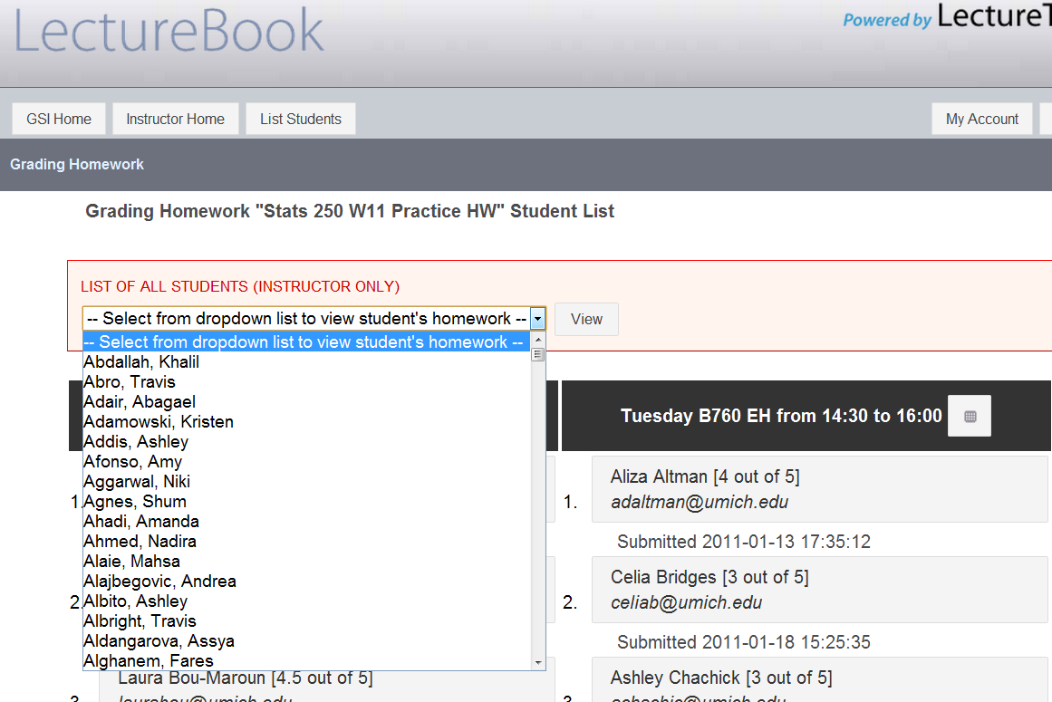
Grader View → Grading HW Student List
Notes:
Once you pick a HW set to work on grading … you are taken to the student listing. Now when I log in as overall instructor, my list has ALL students in it;
That way, if a student emails me about a question, I am able to pull it up and check it out, see their score.
whereas a GSI would only see their own students for their own lab(s).

Slide 33
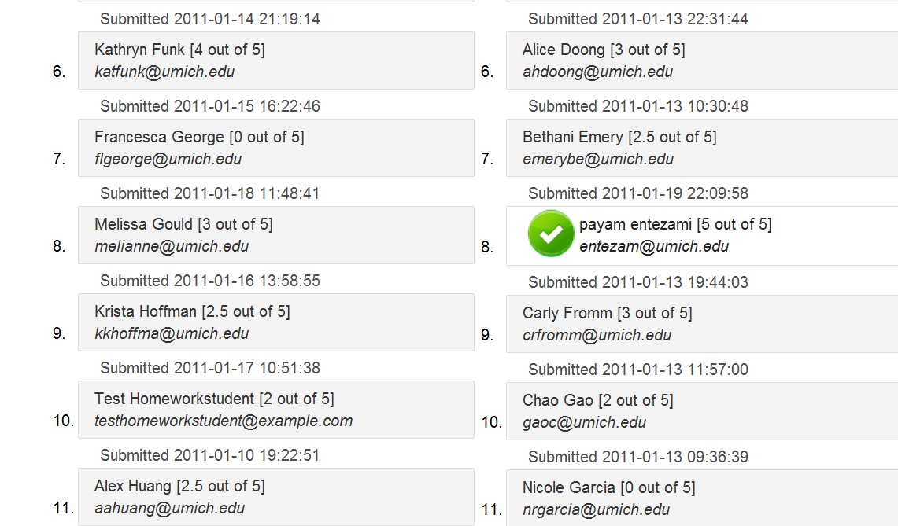
Grader View → check = DONE!
Notes:
When grading, you can MARK a HW set as “DONE” for students as you complete them,
So if you have to stop and come back to grading later, you can quickly see which are done and which students you still need to finish grading for.

Slide 34
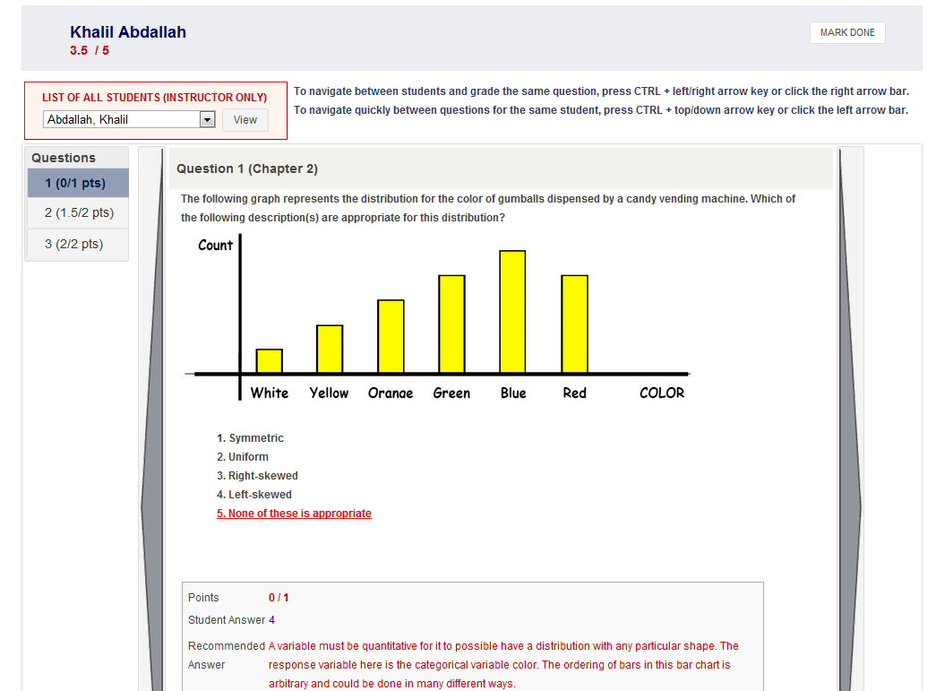
Grader View → grading & navigating
Notes:
This is a MC question, so as soon as you few it, it is graded automatically.
Navigation: go through all questions for a given student
OR across students, staying on and grading the same question.
Points earned and can click on the MARK DONE when DONE.

Slide 35
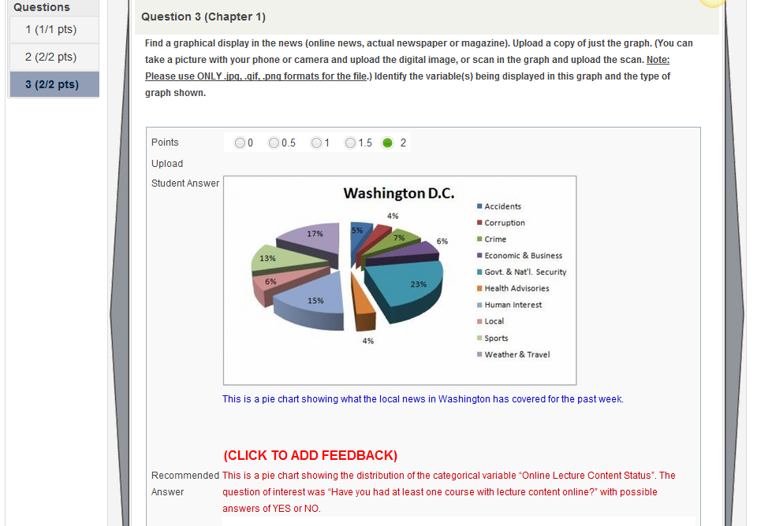
Grader View → view upload, partial credit

Slide 36
Grader View → Tailored Feedback 1

Slide 37
Grader View → Tailored Feedback 2

Slide 38
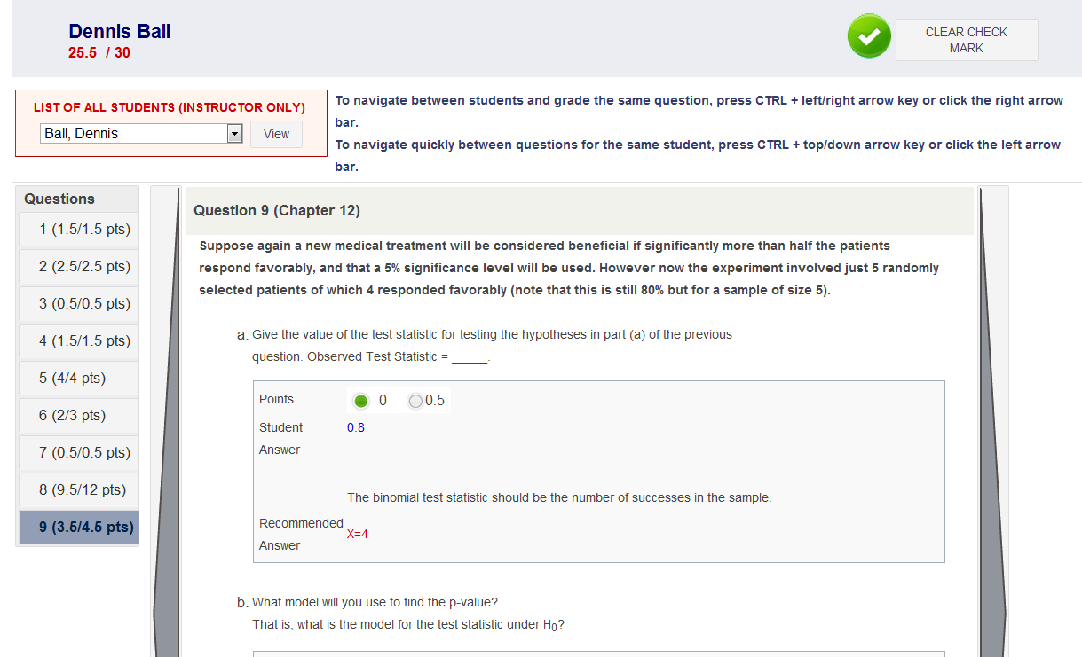
Grader View → fully graded HW
Notes:
A finished graded HW checked as done (and you can uncheck it too).
Can scan to see which problems they really missed.
Total score at the top.

Slide 39
Grader View Summary
Efficient design of grading system: GSIs supply tailored feedback within few days.
Various ways to navigate: grade all questions for a given student, or scroll student by student grading same question (for consistency).
Point summaries (individually, for class, by question/part).
‘Checkmark’ when done grading for a student.
Export scores and upload into CMS (Ctools).
Notes:
In SUMMARY … Grader (GSI) side …
When students go back in, they see the question, their answer and score,
The INSTRUCTOR EDITED solution and if appropriate, individual tailored feedback.

Slide 40
OnLine HW Tool Linked to e-Text
F09: average grade = 3.09 (n = 1326)
F10: average grade = 3.22 (n = 1395)
Online HW Tool + eText only new innovation incorporated.
Buy-In: ~ 25% F10 and > 50% W11
Possible future plans:
mini video snippets of my captured lectures embedded/tagged to specific HW questions
Implementing some of Student and GSI “WISHES”
Notes:
We have seen an increase in average grades and an increase of the buy-in of the e-textbook option as students appreciate the integration of textbook with tailored homework questions.
Future plans to further enhance this tool
to further enhance this online HW/e-textbook tool. I am using Camtasia Relay – a lecture capture software that allows for closed captioning and exporting media in multiple modes to capture all Stats 250 Winter 2011 lectures. The full lectures go up on iTunes U for current students to utilize.
The captured lectures will be further used to create small mini video snippets to be tagged to various homework questions in the online homework tool.
A student working on homework and needing a hint or guidance could click on the associated mini video of few minutes of lecture showing an example or the discussion that correlates with the homework problem.
This will further allow students to build connections between the material they encounter to see the bigger picture (continuous guided learning).

Slide 41
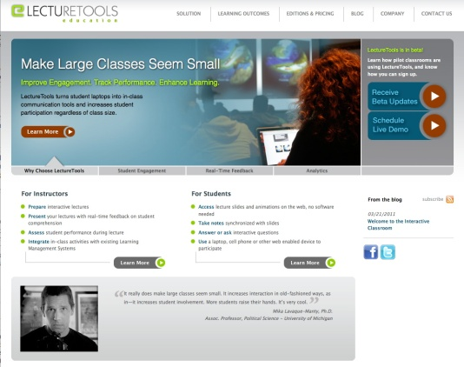
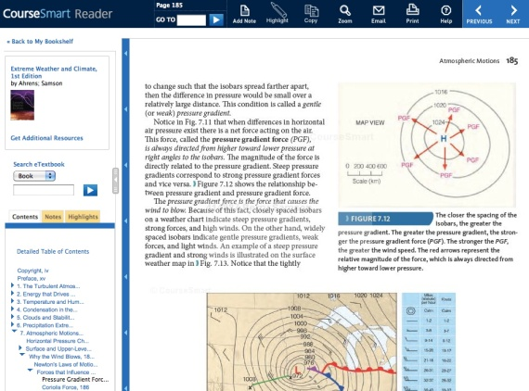
Where Is This Going? Perry Samson says …
Integration between in-class activities (lecturetools.com) & homework + textbook (lecturebook.com)
LectureTools
LectureBook
Cengage
CourseSmart

Slide 42
Using Technology to Guide Continuous Learning
Interact with lecture material via interactive note -taking (tablet)
Incorporate clicker questions into my lectures for feedback and tailoring of my teaching and guiding learning
See it again … captured reviews and captured lectures
Put useful interactive guided learning resources in students hands at appropriate time (video wrappers and prelabs)
Prelabs prepare students for group projects and activities in weekly labs using computers
Students practice and answer questions on-line with guidance and links to text (lecturebook online HW)
Repeat 1 to 6 … see ideas repeat, build as move on to other inference procedures
At some point … assessment via exams (2methods for grades)
All to help guide students to think, reflect,
… to learn!
Notes:
So this ONLINE HW tool with e-text has an important role in how my course is run, how my students move through and interact with the concepts/material.
1 = see it introduced in lecture with me – where they interact with the ideas as we draw and think through that ‘if we repeated the procedure …’ concept/thought experiment,
2 = try out clicker questions about it (and often get it wrong)
3 = they can see it again and again via captured lectures
4 = they see it in a prelab
5 = they do it and discuss it more in lab
6 = they have practice HW and required HW questions about it
7 = they are assessed via exam question
8 = they see it again and again regarding other inference procedures

Slide 43
THANK YOU … Questions?
Brenda Gunderson, Statistics
bkg@umich.edu
and
Perry Samson, AOSS
samson@umich.edu
The University of Michigan
CAUSE Webinar August 9, 2011

