Slide 1

Using a Paper Ruler Activity to Help Students Understand the Difference Between Random and Systematic Errors
By Jamis J. Perrett, Ph.D.
Department of Statistics

Slide 2
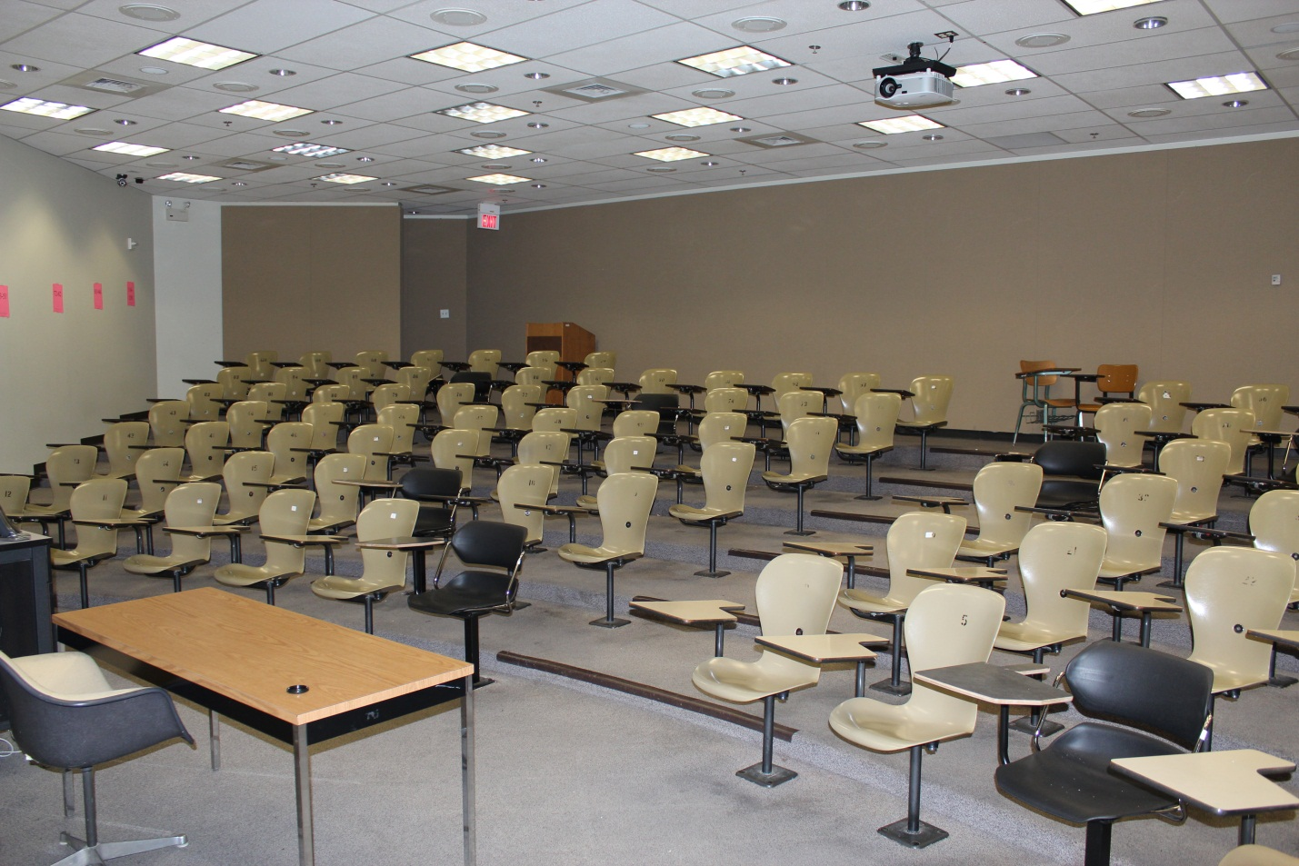
The Classroom: 100 students

Slide 3
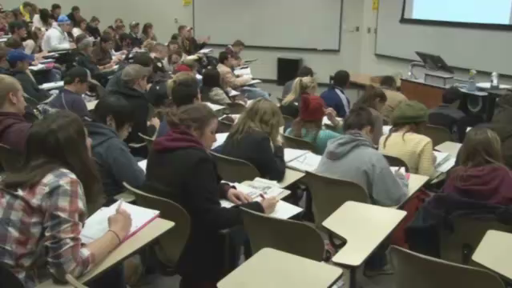
The Class: Statistical Literacy

Slide 4
The Objectives
Help students learn the difference between random and systematic errors.
Engage students in an activity involving statistics.
Focus on concepts.
Give students a concrete application of statistics that they can associate with the topic being studied.

Slide 5
Slides the Students See in Class…

Slide 6
Types of Error
Random Error:
  Expected/Normal/Real-life
  Happens by chance
  Effect can be reduced by caution and averages of repeated measurements
Systematic Error:
  Consistent errors caused by an inaccuracy in the measurement instrument or some other aspect of the measurement process
  Can be removed by correcting the problem in the process that is causing the error

Slide 7
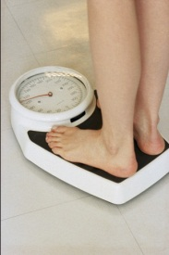
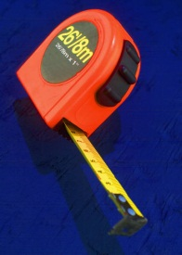
Types of Error
Examples:
How much do you weigh?
  Subtle movements while standing on a scale can cause slightly inaccurate measurements.
  A scale that is always off by +5 lbs. is always giving inaccurate measurements.
What is the actual length of the football field?
  Using a 25 foot tape measure to measure the length of a football field will not always result in an exact measurement.
  A tape measure that had numbers and scales inaccurately printed will consistently give inaccurate measurements.
Potato Chip bags have weights pre-printed. So, a bag that indicates 12oz. Had that weight printed before the actual chips were weighed.
  What random errors could affect the weight of a bag of potato chips?
  What systematic errors could effect the weight of a bag of potato chips?

Slide 8
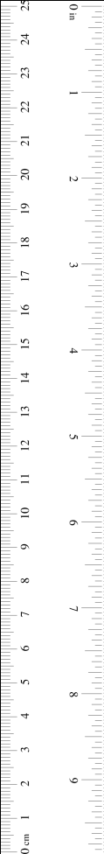
Ruler Activity
Measure the length of your desk (front to back) three times each, using the two paper rulers (to the nearest 1/16th of an inch).
One ruler is accurate. One is not.
Systematic error?
Random error?

Slide 9
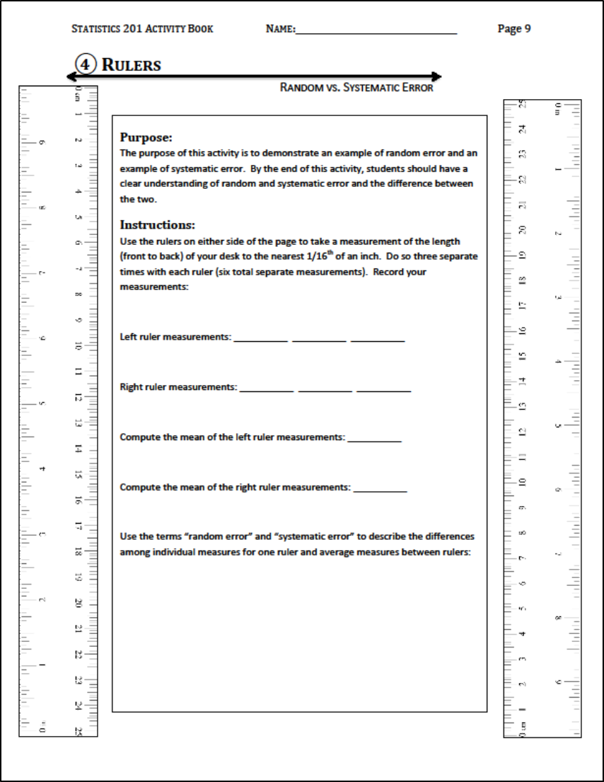
Handout

Slide 10

Students working on the activity.

Slide 11
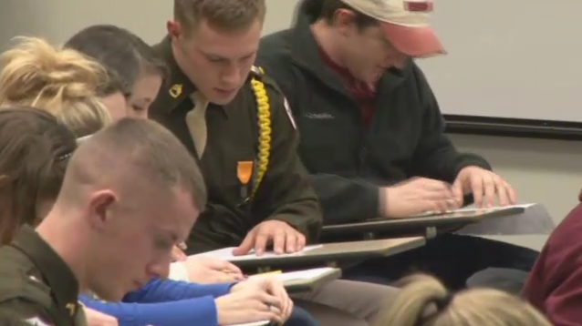
More students working on the activity.

Slide 12
Post-activity Debriefing
What might cause multiple measurements using the same ruler to differ?
What might cause measurements of the same object with different instruments to differ?

Slide 13
In Conclusion…
The activity
gets students engaged.
shows students the difference.
provides students with a concrete application that they can associate with the topic.
focuses on the concept.
can be used with classes of any size.
does not require additional materials.

Slide 14
Questions?
Comments?

