Slide 1
Create an Iron Chef in Statistics Classes? CAUSE Webinar
Rebekah Isaak
Laura Le
Laura Ziegler
& CATALST Team:
Andrew Zieffler
Joan Garfield
Robert delMas
Allan Rossman
Beth Chance
John Holcomb
George Cobb
Michelle Everson
June, 2011
DUE-0814433

Slide 2
Outline
Introduction
CATALST Research Foundations
How We Create the Statistical Iron Chef
Teaching Experiment
Student Learning
To Bring About Change…

Slide 3
Introduction
Following a recipe step-by-step is to “novice thinking” as understanding affordances involved in truly cooking is to “expert thinking”
Notes:
Alan Schoenfield’s paper (1998) influenced this cooking analogy in a statistics classroom. He drew parallels between thinking like a cook and thinking like a mathematician.

Slide 4
CATALST Research Foundations
Origins of CATALST
George Cobb – new ideas about content
Daniel Schwartz – “plowing the field”
Tamara Moore – MEAs in other fields

Slide 5
CATALST Research Foundations
Curricular materials based on research in cognition and learning and instructional design principles
Materials expose students to the power of statistics, real problems, and real, messy data
Radical changes in content and pedagogy: No t-Tests; randomization and re-sampling approaches; MEAs

Slide 6
How We Create the Statistical Iron Chef
Model-Eliciting Activities (MEAs)
Definition (from SERC website):
Model-eliciting activities (MEAs) are activities that encourage students to invent and test models. They are posed as open-ended problems that are designed to challenge students to build models in order to solve complex, real-world problems.

Slide 7
How We Create the Statistical Iron Chef
Model-Eliciting Activities (MEAs)
Start each of three units with a messy, real-world problem
Example: iPod Shuffle MEA
Create rules to allow them to judge whether or not the shuffle feature on a particular iPod appears to produce randomly generated playlists.
End each unit with an “expert” solution
http://serc.carleton.edu/sp/library/mea/what.html

Slide 8
How We Create the Statistical Iron Chef
Goals for the course:
Immerse students in statistical thinking
Change the pedagogy and content
Move to randomization/simulation approach to inference
Have students really “cook”

Slide 9
How We Create the Statistical Iron Chef
Unit 1: Models and Simulation
Develop ideas of randomness and modeling random chance
Build an understanding of informal inference that leads to an introduction to formal inference

Slide 10
How We Create the Statistical Iron Chef
Unit 1: Models and Simulation
Student Learning Goals:
Understand the need to use simulation to address questions involving statistical inference.
Develop an understanding of how we simulate data to represent a random process or model.
Understand how to use the results/outcomes generated by a model to evaluate data observed in a research study.
Learn TinkerPlots

Slide 11
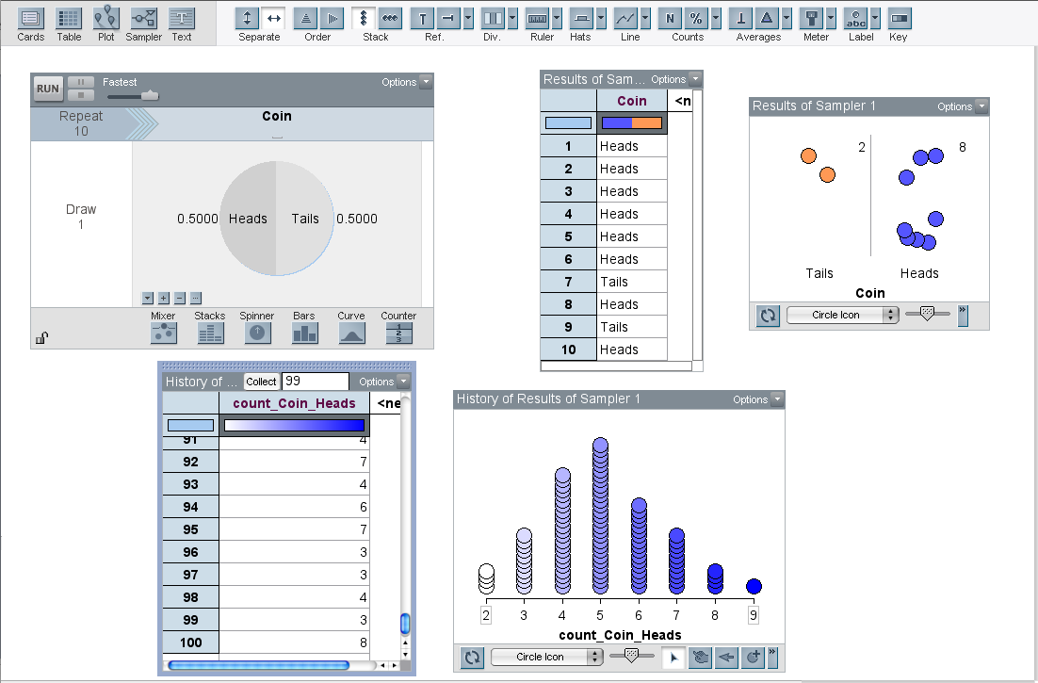
How We Create the Statistical Iron Chef

Slide 12
How We Create the Statistical Iron Chef
Unit 2: Models for Comparing Groups
Extend the concept of models and formal inference by introducing resampling methods
Student Learning Goals
Learn to model the variation due to random assignment (i.e., Randomization Test) under the assumption of no group differences
Learn to model the variation due to random sampling (i.e., Bootstrap Test) under the assumption of no group differences

Slide 13
How We Create the Statistical Iron Chef
Unit 3: Estimating Models Using Data
Continue to use resampling methods (i.e. bootstrap intervals) to develop ideas of estimation

Slide 14
Teaching Experiment
What is it?
They involve designing, teaching, observing, and evaluating a sequence of activities to help students develop a particular learning goal
2010/2011: Two-semester teaching experiment (Year 3 of grant)
Notes:
(Steffe & Thompson, 2000)

Slide 15
Preparation for the Teaching Experiment
Reading, thinking, writing, adapting MEAs
Planning and decisions about sequence of course content, software choice(s), etc.
Conversations and working sessions with visiting scholars

Slide 16
Teaching Experiment: Semester 1
Research Questions:
How would students respond to the demands of the course?
What does it take to prepare instructors to teach the course?
How can we see evidence of the students’ reasoning developing throughout this course?
Notes:
The research questions for the first semester of the teaching experiment were:…

Slide 17
Teaching Experiment: Semester 1
1 graduate student at UMN taught 1 section of undergraduate course (~30 students), while 2-3 graduate students observed
Unit 1 was written (and MEAs for Unit 2 and 3)
Plans/Outline for Unit 2 and 3
Plans for software (TinkerPlots, R-Tools, and R)
Many weekly meetings to debrief and plan

Slide 18
Ch-ch-ch-ch-Changes
Team met in January to make changes based on what was learned during the semester (also met with 6 potential implementers)
Re-sequencing of some topics (e.g., bootstrap)
Course readings added (content) and removed (abstracts only)
Assessments adapted as needed
Group exams rather than individual

Slide 19
Teaching Experiment: Semester 2
Research Questions:
Is the revised sequence more coherent and conceptually viable for students?
How effective is the collaborative teaching model in preparing instructors for teaching the CATALST course?
Can we take the experiences of these instructors and use them to help create lesson plans for future CATALST teachers?
Notes:
The research questions this semester were…

Slide 20
Teaching Experiment: Semester 2
3 graduate students each taught a section at U of M (~30 students each) in active learning classrooms
Also taught in 1 course at North Carolina State University
Many meetings (teaching team, CATALST PIs, instructors, curriculum writing, Herle Skype's into the meeting)
Units 1 & 2 were written
Plan/Outline for new Unit 3

Slide 21
Teaching Experiment: What We Have Learned
We can teach students to “cook”
Based on interview and assessment data, students seem to be thinking statistically (even after only 6 class periods!)
We can change the content/pedagogy of the introductory college course
We can use software at this level that is rooted in how students learn rather than purely analytical

Slide 22
Student Learning: Positive Attitudes Percent who selected Agree or Strongly Agree
COURSE EVALUATION ITEM | (N = 102)
I feel that statistics offers valuable methods to analyze data to answer important research questions. | 95.0%
I feel that as a result of taking this course, I can successfully use statistics. | 88.2%
This course helped me understand statistical information I hear or read about from the news media. | 86.3%
Learning to create models with TinkerPlots™ helped me learn to think statistically. | 85.0%
Learning to use TinkerPlots™ was an important part of learning statistics. | 81.4%
I think I am well-prepared for future classes that require an understanding of statistics. | 85.0%

Slide 23
Student Learning: Preliminary Results
Informal observations
Different ways of answering the same problem
Small group discussions provide insight into student thinking, particularly on hard concepts
Student comments
“I really didn’t anticipate enjoying a stats class this much!”
“I would recommend this course to anyone…I am very satisfied with this course.”
“Really interesting way to learn statistics!”

Slide 24
Challenges We are Working On
Textbook/materials
TinkerPlots™ scaffolding
Get students to explore
Assessments
Individual vs. cooperative
Use of software on exams (not every student has a laptop)
“Cheat” sheets
Grading
Large courses

Slide 25
To Bring About Change…
It takes a village
It takes time
It takes flexibility

Slide 26
Create an Iron Chef in Statistics Classes?
YES!!!
Notes:
- So to answer the question in the title of our webinar…create an iron chef in statistics class? Teaching them to cook rather than follow recipes step-by-step? We believe we can and we believe we are in our curriculum.

Slide 27
http://catalystsumn.blogspot.com/
http://www.tc.umn.edu/~catalyst

