Slide 1
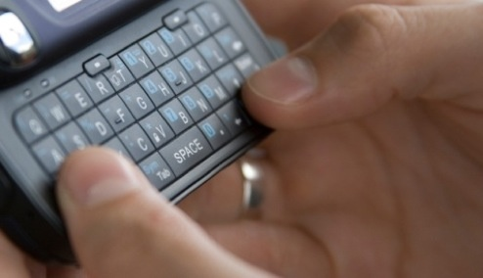
FREE CLICKERS!!! Using PollEverywhere for Formative Assessment in the Classroom
Michael A. Posner, Villanova University
CAUSE Webinar
February 22, 2011
Notes:
No Experience – overview of clickers/PE, Clickers – brief intro to PE, Compare/Contrast them

Slide 2
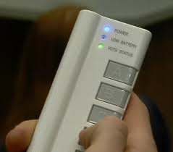
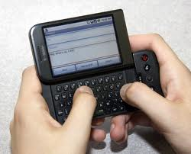
What are “Clickers”?
Personal Response Systems (PRS)
Manual
“Clickers”
Poll Everywhere
A
B
C
D

Slide 3
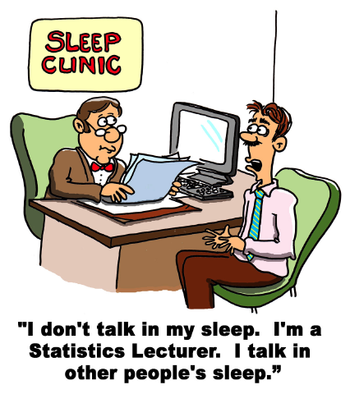
PRS in the Classroom
Benefits/Utility of PRS
Engaged students………
“Just in Time Teaching”
Invest in Predictions
Summarize Simulations
Student Surveys
Formative Assessment

Slide 4
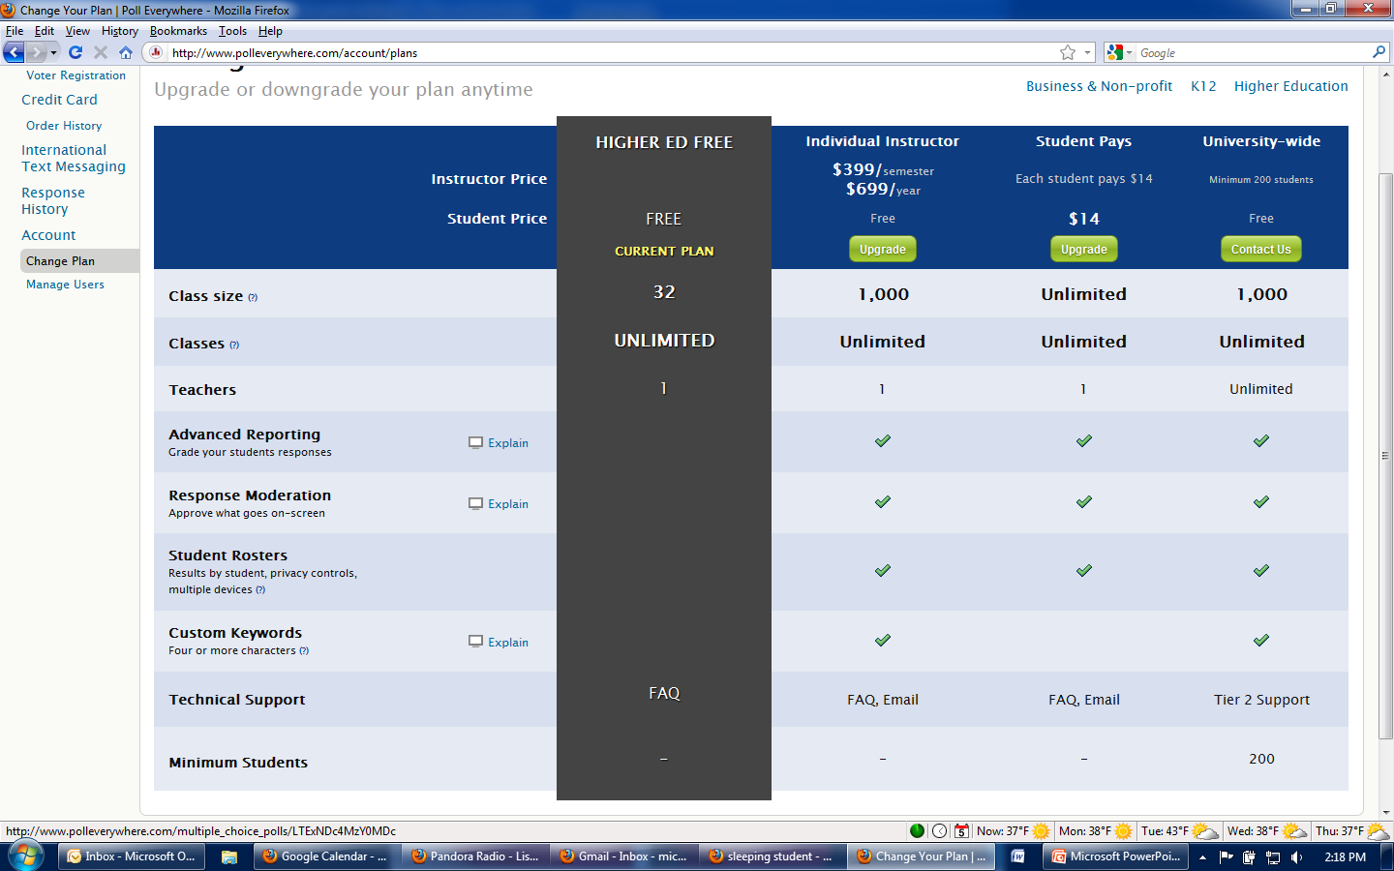
Getting a PollEverywhere Account

Slide 5
Notes:
Make sure to toggle the instructions/results and settings

Slide 6
Day One Questions

Slide 7
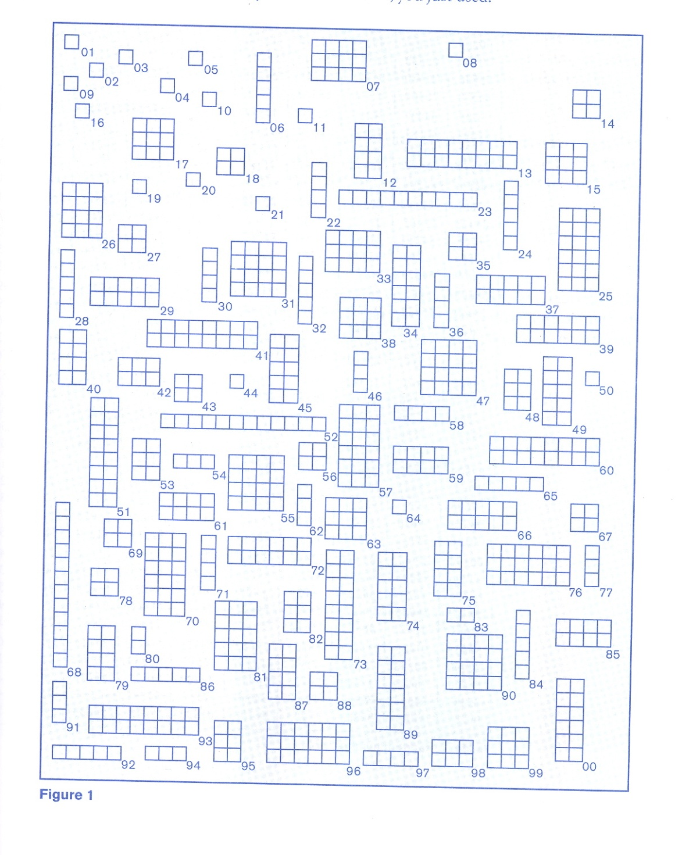
Random Rectangles
What is the average area of the rectangles?
1. Best Guess
2. Representative 5
3. Random 5
4. Random 20

Slide 8
Random Rectangles using PE
(Subset of Instruction Sheet)
Look at the following page for a few seconds. What is your best guess for the average area of the rectangles?
_______
TEXT TO 22333 FOLLOWED BY YOUR ANSWER FROM THE TABLE BELOW:
Guess | <3 | 3-3.9 | 4-4.9 | 5-5.9 | 6-6.9 | 7-7.9 | 8-8.9 | 9-9.9 | 10-10.9 | 11-11.9 | 12-12.9 | 13-15.9 | 16+
Text | 83913 | 83914 | 83915 | 83916 | 83917 | 97479 | 97480 | 97481 | 97547 | 97548 | 97549 | 97550 | 97551

Slide 9
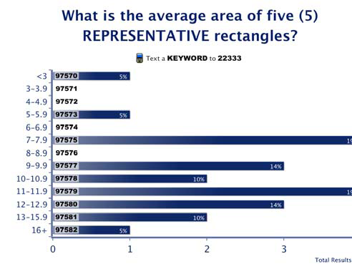
Random Rectangles - Results
Notes:
This can be shown together on one powerpoint slide, and sent to students or posted online

Slide 10
Birthday Problem

Slide 11
Propose an Experiment

Slide 12
Other Uses
Surveys
Basketball game absence
Online homework preferences
Likelihood of taking second course
CLT – proportion, uniform, geometric

Slide 13
PE vs. Clickers: A Novice View
 | Poll Everywhere | Clickers
Cost | Free for small classes, 1/3(?) large (univ), Texting cost? (stud) | $10-55/unit (stud), hardware (univ)
Hardware | None | Required
Internet | Necessary | Not Necessary
Reception | Internet Deadspots | Receiver Deadspots
#char/response | 10 | 1-2
Access | % w/o cellphone? | % w/o clickers?
Cheating | Share cellphone? | Share clicker?
Record Q Result | PE Account | Screenshot
Anonymity | Toggling Unknown | Toggled by Q
On The Fly…. | Create Question | Questionless

Slide 14
PE vs. Clickers: A Novice View II
 | Poll Everywhere | Clickers
Question Types | Multiple Choice Open-ended | Multiple (5) Choice Some have more
Answer Types | Alphanumeric | Clicker-dependent
Records Answers | Yes | Yes
CMS Integration | Unknown | Supported
Results | Online or Powerpoint | “Histogram” in any Presentation
Proximity (online courses) | PollEVERYWHERE Twitter / Web Options | Satellite Polling web>clicker
Multiple Qs | Yes | Some
Clicker Tests | Cumbersome | Some
???
Barchart

Slide 15
PE in My Classroom
Student Reaction
Poll Everywhere Enjoyment: 4.8 / 5
Poll Everywhere Learning: 4.2 / 5
Professor Reaction
Students loved using it…so I did too!
No startup cost/hardware was huge benefit
Was great for saving results of simulations
Want to experiment with integrating student records
Want to experiment with clickers

Slide 16
Summary
Poll Everywhere
Great tool to start learning about PRS
Good for occasional classroom use
Good for presentations
Useful for online courses
Less burden of cost on student
Clickers
Useful for frequent use
Useful for student tracking
Burden of cost typically on student

Slide 17
Resources
Formative Assessment Theory
Black & Wiliam, Inside the Black Box: Raising Standards Through Classroom Assessment.
Assessment Methods in Statistical Education: An International Perspective. By Bidgood, Hunt, and Joliffe. Wiley.
Databases in Clicker Questions
http://mathquest.carroll.edu/resources.html
http://www.ou.edu/statsclickers/clickerQuestions.htm
Includes misconceptions
Publishers
Effectiveness
Search ICOTS, IASE, JSE, SERJ
See providers websites

Slide 19
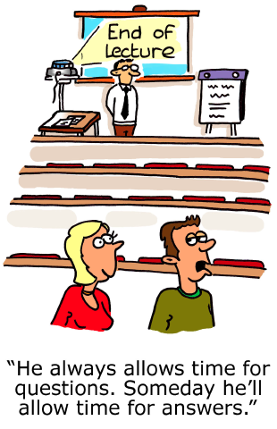
This presentation will be posted on my website: http://homepage.villanova.edu/michael.posner
If you have any feedback, please let me know
Conflict of Interest Disclaimer: I have no financial or other affiliation with any of these companies

