Slide 1
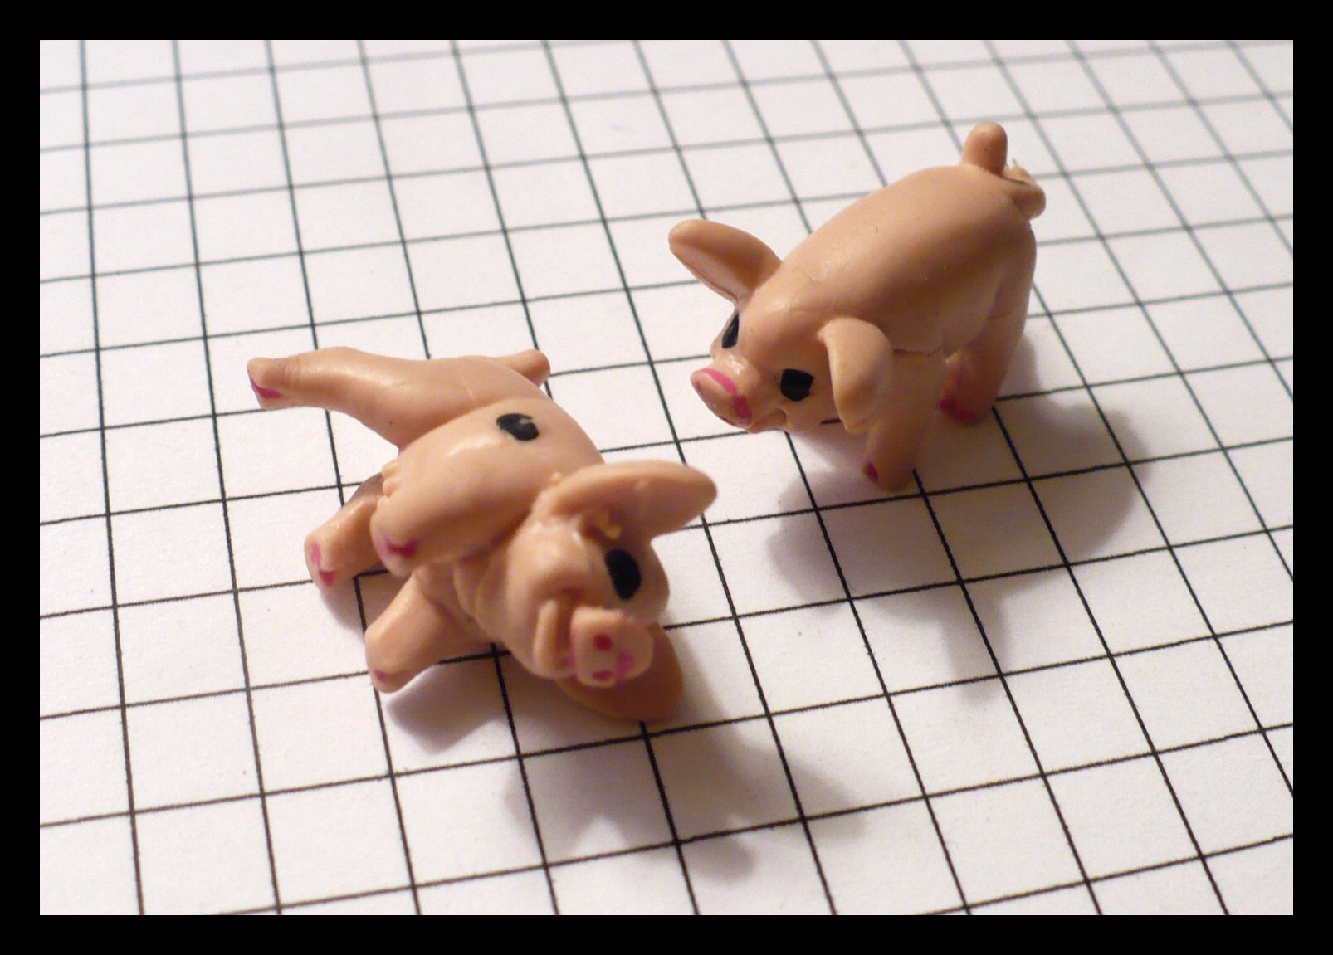
This Little Piggy Teaches Probability
CAUSE Webinar, November 2010
Stacey Hancock, Clark University
Jennifer Noll, Portland State University
Sean Simpson, Westchester Community College
Aaron Weinberg, Ithaca College
Notes:
Stacey

Slide 2
Pass the Pigs (Originally Pig Mania!)
The first player to 100 points wins.
On your turn, toss two pigs; compare their positions to the scoring chart:
If you earn points, you can keep those points or try to accumulate more points by rolling again.
If you get a “Pig-Out”, you lose all the points you earned during your turn and your turn ends.
Rolling an “Oinker” (or “Makin’ Bacon”) means you lose all the points you earned the entire game!
Copyright © 2008 Winning Moves UK Ltd. All rights reserved.
Notes:
Stacey
“Pig-Out” = both pigs land on their sides with only one of the dots facing up.
“Oinker” = both pigs are touching

Slide 3
Possible outcomes
Dot Up Sider: Pig lies on its left side.
Dot Down Sider: Pig lies on its right side.
Trotter: Pig stands on all fours.
Razorback: Pig lies on its spine, with feet skyward.
Snouter: Pig balances on front two legs and snout.
Leaning Jowler: Pig balances on front left-leg, snout, and left-ear.
Table 2 from Kern (2000).
Notes:
Stacey

Slide 4
Point Values for Two Pigs
Notes:
Stacey
The “makin’ bacon” picture is censored.

Slide 5
Pig characteristics
The expensive ones that come with the game have 6 possible outcomes:
Dot up, dot down, trotter, razerback, snouter, leaning jowler.
Cheaper ones may not be able to land on leaning jowler. So… be sure to try them out first!
Notes:
Stacey
Jen - I cannot remember this since its been a while…Aaron do you know if the expensive pigs can land on their tail and the cheap ones can’t? Or maybe the leaning jowler? We could just leave it as “you need to test them out and see what the possibilities are”

Slide 6
Why pigs?
Ideal for teaching the long-run frequency definition of probability.
Probability of each outcome unknown (as opposed to dice or coins).
Outcomes are not equally likely.
The activity is hands-on and fun.
Lots of possibilities for building on and extending the Pigs game.
Notes:
Stacey

Slide 7
Where do pigs fit within the curriculum?
Introduce probability with the pigs
Definition of probability
Empirical probabilities & long-term relative frequency
Connect probability to sampling ideas
Sampling variability
Describing and quantifying “unusual”, “unlikely”, “rare” and “expected”
The role of simulation in data collection and informal statistical inference
Notes:
Stacey

Slide 8
In class pig activity
We have received a request from the board game company, Porker Brothers®, to develop rules for their new game. It’s similar to a dice game except instead of dice, players roll a plastic pig. They want players to get different amounts of points depending on how the pig lands and they want to assign points in a way that most players will think is fair. Our assignment is to determine how many points to assign to each type of landing.
Teacher Notes: Give each group a pig and ask them to describe all of the ways the pig could land if they roll it. As a class, decide on terms (e.g. “side”, “back”, “jowler”, etc.) to represent each outcome. The instructor should record the outcomes on the board and summarize the class discussion.
Notes:
Jen

Slide 9
In class pig activity
In your groups write a proposal to Porker Brothers for assigning points. As part of your proposal describe what your group means by a “fair” way of assigning points and provide a rationale for each point value. Be prepared to present your report to the class.
Teacher Notes. As the students are working, ask the pairs/groups questions such as:
Should any outcomes be worth more points than others? Why or why not?
If you just consider [two of the outcomes like snouter vs. razorback], how might you decide how many more points one should be than the other?
[If students have started to discuss “likelihood” or “probability” in their groups] Since the probabilities aren’t all equal, how could you estimate what they are? If students don’t initially propose that they might roll the pigs repeatedly, ask them to make conjectures about the probabilities.
Notes:
Jen

Slide 10
In class pig activity
Possible Follow-up Questions (in class or for hw):
If you rolled a pig 200 times, how many times would the pig need to land on its feet for you to be surprised (i.e. think that there was something wrong with the pig)?
If you rolled the pig 200 times, what’s the lowest number of times you think the pig would land on its side? What’s the highest number of times you think the pig would land on its side? Explain your reasoning.
Suppose Porker Brothers wants to make a more complex version of their pig-rolling game. Instead of just rolling one pig, you roll two pigs at a time. How many different combinations of pig-rolls are there? (Run through same questions as before, but with two pigs)
Notes:
Jen

Slide 11
Our Experiences playing with pigs
Students immediately want to roll pigs – even before the entire scenario is given
Students don’t always come up with very creative labels for possible outcomes (such as “nose” for “snouter”)
The results students obtain in class differ, so sharing results is very important to get a sense about the “true” probabilities
Student understand the concept of “fairness” in assigning points – but don’t necessarily create a truly fair game
Notes:
Sean and Aaron

Slide 12
Our Experiences playing with pigs
Need a good way to organize and display class data
Two systems
Ordinal
Probability
How to deal with “not nice” and “close” results
How to build on this example to help students “transfer” their understanding of probability
Discussion of sampling variability
Discussion of “surprising” results
Notes:
Sean and Aaron

Slide 13
Where to buy (high quality) pigs?
Math n’ Stuff (Seattle): http://mathnificent.com/store/product/3534/Piglet%2C-Probability-%287-way%29/
Item code 109750
$0.35 each for 10, $0.30 each for 50, $0.28 each for 100
Or for cheaper pigs: BJ’s Math Supplies (Texas): http://www.bjcraftsupplies.com/
Look for Mini Plastic Pigs
Notes:
Sean and Aaron

Slide 14
References
Kern, John C. “Pig Data and Bayesian Inference on Multinomial Probabilities”. Journal of Statistics Education, Vol. 14, No. 3 (2006).
http://en.wikipedia.org/wiki/Pass_the_Pigs
Physical simulations:
http://www.tellapallet.com/pig_game.htm
http://www.members.tripod.com/~passpigs/prob.html
Play online! http://www.toptrumps.com/play/pigs/pigs.html

