Slide 1
"Why Not Just Take A Census?"
Carolyn Cuff
Westminster College, PA

Slide 2
Create Cognitive Dissonance
Current students have participated in decennial US Census
Possibly know The U. S. Constitution (Article I, Section II) requires that there be a census every ten years in order to apportion the seats in the House of Representatives among the states.

Slide 3
Two Activities to QUICKLY demonstrate the problems inherent in a census
Count the F’s
The number of red books in your library (André Lubecke Lander University)

Slide 4
Count the F’s
Complete in 10 minutes
Works at all levels; any size class
Memorable
Extendable for courses examining more than simple random sampling
Gives touchstone

Slide 5
THE NECESSITY OF TRAINING HANDS FOR FIRST-CLASS FARMS IN
THE FATHERLY HANDLING OF FRIENDLY FARM LIVESTOCK IS
FOREMOST IN THE MINDS OF FARM OWNERS. SINCE THE
FOREFATHERS OF THE FARM OWNERS TRAINED THE
FARM HANDS FOR THE FIRST-CLASS FARMS IN THE
FATHERLY HANDLING OF FARM LIVESTOCK, THE OWNERS OF THE
FARMS FEEL THEY SHOULD CARRY ON WITH THE FAMILY TRADITION OF
TRAINING FARM HANDS IN THE FATHERLY HANDLING OF FARM STOCK
BECAUSE THEY BELIEVE IT IS THE BASIS OF GOOD FUTURE FARMING.

Slide 6
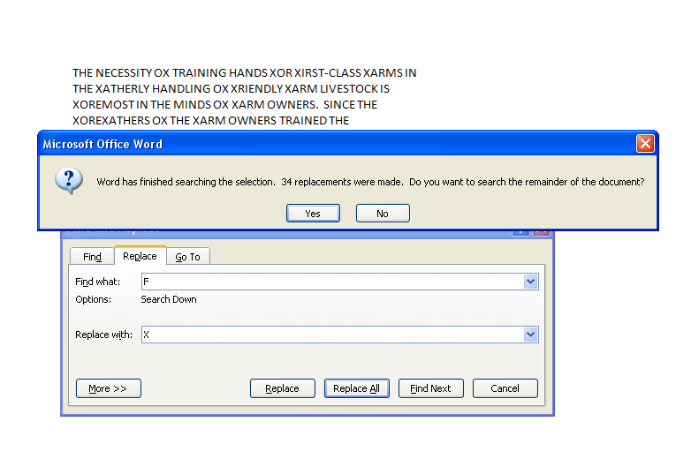

Slide 7
Extension
If a cluster sample is taken (one simple random sample of the lines with a complete enumeration of the Fs) and then multiplied by 9 (the number of lines in the paragraph) the students often will have a better estimate of the total count than their census. Here are the numbers of Fs in each of the lines respectively 4, 4, 3, 4, 4, 4, 4, 4, 3

Slide 8
Documentation of exercise can be found at
http://serc.carleton.edu/sp/cause/interactive/examples/18173.html

Slide 9
Red books in Library (André)
Complete in one period
Works at all levels; small (5-10) to medium size (~ 30) classes
Memorable
Extendable for courses examining more than simple random sampling
Gives touchstone

Slide 10
Process
Meet in Library
Tell students goal is to determine number of red books in library
Pair up

Slide 11
Discussion points
What is a book?
Multi-color books such as children’s books

Slide 12
Results
What is red?
Some sections have lots of red books (Chinese section)
Should have had a better plan
Estimates were wrong when students found out they completely mis-estimated the number of books in library

Slide 13
Assessment questions
Give an example of measurement error that can be found in sampling.
Give an example of a benefit of sampling over taking a census.
Explain the value of different types of sampling plans.

