Slide 1
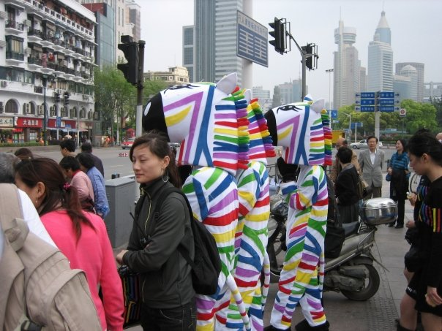
Helping Students Understand the Meaning of Random: Addressing Lexical Ambiguity CAUSE Webinar - 10 Aug 2010
Diane Fisher - University of Louisiana at Lafayette
Jennifer J. Kaplan - Michigan State University
Neal Rogness - Grand Valley State University
Notes:
1

Slide 2
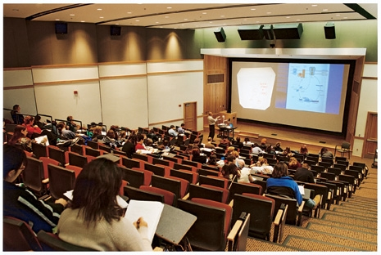
What is Lexical Ambiguity?
Motivation for the study of
Language
Lexical Ambiguity
Undergraduates
Goals of the research program:
Identify problematic words
Understand the nature of student difficulties
Design instructional materials
Test whether the materials improve student understanding of
the term itself
The related statistical concepts

Slide 3
1. Identify Problematic Words
Association | Event | Normal | Significant
Average | Experiment | Null | Simple
Bias | Independent | Parameter | Skew
Center | Margin | Population | Spread
Confidence | Mean | Random | Standard
Control | Median | Range | Statistic
Correlation | Minimum | Response | Statistics
Distribution | Mode | Sample | Variance
Error | Nominal | Scatter
Notes:
3

Slide 4
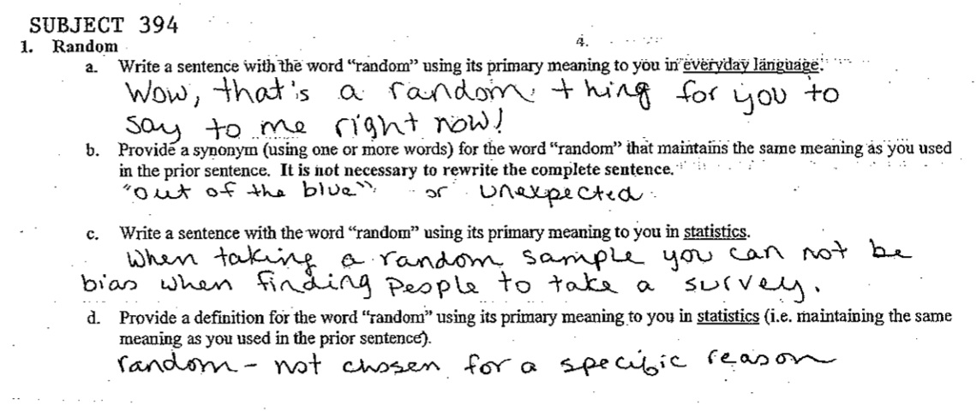
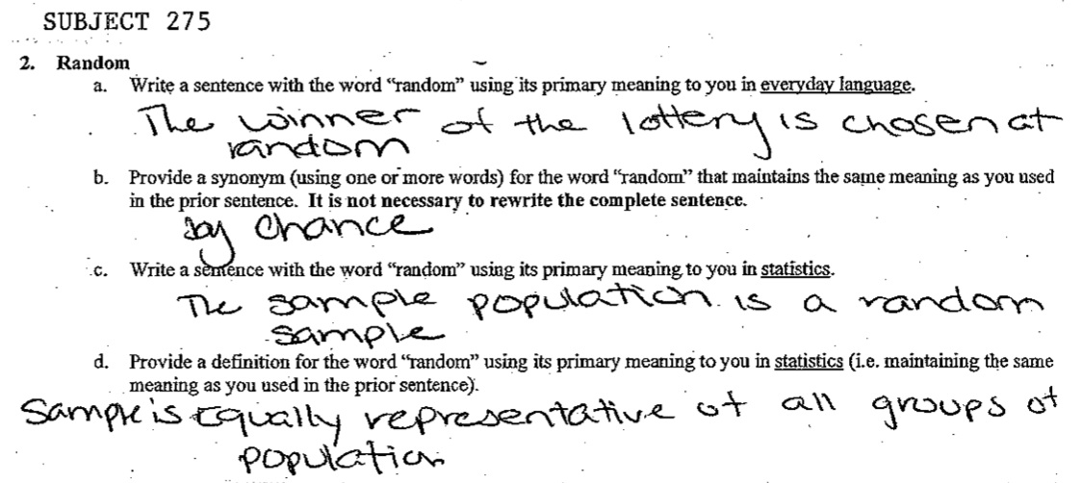
2. Student Difficulties - Prior to instruction
Most common use of random (49%):
An occurrence that is unplanned, unexpected or haphazard (Subject 394)
Types of choosing:
without criteria, plan or prior knowledge (17%)
without order or pattern (8%)
without bias (4%)
Vague definition (10%): By chance (Subject 275).

Slide 5
2. Student Difficulties - Post instruction
Definition Category | % | Student Example
Incorrect | 12% | We used a random variable today. Random: unknown
By Chance | 4% | For the survey, a random sample was picked. By chance that something occurred.
Without Order or Reason | 39% | It was a random sample, which provides independence. Random: persons were chosen not based on any reason.
Unexpected, Not Predictable | 14% | I was picked for a random sample. Not pre-determined.
Without Bias, Representative | 23% | The sample population is a random sample. Sample is equally representative of all groups of the population
Equally Likely | 8% | We took a random sample of the the students. Everyone was equally likely to be chosen for the sample.

Slide 6
3. Designing Instructional Intervention: exploit and process

Slide 7
3. Designing Instructional Intervention: exploit and process
Gettysburg Address Activity

Slide 8
3. Designing Instructional Intervention: exploit and process
When I was in college, I used to work as a candy girl at a movie theater. I had this pair of very short red shorts and my boss used to say that my tips would be better on the nights I wore them. Let’s say I wanted to test the theory. In order to account for differences in numbers of people at the theater, I will compare the amount of tips as a percent of all candy sales for nights I wear the short shorts with the same values for the nights I wear regular length shorts or jeans.
To make sure the sample is random and to have independent groups I could:
Wear the red shorts on Sat, M, W and not wear them on Sun, T, Th. (I always had Fridays off.)
Flip a coin before I get dressed every day; heads I wear the red shorts, tails I do not.
Wear the red shorts for 2 days in a row after I do laundry and then don’t wear them until they are washed again.
Have my roommate pick out my clothes every day and always include the red shorts in the options .
More than one of the above methods will ensure the conditions are met.

Slide 9
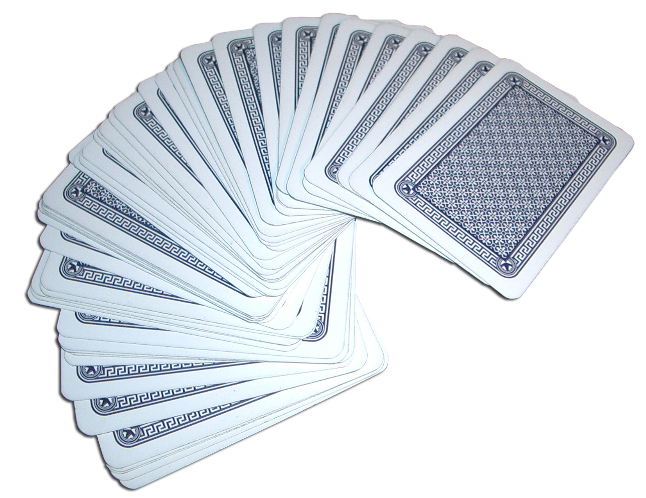
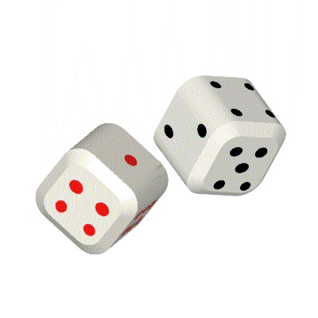
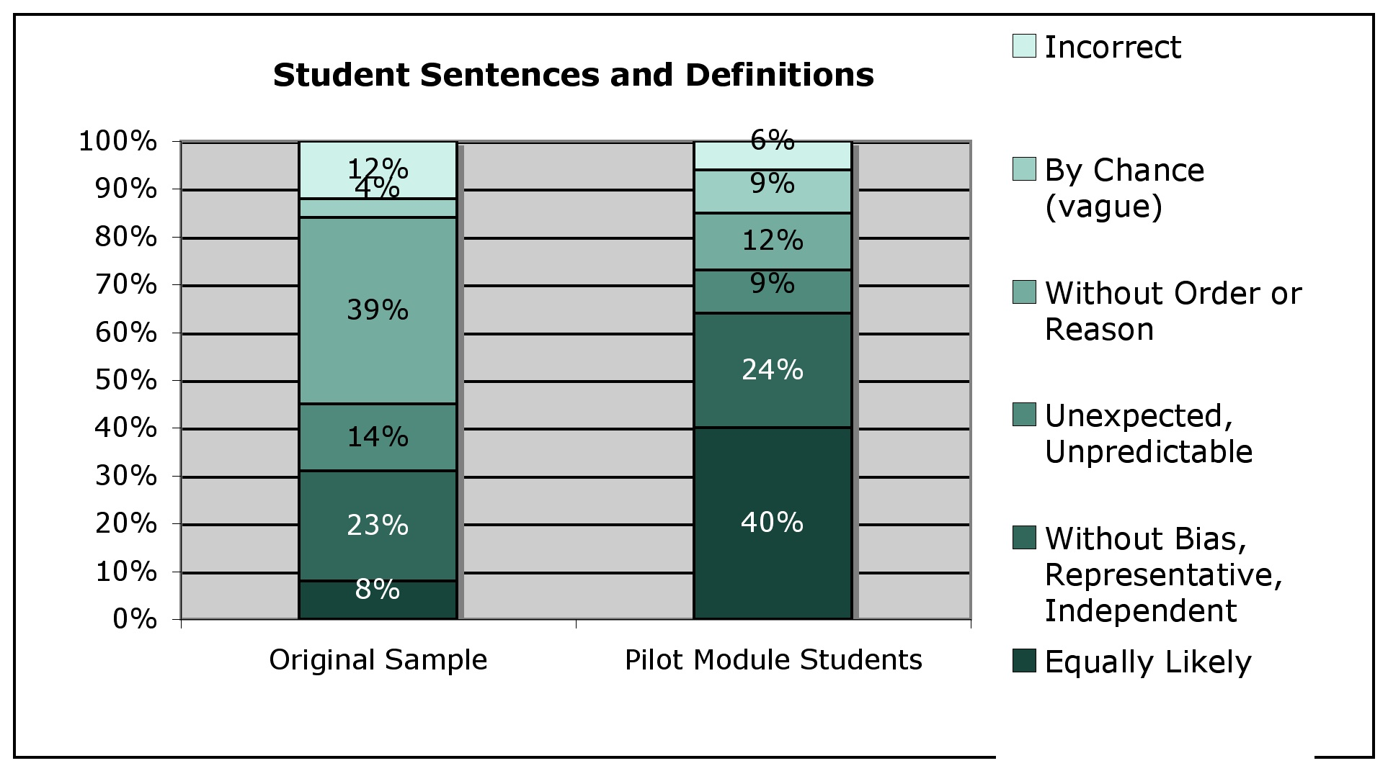
4. Testing the Intervention

Slide 10
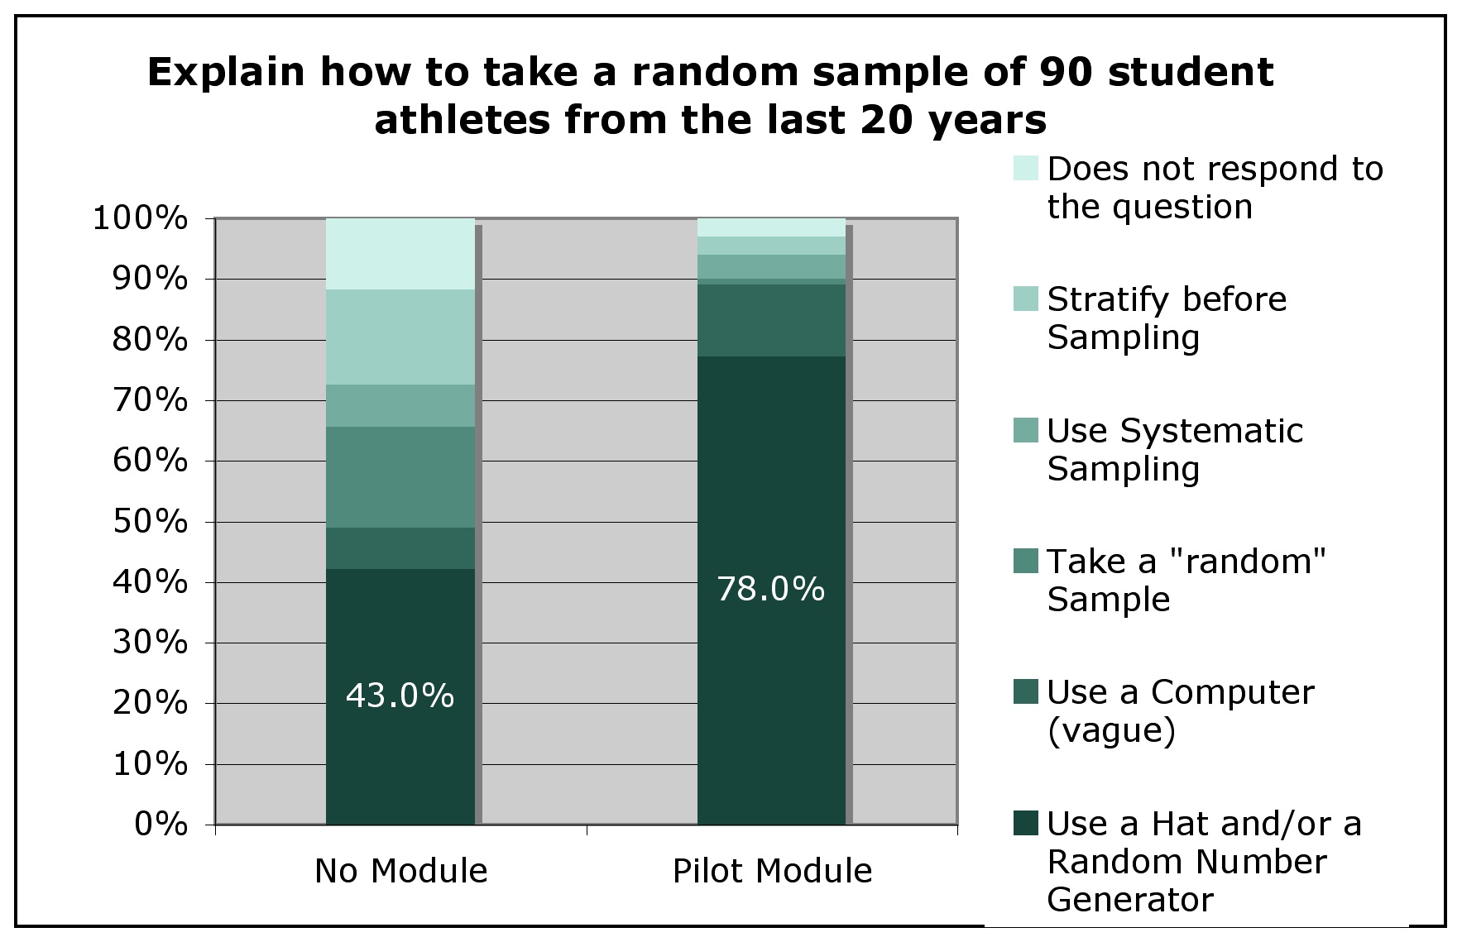
4. Testing the Intervention

Slide 11
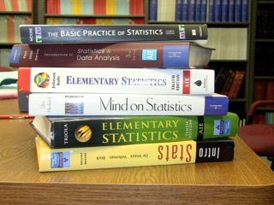
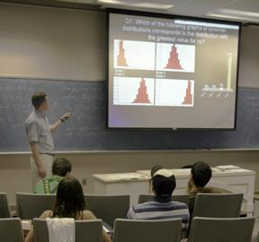
Future Directions
1. Additional Sources of Data (Goal 2)
Textbooks
Student Interviews
Recording of Instructors
2. Develop and Test Teaching Modules (Goals 3 and 4)

Slide 12
Thank You!
For your attention and
to our sponsors
Questions?
Suggestions for other words with potential lexical ambiguity?
and our mentors

Slide 13
For more information:
Kaplan, J.J., Fisher, D. & Rogness, N. (2010). Lexical Ambiguity in Statistics: How students use and define the words: association, average, confidence, random and spread. Journal of Statistics Education, 18(2), http://www.amstat.org/publications/jse/v18n2/kaplan.html
Kaplan, J.J., Fisher, D. & Rogness, N. (2009). Lexical Ambiguity in Statistics: What do students know about the words: association, average, confidence, random and spread? Journal of Statistics Education, 17 (3). http://www.amstat.org/publications/jse/v17n3/kaplan.html
Letting Go of Assumptions About How Students Understand Statistical Language. Breakout Session, United States Conference on Teaching Statistics (USCOTS) 2009. Columbus, OH, June 2009. Slides and handouts: http://www.stt.msu.edu/~jkaplan
What Do Students Hear When We Say 'Random'?: Empirical Results from a Study of Lexical Ambiguity. Contributed Paper, 2009 Joint Statistical Meetings. Washington, DC, August 2009. Slides and handouts: http://www.stt.msu.edu/~jkaplan

