Slide 1
Supporting Statistical Thinking Through a Capstone Project
Herle McGowan
(herle_mcgowan@ncsu.edu)
Roger Woodard
(woodard@stat.ncsu.edu)
North Carolina State University

Slide 2
Statistical Thinking
“Understanding of why and how statistical investigations are conducted”
Question posing
Data collection
Choosing analyses
“Being able to understand and utilize the context of a problem to plan and evaluate investigations and to draw conclusions.”
https://app.gen.umn.edu/artist/glossary.html

Slide 3
GAISE
Guidelines for Assessment and Instruction in Statistics Education
Published, endorsed by ASA in 2005
Best-practices in statistics education
Emphasize statistical literacy and develop statistical thinking
Use real data
Foster active learning in the classroom
http://www.amstat.org/education/gaise/

Slide 4
GAISE: Carpentry Analogy
In week 1 of the carpentry (statistics) course, we learned to use various kinds of planes (summary statistics). In week 2, we learned to use different kinds of saws (graphs). Then, we learned about using hammers (confidence intervals). Later, we learned about the characteristics of different types of wood (tests). By the end of the course, we had covered many aspects of carpentry (statistics). But I wanted to learn how to build a table (collect and analyze data to answer a question) and I never learned how to do that.

Slide 5
The Capstone
Presents students with a real world problem involving workplace safety
Using gloves to protect fingers from metal shards while sorting screws, possibly slowing workers down
Has students go through full process of a statistical investigation, starting with exp. design
Completed during class time at end of semester
No out-of-class time required for students, instructors

Slide 6
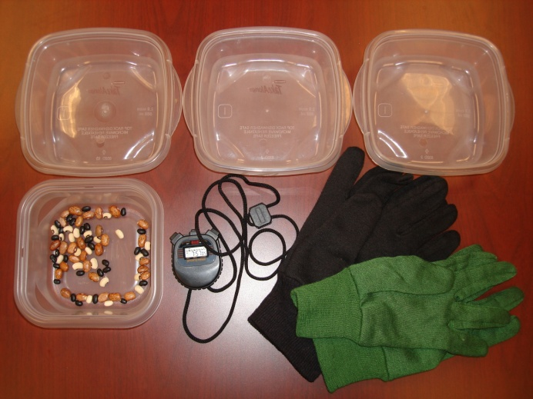
Implementation
2-3 class periods
Materials for experiment:
Stopwatch
Gardening gloves of various sizes (e.g. M/F)
Container of 3 types of dry beans of various sizes
3 containers for sorting beans into
Students (about 10 per group)
Technology: Computer/calculator for data analysis

Slide 7
Step 1: Design
Handout presents:
The real-world problem (workplace safety)
The question of interest: Does wearing the gloves make a real difference in the speed at which workers can do small manual tasks?
The task: Design an experiment to answer this question
A list of the available materials
Reminders of the principles of good exp. design

Slide 8
Step 1: Design
Small group (3-4 students) discussion of the design for 10-15 minutes
Whole-class discussion of design for another 10-15 minutes
Seek consensus on a design which can actually be carried out in a classroom setting

Slide 9
Step 2: Data Collection
Each group (~10 students) is given a set of materials and reminded of the agreed upon experimental design
Students assign roles within a group:
Set-up, mix beans and get everything ready to go between runs
Time keeper, to operate the stopwatch
Data recorder(s), keeping accurate records about which times are with gloves and which are without
Allow 40-50 mins to carry out the experiment

Slide 10
Step 3: Analysis
Data from each group could be combined to form 1 large sample
Or each group could analyze their own data
Analyze data using statistical software or graphing calculator
Or produce summary statistics using a spreadsheet (or graphing calculator) and then calculate test statistic and p-value ‘by hand’

Slide 11
Step 4: Conclusions
Mean difference will be (highly) significantly different from zero
Students should conclude that wearing gloves does slow down manual tasks on average

Slide 12
Wrapping-up the Activity
We wrap-up with class-wide discussion
Could have students prepare more formal reports
Formal presentations likely not the best idea, since every group did the same thing

Slide 13
Real World Connections
Motivating problem has real-world connections, but what about the conclusion?
Can’t recommend that workers not wear gloves
Opportunity for discussion about what employers could do instead
Allow workers more time to complete tasks
Reduce expectations about how much workers can complete
Hire more workers

Slide 14
Assessment
How to assess statistical thinking?
“Mattress Castle” question on Final Exam:
The Mattress Castle is a store in Raleigh that sells mattresses. The store has the following statement in their advertising "Free delivery and setup of mattress and box-springs to any home in Wake County." Bob lives in Wake County) and recently purchased a mattress from the Mattress Castle. When the delivery staff arrived at Bob's home they told him it would be an extra charge ($200) to put the mattress and box-springs in Bob's bedroom. They pointed out that the advertisement had fine print that said "Extra fee for delivery to unusual bedrooms." The problem is that Bob's bedroom is on the second floor of his house and according to the delivery driver that is unusual. Bob paid the fee but is now taking the Mattress Castle to court. As part of his preparation Bob would like to use statistical evidence to support his belief that a bedroom on the second floor is not unusual. He has about 1 week to gather this evidence and prepare it for the trial. Based on what you have learned in this class what would you do to provide statistical evidence to help Bob? (Limit your answer to 2 to 5 sentences).

Slide 15
Notes and Tips
Project elicits good discussions of:
How to define/operationalize response
What are sources of variation, how to deal with them
Need to keep an eye on time, guide toward design that can be carried out in class
Data collection can have lots of “down-time”
Could plan alternate tasks/practice to keep other group members busy while 1 person is sorting beans
If each group analyzes their own data:
Ask that 1 student per group brings laptop to class for data collection day
Students often need help knowing how to enter data, what to produce summary statistics for

Slide 16
Variation
Switch back story from needing protection from metal shards (requiring thicker gloves) to limiting exposure to trace chemicals (so that thinner Latex gloves could be used)
Could compare Latex gloves to no gloves
Likely not significant; conclude that wearing gloves does not slow down manual tasks on average
Or could compare Latex gloves to gardening gloves
Practical decision about which gloves are best

Slide 17
Thank you!
Questions? Comments?

