Slide 1
A Guitar Hero Based Project in Mathematical Statistics
Ivan Ramler
St. Lawrence University
Canton, New York
iramler@stlawu.edu

Slide 2
Outline
Background and learning goals
Description of project
Some student based results
Tips for implementing in your classroom

Slide 3
Background of Students
Mathematical Statistics Course
Estimation
Hypothesis testing
Introduction to Bootstrap
Upper level undergraduates
Mostly Senior Math Major/Stat Minors
All have had Probability
Most have had a second applied statistics course
Exposure to R helps
Learn some during Math Stat course as well

Slide 4
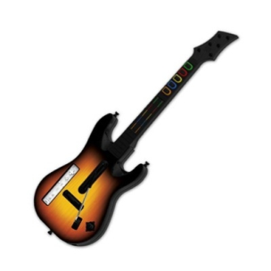
What is Guitar Hero?
Series of popular video games for many platforms
Players use a plastic guitar-controller to play notes as they scroll across the screen
Receive points for hitting notes correctly
While playing I raised the question
“Are missed notes occurring at random?”
and
“If not, prove it.”

Slide 5
Learning Goals
Develop statistical thinking to answer a research objective
Improve R programming skills
Learn how to evaluate and compare competing methodologies through simulation experiments
Have fun while learning some interesting Statistics!

Slide 6
Steps to the Project
This was a semester long project with the following parts.
Developing an “intuitive” estimator/methodology
Program method into R
Collecting data
Developing a hypothesis test
Evaluating the power of the methodology
Writing up the results

Slide 7
Step 1: Develop an Estimator
Devise an “estimator” that they believe is useful in answering:
“Are missed notes occurring at random?”
3 practice songs to visualize data and test estimator
Describe WHY their estimator might be able useful
Assigned the second day of class
Two weeks to work on it
Students worked with a partner
Provided an example
maximum number of consecutive misses in a song (Cmax)

Slide 8
Step 1: Practice Songs
Note | 1 | 2 | 3 | 4 | 5 | 6 | 7 | 8 | 9 | 10
Song A | 1 | 0 | 0 | 0 | 0 | 0 | 1 | 0 | 1 | 0
Song B | 0 | 0 | 0 | 1 | 0 | 0 | 0 | 0 | 0 | 0
Song C | 0 | 0 | 0 | 1 | 0 | 0 | 0 | 0 | 0 | 0
Note | 11 | 12 | 13 | 14 | 15 | 16 | 17 | 18 | 19 | 20
Song A | 0 | 1 | 0 | 0 | 0 | 0 | 1 | 0 | 0 | 0
Song B | 1 | 1 | 0 | 0 | 0 | 0 | 0 | 0 | 1 | 1
Song C | 0 | 1 | 1 | 1 | 1 | 0 | 0 | 0 | 0 | 0

Slide 9
Step 2: R Programming
Write an R function that, given a song represented by a vector of 0’s and 1’s, returns a numerical value
This will be their test statistic for future parts
Have R code for Cmax to modify
Assigned shortly after step 1 is due
Have one week to struggle by themselves
Then they sign up for a time with me to go over it with them
Need to email me their attempted code the day before we meet

Slide 10
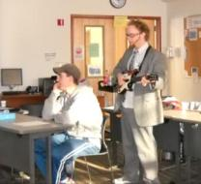
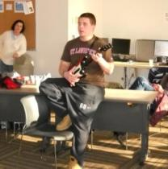
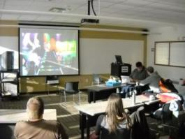
Step 3: Collecting Data
Took a Friday afternoon for an optional data collection event
Play Guitar Hero on a projector screen
Show them the difficulties of collecting accurate data
By hand…no one could keep up
Webcams!
Stressed the importance of simulated data

Slide 11
Step 4: Hypothesis Testing
H₀: Notes are missed completely at random
H_{A}: Notes are not missed completely at random
Tested these hypotheses using the two (successfully) collected real songs
Hungry Like the Wolf – Duran Duran (Expert player)
Ring of Fire – Johnny Cash (Beginning player)
Obtain a bootstrapped p-value
One week to obtain p-values

Slide 12
Step 5: Power Study
Learn that statistical power can be more than just a simple calculation from a Normal distribution
Using Monte Carlo methods
11 Scenarios
Short songs (200 notes) and longer songs (600 notes)
Various correlation structures
Random sequences of 0’s and 1’s (sampling under H₀)
Used to estimate Type 1 error rate
Two days to finish study

Slide 13
Step 6: Written Report
Technical report concerning all aspects of the project
Professional manuscript style
LaTeX encouraged/preferred
About 4 pages excluding R code attached in an appendix
Rough draft due mid April
Final draft due last day of class

Slide 14
Some Results: Students’ Estimators
Number of pairs of missed notes in a song
n consecutive misses counted as n-1 pairs
E.g., 3 misses in a row = 2 pairs
Variance of number of misses in partitioned song
Split song into (approximately) equal length sections
Find the variance of the # of misses in a section – “Var(X)”
Under H₀, Var(X) = Kp(1-p)
K is the length of the section
p is the overall proportion of missed notes in the song
Under H_{A}, Var(X) > Kp(1-p)

Slide 15
“Best” Students’ Estimator
“Carrying Value”
Assigns different values to misses during a song
Each miss get a flat value of 2 + Carrying Value
Carrying Value = 4 – consecutive number of correct notes played between misses
Bounded between 0 and 4
Results
Great power for nearly all scenarios
Appropriate Type 1 error rates
which was a problem for many other methods
Hungry Like the Wolf (Expert player) - Reject H₀
Ring of Fire (Beginning player) – Fail to Reject H₀

Slide 16
Optional Components
Extra credit given to people who presented a poster at the annual “Festival of Science”
Two posters, 3 people per poster
Split estimators into two groups
Presenters had to be able to give basic descriptions of other peoples methods
All six presenters enjoyed this
Felt they better understood the project
Especially the power study and using it to evaluate methods

Slide 19
Implementing in your Classroom
Use Partners!
8 groups was about as much as I could handle
Easily could have made groups of 3+ and required at least 2 estimators
Good tool for having them learn R programming and bootstrap on a more independent basis
Be open about how not all methods will work well
Relay to them how research is an ongoing process without a clear/correct answer at all times
They were only graded on their ability to convey the ideas and evaluate them in an objective way

Slide 20
Things for next time
Require all students to participate in the Festival of Science poster session
Make each group devise at least 2 estimators (many of the better students already had)
Shrink power study and make them focus on why these scenarios were used
Give some type of prize (gift certificate for a pizza?) for the “best” estimator
Still making sure the project isn’t graded on how well the estimator works

Slide 21
Thank You!
Any Questions?

