Slide 1
using data from the federal statistical agencies to inspire students
CAUSE webinar, Nov. 10, 2009
Ron Wasserstein
Executive Director, The American Statistical Association

Slide 2
Goals for this presentation
Inform you about the role and scope of the federal statistical agencies
Inspire you to explore a rich source of data to inspire your students

Slide 3
Observations from many discussions with federal statisticians
An incredible array of data is collected by the federal government
Government statisticians are deeply invested in the quality of their data
They are open to the assessments of others to help improve quality and usability
Their methods are transparent
They want the data to be used (not collected for its own sake)

Slide 4
Federal Statistical System
A vast decentralized system of agencies and departments within agencies
Fifteen agencies make up the “principal statistical agencies,” and collaborate via the Interagency Council on Statistical Policy (ICSP)
Katherine Wallman, former ASA President, is the Chief Statistician of the United States (OMB)

Slide 5
Principal Statistical Agencies
Bureau of Economic Analysis http://www.bea.gov/interactive.htm
Bureau of Justice Statistics http://www.ojp.usdoj.gov/bjs/
Bureau of Labor Statistics http://www.bls.gov/data/
Bureau of Transportation Statistics http://www.bts.gov/data_and_statistics/
Census Bureau http://www.census.gov/main/www/access.html, http://dataferrett.census.gov/
Economic Research Service, Dept of Agriculture http://www.ers.usda.gov/Data/
Energy Information Administration http://www.ers.usda.gov/Data/
Environmental Protection Agency http://www.epa.gov/epahome/data.html, http://www.epa.gov/oar/airpolldata.html, http://www.epa.gov/triexplorer/
Internal Revenue Service, Statistics of Income http://www.irs.gov/taxstats/index.html
National Agricultural Statistics Service, http://www.nass.usda.gov/Data_and_Statistics/Quick_Stats/index.asp
National Center for Education Statistics, http://nces.ed.gov/datatools/, http://nces.ed.gov/nationsreportcard/naepdata/ (explore NAEP data)
National Center for Health Statistics http://www.cdc.gov/nchs/data_access/datatools.htm, http://www.cdc.gov/nchs/VitalStats.htm
National Science Foundation, Science Resources Statistics, http://www.nsf.gov/statistics/database.cfm
Office of Management and Budget, http://www.gpoaccess.gov/usbudget/index.html
Social Security Administration, Office of Policy, http://www.ssa.gov/policy/

Slide 6
Three data “warehouses”
dataferret.census.gov
www.fedstats.gov
www.data.gov

Slide 7
So there’s a lot of data out there…
It is primarily designed to provide information to policy makers and to the public
As such it is not always in a format that makes it easy to use for classroom purposes
However, there is increasing interest in making classroom-ready materials.
Much of the data is tabular, but there is also plenty of micro-data at varying levels of complexity

Slide 8
Accessing this data is a lot like riding a roller coaster, says the EPA’s David Mintz:
There is great anticipation at the beginning
The middle can be a little scary
If you don’t throw up, the end is quite rewarding.

Slide 9
What can we do with this data?
Illustrate basic concepts with data students care about
Discuss difficulties associated with good data collection
Interesting and relevant examples for class, homework, projects, exams
Convince students of relevance of our discipline
(Perhaps, and where appropriate) connect to students’ interests in societal concerns

Slide 10
Data always have limitations
DATA IN USE.
Proceed with
understanding.

Slide 11
Let’s teach “Responsible skepticism”
Ignorant skeptic
Responsible skeptic

Slide 12
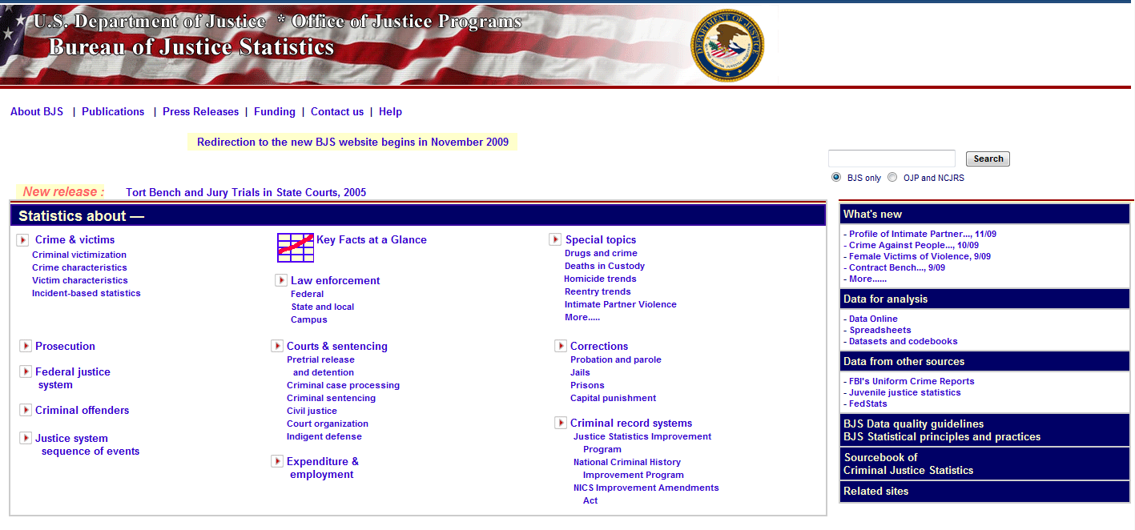
Some examples - BJS

Slide 13
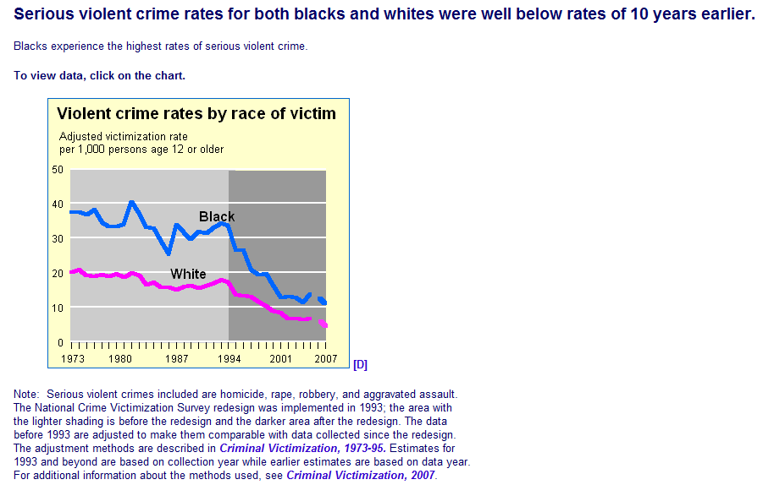
http://www.ojp.usdoj.gov/bjs/glance/race.htm

Slide 14
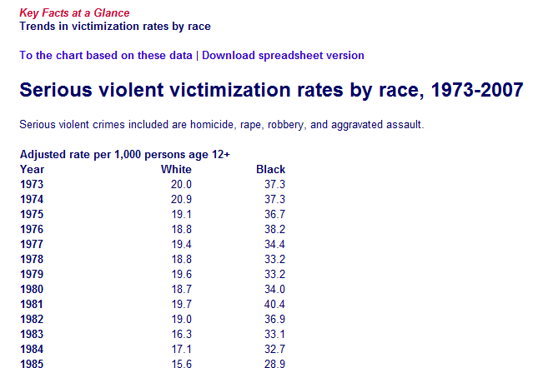
http://www.ojp.usdoj.gov/bjs/glance/tables/racetab.htm

Slide 15
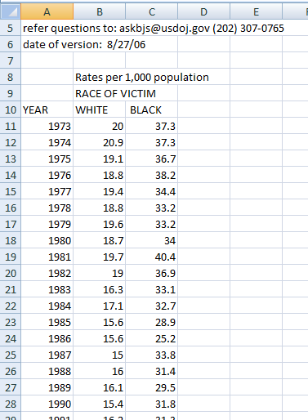

Slide 16
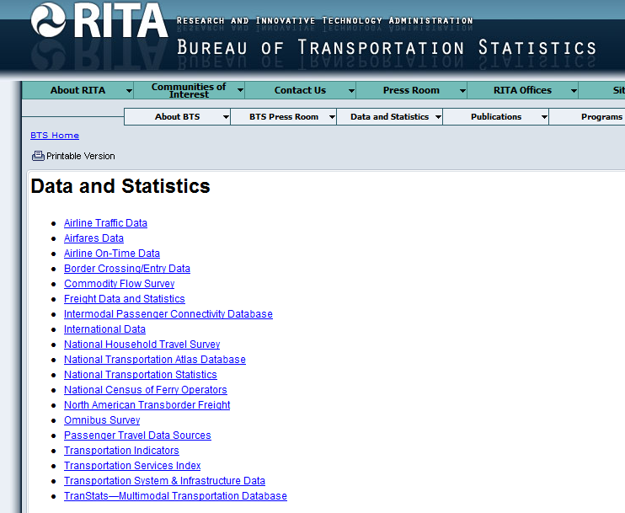
Bureau of Transportation Statistics

Slide 17
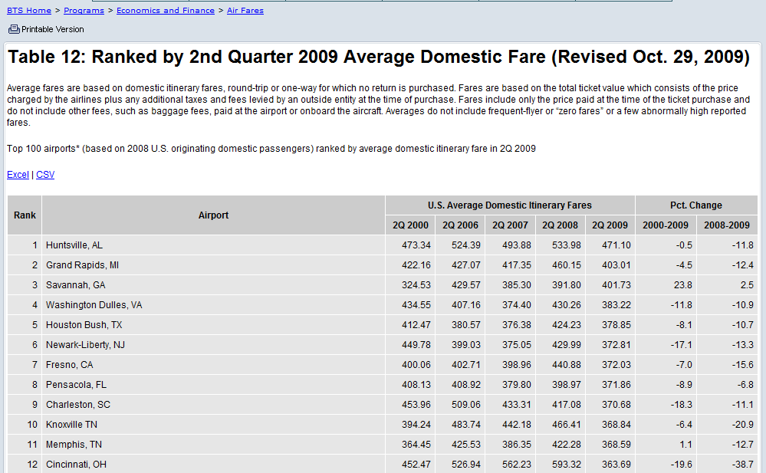
http://www.bts.gov/programs/economics_and_finance/air_travel_price_index/html/table_12.html

Slide 18
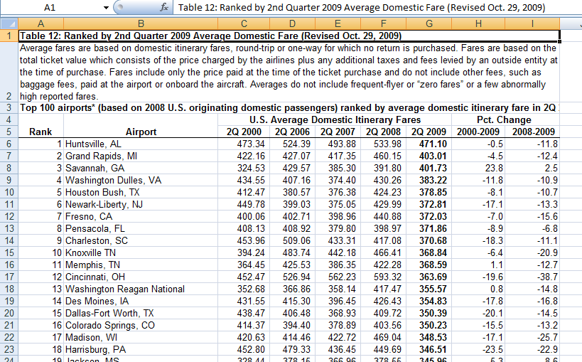

Slide 19
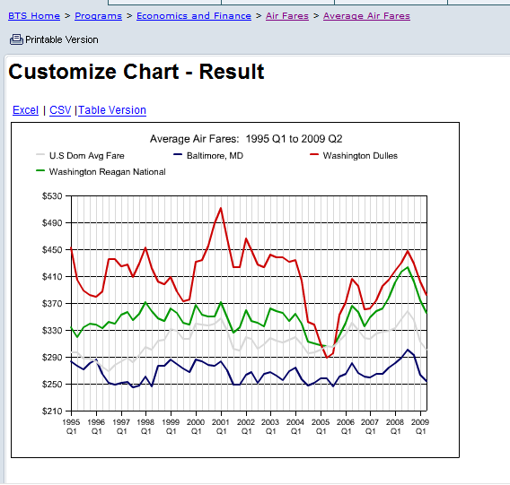
http://www.bts.gov/xml/atpi/src/resultTop100.xml

Slide 20
Average adjusted gross income of the top 400 US individual taxpayers, 1992-2006 (in $1000)
http://www.irs.gov/taxstats/article/0,,id=203102,00.html

Slide 21
Not made it into the top 400 yet?
Don’t feel too bad. Few stay there once they do!
Only about 27% made the list more than once in the last 15 years, and only about 15% made it more than twice.
http://www.irs.gov/pub/irs-soi/06intop400.pdf

Slide 22
 | No. of returns | % of total | cumulative % of total
No adjusted gross income | 2,675,594 | 1.93% | 1.93%
$1 under $5,000 | 11,633,370 | 8.41% | 10.34%
$5,000 under $10,000 | 11,786,747 | 8.52% | 18.86%
$10,000 under $15,000 | 11,711,680 | 8.46% | 27.32%
$15,000 under $20,000 | 10,937,694 | 7.90% | 35.22%
$20,000 under $25,000 | 9,912,261 | 7.16% | 42.38%
$25,000 under $30,000 | 8,749,761 | 6.32% | 48.71%
$30,000 under $40,000 | 14,151,824 | 10.23% | 58.93%
$40,000 under $50,000 | 10,687,193 | 7.72% | 66.65%
$50,000 under $75,000 | 18,854,917 | 13.62% | 80.28%
$75,000 under $100,000 | 11,140,408 | 8.05% | 88.33%
$100,000 under $200,000 | 12,088,423 | 8.73% | 97.06%
$200,000 under $500,000 | 3,121,485 | 2.26% | 99.32%
$500,000 under $1,000,000 | 589,306 | 0.43% | 99.74%
$1,000,000 under $1,500,000 | 150,431 | 0.11% | 99.85%
$1,500,000 under $2,000,000 | 64,007 | 0.05% | 99.90%
$2,000,000 under $5,000,000 | 98,724 | 0.07% | 99.97%
$5,000,000 under $10,000,000 | 24,975 | 0.02% | 99.99%
$10,000,000 or more | 15,956 | 0.01% | 100.00%
 | 138,394,754 | 100.0
Distribution of adjusted gross income, individual taxpayers, 2006
(percentages are estimates based on samples)
http://www.irs.gov/pub/irs-soi/06in11si.xls

Slide 23
Average weekly retail price of gasoline (cents per gallon), Ohio, 2003-2009 http://tonto.eia.doe.gov/dnav/pet/pet_pri_gnd_dcus_soh_w.htm

Slide 24
Gas prices, Ohio & Florida, 2003-2009 (blue line is Ohio)

Slide 25
Where do they get this stuff?
http://www.eia.doe.gov/pub/oil_gas/petroleum/survey_forms/eia878f.pdf
http://www.eia.doe.gov/oil_gas/petroleum/data_publications/wrgp/sampling_methodology.html
Every Monday, retail prices for all three grades of gasoline are collected by telephone from a sample of approximately 900 retail gasoline outlets. The prices are published by 5:00 P.M. Monday, except on government holidays, when the data are released on Tuesday (but still represent Monday's price). The reported price includes all taxes and is the pump price paid by a consumer as of 8:00 A.M. Monday. This price represents the self-serve price except in areas having only full-serve. The price data are used to calculate weighted average price estimates at the city, state, regional and national levels using sales and delivery volume data from other EIA surveys and population estimates from the Bureau of Census.

Slide 26
Ohio vs. Michigan in…
Annual turkey production

Slide 27
Year | State | Number Raised (thousand head) | Pounds Produced (thousand pounds) | Price per Unit ($/lb) | Value of production ($1,000)
1999 | Michigan | 2700 | 85590 | 0.41 | 35,092
1999 | Ohio | 4700 | 172020 | 0.35 | 60,207
2000 | Michigan | 3500 | 119000 | 0.34 | 40,460
2000 | Ohio | 4400 | 165000 | 0.36 | 59,400
2001 | Michigan | 4500 | 162000 | 0.35 | 56,700
2001 | Ohio | 4800 | 181440 | 0.35 | 63,504
2002 | Michigan | 4800 | 179520 | 0.35 | 62,832
2002 | Ohio | 5700 | 218880 | 0.35 | 76,608
2003 | Michigan | 4900 | 187180 | 0.34 | 63,641
2003 | Ohio | 5500 | 212300 | 0.39 | 82,797
2004 | Michigan | 4900 | 183750 | 0.37 | 67,988
2004 | Ohio | 5800 | 219820 | 0.42 | 92,324
2005 | Michigan | 4600 | 172500 | 0.37 | 63,825
2005 | Ohio | 6000 | 223800 | 0.44 | 98,472
2006 | Michigan | 4700 | 178600 | 0.39 | 69,654
2006 | Ohio | 5800 | 216920 | 0.43 | 93,276
2007 | Michigan | 5100 | 191760 | 0.46 | 88,210
2007 | Ohio | 6000 | 227400 | 0.46 | 104,604
2008 | Michigan | 4800
2008 | Ohio | 6000 | 230400 | 0.58 | 133,632

Slide 28
Which state raises the most turkeys?
(www.ncturkeyfestival.org)

Slide 29
http://www.eia.doe.gov/cneaf/electricity/esr/table5.html
Another Ohio vs. Michigan comparison
Census Division State | Number of Consumers | Average Monthly Consumption (kWh) | Average Retail Price (Cents per Kilowatthour) | Average Monthly Bill (Dollar and cents)
East North Central | 19,558,522 | 830 | 9.74 | $80.84
IL | 5,065,123 | 790 | 10.12 | $80.01
IN | 2,727,752 | 1,058 | 8.26 | $87.44
MI | 4,298,455 | 686 | 10.21 | $70.02
OH | 4,894,635 | 926 | 9.57 | $88.60
WI | 2,572,557 | 725 | 10.87 | $78.75

Slide 30
From NHANES food security questionnaire
Real questions, real data about real issues

Slide 31
Social Security data
http://ssa.gov/policy/docs/statcomps/supplement/2008/3e.html#table3.e2

Slide 32
Social Security data
http://ssa.gov/policy/docs/statcomps/supplement/2008/5a.html#table5.a1

Slide 33
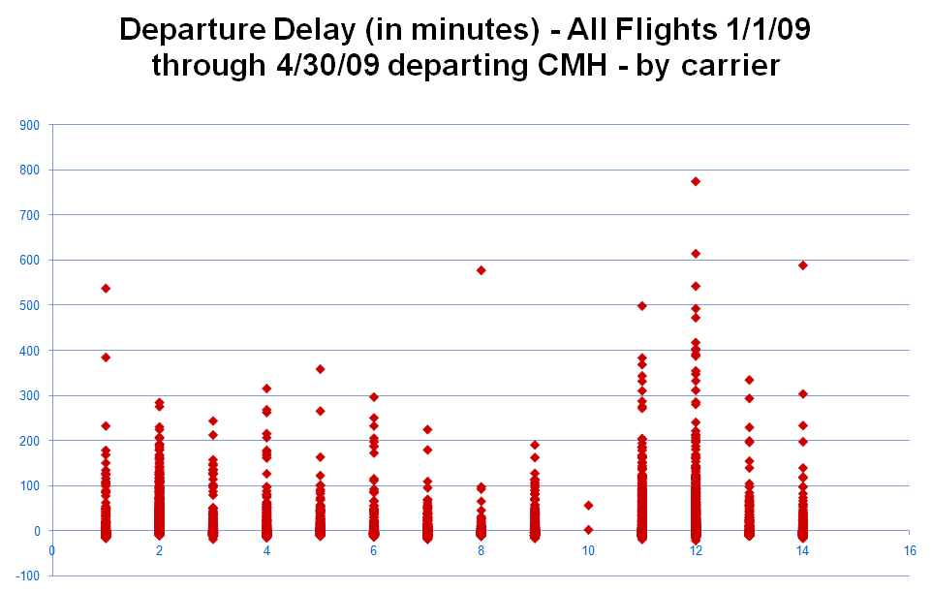

Slide 34
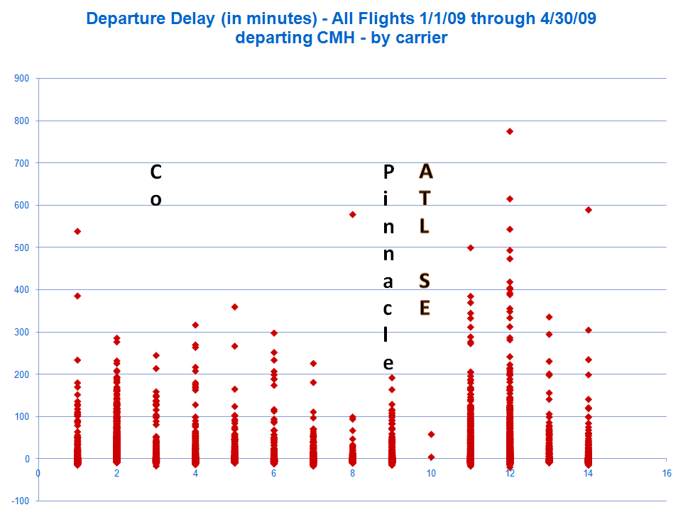
American Eagle
NW
SW
DL
A A
UA
Sky West
U S Air
Exp Jet
Comair
Airtran

Slide 35
I’m just wondering…
If our students are asking “When will I ever use this stuff?”, is it possible we’re showing them the wrong stuff?

